Slide 1
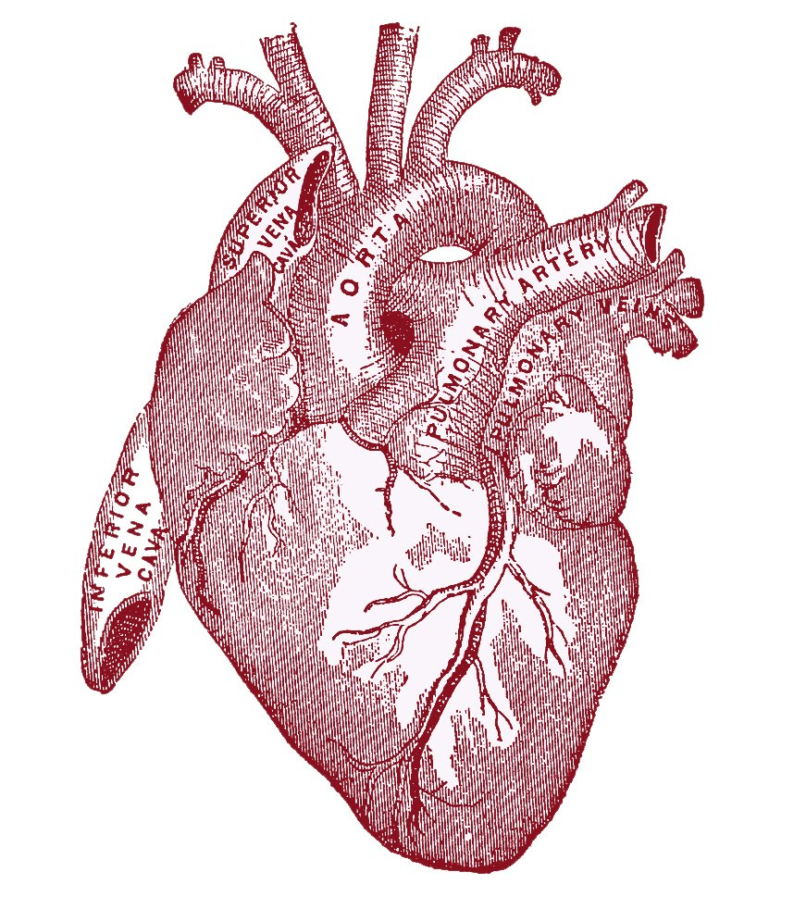
I Biology

Slide 2
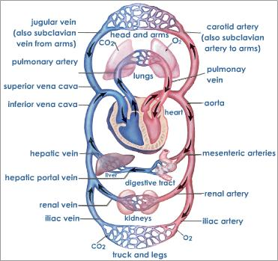
Movement of Blood Simplified on Page 319

Slide 3
Veins Vs. Arteries
Veins | Arteries
-Thin Walls One way valves Low blood pressure Blood towards heart | Thick walls Elastic tissue High blood pressure Blood away from heart
http://www.science.nelson.com/ABbio20-30/teacher/protect/media/vessels.html

Slide 4
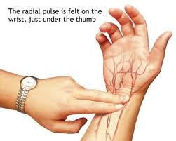
Your Pulse Artery

Slide 5
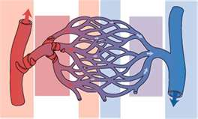
Capillaries
The advantage of capillaries being composed of a single cell layer is that there is a small distance for gases, nutrients, and wastes to diffuse across. One disadvantage is that they can easily be damaged or destroyed.
Ex. Bruising

Slide 6
Vasoconstriction & Dilation
Autonomic nervous system = controls the motor nerves (Involuntary).
regulates the diameter of the arterioles based on blood flow requirements.
Vasoconstriction = narrowing of blood vessels - decreases blood flow to area (not in use).
Vasodilation = widening of blood vessels - increases blood flow to area (in use).
- remove excess heat

Slide 7
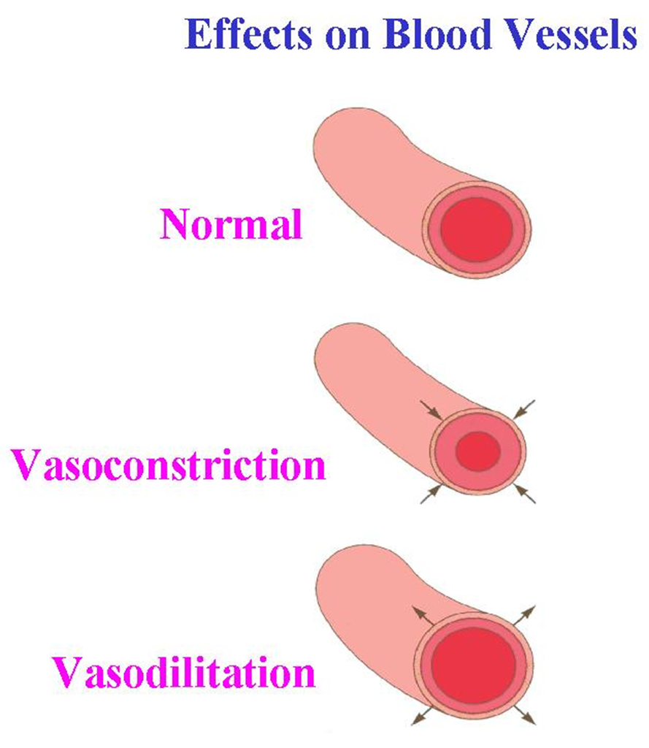
Vasoconstriction & Dilation Ex. Fight or Flight Ex. Nervous

Slide 8
Blood’s Return to the Heart
Skeletal muscles
massage blood back to
the heart.
Body movements such
as stretching help the
massaging action.

Slide 9
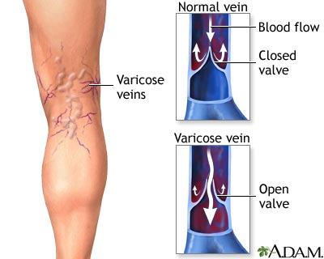
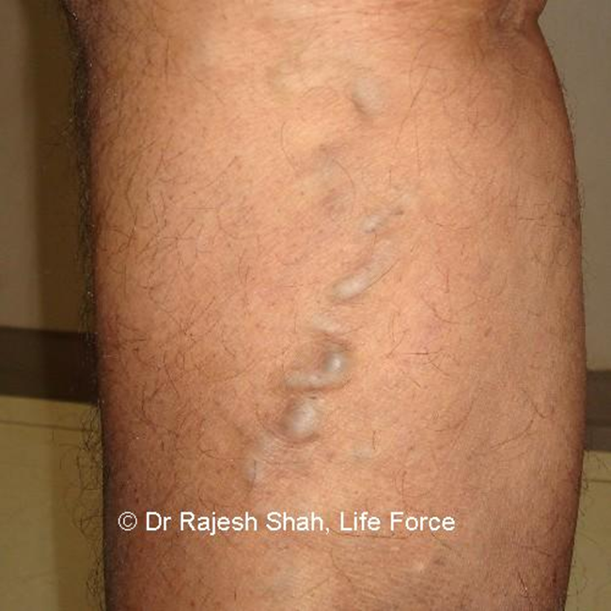
Blood’s Return to the Heart
In addition, the veins have
a series of one-way valves,
which prevent the
backflow of blood in the
veins.
Problems with these
valves can cause backflow
and pooling.
Ex. Varicose Veins

Slide 10
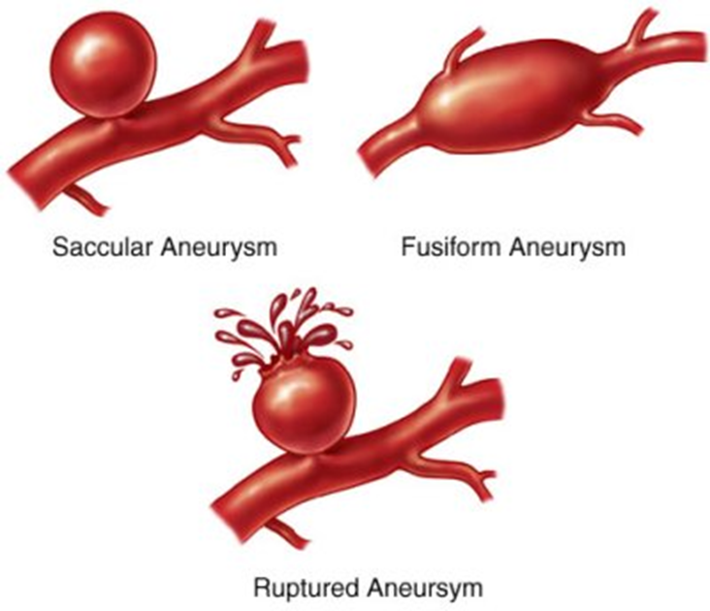
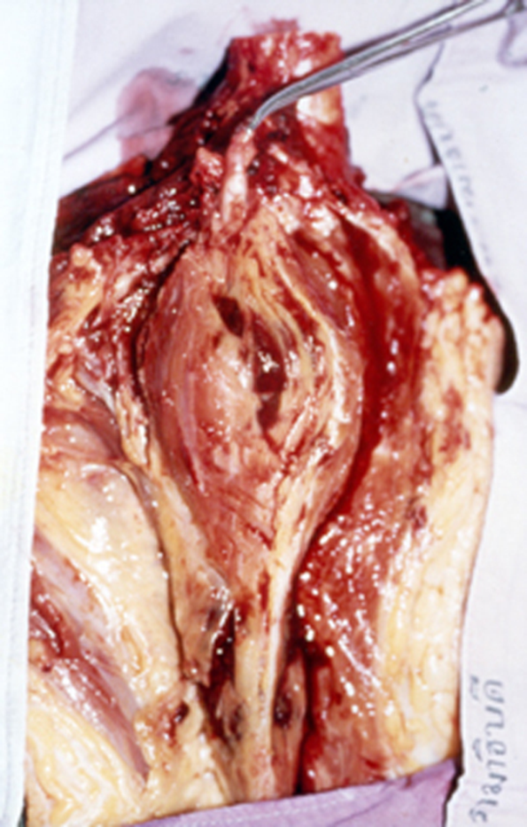
Aneurysm
Aneurysm - Bulge that forms in the wall of a weakened blood vessel, usually an artery, often due to atherosclerosis. Increased blood pressure in the artery over time with less structural support can cause eventual rupture.

Slide 11
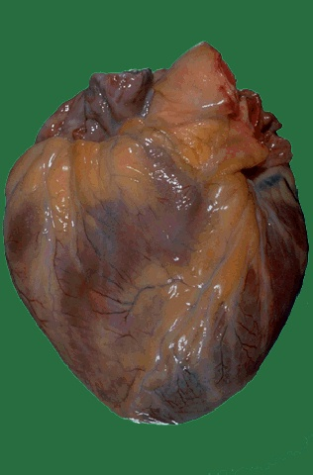
The Heart

Slide 12
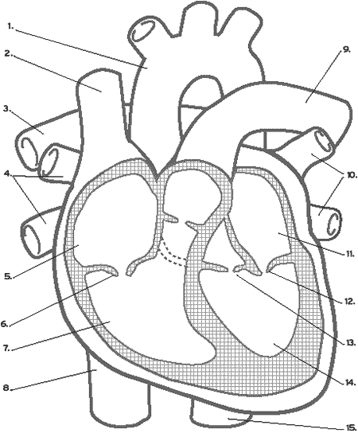
Blood Flow In and Out of the Heart
http://www.youtube.com/watch?v=Rj_qD0SEGGk

Slide 13
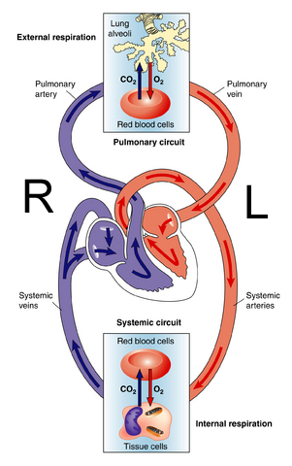
Heart - 2 systems
Two pumps - separated by a wall of muscle called the septum
Pulmonary circulatory system
Systemic circulatory system

Slide 14
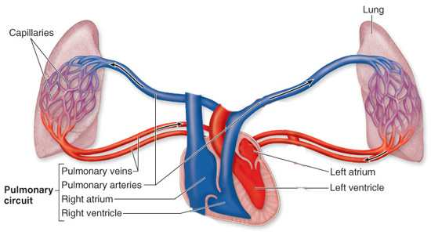
Pulmonary Circulatory System
carries deoxygenated blood to the lungs and oxygenated blood back to the heart
Blood Vessels
Pulmonary Artery
Pulmonary vein

Slide 15
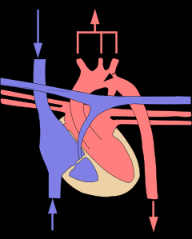
Systemic Circulatory System
carries oxygenated blood to the tissues of the body and deoxygenated blood back to the heart
Blood Vessels
Aorta
Superior & Inferior Vena Cava
Head & Upper Extremities
S.V.C
Aorta
I.V.C
Abdomen & Lower Extremities

Slide 16
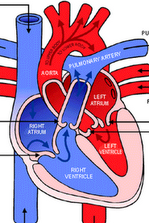
Heart - structures
Atria - thin walled heart chambers that receive blood from veins
Ventricles - muscular; thick-walled chambers that pump blood through the arteries
Human heart is 4 chambered - two atria, two ventricles (pg. 320 – fig 2)

Slide 17
Heart - structures
Which Ventricle would have the thickest wall?
Why??

Slide 19
The Strong Muscle of the Left Ventricle…

Slide 20
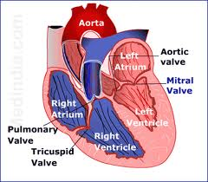
Valves...
Atrioventricular (AV) valves - valves that separate the atria from the ventricles, prevent the backflow of blood from the ventricles into the atria
Right atrium has the
tri-cuspid valve and the
left has the bi-cuspid or
(mitral) valve
AV valves supported by
connective tissue called
chordae tendonae

Slide 21
Valves…
A second set of valves separates the blood vessels and the ventricles they are called semilunar valves (half-moon shaped)

Slide 22
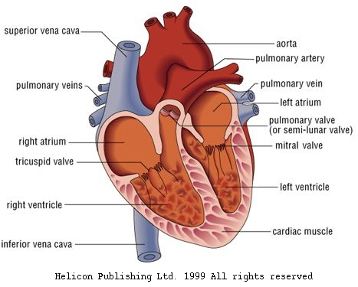

Slide 23
One-Way Blood Flow
Venae Cavae - the veins that carry blood back to the heart
Superior vena cava - blood from the head
Inferior vena cava - blood from the tissues of the body
both feed into the right atrium

Slide 24
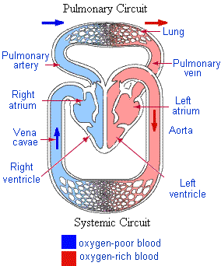
One-way...
So blood that is in the pulmonary veins has oxygen in it.
The blood from all the other veins in your body does not have oxygen in it

Slide 25
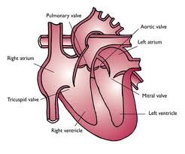
How does it all work together?

Slide 26
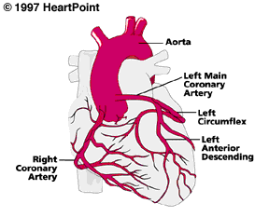
Coronary Arteries
Branch off aorta and supply the cardiac muscle with oxygen and other nutrients

Slide 27
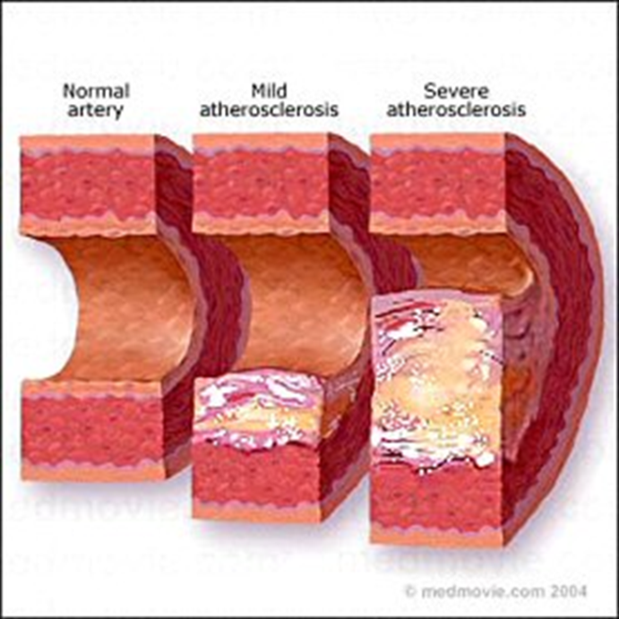
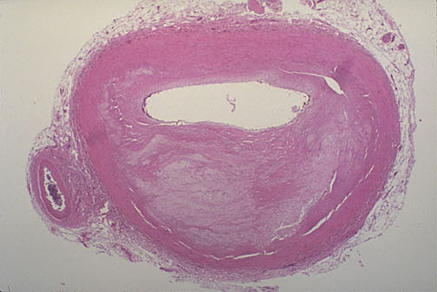
Blocked Coronary Artery
Atherosclerosis = Lipids or fatty substances (cholesterol and triglycerides) build up along the inner lining of the artery and causes a narrowing or blockage.
Without oxygen and nutrients, the patient suffers from a heart attack and the involved heart muscle can get permanently damaged.

Slide 28
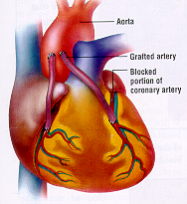
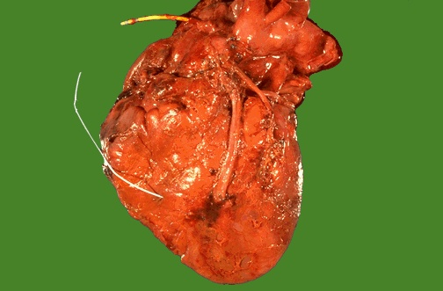
Choice #2 - Coronary Bypass Surgery
Choice #1 - Catheterization

Slide 29
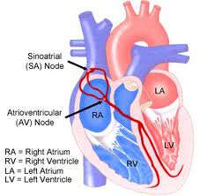
Setting the Heart’s Tempo
Heart made of Myogenic Muscle - tissue can contract without external nerve stimulation.
Sinoatrial (SA) Node
Heart’s Pacemaker
located where venae cavae
enter the right atrium
impulses travel to other muscle
cells by modified muscle tissue
Atrioventricular (AV) Node

Slide 30
Impulses travel to Atrioventricular (AV) node (in atrium) delayed here for about 0.1 seconds
Impulses transferred the through the septum to the Purkinje Fibres in the ventricles which then contract
Purkinje Fibres
http://www.youtube.com/watch?v=v3b-YhZmQu8

Slide 31
Nerve Transmission
SA Node
AV Node
Purkinje Fibers

Slide 32
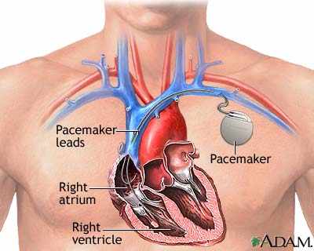

Slide 33
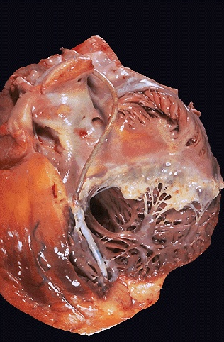
Pacemaker

Slide 34
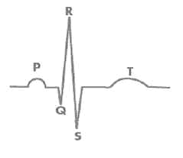
Heart’s tempo...
The impulses can be detected by an Electrocardiograph (ECG or EKG), which measures the electrical activity of the heart
P. 324

Slide 35
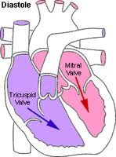
Diastole
Contraction of the atria pushes blood through the
AV valves into the ventricles
After the atria push out the
blood, they relax and fill up with
blood again
…this relaxation is called Diastole

Slide 36
Diastole
Atria contract pushing blood through the AV valves into the ventricles.

Slide 37
Diastole
Atria relax and refill with blood after the AV valves close (caused by increase in ventricular pressure), causing a “lubb” sound.

Slide 38
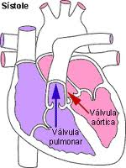
Systole...
As the ventricles contract, the increased pressure causes the AV valves to close.
This also forces blood through
the SL valves.
… this contraction of the heart
tissue is referred to as Systole

Slide 39
Systole
Ventricles contract, the increased pressure causes the AV valves to close, causing a “lubb” sound.

Slide 40
Systole
The ventricles relax after the contraction and the SL valves close, making the “dubb” sound

Slide 41
Heart Murmur
- caused by faulty heart valves, backflow of blood into one of the heart chambers
When the doctor listens to the heart and heard a lubb-hiss instead of a lubb-dubb
Body can compensate in two ways:
beating faster
atrium driving blood into ventricle with greater force

Slide 42
Homework: (check Edmodo)
Chap 10/11 Vocab. (Wed.)
Heart Puzzle (Thurs.)
pg. 318 # 1-3,5-9 (Fri.)
pg. 327 # 1, 2, 5-9

