Slide 1
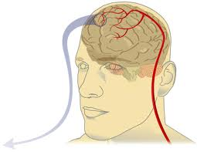
10.3 -
Regulation of Blood Flow

Slide 2
Cardiac Output
the amount of blood pumped from the heart each minute.
blood coming from left side of heart = blood coming from the right side
unless there is a dysfunction
Ex. leaky valve

Slide 3
Cardiac Output
Two factors affect cardiac output:
Stroke Volume - measures the quantity of blood pumped with each beat of the heart.
mL/beat
Higher the SV = Healthier the heart
Heart Rate - # of times the heart beats per minute.
b.p.m.
Lower the resting HR = Healthier the heart

Slide 4
Measuring Heart Rate
Resting in adults in 60-80 beats per minute (bpm).
Yours is probably lower. (lack of responsibility will do that….OH SNAP!)
Place your pointer and middle finger below your thumb on the inside of your wrist.
Watch the clock for 30 sec. and count how many beats you feel. ______beats x2 = _______ bpm.

Slide 5
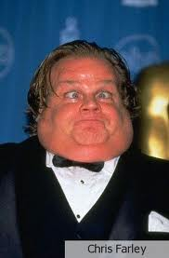
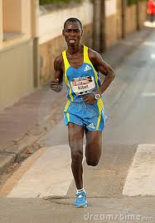
Cardiac Output...
Cardiac Output = stroke volume X heart rate

Slide 6
Examine two people with the same mass:
- if both people are at rest, both should require the same quantity of oxygen each minute
Chris
Stroke Volume: 50ml/beat
Heart Rate: 100 beats/min
Cardiac Output :=(50ml/beat)(100beats/min)
= 5000ml (or 5L)
Josh
Stroke volume:100ml/beat
Heart rate: 50 beats/min
Cardiac Output: =(100ml/beat)(50 beats/min)
= 5000ml (or 5L)
Hearts that aren’t as strong are unable to pump as much blood so have to compensate by increasing its heart rate.

Slide 7
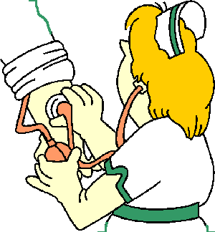
Blood Pressure
= the force of blood on the walls of the arteries
Measured with a Sphygmomanometer

Slide 8
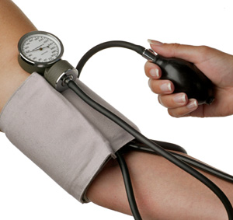
Blood Pressure
Cuff wrapped around the arm is pumped up
with air, stopping the blood flow of the brachial
artery (major artery of the arm)
Stethoscope is placed
below the cuff and air is
slowly released until a
low pitched sound is heard…
Measuring B.P

Slide 9
Blood Pressure
… This is the sound of blood entering the previously closed artery. At this point, the sphygmomanometer measures the pressure exerted by the blood during ventricular contraction.
This is caused systolic blood pressure.

Slide 10
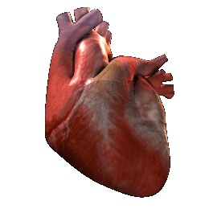
Blood Pressure...
Normal Systolic Pressure is 120 mmHg for young adults

Slide 11
Blood Pressure...
A second reading is then taken when the sound ends. At this point the ventricle is relaxing (filling back up) and this reading is called the Diastolic Blood Pressure.
Normal Diastolic Blood Pressure of 80mmHg

Slide 12
Blood Pressure is reported as:
Systolic Pressure / Diastolic Pressure
Normal:
120mmHg / 80mmHg
(“120 over 80”)

Slide 13
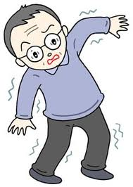
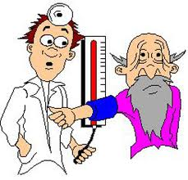
Regulation of Blood Pressure
Too low = “Hypotension”
Too high = “Hypertension”

Slide 14
Blood Pressure Depends On:
Cardiac Output:
↑ in Cardiac Output = ↑ Blood Pressure
Arteriolar Resistance:
- Diameter of arteriole constricted by smooth muscle = ↓ Blood Flow = ↑ Blood Pressure

Slide 15
Vasoconstriction & Dilation
autonomic nervous system = controls the motor nerves
regulates the diameter of the arterioles
vasoconstriction = narrowing of blood vessels which decreases blood flow
vasodilation = widening of blood vessels with increased blood flow

Slide 16
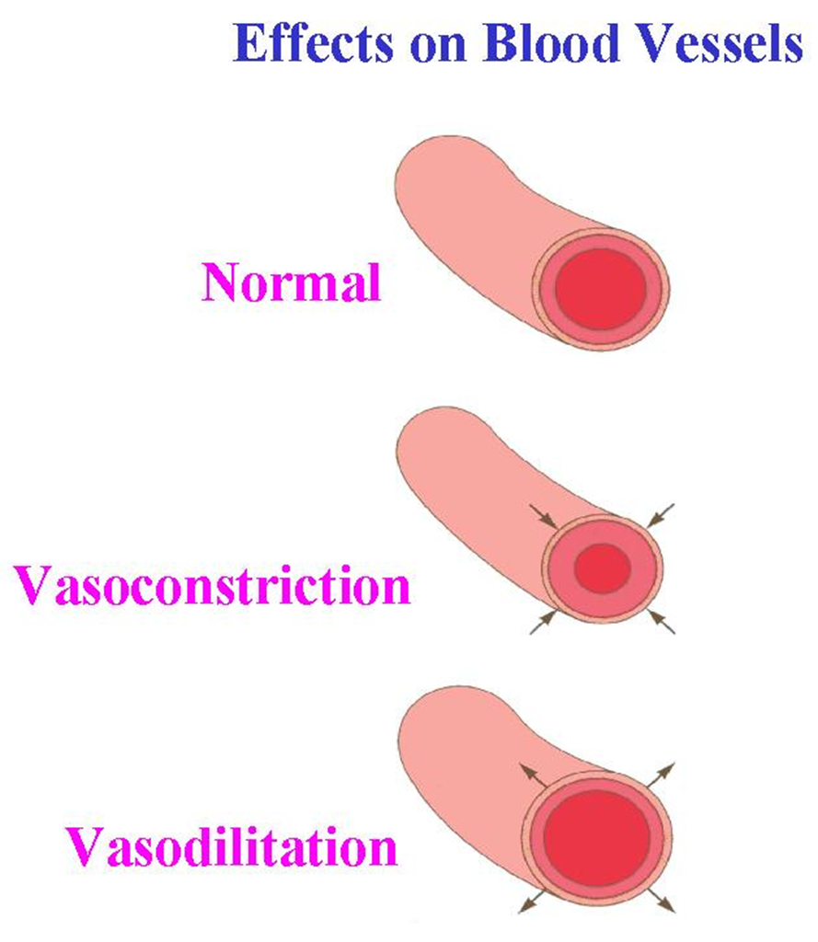
Vasoconstriction & Dilation

Slide 17
Blood Pressure Receptors
Specialized nerve cells that are activated by high blood pressure.
Signal the medulla when BP too high or low.
Triggers responses in the body to counteract high blood pressure.

Slide 18
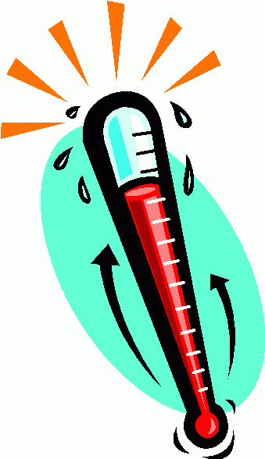
Body Temperature
Normal body temperature
= ________
________________ – maintenance
of body temp. within a range that enables cells to function efficiently

Slide 19
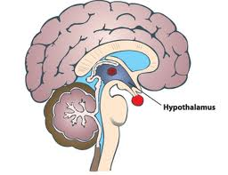
RESPONSE TO TEMPERATURE STRESS
Skin is cooled and
blood becomes cool
Decrease body temp.
Hypothalamus turns
off the cooling system
High Temperature
Senors in brain
Hypothalamus sends nerve impulses
START
Sweat glands start sweating
Evaporation = COOLING
Vasodilation
- Increased blood flow
⬆ Heat
Negative Feedback

Slide 20
RESPONSE TO TEMPERATURE STRESS
Heat is produced from contractions
and less blood flow reduces heat lost
Hypothalamus turns
of heating system
Low temperature
Sensors notice
Hypothalamus sends a nerve impulse
Skin blood vessels CONSTRICT
Skeletal muscles = shivering
& goosebumps
START
⬆ COLD
Negative Feedback

Slide 21
Homework:
Due Monday
pg. 335 #1, 3-6, 9-12, 15

