Slide 1
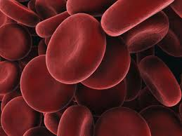
11.1 –
Components
of Blood

Slide 2
Importance of Blood
Transport functions (nutrients, waste, O₂)
Maintains Water Balance
Temperature Regulation
pH Balance (Buffering!)
Immune System

Slide 3
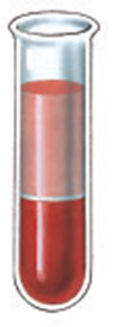
Components of Blood
55% = Fluid Portion (Plasma)
1% = White Blood Cells
44% = Blood Cells
Plasma:
- 90% water but contains blood proteins, glucose,
vitamins, minerals, dissolved gases, urea
Plasma Proteins:
Albumins – help with osmotic balance
globulins - antibodies (immune responses)
fibrinogens - blood clotting
Biuret Q

Slide 4
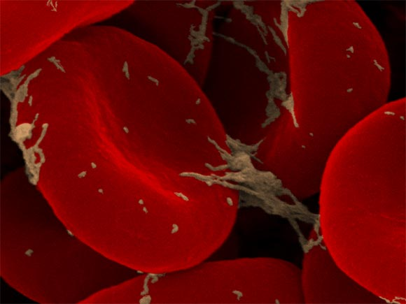
Red Blood Cells → Erythrocytes
Shape = Biconcave
→ more surface area for gas exchange
Enucleated = No Nucleus
→ more space for hemoglobin to be in the cell
Life span = 120 days
→ Produced in bone marrow (5 million/min.)
→ 4.5-8 billion RBC/mL of blood (age, sex, elevation)

Slide 5
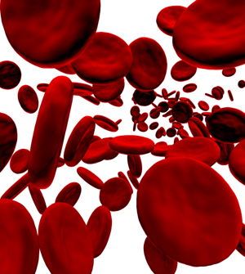
Red Blood Cells - Erythrocytes
Transport of oxygen
Hemoglobin (Hb)
→ 280 million molecules/RBC
→ Enhances the red blood cell’s ability to carry oxygen
→ Two parts:
- heme = the iron containing pigment
- globin = the protein structure

Slide 6
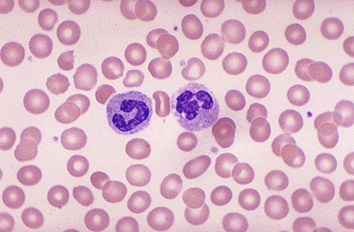
Red Blood Cells

Slide 7
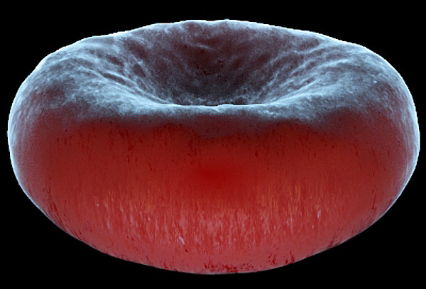
Erythrocytes...
Interesting fact:
If you are placed in an oxygen free environment, humans can survive 4 to 5 minutes because of the excess oxygen carried by Hb. Without Hb, it would be 4-5 sec.

Slide 8
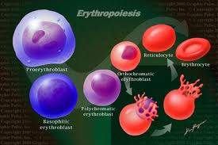
Erythropoiesis
Process by which red blood cells are made
Cells are recycled when old and brittle
Iron reused
Rest of heme broken
down into bile salts by
the liver

Slide 9
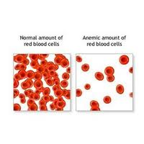
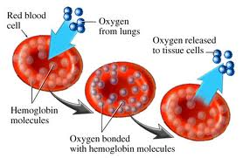
ANEMIA
A deficiency in # of erythrocytes or in hemoglobin can lead to anemia (reduction in blood oxygen levels)

Slide 10
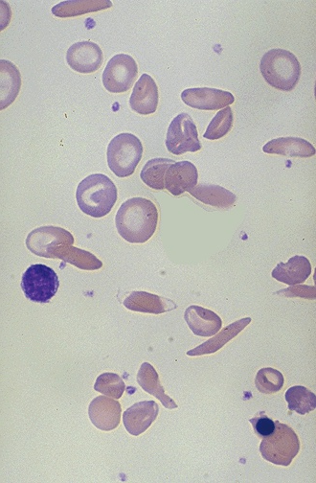
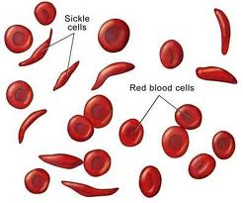
Sickle Cell Anemia
Blood cells form an
abnormal crescent shape.
Delivers less oxygen to cells.

Slide 11
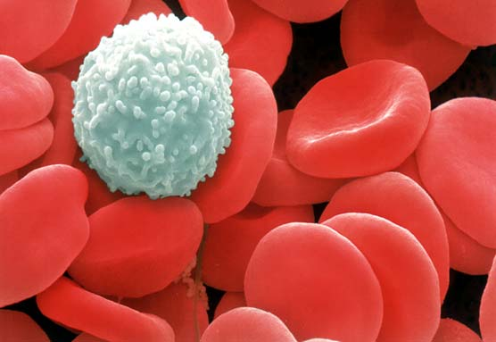
White Blood Cells Leukocytes
Role: Kill invaders of body
RBC to WBC Ratio:
700 erythrocytes to 1 leukocyte
Have a nucleus
Different types based on shape of nucleus and granules in cytoplasm

Slide 12
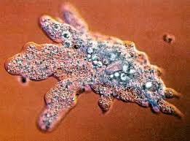
How Leukocytes Work…
Some function by destroying invading
microbes by PHAGOCYTOSIS
Engulf microbe and
digest it (PAC-MAN Style)

Slide 13
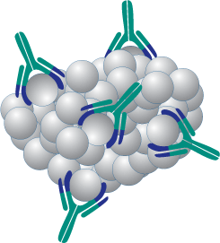
How Leukocytes Work…
Others function by
forming ANTIBODIES
Tag invaders to be destroyed
by other leukocytes.
- Act like a beacon.

Slide 14
Pus (exudate)
formed when leukocytes engulf and destroy invading microbes.
The white blood cell is also destroyed in the process.
If under the skin the
collection of pus is
also called an abscess
or pimple.

Slide 15
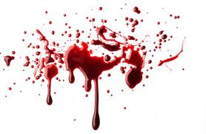
Practice Q’s
Pg. 356 # 3-6, 10-14

