Slide 1
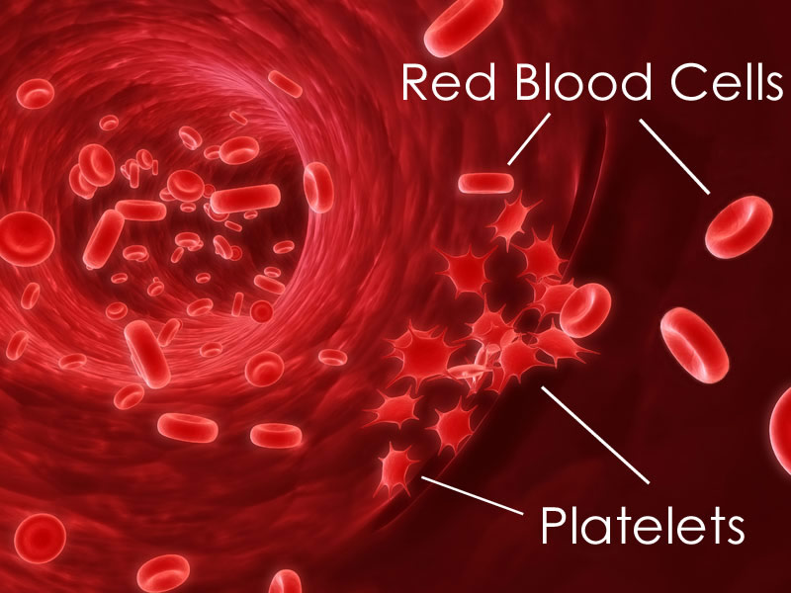
Platelets
Do not contain a nucleus
produced in bone marrow
when blood vessels are ruptured, they initiate the blood clotting reactions
http://youtube.com/watch?v=1ncvcgffGlY

Slide 2
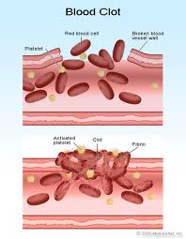
Blood Clotting
Clotting of blood prevents
loss of blood from torn or
ruptured vessels.
Also prevents pathogens
from entering our body
(physical barrier)

Slide 3
Blood Clotting
How it works:
1. Platelets in blood vessels strike a rough surface (broken vessel wall) and break

Slide 4
Blood Clotting
How it works:
Platelets in blood vessels strike a rough surface (broken vessel wall) and break
2. Platelets release thromboplastin (protein)

Slide 5
Blood Clotting
How it works:
Platelets in blood vessels strike a rough surface (broken vessel wall) and break
2. Platelets release thromboplastin (protein)
3. Thromboplastin and calcium activate prothrombin (protein)

Slide 6
Blood Clotting
How it works:
Platelets in blood vessels strike a rough surface (broken vessel wall) and break
2. Platelet releases thromboplastin (protein)
3. Thromboplastin and calcium activate prothrombin
(protein)
4. Prothrombin (made by the liver) is changed into
thrombin by thromboplastin

Slide 7
Blood Clotting
How it works:
1. Platelets in blood vessels strike a rough surface (broken vessel wall) and break
2. Platelet releases thromboplastin (protein)
3. Thromboplastin and calcium activate prothrombin (protein)
4. Prothrombin (made by the liver) is changed into thrombin by thromboplastin
5. Thrombin changes fibrinogen (plasma protein) to fibrin, which goes to damaged area, sealing the cut with a clot.

Slide 8
Blood Clotting
Invading microbes cannot gain access and red blood cells cannot escape, but white blood cells can crawl in and patrol against pathogens.

Slide 9
Blood Clotting
Platelet
1. Platelets in blood vessels strike a
rough surface and break
2. Platelet releases
thromboplastin (protein)
3. Thromboplastin and calcium
activate prothrombin (protein)
4. Prothrombin (made by the liver)
is changed into thrombin
by thromboplastin
5. Thrombin changes fibrinogen to
fibrin, which goes to damaged area,
sealing the cut with a clot.

Slide 10
Blood Clotting
Platelet
1. Platelets in blood vessels strike a
rough surface and break
2. Platelet releases
thromboplastin (protein)
3. Thromboplastin and calcium
activate prothrombin (protein)
4. Prothrombin (made by the liver)
is changed into thrombin
by thromboplastin
5. Thrombin changes fibrinogen to
fibrin, which goes to damaged area,
sealing the cut with a clot.
Thromboplastin

Slide 11
Blood Clotting
Platelet
1. Platelets in blood vessels strike a
rough surface and break
2. Platelet releases
thromboplastin (protein)
3. Thromboplastin and calcium
activate prothrombin (protein)
4. Prothrombin (made by the liver)
is changed into thrombin
by thromboplastin
5. Thrombin changes fibrinogen to
fibrin, which goes to damaged area,
sealing the cut with a clot.
Thromboplastin
+ Ca²⁺
Prothrombin

Slide 12
Blood Clotting
Platelet
1. Platelets in blood vessels strike a
rough surface and break
2. Platelet releases
thromboplastin (protein)
3. Thromboplastin and calcium
activate prothrombin (protein)
4. Prothrombin (made by the liver)
is changed into thrombin
by thromboplastin
5. Thrombin changes fibrinogen to
fibrin, which goes to damaged area,
sealing the cut with a clot.
Thromboplastin
+ Ca²⁺
Prothrombin
Thrombin

Slide 13
Blood Clotting
Platelet
1. Platelets in blood vessels strike a
rough surface and break
2. Platelet releases
thromboplastin (protein)
3. Thromboplastin and calcium
activate prothrombin (protein)
4. Prothrombin (made by the liver)
is changed into thrombin
by thromboplastin
5. Thrombin changes fibrinogen to
Fibrin, which goes to damaged area,
sealing the cut with a clot.
Thromboplastin
+ Ca²⁺
Prothrombin
Thrombin
Fibrinogin
Fibrin

Slide 14
Blood Clotting
Platelet
1. Platelets in blood vessels strike a
rough surface and break
2. Platelet releases
thromboplastin (protein)
3. Thromboplastin and calcium
activate prothrombin (protein)
4. Prothrombin (made by the liver)
is changed into thrombin
by thromboplastin
5. Thrombin changes fibrinogen to
fibrin, which goes to damaged area,
sealing the cut with a clot.
Thromboplastin
+ Ca²⁺
Prothrombin
Thrombin
To Cut
Fibrinogin
Fibrin

Slide 15
Blood Clotting
Platelet
Invading microbes cannot
gain access and red blood
cells cannot escape, but
white blood cells can crawl
in and kill any unwanted
visitors.
Thromboplastin
+ Ca²⁺
Prothrombin
Thrombin
To Cut
Fibrinogin
Fibrin

Slide 16
Blood Clotting...
Blood clotting is bad when:
a Thrombus is formed: A blood clot that blocks a blood vessel, can cause damage to local tissues due to lack of O₂. If this happens in the head a stroke can occur.
or Embolus - Blood clot that dislodges and is carried by the circulatory system to vital organs.
Ex. cerebral, coronary, pulmonary embolism

Slide 17
Blood Groups
Blood transfusions not very successful until the discovery of blood types…
The different blood groups are due to…
…Glycoproteins
large chemical complexes, made from
carbohydrates and protein.
- Found on cell membranes

Slide 18
Blood Groups
Blood types - A, B, AB, and O
People with type:
Type A - glycoprotein A on the red blood cell membrane
Type B - B glycoprotein
Type AB - both glycoproteins
Type O - no marker proteins

Slide 19
Blood Groups
Blood types - A, B, AB, and O
People with type:
Type A - glycoprotein A on the red blood cell membrane
Type B – glycoprotein B
Type AB - both glycoproteins
Type O - no marker proteins

Slide 20
Blood Groups
Blood types - A, B, AB, and O
People with type:
Type A - glycoprotein A on the red blood cell membrane
Type B – glycoprotein B
Type AB - both glycoproteins
Type O - no marker proteins

Slide 21
Blood Groups
Blood types - A, B, AB, and O
People with type:
Type A - glycoprotein A on the red blood cell membrane
Type B – glycoprotein B
Type AB - both glycoproteins
Type O - no marker proteins

Slide 22
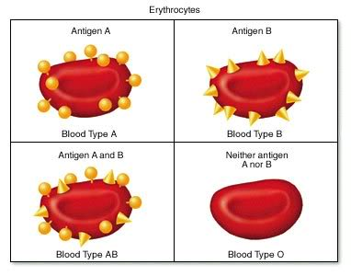
Glycoproteins act as Antigens
Antigen - substance, usually a protein, that stimulates the formation of antibodies

Slide 23
Antibodies
Plasma (serum) Proteins formed that react with a specific antigen.
Antibodies attach to antigens and cause cells to “clump” together
- Opposite of Blood Antigens.

Slide 24
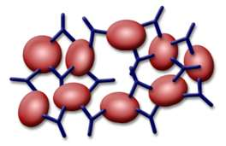
Agglutination
Agglutination - Clumping of blood cells caused by antigen-antibody interaction.
→ If transfused blood does
not match it will agglutinate
→Agglutinated blood cannot
pass through capillaries = blood clots = trouble

Slide 25
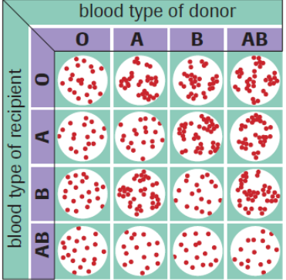
Agglutination Results

Slide 26
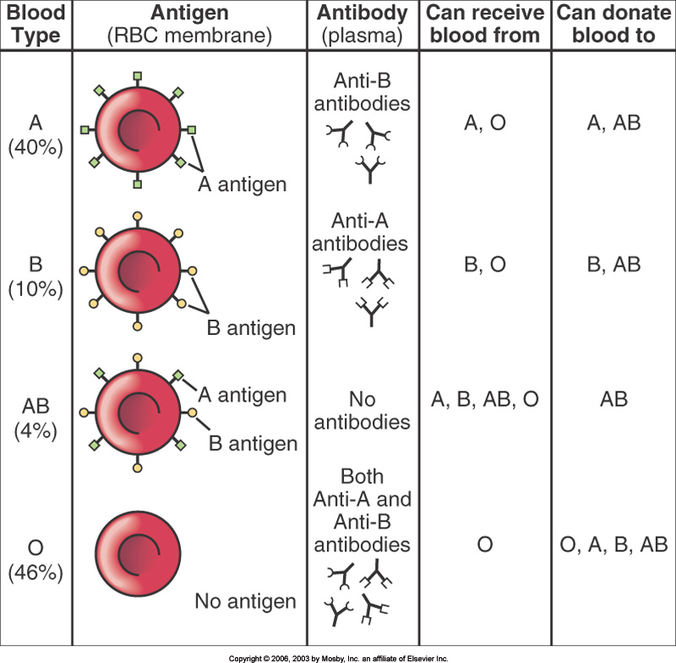
Transfusion...

Slide 27
Rhesus Factor
Another type of antigen found on RBC’s
Have it = Rh+ (85%)
Don’t have it = Rh- (15%)
Rh- can donate to Rh+
Rh+ cannot donate to Rh-
There are no natural Rh antibodies but the body can develop them after repeated exposure.
Ex. After pregnancy (pg. 355)

Slide 28
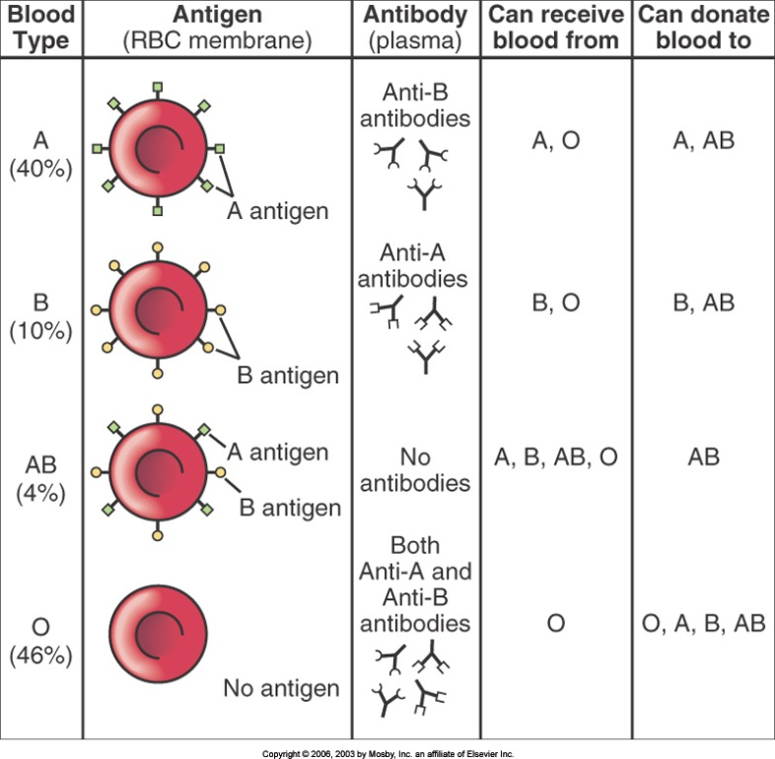
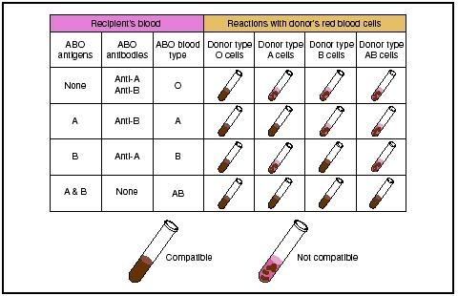
Transfusion
Universal Recipient
Type AB⁺
- blood cells contain A, B and Rh antigens
- serum contains no antibodies
Universal Donor
Type O⁻
Blood cells have no surface antigens
Serum contains A + B antibodies

Slide 29
Blood Typing Questions
pg. 356 # 7, 8, 15-18

