Slide 1
Hearts = type A
Clubs = type B
Diamonds = type AB
Spades = Type O
What's your blood type?

Slide 2
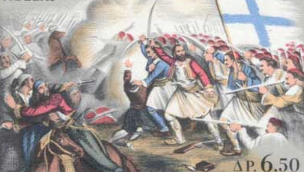
The Body’s Lines of Defence!

Slide 3
The First Line of Defence…
… is largely physical
The skin and mucous membranes defend against viral and bacterial invaders.

Slide 4
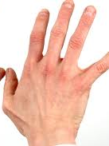
The First Line: The Skin
Acts as Protective Barrier
- can’t be penetrated by bacteria or viruses
A chemical defence in the
form of Acidic Secretions
- skin’s pH is acidic enough
to inhibit the growth of
microbes

Slide 5
The First Line: Lysozyme
An antimicrobial enzyme secreted in tears, saliva, mucous, and perspiration
Kills cells by destroying cell walls

Slide 6
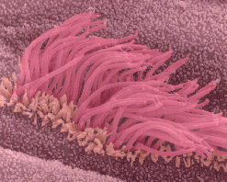
The First Line: The Respiratory Tract
Mucus traps invading microbes and foreign debris
Hairlike structures
called Cilia act as a filter
and moves in waves,
sweeping particles up
toward the throat

Slide 7
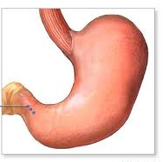
The First Line: The Stomach
Corrosive acids and protein-digesting enzymes
Acid=
Enzyme=

Slide 8
The second line of defence is mobilized if the invader enters the body…
2nd Line = Non-Specific Line of Defence

Slide 9
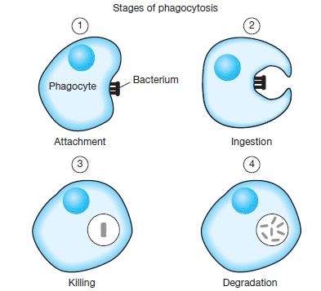
The Second Line: Phagocytosis
Ingestion of invading microbes by Leukocytes (WBCs)

Slide 10
The Second Line: Phagocytosis
When invaders penetrate
the skin special WBCs called
monocytes move from the Blood
blood into tissues, where they
become MACROPHAGES Tissue

Slide 11
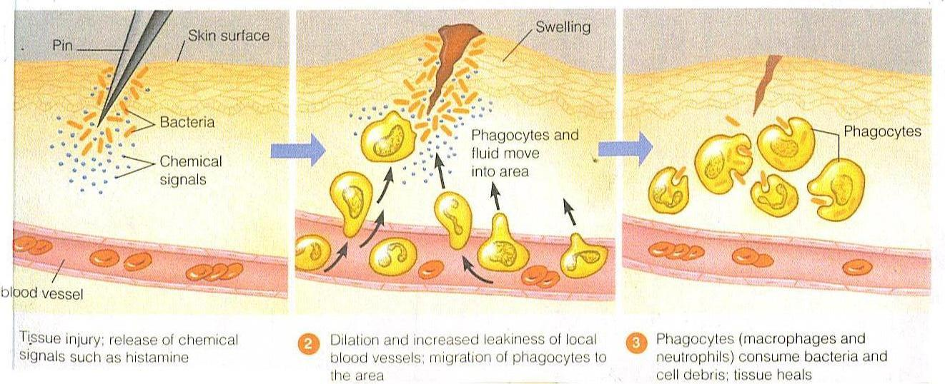
The Second Line: Inflammatory Response
A localized, nonspecific response triggered when tissue cells are injured by bacteria or physical injury
Characterized by swelling, heat, redness and pain

Slide 12
The Second Line: Inflammatory Response
FIGURE 2 on Page 358

Slide 13
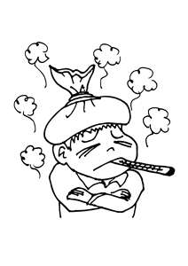
The Second Line: Fever
Some WBCs respond to invaders by releasing hormones that send signals to the hypothalamus in the brain
Hypothalamus triggers
physical responses to
increase body temperature
and help WBC kill invaders

Slide 14
Osmosis Jones
http://www.youtube.com/watch?v=3IzFxBzfBQs

