Slide 1
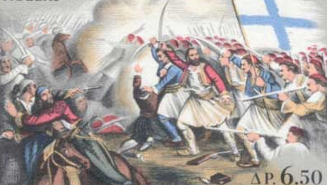
11.2 - The Body’s Lines of Defence!

Slide 2
The First Line of Defence:
Primarily physical defence
Includes:
- The Skin
- Lysozymes
(antimicrobial enzymes in tears, sweat, saliva, & mucous)
- Mucous and Cilia in Respiratory Tract
- Stomach Acid and Enzymes

Slide 3
The Second Line of Defence:
When invader gets past the first line
Is a Non-Specific line of defence
Includes:
- Phagocytosis by macrophage cells
- An inflammatory Response
(cells release histamine, phagocytes leave blood migrate to injury site, swelling, pain, redness)
- Fever

Slide 4
The Body's 3rd Line of Defence:
The Immune Response

Slide 5
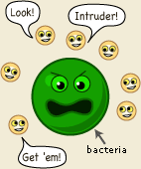
The 3rd Line: The Immune Response
The presence of foreign
organisms activate
antimicrobial plasma proteins
in the circulatory system,
called COMPLEMENT PROTEINS

Slide 6
The 3rd Line: The Immune Response
COMPLEMENT PROTEINS can work in three ways:
1) Triggers the formation of a protective coating around the invading cell, immobilizing it
COATING PROTEIN
INVADER
CELL

Slide 7
The 3rd Line: The Immune Response
COMPLEMENT PROTEINS can work in three ways:
1) Triggers the formation of a protective coating around the invading cell, immobilizing it
2) Punctures the invader’s cell membrane, causing water to rush in and busting the cell
H₂O
INVADER
CELL

Slide 8
The 3rd Line: The Immune Response
COMPLEMENT PROTEINS can work in three ways:
1) Triggers the formation of a protective coating around the invading cell, immobilizing it
2) Punctures the invader’s cell membrane, causing water to rush in and busting the cell
3) Attach to the invader cell, tagging it for phagocytosis
INVADER
CELL
PHAGOCYTE

Slide 9
The 3rd Line: The Immune Response
LYMPHOCYTES
a type of WBC that produces ANTIBODIES
- Protein that protects the body from invaders
Y
ANTIBODIES
Y
Y
LYMPHOCYTE
LYMPHOCYTE

Slide 10
The invading cells have ANTIGENS on their cell
membranes and the specific ANTIBODIES are
made to detect the specific antigen
Y
ANTIBODIES
Y
Y
ANTIGENS
INVADER
LYMPHOCYTE
LYMPHOCYTE

Slide 11
Two Types of Lymphocytes
1) T Cells
2) B Cells

Slide 12
Two Types of Lymphocytes
T Cells
Seeks out intruder and
identifies it by the antigen
Once identified, send the
info to B Cells…
B Cells
Multiple and produce weapons (antibodies)
The weapons are specific to the invader’s antigen
Ah, intruder!
T Cell

Slide 13
Two Types of Lymphocytes
B Cells
Multiply and produce antibodies (plasma cells)
The weapons are specific
to the invader’s antigen
Y
Y
Y
Y
Y
Y
Y
Y
B Cell

Slide 14
Antigens - Antibodies
Every type of antibody is specific to one type of antigen
(i.e. An HIV antibody can’t fight against FLU antigens)
Y
FLU Antigens
Y
HIV Antibody
Y
FLU Antibody
Invader FLU Cell
Peanut Antibody

Slide 15
Antigens - Antibodies
Antibodies are quite similar in structure
The specificity comes from the tips of the Y shaped
end – called VARIABLE REGIONS
Y
Y
Y
HIV Antibody
FLU Antibody
Peanut Antibody

Slide 16
Antigens - Antibodies
When the antibody attaches to the antigen, the invader is ‘tagged’ for phagocytosis by the macrophages
Y
Invader FLU Cell
MACROPHAGE

Slide 17
When a macrophage engulfs the invader, the antigen markers are not destroyed, but placed on the macrophage’s cell membrane
Invader Cell
MACROPHAGE

Slide 18
When a macrophage engulfs the invader, the antigen markers are not destroyed, but placed on the macrophage’s cell membrane
Invader Cell
MACROPHAGE

Slide 19
Helper T Cells
recognize and identify the invader antigens on macrophages and sends signals to B cells to make more antibodies
Helper T Cells
MACROPHAGE

Slide 20
Helper T Cells
recognize and identify the invader antigens on macrophages and sends signals to: … B cells to make more antibodies
… Killer T Cells to search-and-destroy
more invaders
Helper T Cells
MACROPHAGE

Slide 21
Suppressor T Cells → a T cell that turns off the immune system after the battle is won.
Suppressor T Cells
MACROPHAGE

Slide 22
Memory B Cells → a cell that retains information about the shape of the invader’s antigen → keeps this information forever in case the invader reappears. Creates Acquired Immunity
There was something I was supposed to remember…..
Memory B Cell

Slide 23
Re - Cap
http://www.youtube.com/watch?v=BeV7BtP18N8

Slide 24
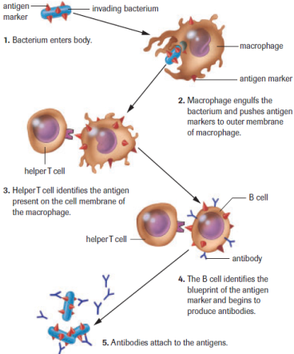
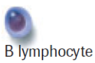
Suppressor T Cell
Memory B Cell
Killer T Cell
Plasma Cell

