Slide 1
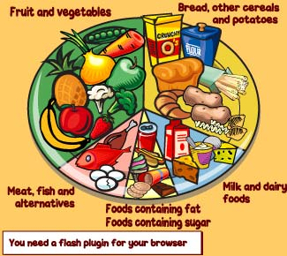
8.1 Essential Nutrients

Slide 2
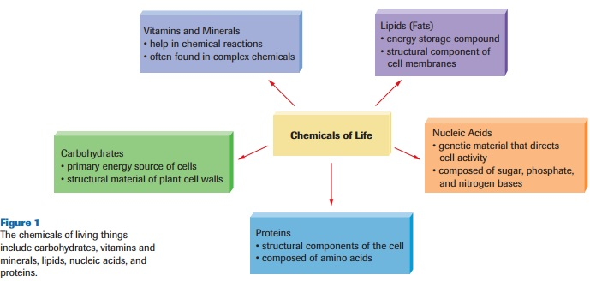
Essential Nutrients
The chemicals our body needs to function and maintain itself properly.

Slide 3
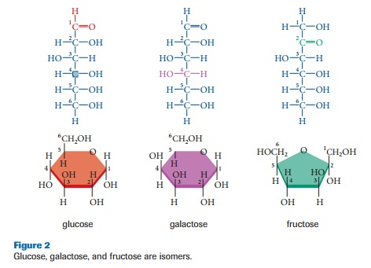
Carbohydrates
Monosaccharides are the simplest form of carbs

Slide 4
Carbs cont.
Combine two via dehydration synthesis and you get a Disaccharide
Ex. glucose + fructose – H2O= sucrose
Many more and you get Polysaccharides
Ex. Starch, glycogen, cellulose

Slide 5
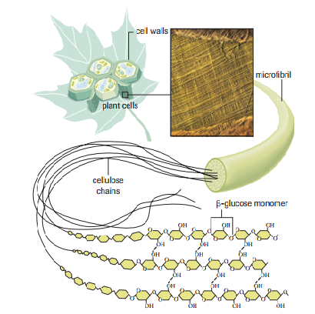
Carbs cont.
Starch – Plant carbohydrate used to store energy, made from many glucose subunits.
Glycogen – The form carbohydrates are stored as in animal tissues (liver & muscle tissue).
Cellulose – carbohydrate
found in cell walls which is
very rigid and strong (50% +
of all organic carbon in
the biosphere).

Slide 6
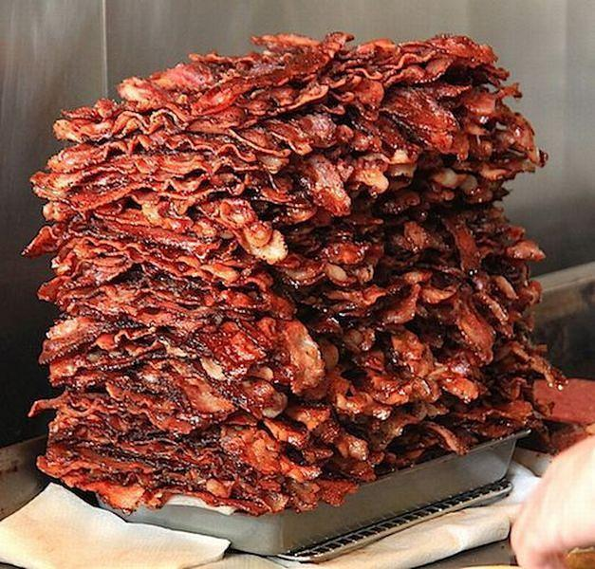
Lipids
Non-polar
Most are composed of two subunits:
Glycerol
Fatty acids
Primary Function - storage of energy
Key components in:
Cell membranes
Cushioning of organs in the body
Carrying vitamins A, D, E, and K
Produced via dehydration synthesis

Slide 8
Lipids cont.
Dehydration Synthesis of glycerol & fatty acid subunits into Triglyceride (Lipid)

Slide 9
Three Groups of Lipids (Just write down the names!)
1) Triglycerides:
Made of a glycerol and 3 fatty acids
If solid at room temperature = Fats
Saturated
Bad Fats
If liquid at room temperature = Oils
Unsaturated
Good Fats

Slide 10
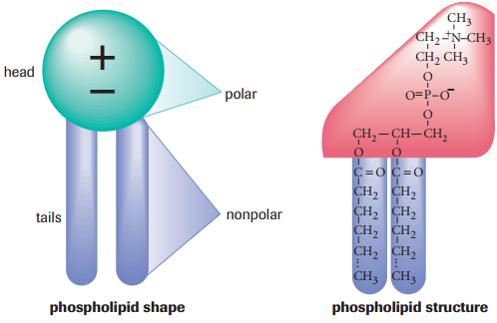
Three Groups of Lipids (Just write down the names!)
2) Phospholipids:
Phosphate group
bonded to a glycerol
backbone
Polar and Non-polar ends
Major component of cell membranes

Slide 11
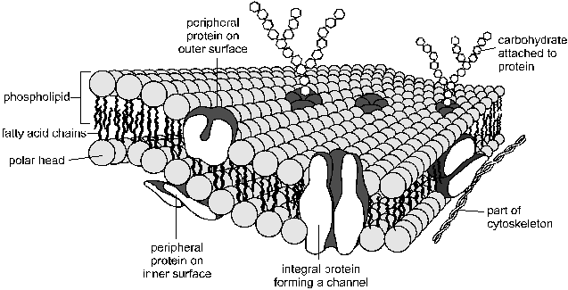
Cell Membrane

Slide 12
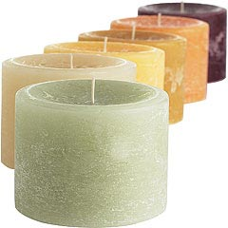
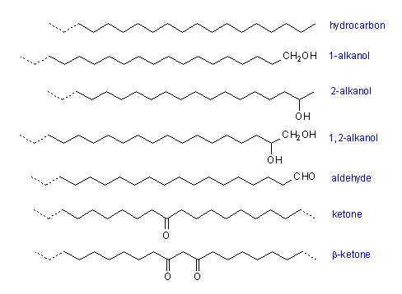
Three Groups of Lipids (Just write down the names!)
3) Waxes:
Long-chain fatty acids are joined to long-chain alcohols or carbon rings.
Insoluble in water – natural waterproof coating
Plant leaves, bird feathers

Slide 13
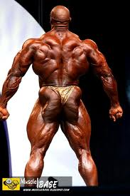
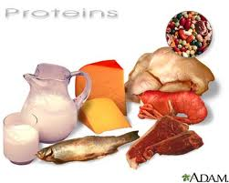
Proteins
Not primarily energy compounds
Used to form the structural parts of a cell
Helps repair cells
Made up of amino acids
Communication and transport
Proteins can be found in:
mitochondria and ribosomes
muscle, nerve cells
skin, hair
antibodies, enzymes

Slide 14
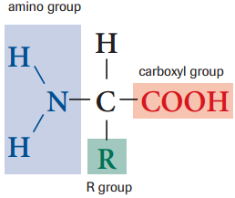
Amino Acids
Building blocks of proteins
Essential amino acids – eight amino acids our body cannot make itself that we must get from our diet
isoleucine, leucine, lysine, methionine, phenylalanine, threonine, tryptophan and valine
R Group is variable (changes)
to make different
amino acids.
Fig. 11 pg. 249

Slide 15
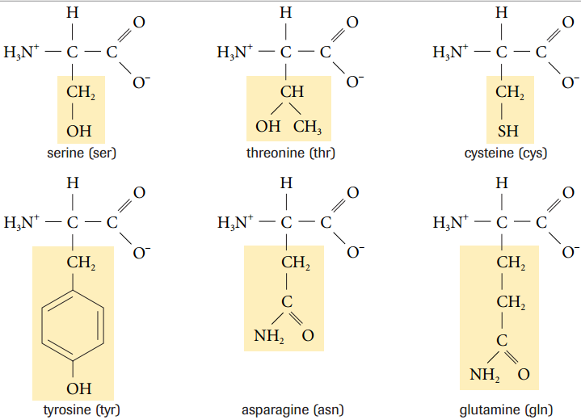

Slide 16
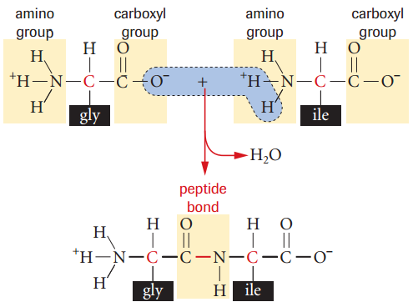
Amino Acid Bonding
Dehydration synthesis between amino acids form peptide bonds – chains of A.A`s = polypeptides

Slide 17
Protein Structures
Polypeptides are folded into specific 3D shapes
Some proteins have more than one polypeptide
1) Primary
unique sequence of amino acids in the chain
2) Secondary
when a protein folds (β-pleated sheet) or coils (α helix) and hydrogen's bond together
3) Tertiary
additional folding which is stabilized by R group interactions
4) Quaternary
large globular proteins formed from two or more polypeptides
Ex. haemoglobin (four individual polypeptide chains)
Levels of Protein Structure

Slide 18
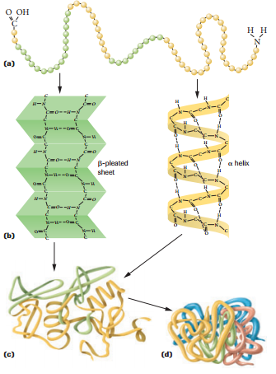

Slide 19
Denaturation and Coagulation
Denaturation
Occurs when the bonds of a protein are disrupted causing a temporary change in shape of the protein.
Causes change in physical properties and biological processes
Coagulation
Occurs when bonds of a protein are disrupted causing permanent change in shape of the protein.
Causes change in chemical properties
Can BOTH occur through heat (Ex. cooking an egg), radiation,
change in pH (Ex. stomach acid)

Slide 20
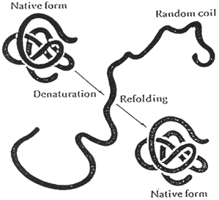
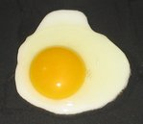

Slide 21
Indicators
Chemicals that change colour in the presence of a particular substance
Indicator | Original Colour | Positive Test | Negative Test | Used to Identify
Sudan IV | Red Powder | Dissolves - different shades of red | Does not Dissolve | Fats
Translucence | Brown Paper | Light Shines through | Light does not Shine through | Fats
Biuret’s Reagent | Blue Liquid | Purple | Blue | Proteins
Lugol’s Solution | Yellow-brown | Blue-black | Yellow | Starch
Benedict’s Solution (+ heat) | Blue | Green (least) Yellow Red (most) | Blue | “Reducing Sugars” Monosaccharides And Disaccharides

