Slide 1
8.2 Enzymes (pg. 254-258)
By Patrick Shackleford
Adapted from a presentation by
Dr. Jared Heidinger M.D. Ph.D

Slide 2
Enzymes and Metabolic Reactions
catalysts - chemicals that regulate the rate of chemical reactions without themselves being altered
enzymes - protein catalysts that permit chem. reactions within your body to occur at low temperature
substrate - molecules that attach to enzymes (altered by enzyme)

Slide 3
What do Enzymes do for us?

Slide 4
Enzymes are specific to their substrates (each substrate has one specific enzyme that works with it)
most enzymes have the suffix -ase
Ex. maltase breaks down maltose

Slide 5
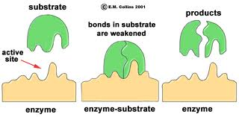
Structure of Enzymes
Active site - area that joins substrate and enzyme
lock and key model

Slide 6
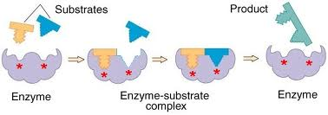
Induced Fit Model
some enzymes also require co-factors or co-enzymes to help bind substrate molecules.

Slide 7
Co-factor - inorganic ions that help the enzyme combine with substrate molecules.
Ex. Fe, Zn, K, Cu compounds
Co-enzymes - organic molecules that help the enzyme. they are synthesized from vitamins. “Take your vitamins!”
Estimated that a single enzyme can catalyze from 100 to 30 million reactions every minute!

Slide 8
Factors that affect Enzyme Reactions
There are various factors that will affect the speed of enzyme reactions. They are:
Temperature
pH
Substrate concentration
Competitive inhibitors

Slide 9
1. Temperature
The higher the temperature the faster the reaction (up to a point)
Why?
More energy means more
movement of molecules,
which means more reactions
What happens when the
temperature gets too high?
Denaturation and then
coagulation.

Slide 10
2. pH
Different enzymes function
better in a certain pH range
pH scale 0 to 14 (0-very
acidic - 14-very basic,
7 neutral)
Ex. Pepsin, in the stomach
works best in a pH range from 1.0 to 3.0
Vs.
Trypsin, in the small intestine works best in a range from 8.0 to 9.0

Slide 11
3. Substrate Concentration
Higher substrate concentration = more
collisions between substrate
and enzymes.
Rate increases until the
Conc. of substrate = the
Conc. of enzymes.
Why?
Because you can’t have more
reactions than enzymes

Slide 12
4. Competitive Inhibitors
Shapes similar to substrate get to the active site and “clog” it before the real substrate does.
Ex. carbon monoxide steals the active site of haemoglobin so the oxygen molecule cannot attach.
Causes cell suffocation and death.

Slide 13
Regulation of Enzyme Activity
Allosteric activity - Change in the protein enzyme caused by the binding of a molecule to the regulatory site of an enzyme. 2 Types:
Feedback inhibition – Inhibition of an enzyme in a metabolic pathway by the final product of that pathway.

Slide 14
Regulation of Enzyme Activity
2. Precursor activity - The activation of an
enzyme in a metabolic pathway by the
initial reactant.

Slide 15
Why does the body need to control its enzymes?
To maintain homeostasis
Homeostasis - process by which a constant internal environment is maintained despite changes in the external environment.

