Slide 1
Cellular Biology

Slide 2
Cell Theory
Hierarchy Chart

Slide 3
Study of?
Biology – living organisms
Morphology – structure in organisms
Physiology – function in organisms
Ecology – populations, communities, ecosystems
Zoology – animals
Botany – plants
Cytology - cells

Slide 4
Microscopy
Advances in discovery of cells was preceded by technological advances in microscopy and preparation of study materials

Slide 5
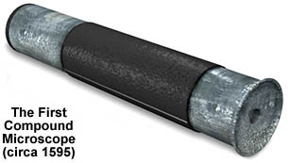
Timeline
1595 – microscope invented - Hans and Zacharias Janssen

Slide 6
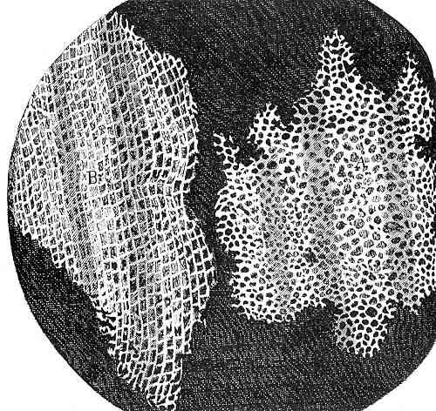
1665 – cork examined by Robert Hooke, invents the term cells

Slide 7
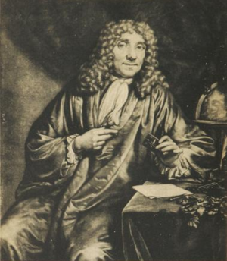
1650 – 1700 – Unicellular organisms viewed by Antoni van Leeuwenhoek

Slide 8
1833 – Robert Brown identifies the nucleus
1838 – Schleiden concludes all plants are made of cells
1839 – Schwann concludes all animals and plants are made from cells
1855 – Virchow concludes all cells arise from pre-existing cells

Slide 9
Modern Cell Theory
1. All living organisms are composed of cells
2. Chemical reactions of living organisms(both energy consuming and producing) occur in cells
3. Cells arise from other cells
4. Cells contain hereditary information and pass this on from parent to daughter cell

Slide 10
Unicellular organisms
Carry out all the functions of life
Metabolism, response, homeostasis, growth, reproduction and nutrition

Slide 11
Surface Area to Volume ratio
Rate of heat and waste production as well as resource consumption is a function of volume
The bigger the more stuff produced and used
Rate of exchange of materials and energy is a function of surface area
More surface area more exchange
Limits cell size

Slide 12
Emergent properties
Multicellular organisms show emergent properties
What does that mean?
Increasing levels of complexity, new characteristics emerge which are not present at the lower levels.

Slide 13
Multicellular organisms
Cells differentiate to carry out specialized functions by expressing some of their genes but not others
Brain cell does not express same genes as skin cells

Slide 14
Stem Cells
Retain the capacity to divide and have the ability to differentiate along different pathways
Can make all types of cells in an organism

Slide 15
Microscopes and Staining
Staining allows structures to be seen that normally would not be seen.
Provide magnified image that increases our ability to see small objects
Types
Light microscope – light must pass through the object
Electron Microscopes

Slide 16
Transport in Cells

Slide 17
Reason for Transport
Maintain optimal internal environment inside cell
Some materials not allowed in
Some pass freely through membrane (passive transport)
Some actively moved through membrane (active transport)

Slide 18
Passive vs. Active
Passive Transport | Active
No energy required | Energy in form of ATP required
Materials move with a gradient | Against gradient
Ex. – diffusion, osmosis, facilitated diffusion | Ion pumps, endocytosis (phagocytosis/pinocytosis), exocytosis

Slide 19
Passive transport
Diffusion
Random movement of molecules that results in equal distribution
Move “down” or “with” concentration gradient
Diagram

Slide 20
Diffusion cont.
Results in equal concentration, molecules keep moving
Types of molecules move independently
Tea and sugar diffuse independently through hot mug
Cells depend on diffusion for movement of O2 and CO2 (small particles, easily through membrane)

Slide 21
Diffusion rates
1. strength of conc. gradient – greater strength=greater rate of diffusion
2. temperature: higher temp.= greater rate
3. stirring: increased movement=greater rate
DEMO!

Slide 22
Facilitated Diffusion
Diffusion across membrane that requires helper molecules
Still follows conc. Gradient
No energy input
“carrier-mediated” transport
Eg. Transport proteins in cell membrane

Slide 23
Osmosis

Slide 24
Osmosis!
Diffusion of water across membrane
Water moves across semipermeable membrane from high water concentration to low
Net movement of water is from hypotonic to hypertonic regions.

Slide 25
terms
Solution, solvent, solute, permeable membrane, semi-permeable membrane, water potential, hypertonic solution, isotonic solution, hypotonic solution

