Slide 1
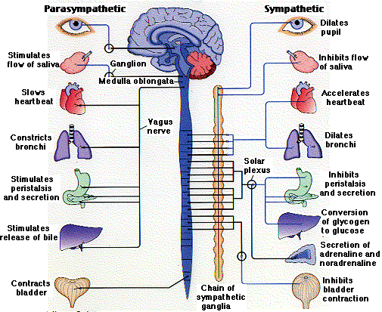
Nervous System and the Senses
Chapter 13 & 14

Slide 2
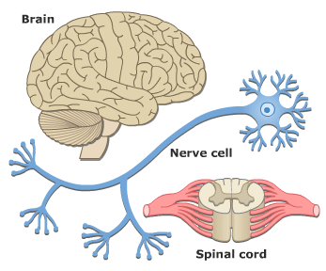
Topic 13.1
Importance of the Nervous System

Slide 3
What is the Nervous System?
Made up of the brain, spinal cord and emerging (body) nerves
Senses (collect data about outside world)
Maintenance of Homeostasis
body maintains a relatively constant internal environment
Close connection to Endocrine (hormonal) and Organ systems......Runs the Show!!!

Slide 4
Structure of the Nervous System
2 Divisions:
Central Nervous System (CNS)
Spinal cord and brain
Processes information

Slide 5
Structure of the Nervous System
2 Divisions:
Peripheral Nervous System (PNS)
Sensory neurons (take in info.)
Motor neurons (act on sensory info.)

Slide 6
Peripheral Nervous System
Somatic N.S.
Voluntary
Carries sensory info from the sensory neurons to the CNS
CNS processes message and sends info to motor neurons to produce a response
Autonomic N.S.
Involuntary
Glandular secretions (Ex. salivation)
Smooth muscle control (Ex. labour)
Cardiac muscle control – heart

Slide 7
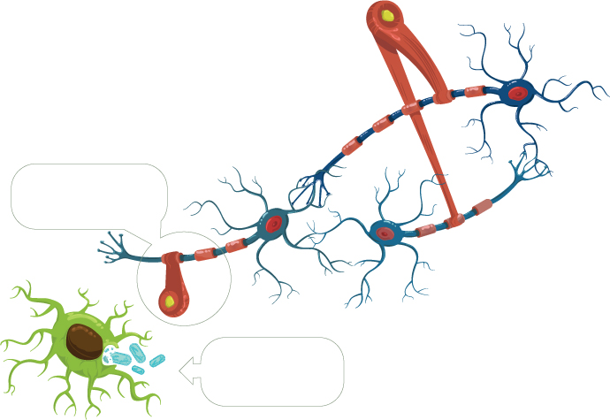
Cells in the Nervous System
2 Major Types:
Glial cells – nourish, support & protect neurons, remove waste and defend against infection.

Slide 8
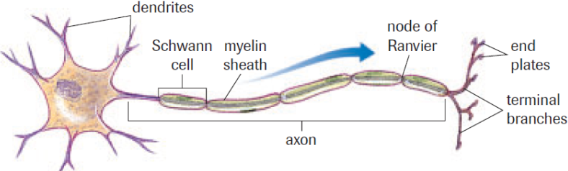
Cells in the Nervous System
2 Major Types:
Neurons – Functional Unit of the Nervous System.
Respond to physical and chemical stimuli and conduct electrochemical signals.
A group of neurons is known as nerve tissue
1.
6.
5.
4.
7.
Cell body
2.
3.

Slide 9
Parts of the Neuron
Dendrites - Receive nerve impulses from other neurons or sensory receptors – branched to increase surface area
Cell body - Receives input from dendrites, if input is large enough it relays it to the axon to initiate an electrical impulse.
Axon – Extension of cell body; transmits signal / nerve impulse away from cell.

Slide 10
Parts of the Neuron
Myelin sheath - fatty, insulating layer – protects the axon and increases the speed of the nerve impulse.
Schwann cells - type of glial cell – form the myelin sheath by wrapping around the axon.
Nodes of Ranvier – Gaps in the myelin sheath, allows faster nerve impulse transmission by “skipping”.

Slide 11
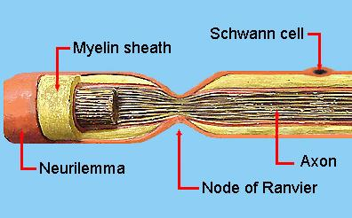
Parts of the Neuron
Terminal Branches / End Plates – Communicate with other neurons by releasing chemical signals in between the axon bulb and dendrites.
Forms the Synapse
Neurilemma - Membrane that surrounds the
axon of PNS nerve fibres, promotes
regeneration of axons after injury.
Ex. “Feeling Returns” post-injury.

Slide 12
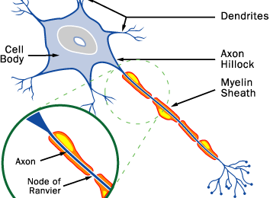
The Neuron
Schwann Cell
Terminal Branches

Slide 13
Types of Neurons
3 Types:
Sensory neurons (ie. input)
Gather info from sensory receptors and transmits impulses to the CNS.
Interneurons
Only present in the CNS
Act a as a link between sensory and motor neurons
Process and integrate incoming information and relay outgoing info to motor neurons
Motor neurons (ie. output)
Transmit info from the CNS to muscles, glands and other organs (aka effectors)

Slide 14
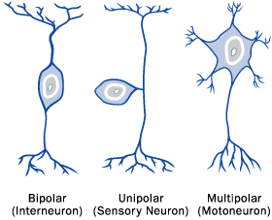
Types of Neurons

Slide 15
Reflexes
Reflexes are sudden, unlearned, involuntary responses.
Ex. Emetics (vomit inducing), hot surfaces, eye puff
Interneurons of CNS process data
(Ex. Decrease the amount of light)
Stimulus of
Sensory Neurons
(Ex. Bright light)
Response of Motor Neurons
(Ex. decrease the size of pupil)

Slide 16
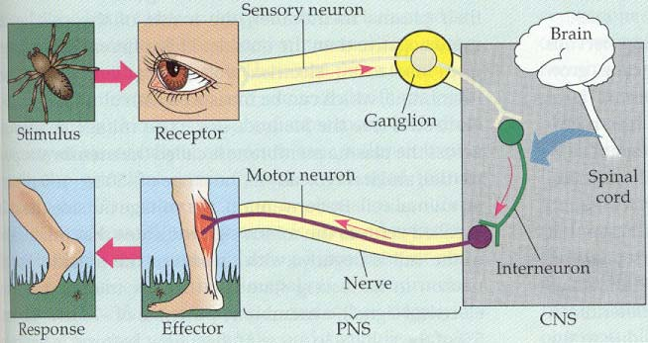
Reflexes

Slide 17
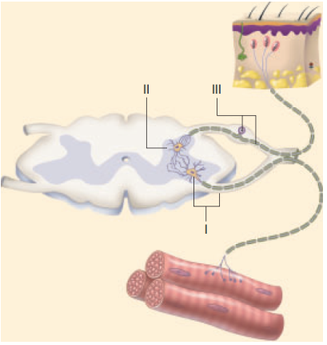
Reflex Arc
Simple connection of a few neurons so that a response can occur rapidly (split second).
5 Parts:
1. Receptors
2. Sensory neuron
3. Interneuron
4. Motor neuron
5. Effectors (muscles)
Ex. Pupillary reflex or
Patellar reflex

Slide 18
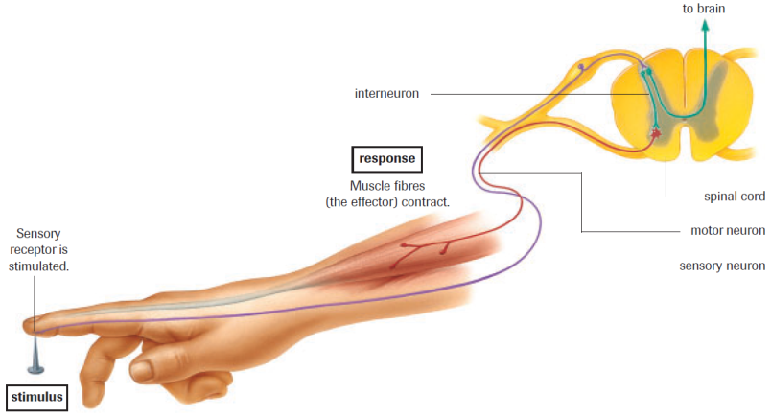
Reflex Arc - Pain Stimulus

Slide 19
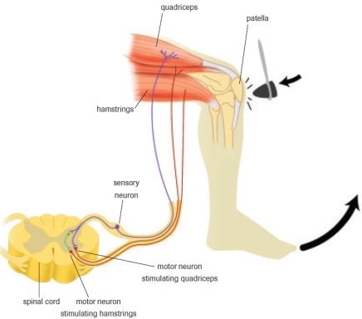
Reflex Arc - Patellar Reflex

Slide 20
Practice
Fill in diagrams for:
Nervous System Divisions
Neuron Structure
Reflex Arc
Pg. 410 Practice #1-4
Pg. 414 Section 13.1 #1-6
Read Section 13.2
Watch Khan Academy – Anatomy of a Neuron

Slide 21
Reflex Lab
pg. 436 & 437 DUE MONDAY
Partners (this means 2 groups of two only)
Write a Hypothesis based on the problem given on Loose-leaf paper with partners names on it
Record Observations for each procedure.
Answer Analysis questions.
Lab must be typed or VERY NEATLY hand written.

Slide 22
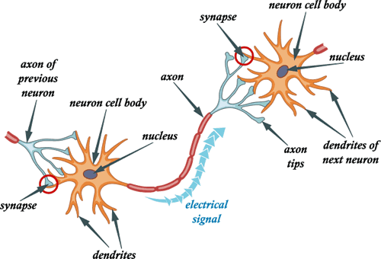
Topic 13.2 A
The Action Potential

Slide 23
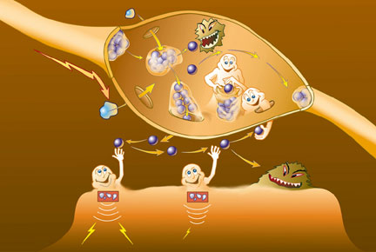
Nerve Impulses
Neurons conduct an
electrical impulse through the
use of voltage differences
Nerve impulses are as strong at the end as at beginning
Slower than electricity on a wire but still up to 100 m/sec
Movement of positively charged ions across cell membrane causes impulse

Slide 24
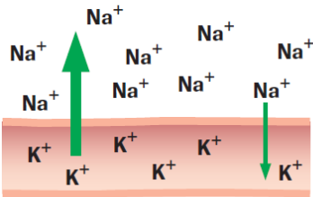
The Conduction of Nerve Impulses
Membrane potential - charge separation across the nerve cell membrane.
Inside cell membrane will be negative or positive compared with outside at different times during nerve impulse due to varying cation (Na⁺ and K⁺) concentrations.

Slide 25
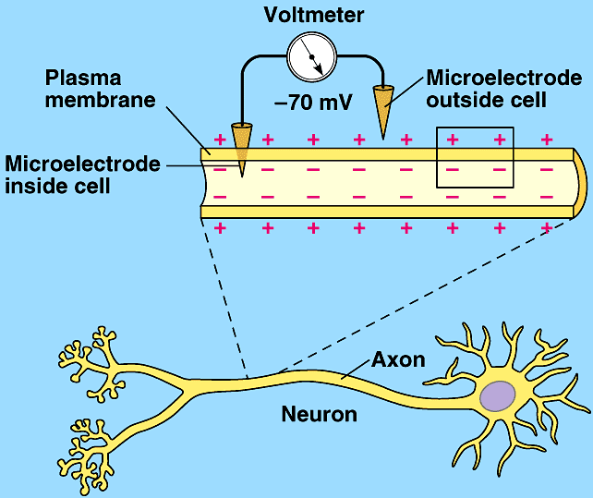
The Conduction of Nerve Impulses

Slide 26
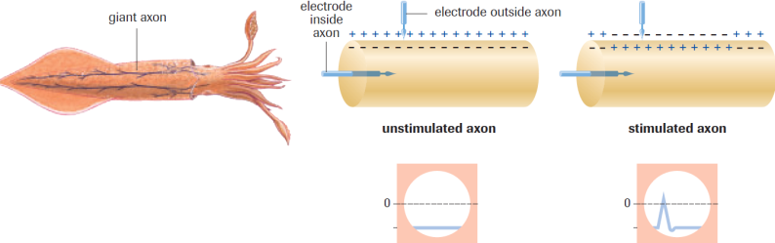
The Conduction of Nerve Impulses
Resting potential – voltage difference when membrane is NOT firing; nerve is unstimulated.
-70mV - negative inside the cell membrane compared to the outside.
Action potential – voltage difference when membrane IS firing; nerve is stimulated.
+40 mV – inside of cell membrane positive compared to outside

Slide 27
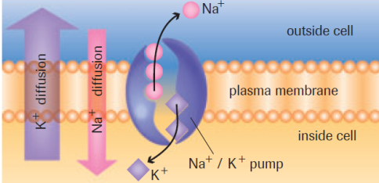
Sodium-Potassium Exchange Pump
Membrane potential is maintained via active transport (requires energy in the form of ATP) of Na⁺ (high Con^{c} outside) and K⁺ (high Con^{c} inside)
Exchanges 3Na⁺ ions (out of the cell) for 2K⁺ ions (into the cell)
Charged ions can’t cross the membrane through passive
transport against their
Con^{c} gradients.

Slide 28
Sodium-Potassium Exchange Pump
5 Steps:
3Na⁺ fits into carrier protein
One P(phosphate) from ATP molecule attaches to the carrier protein
Carrier protein changes shape to release 3Na⁺ and accept 2K⁺ from outside the membrane.
P (phosphate) is released from the carrier protein
Carrier protein changes shape to release 2K⁺ and accept 3Na⁺ again
NET GAIN = 1⁺ out (keeps resting potential -70mV)

Slide 29
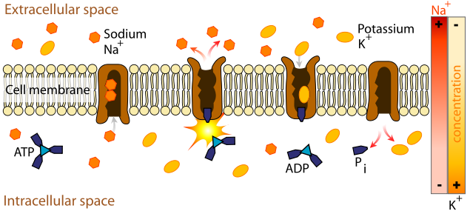
Sodium-Potassium Exchange Pump

Slide 30
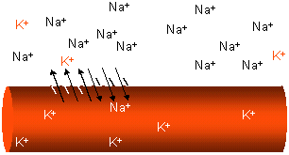
Action Potentials
Occur only at the Nodes of Ranvier (only areas along the axon not covered by myelin sheath).
Stimulation of the neuron causes the cell membrane to become more permeable to Na⁺ than K⁺

Slide 31
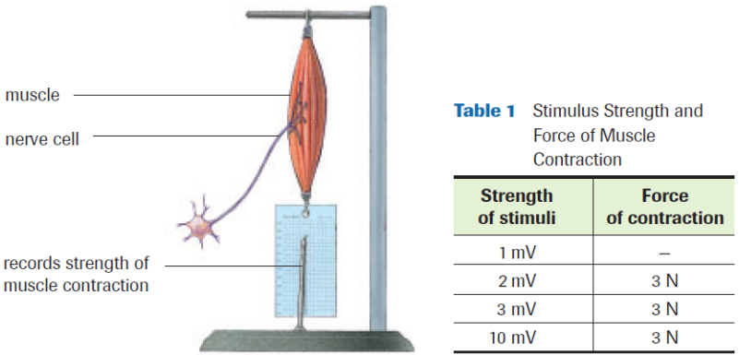
Action Potentials
All-or-none Response
-55mV is the threshold and must be reached in order for an impulse to occur. Nerve is stimulated enough to respond completely or not at all.

Slide 32
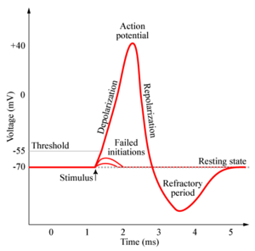

Slide 33
Action Potentials
All-or-none Response
How do we detect variability in sensation and stimulus?
Ex. How can we tell something feels ``hotter`` than something else?
Pg. 419 (Fig. 9)

Slide 34
Action Potential
Once threshold is met the following steps occur:
Voltage-gated Na⁺ channels open and Na⁺ flows into the cell.
During cation (Na+) influx, membrane potential becomes less negative =
Depolarization - decrease in negative charge along
the membrane from -70mV to -55mV

Slide 35
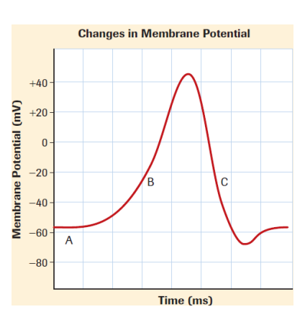

Slide 36
Action Potential
Membrane reaches +35mV.
Voltage-gate Na⁺ channels close.
Voltage-gated K⁺ channels open and K⁺ flows out of the cell (leads to repolarization of the membrane)
During cation (K⁺) eflux, membrane potential
becomes more negative = Repolarization – Return to
resting membrane potential. +35mV to -70 mV

Slide 38
Action Potential
Voltage-gated K+ channels close.
Na+ / K+ exchange pump leads to membrane resting potential (-70mV).

Slide 39
Action Potential
Cell usually overshoots its resting membrane potential.
Hyperpolarization - Increase in negative charge along
the membrane from -70mV to -90mV due to excess
cation (K⁺) eflux.
Refractory period – Period during hyperpolarization
in which the membrane cannot undergo another
action potential. Range 1-10 ms

Slide 40
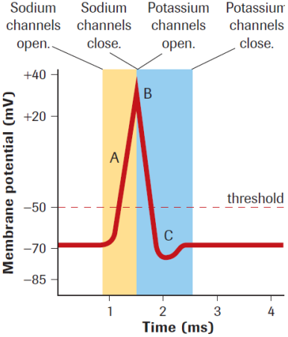
Click for RECAP

Slide 41
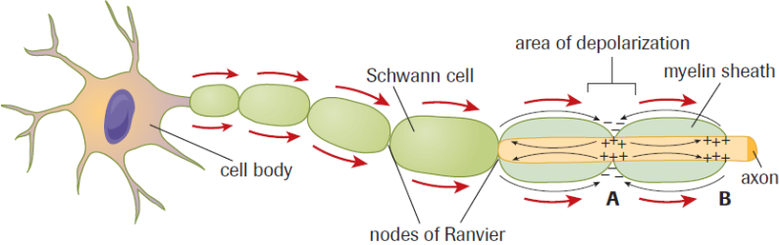
Nerve Impulse
A nerve impulse is a series of action potentials at the Nodes of Ranvier along the length of an axon
How do Action Potentials ``Jump``?
Na⁺ cannot easily diffuse through the myelin sheath , so it diffuses to other neighbouring nodes
Leads to Depolarization and Action Potential

Slide 42
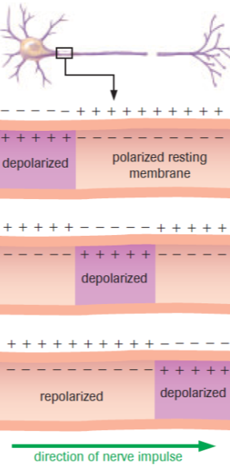
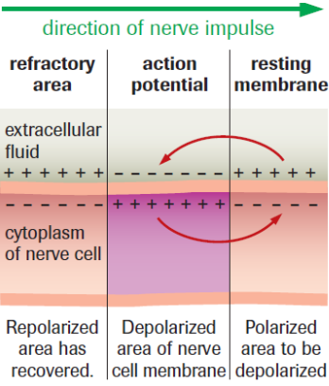
Nerve Impulse

Slide 43
Nerve Impulse
Stages of Action Potential force depolarization along the axon in one direction, known as saltatory conduction.
Myelinated neurons – Action potential travels at 120m/s
Unmyelinated neurons – Action potential travels at 0.5 m/s
Multiple Sclerosis (MS)
Degradation of the myelin in the CNS (slows conduction)

Slide 44
Practice
Fill in diagrams for:
The Action Potential
Practice Pg. 418 #1-4 & Pg. 420 # 5,6
Pg. 425 Section 13.2 #1-5
Read the rest of Section 13.2 (Synapse)
Watch Khan Academy
Action Potential
Saltatory Conduction

Slide 45
Topic 13.2 B
Synaptic Transmission

Slide 46
Signal Transmission Across Synapse
Synapse: Space between an end plate & dendrite which acts as a connection between two neurons or a neuron and an effector (muscle, gland, etc.)
Action Potential travels to the axon terminal but cannot jump across the synaptic cleft to the next neuron or effector.
The message is passed by the A.P. causing the release of chemical transmitters called neurotransmitters (N.T.)

Slide 47
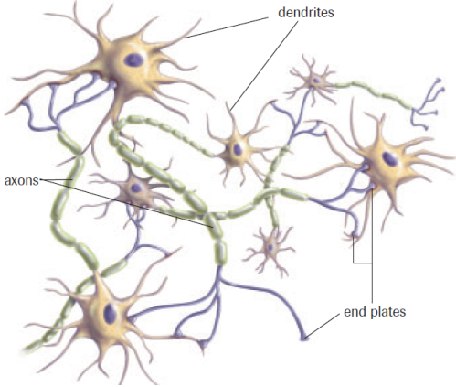
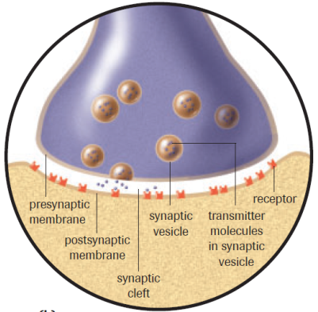
Signal Transmission Across Synapse

Slide 48
Signal Transmission Across Synapse
Neurotransmitter Types (2):
If the N.T. binds with the postsynaptic receptor and depolarization (-55mV) to threshold occurs on the next neuron = (EXCITATORY)
Opens Na⁺ channels = impulse transmission continues
If the N.T. binds with the postsynaptic receptor and hyperpolarization (-90mV) occurs on the next neuron = (INHIBITORY)
Opens K⁺ channels = impulse transmission stops

Slide 49
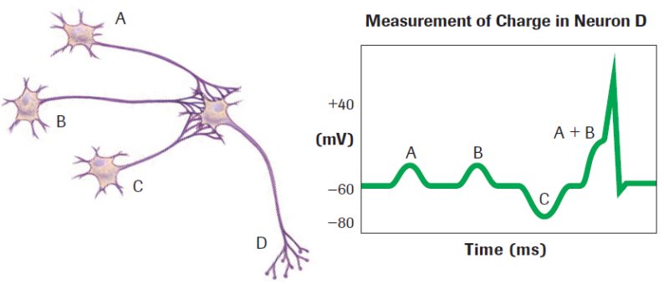
Neurotransmitters
Summation - Effect produced by the accumulation of neurotransmitters from two or more neurons.
Ex. Functions like N.T. Peer Pressure

Slide 50
Neurotransmitters
N.T. must be either reabsorbed or destroyed by enzymes (aka metabolized) after transmission is complete.
Ex. Acetylcholine (Ach) is broken down by
cholinesterase.
Why MUST this happen?
Ex. Insecticides

Slide 51
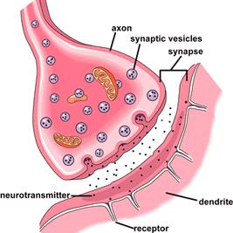
The Synapse

Slide 52
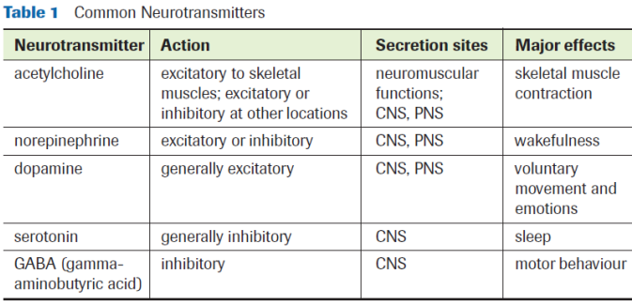
Neurotransmitters
Many neurological disorders are linked to deficiencies or excesses of N.T.
Many drugs effect the function of N.T.

Slide 53
Synapse Types
Cholinergenic Synapses (use acetylcholine)
Most synapses of the Parasympathetic N.S.
Neuromuscular junctions (connection b/w motor neurons and muscle fibres)
Adrenergenic Synapses (use norepinephrine/ noradrenaline)
Synapses of the Sympathetic N.S.

Slide 54
Practice
Fill in diagrams for:
The Synapse
Pg. 420 Practice # 7
Pg. 425 Section 13.2 # 6-8
Case Study - Drugs & the Synapse (READ ONLY)
Watch Khan Academy - Synaptic Transmission
Read Section 13.3

