Slide 1
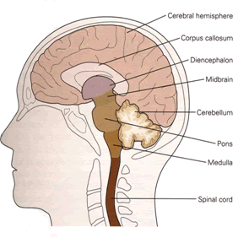
Topic 13.3
The Central Nervous System

Slide 2
Central Nervous System (CNS)
Brain and Spinal Cord are central structures to the entire N.S.
Receives information from the senses, evaluates (processes) information and initiates outgoing responses to the body.
Damage to the CNS affects mood, motor control and homeostasis.
Ex. Creutzfeldt–Jakob disease (BSE in Cows)
Spongy-holes in the brain
Nervousness, oversensitive to touch, lose ability to walk and eventually die.

Slide 3
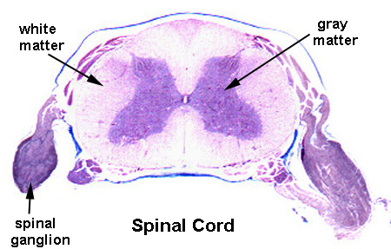
Types of Matter
N.S. composed of two types of matter:
Grey matter - contains cell bodies, dendrites and short unmyelinated axons.
Found around the outside of the brain and makes up the inside of the spinal cord.
White matter - made of myelinated axons.
Located within some areas of the brain and the outside of the spinal cord.

Slide 4
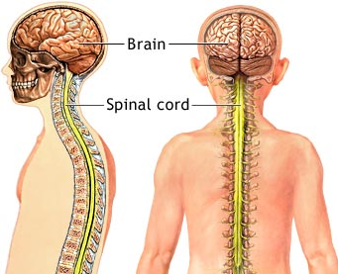
Spinal Cord
Links the CNS to the PNS
Contains sensory neurons, interneurons, and motor neurons
Primary reflex center (reflex arcs)
Spinal cord protected by cerebrospinal fluid, meninges tissue layers and spinal column (vertebrae)
pg. 426.

Slide 5
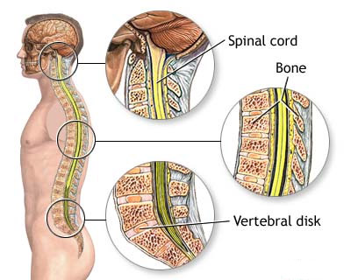
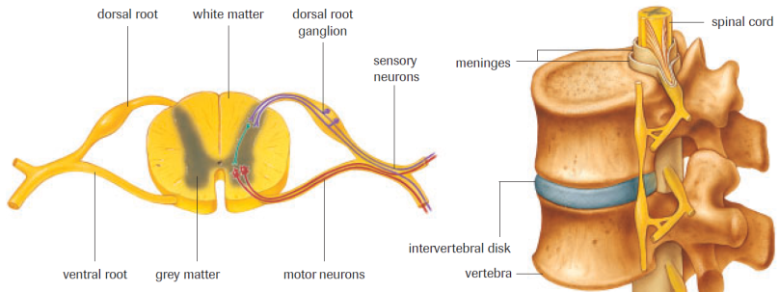
Spinal Cord
interneuron

Slide 6
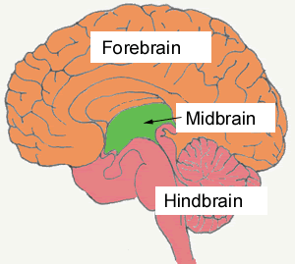
The Brain
Subdivided into 3 sections:
1. Hindbrain
2. Midbrain
3. Forebrain
Protected by the skull and meninges
Meninges:
3 layers of tough, elastic type tissue within the skull and the spinal column
Prevent direct blood flow through the brain and spinal cord
Blood brain barrier (BBB)

Slide 7
Blood Brain Barrier
- Separation of blood from the CNS by Meninges & C.S.F.
- Brain only makes up 2% of the body’s weight but
uses 20% of the bodies oxygen
Therefore BBB allows glucose and oxygen to pass but prevents most infectious agents and toxins.
- Lipid-soluble drugs cross the BBB rapidly
Ex. Alcohol, caffeine, nicotine and heroin

Slide 8
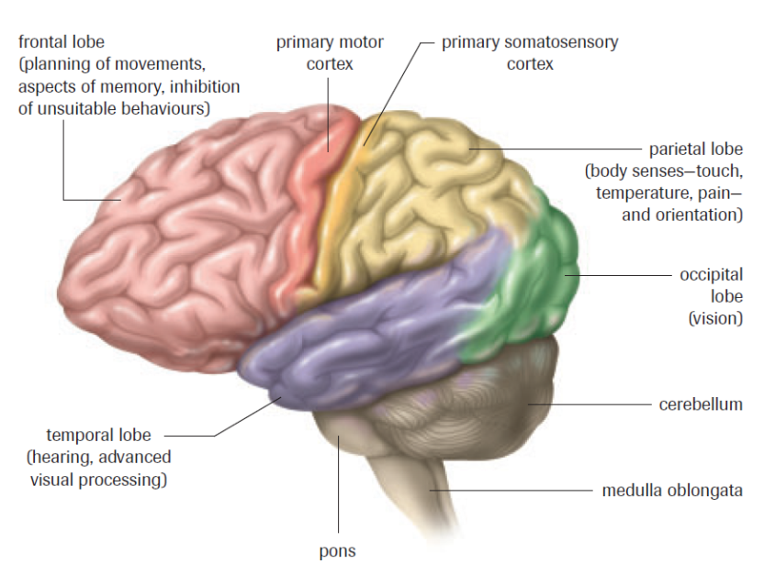
Hindbrain

Slide 9
Hindbrain
Cerebellum:
The “walnut”
Involved in coordination, reflexes and fine motor movements
Medulla oblongata:
Controls autonomic responses (heart rate, constriction and dilate blood vessels, breathing etc.)
Pons:
Relay station b/w medulla and cerebellum

Slide 10
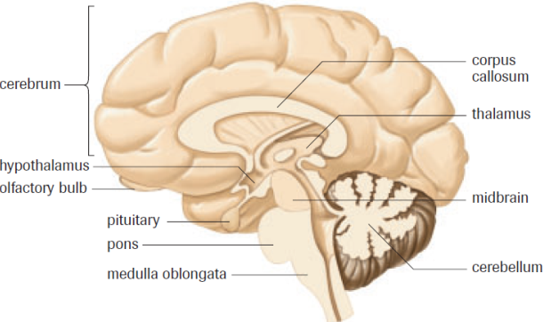
Midbrain
Relays sensory information between the areas of the hindbrain and forebrain
Plays a role in eye movement and control of skeletal muscles

Slide 11
Forebrain

Slide 12
Forebrain
Thalamus:
“the great relay station of the brain”
Relays info from forebrain to hindbrain
Relays info sensory system to cerebellum
Hypothalamus:
Homeostasis – control blood pressure, heart rate, temperature and emotions
Major link between N.S. and endocrine system (controls pituitary gland)

Slide 13
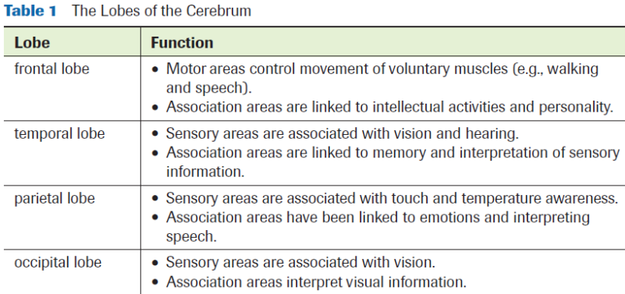
Forebrain
Cerebrum:
outer - gray matter, inner - white matter
basal ganglia - motor coordination, degeneration results in Parkinson’s disease
Contains centers for intellect, language, memory and responses to sensory information

Slide 14
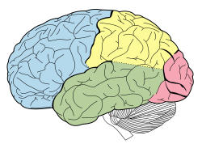
Cerebrum – Structure and Function

Slide 15
Cerebrum – Structure and Function
Cerebral Cortex:
Largest, most complex part of the brain.
Highly convoluted (increases SA)
Language, memory, personality, vision and thought
Split into two halves: right hemisphere and left hemisphere
Hemispheres connected by Corpus Callosum (relays info)
Epilepsy (search)

Slide 16
Corpus Callosum – Connects R & L

Slide 17
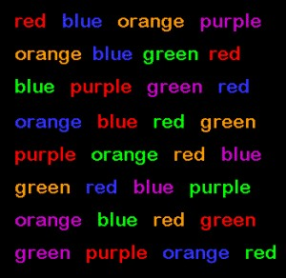
Right Hemisphere vs. Left Hemisphere
Holistic thinking
Visual-spatial skills
Artistic ability
Logical thinking
Linguistics
Math skills

Slide 18
Forebrain

Slide 19
Cerebral Cortex
4 Functional Lobes:
1. Occipital lobe:
Receive and analyze visual information
2. Temporal lobe:
Smell & Hearing
Linked to understanding speech and memory retrieval
3. Parietal lobe:
Process sensory info from skin, emotions, speech
4. Frontal lobe:
Control reasoning, critical thinking, memory and personality, motor control

Slide 20
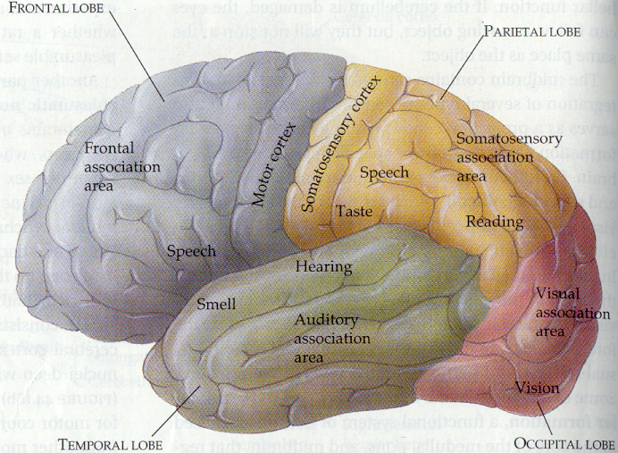
Cerebral Cortex

Slide 21
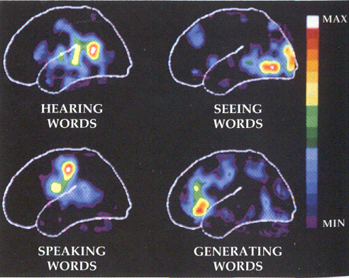
Cerebral Cortex

Slide 23
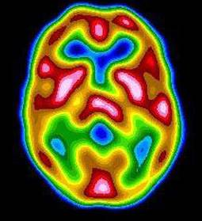
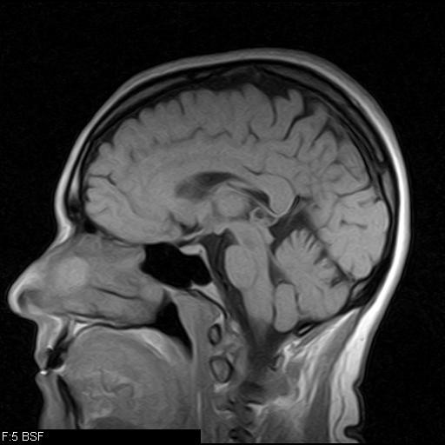
Brain Imaging Techniques
PET scans (positron emission tomography)
More active areas of the brain require more energy
Person injected with radioactive-labelled glucose and glucose consumption of the brain is monitored
MRI (magnetic resonance imaging)
Magnet surrounds and causes hydrogen atoms to emit radio signals that can be mapped

Slide 24
Practice
Complete the Diagrams for:
Spinal Cord
Brain Diagram
Brain Diagram (Lateral)
Pg. 432 #3-5, 8
Read Section 13.4
Tomorrow – PNS Notes & Brain Dissection/Models

Slide 25
Brain Dissection Demo & Models
The Brain(s) will be available for viewing at the front and back of the room, please do not damage them so everyone gets a chance to see the intact specimens.
Use the Lab outline on Pg. 437-39 as a guide when viewing the brain as there are differences in structure from the human brain in the chapter.
Take as many pictures as you would like of the brain so you can use them as a reference.

Slide 26
Brain Dissection Demo & Models
Your task is as follows:
Make two models of the brain using ¹ the “fun dough” provided and ² a piece of poster board.
Outer (lateral) view of the brain showing:
The 4 different lobes of the cerebral cortex (outside of the cerebrum) using a different color for each, as well as the 3 hindbrain structures (1 color for all 3).
A short description of the function of each structure.
Inner (lateral) view of the brain showing:
The different structures as labelled in your diagram (and text)
A separation of the brain (using different colors) into hindbrain, midbrain, and forebrain.
A short description of the function of each structure.

Slide 27
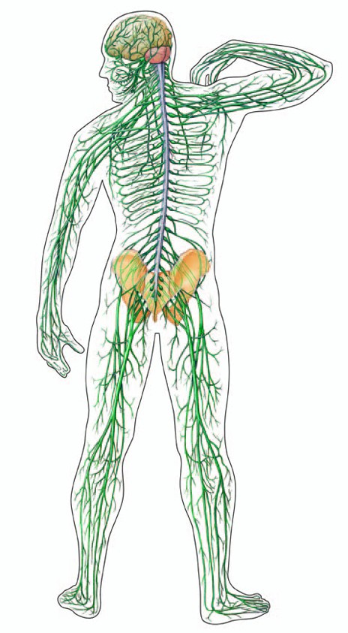
Topic 13.4
Peripheral Nervous System

Slide 28
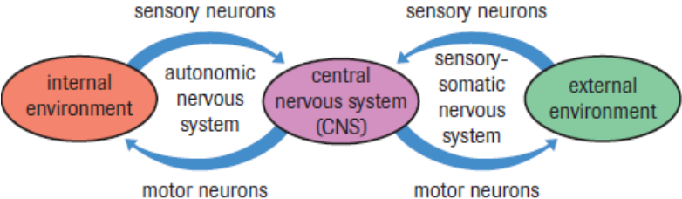
Peripheral Nervous System (PNS)
Nerve linkages between the CNS (brain & spinal cord) and the rest of the body
Ex. Senses, muscles, glands, and internal organs
2 Divisions:
Autonomic N.S.
Somatic N.S.
1.
2.

Slide 29
Peripheral Nervous System (PNS)

Slide 30
Autonomic Nervous System
Involuntary
Controlled by hypothalamus and medulla oblongata
Most effectors are (can be) controlled by a mixture of hormones and nerve impulse.
2 Subdivisions:
Sympathetic N.S.**
Parasympathetic N.S.**
** Have opposing effects on the same organs**

Slide 31
Autonomic Nervous System

Slide 32
Sympathetic Nervous System
Fight-or-flight Response
Release NE (norepineprhine) – has an excitatory effect on target muscles
Sympathetic nerves stimulate adrenal glands to release epinephrine and norepinephrine
Increases blood pressure and slows digestion
Characteristics of the sympathetic N.S. are used in polygraphs (lie detector testing)

Slide 33
Autonomic Nervous System

Slide 34
Parasympathetic Nervous System
Activated when the body is at rest
Restores and conserves energy “rest-and-digest” response
Slows heart rate and increases digestion of food
Releases Ach (acetylcholine)

Slide 35
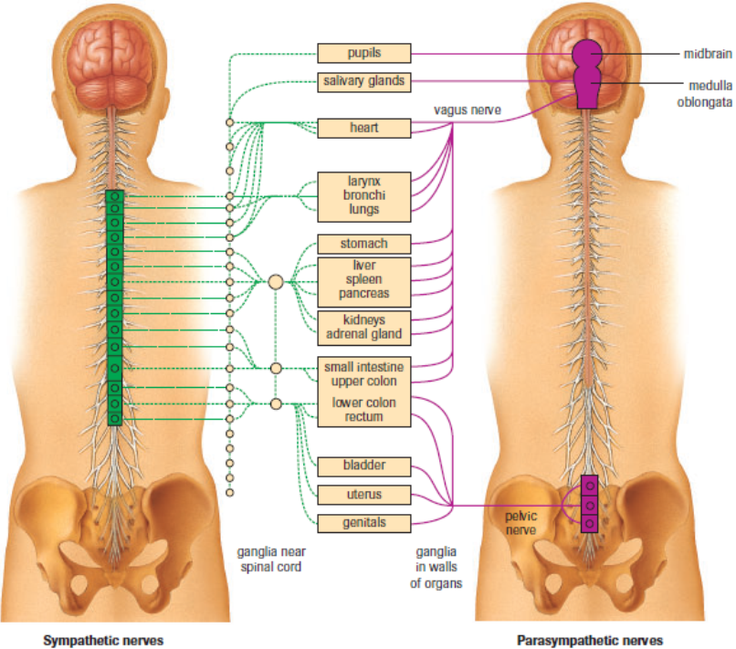

Slide 36
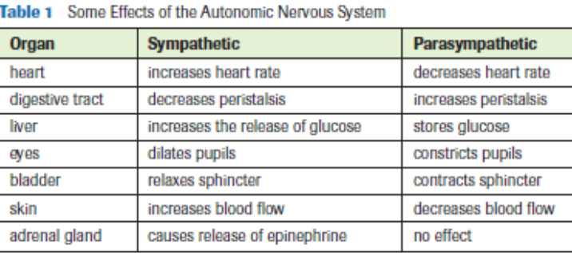
Autonomic Nervous System
N.T. = Ach
N.T. = N.E.

Slide 37
Peripheral Nervous System (PNS)

Slide 38
Somatic Nervous System
Voluntary controls
Neurons throughout the head, trunk and limbs
Made up of sensory neurons and motor neurons
Allow for voluntary (requires thought) muscle control for bodily movement.

Slide 39
Practice
Pg. 435 #1-5
The Effects of Injuries on the Brain Worksheet
Read Section 14.1 & 14.2
Brain Model and Functions (DUE Monday)

