Slide 1
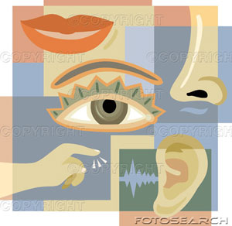
Chapter 14
Sensory Reception

Slide 2
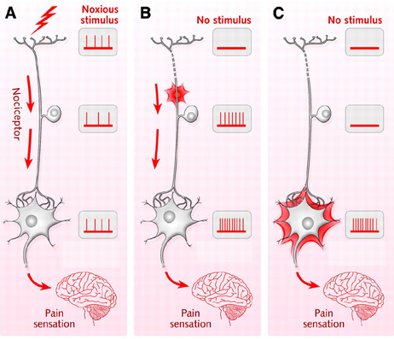
Sensory Receptors and Sensation
Topic 14.1

Slide 3
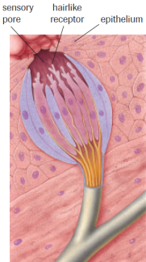
The Senses
Senses transmit sensory information to the brain through electrochemical signals
Different types of energy stimulate
different sensory receptors
Sensory Receptors – Specialized
endings of the neuron that collect
sensory information

Slide 4
Sensation
Sensation - the feeling that occurs when the neural impulse reaches the cerebral cortex
Ex. A cold wind
The type of sensation depends on the area of the brain that has processed the sensory information
Ex. Perception of stimulus can be different from person to person

Slide 5
Sensory Adaptation
Sensory adaptation - filtering by the brain that blocks out redundant or insignificant sensory information
Ex. Driving by feedlot (smells terrible) vs. Working on a feedlot (don’t notice)
Neural multi-tasking - brain splits up input of sensory info to various areas in order to process sensory information quickly
Ex. Different areas/lobes of the brain deal with different sensory info. Act like multiple processors.

Slide 6
Herman’s Square

Slide 7
Human Sensory Receptors
4 Types:
1. Photoreceptors 2. Chemoreceptors
3. Mechanoreceptors 4. Thermoreceptors

Slide 8
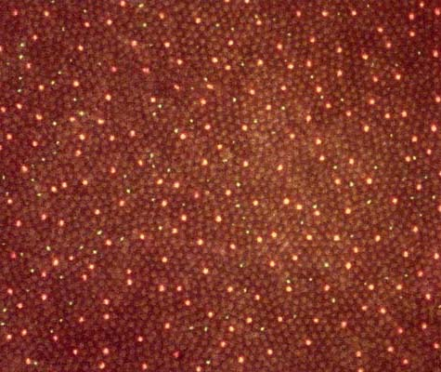
Photoreceptors
Stimulated by light energy
Ex. Rods and cones in the human eye

Slide 9
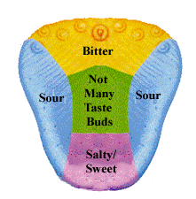
Chemoreceptors
Stimulated by certain chemicals
Ex. Taste buds, olfactory receptors (smell), osmoreceptors (hypothalamus), & receptors of the carotid artery and aorta

Slide 10
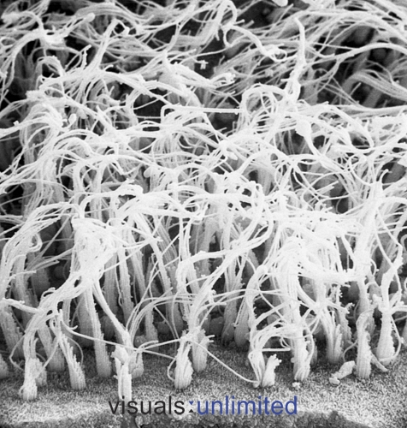
Mechanoreceptors
Respond to mechanical forces
Ex. Hair cells of the inner ear, skin receptors, and proprioceptors (muscles, joints, tendons)

Slide 11
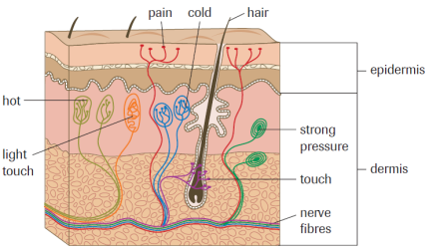
Thermoreceptors
Stimulated by temperature; sensitive to heat and cold
Located in skin

Slide 12
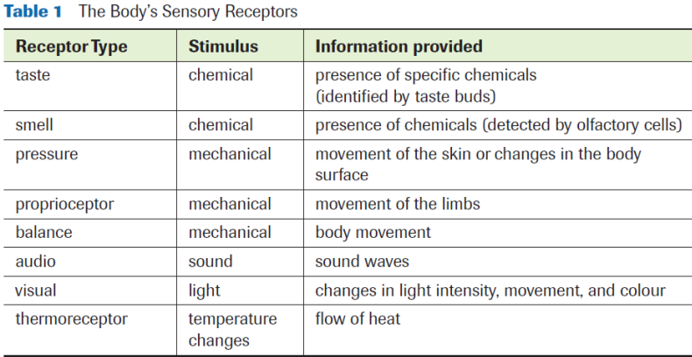
Sensory Reception Summary
Practice – pg. 448 #1-4

Slide 13
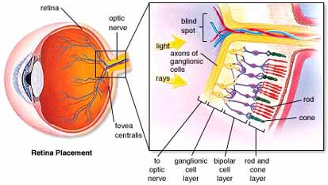
Photoreception – THE EYE
Topic 14.2

Slide 14
Human Eye
Fluid-filled, hollow ball ~2.5cm in diameter
Purpose - focuses incoming light onto photoreceptors of the retina
3 Distinct layers:
External
Intermediate
Internal

Slide 15
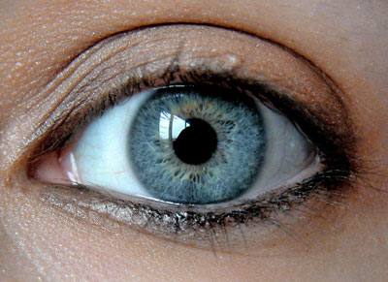
External Layer (aka Sclera)
Sclera - protects and supports the eyeball
White, tough and fibrous layer
Cornea - bends light rays into the eye
Transparent part of the sclera on the front of the eye

Slide 16
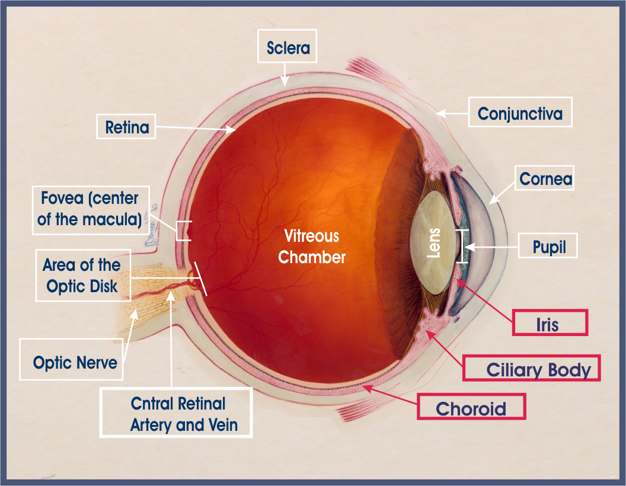
External Layer (aka Sclera)

Slide 17
Intermediate Layer (aka Choroid)
Choroid - inner layer of the sclera that absorbs stray light rays that are not detected by the photoreceptors
Iris - regulates the amount of light that enters the eye
Pupil - opening in which the light enters and travels to the inner eye
Ciliary muscles - changes shape of the lens for focus (thickening of the choroid behind the iris)

Slide 18
Intermediate Layer (aka Choroid)

Slide 19
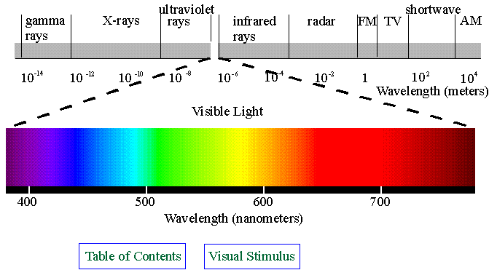
Internal Layer (aka Retina)
Retina - thin layer of vascular tissue which contains photoreceptors (cones and rods)
Rods - sensitive to dim light
Cones - sensitive to different wavelengths of light; or colour vision
Fovea centralis - contains the highest density of cones (light is focused onto this point by the lens)

Slide 20
Internal Layer (aka Retina)

Slide 21
Other Parts of the Eye
Lens – Held behind iris and pupil by the ciliary body muscles
focuses light onto the fovea centralis
Humours
Aqueous humour: located in the anterior chamber (in front of the lens) and maintains shape of the cornea and provides oxygen to surrounding cells (watery fluid)
Vitreous humour: located in the posterior chamber (behind the lens) maintains shape of the eye ball and supports surrounding cells (jelly-like)
Optic nerve - transmits sensory information to the brain. (creates “blind –spot”)

Slide 23
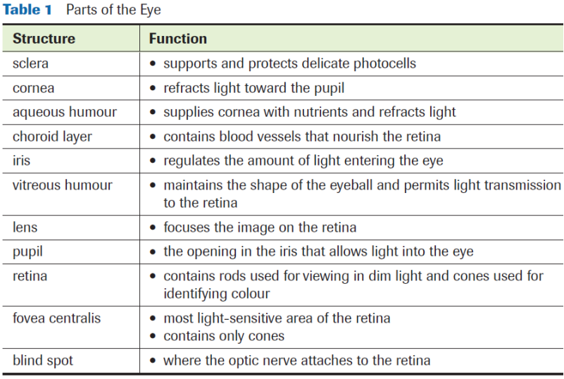

Slide 24
How Does the Eye Focus?
Focusing on distant objects:
Ciliary muscles relax causing
the suspensory ligaments to
pull the lens flat
Focusing on close objects:
Ciliary muscles contract,
suspensory ligaments relax
and the lens becomes more
rounded

Slide 25
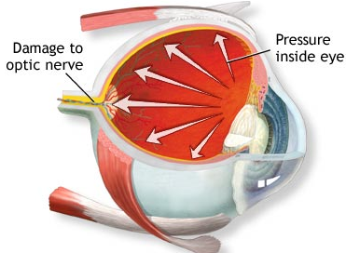
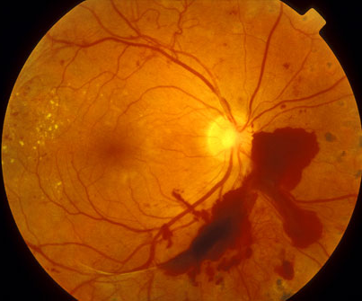
Glaucoma
If the aqueous humour is unable to drain due to blockage of ducts, pressure will build in the eye and blood vessels will rupture.
If blood vessels continue to rupture, cells will not receive sufficient oxygen and die.
If this condition goes untreated blindness may ensue.

Slide 26
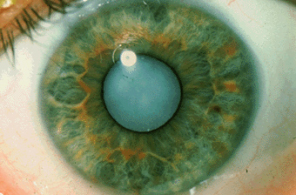
Conditions Affecting Cornea and Lens
Cataracts
Protein structures in the lens degenerate and cause the lens to become clouded (therefore light cannot pass through)
Surgery to replace lens

Slide 27
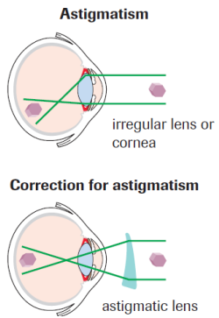
Conditions Affecting Cornea and Lens
Astigmatism
Due to uneven curvature on part of the cornea, therefore cannot bend light directly onto the focal point
Must wear specialty lenses
to correct exact malformation.

Slide 28
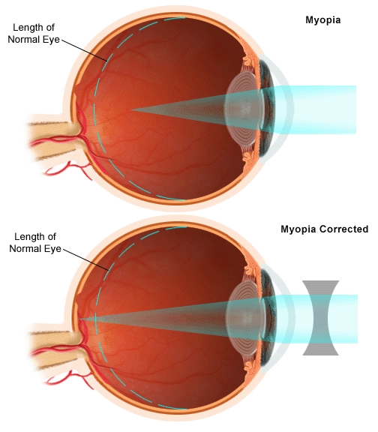
Nearsighted vs. Farsighted
Myopia (nearsighted)
Difficulty focusing on distant objects
Eyeball is elongated so the image lands short of the retina
Wear concave lenses

Slide 29
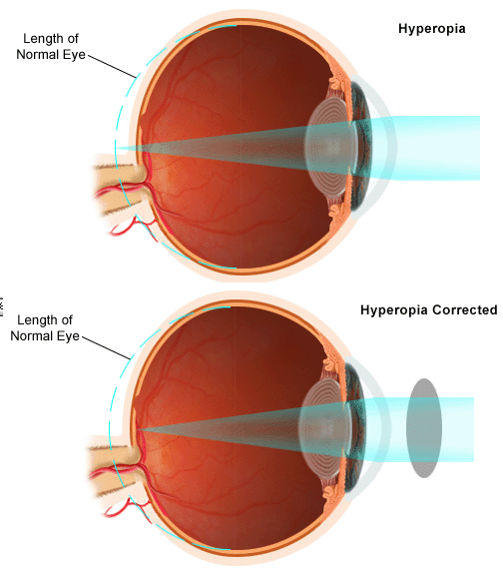
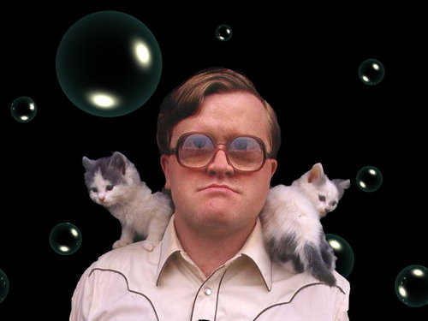
Nearsighted vs. Farsighted
Hyperopia (farsighted)
Difficulty focusing on nearby objects
Eyeball is “too short” and the image lands behind the retina
Wear convex lenses

Slide 30
Photoreceptors

Slide 31
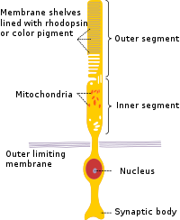
Photoreceptors: Rods
Rods
~125million/eye
Extremely sensitive
Degrees of black and white
Detect motion and are responsible
for peripheral vision
Spread throughout the retina, but
concentrated along the outside edges
Rhodopsin is derived from Vitamin A

Slide 32
How Rods Transmit Neural Impulses
Rhodopsin
Retinene
Opsin
Inhibits inhibitory neurotransmitter
Transmission of impulse to optic nerve
Light

Slide 33
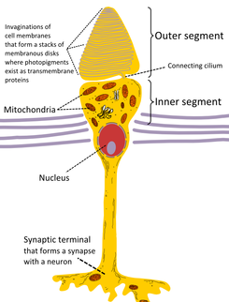
Photoreceptors: Cones
Cones
~6million/eye
Densely packed at the fovea
centralis
Require intense light for stimulation
Important in tasks such as reading
3 Types: red, blue and green
Red-green colour blindness due to lack of red cones

Slide 34
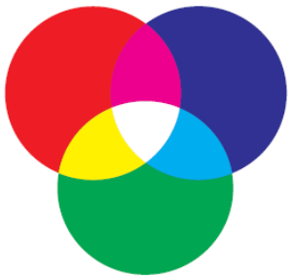
How Cones Transmit Neural Impulses
Photopsin
Inhibits inhibitory neurotransmitter
Transmission of impulse to optic nerve
Visible light

Slide 35
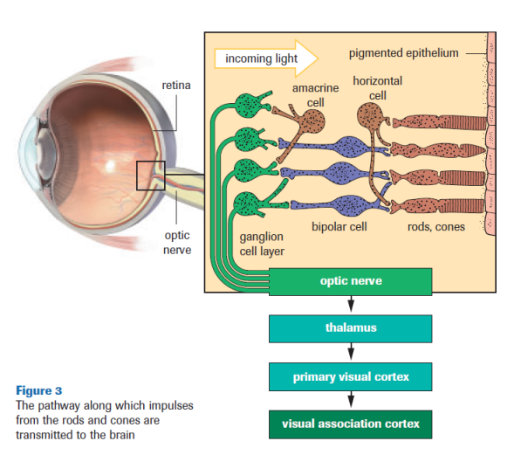

Slide 36
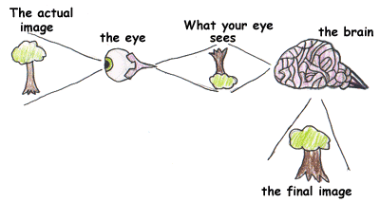
How Does the Eye “See”?
Images are projected on to the fovea centralis smaller, upside down and reversed from left to right
The brain (occipital lobe) must make sense of the image during processing

Slide 37
Visual Interpretation
Blind spot
Where the ganglion cells and the optic nerve meet
No photoreceptors
Visual pathway
Retina - optic nerve - thalamus - occipital lobe (for interpretation – what am I seeing?)
**The left optic tract carries information from the right visual field.**
**The right optic tract carries information from the left visual field.**

Slide 38
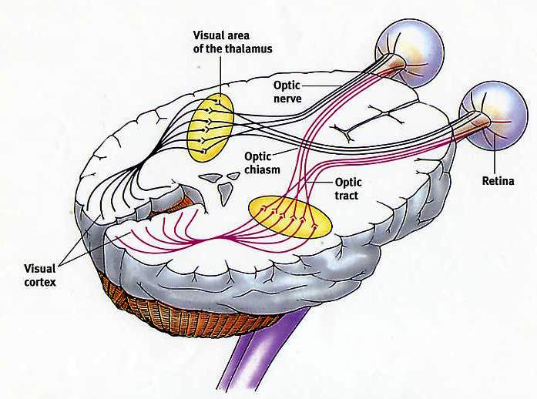
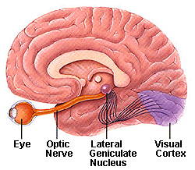
Visual Pathway

Slide 39
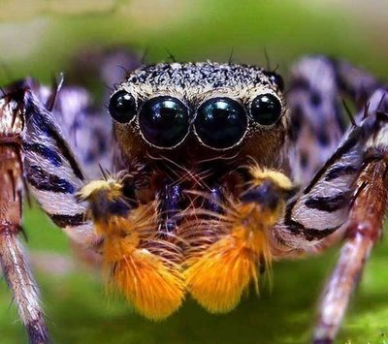
Human Vision
Binocular vision – both eyes are used to collect visual information about the same object
Unlike the jumping spider...
http://www.youtube.com/watch?v=qxbuysNGLOM

Slide 40
Practice
Fill in Diagram for:
The Human Eye
EYE DISSECTION LAB
Pg. 455 # 2-5, 8
Read Section 14.3

Slide 41
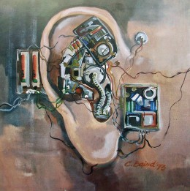
Mechanoreception – THE EAR and Chemoreception
Topic 14.3

Slide 42
Mechanoreceptors and Chemoreceptors
Mechanoreceptors -
Hearing
Touch
Chemoreceptors -
Taste
Smell

Slide 43
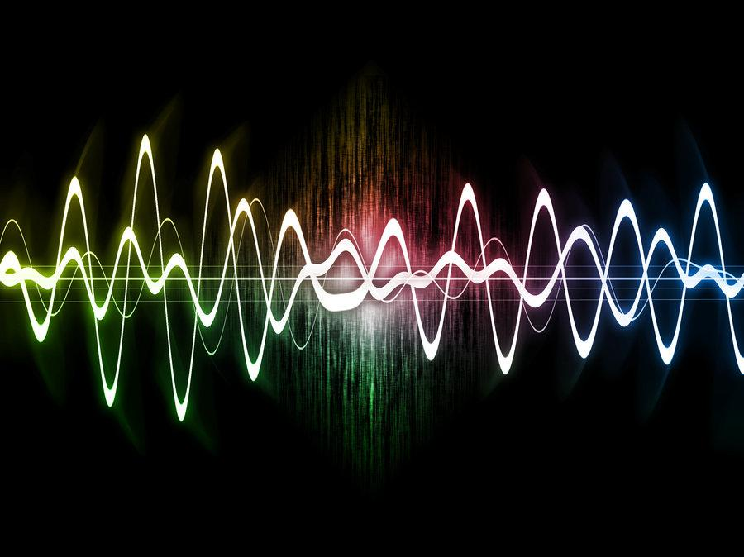
Hearing and Balance
Auditory system detects changes in air pressure
Ex. sound waves
The energy of sound is converted into electrochemical energy that the brain interprets as sound

Slide 44
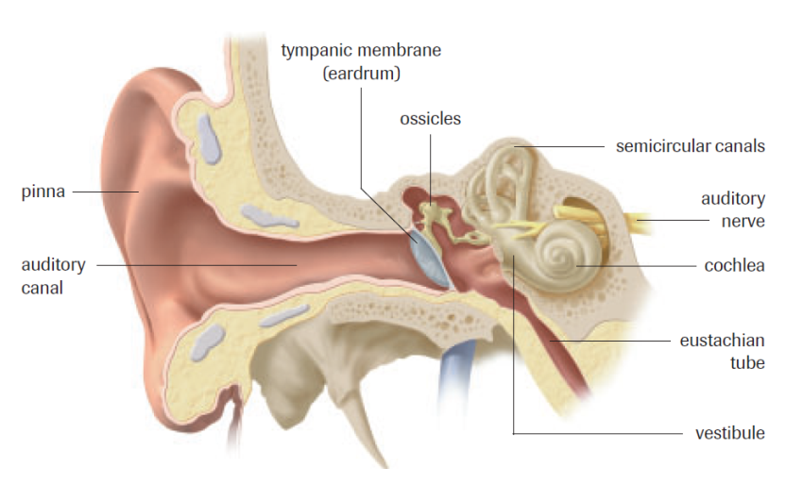
Parts of the Ear

Slide 45
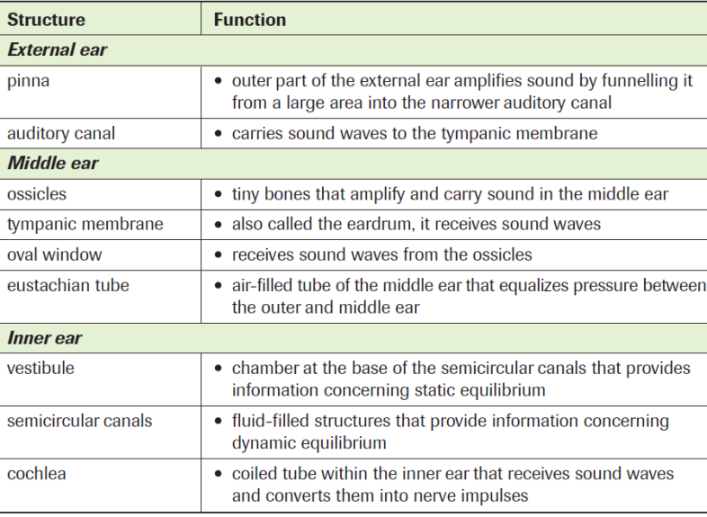
Parts of the Ear

Slide 46
Outer Ear
Pinna
External earflaps that funnels sound
into the ear.
Auditory canal
Carries sound to eardrum

Slide 47
Middle Ear
Tympanic Membrane (aka eardrum)
Thin layer of tissue that vibrates in response to sound waves
Ossicles
Tiny bones that amplify sound in the middle ear (in order - malleus, incus, stapes)
Oval Window
Opening in the wall of the middle ear; transfers sound to inner ear

Slide 48
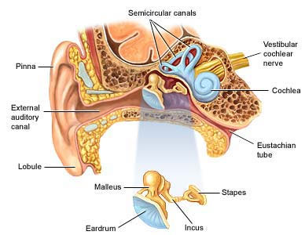
Ossicles

Slide 49
Eustachian tube connects the ear to the throat and equalizes air pressure.
Oval window
Eustachian tube

Slide 50
Inner Ear
Semicircular canals
Contain sensors for balance
Vestibule
Contains sensors for balance
Cochlea
Coiled structure of inner ear that responds to various sound waves and converts them to nerve impulses

Slide 52
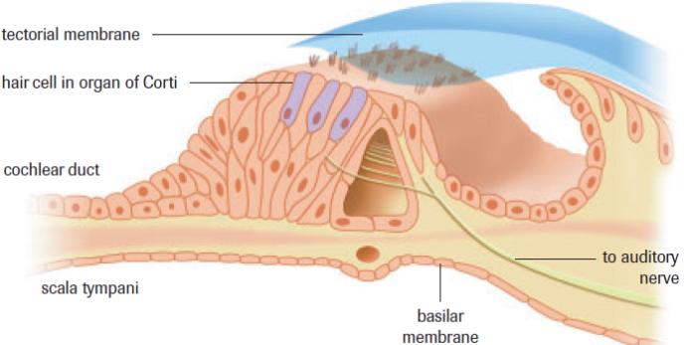
cochlea

Slide 53
Within the Cochlea
Organ of Corti
Primary sound receptor in the cochlea
“Organ of hearing”
Contains hair cells which can distinguish between frequency and amplitude
Frequency = high/low pitches
Amplitude = volume (intensity)

Slide 54
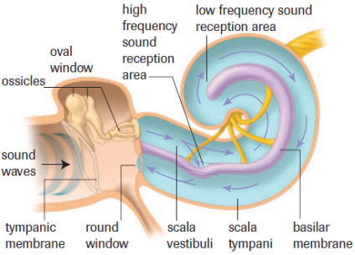
Within the Cochlea

Slide 55
Hearing Loss
Caused by either:
damage of hair cells in inner ear (nerve deafness) OR
damage of outer or middle ear (conduction deafness)
Ex. Birth defects, aging, exposure to loud noises
http://www.youtube.com/watch?v=-WA7-k_UcWY&feature=player_embedded

Slide 56
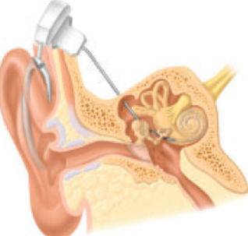
Hearing Correction
damage of hair cells in
inner ear (nerve deafness)
damage of outer or middle
ear (conduction deafness)

Slide 57
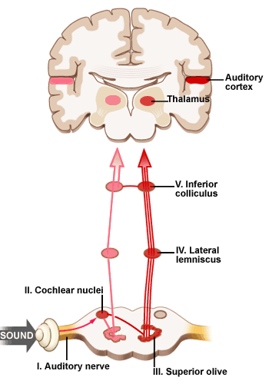
Auditory Pathway
Auditory nerve – Brain stem – Thalamus – Temporal lobe
Different sensory neurons
in the brain are stimulated
depending on frequency,
amplitude and position of
sound

Slide 58
Balance and Coordination
The ear plays a major role in balance and coordination
Semicircular canals – contain mechanoreceptors which detect head and body movement
3 different planes of motion
There are 2 ways for your brain to know where your body is in space.

Slide 59
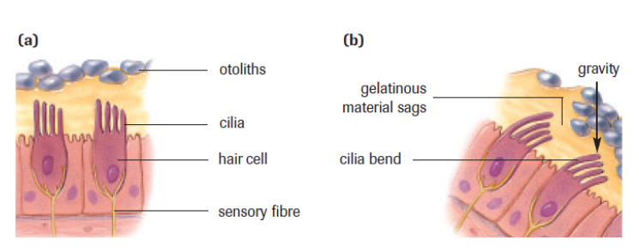
Balance and Coordination 1. Static Equilibrium

Slide 60
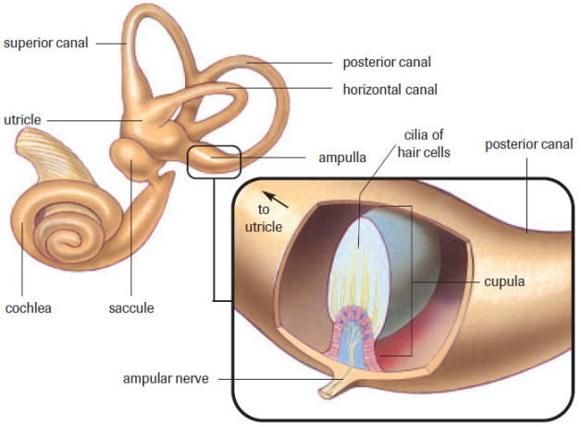
2. Dynamic Equilibrium

Slide 61
Chemoreceptors – Taste and Smell
Tastes
Salty, bitter, sweet and sour
Chemoreceptors in the form of taste buds
Pathway: taste buds – brain stem – thalamus – parietal lobe
Smell
Chemoreceptors = olfactory cells
Impulse received in frontal lobe
80-90% of what we perceive as taste is actually smell

Slide 62
The Senses
How do our senses allow our body to maintain homeostasis?

Slide 63
Practice
Fill in Diagram for:
The Human Ear
Pg. 458 # 1, 2
Pg. 461 # 1-7 & 10
Why can`t you hear in a Vacuum?

