Slide 1
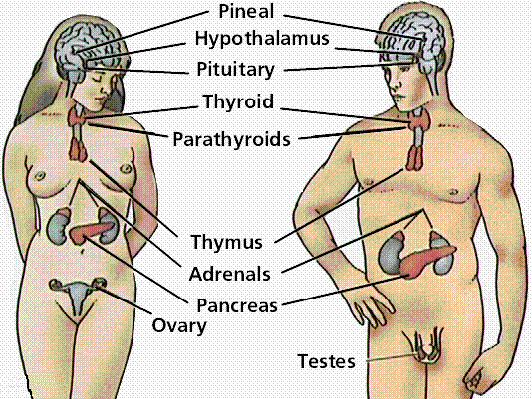
THE ENDOCRINE SYSTEM
Chapter 15

Slide 2
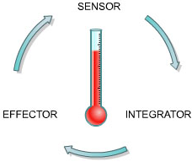
Homeostasis, Hormones & the Endocrine System
Topic 15.1

Slide 3
Homeostasis
The human body works best at a temperature of 37°C,
with a 0.1 % blood glucose level and a blood pH of
7.35.
What conditions can get in the way of these
“ideal settings”?
Homeostasis refers to the body’s attempt to adjust to a fluctuating environment.
The body maintains a constant balance, or steady state, through a series of adjustments.
This system of balance requires constant monitoring and feedback about body conditions.

Slide 4
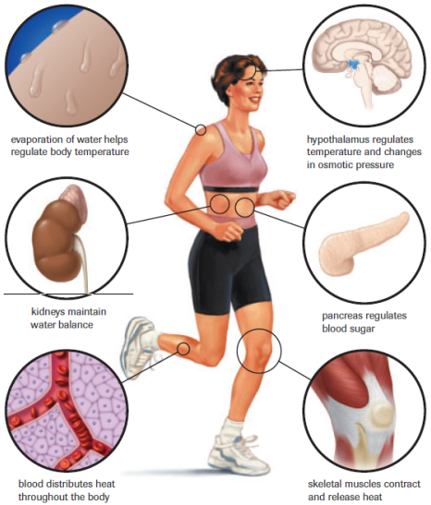
Homeostasis Body Temp. H₂O Blood Sugar

Slide 5
Homeostasis
Homeostasis is often referred to as a Dynamic
Equilibrium - a state of stability within
Fluctuating limits.
Although there are fluctuations in blood glucose, body temp., blood pressure, and blood pH, the homeostatic mechanism ensures that all body systems function within an acceptable range to sustain life.

Slide 6
Homeostasis

Slide 7
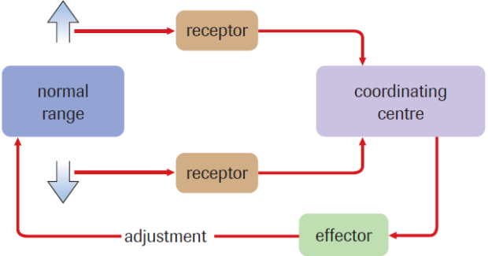
Control of Homeostasis
All homeostatic control systems have three functional
components:
Receptors
Coordinating Centre (Modulator)
Effectors

Slide 8
Control of Homeostasis
Ex. Blood CO2 levels increase during exercise
Chemical receptors in the brainstem are stimulated.
Nerve cells from the brain then carry impulses to effector muscles, which increase the depth and rate of breathing.
The increased breathing movements help flush excess carbon dioxide from the body.

Slide 9
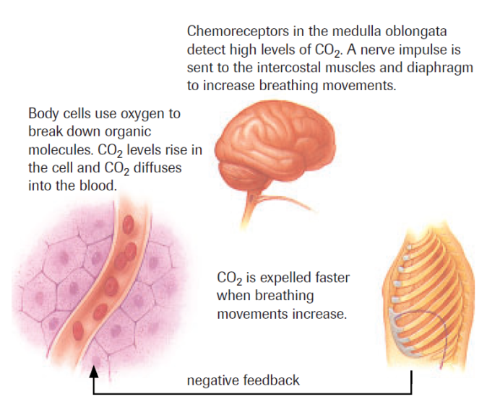
Control of Homeostasis

Slide 10
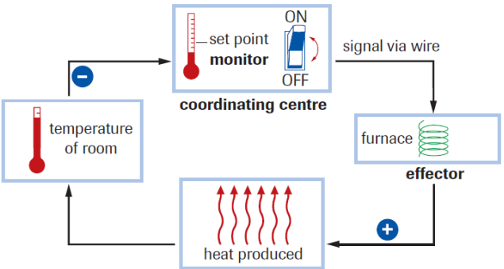
Homeostasis and Feedback Systems
Mechanisms that make adjustments to bring the body back within an acceptable range are referred to as Negative Feedback Systems (the process by which a mechanism is activated to restore conditions to their original state)
Ex. Thermostat

Slide 11
General Model of Negative Feedback
Too High
Effector
After modification
Normal Range
Receptor Systems
Modulator
Effector
Too Low
Before modification

Slide 12
Homeostasis and Feedback Systems
Positive feedback systems are less common in the body. Instead of resisting change, they reinforce (or amplify) change.
Positive feedback systems move the controlled variable away from a steady state.
Value of this?
Allows a discrete physiological event to be accomplished rapidly. Once this event is accomplished, the feedback system stops.

Slide 13
Messages and the Nervous System
Endocrine glands - Secrete chemical messengers called Hormones directly into the bloodstream.
Hormones – chemicals (in very small amounts) that target cells and set into motion specific regulatory responses.
Endocrine glands and Hormones make up the Endocrine System.
The Endocrine System is slower but has longer acting effects than the nervous system

Slide 14
Endocrine System
Important endocrine glands:
Hypothalamus
Pituitary
Thyroid
Parathyroid
Adrenal glands
Pancreas
Thymus
Testes
Ovaries

Slide 15
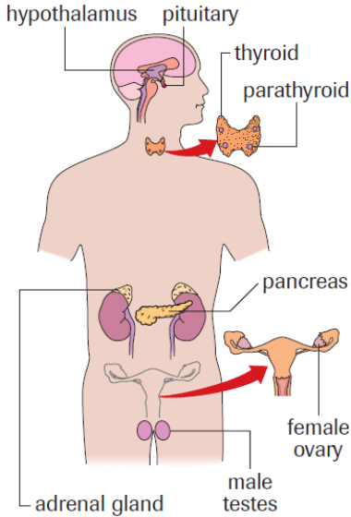
The Endocrine System
thymus

Slide 16
Types of Hormones
Non-target - general hormones that affect many cells throughout the body
Ex. Epinephrine, Insulin
Target hormones - can only bind to specific tissues, called target tissues
Ex. Gastrin, FSH, LH

Slide 17
Water-soluble vs. Lipid-soluble
Lipid-soluble hormones cross the membrane and interact with the genes inside the cell
Steroid hormones - made from cholesterol, soluble in fat, not water
Ex. estrogen, progesterone, testosterone
Water-soluble hormones interact with receptor proteins and cause a cascade of events inside the cell.
Protein hormones - made from amino acids, soluble in water
Ex. ADH (vasopressin), insulin, epinephrine, HGh

Slide 18
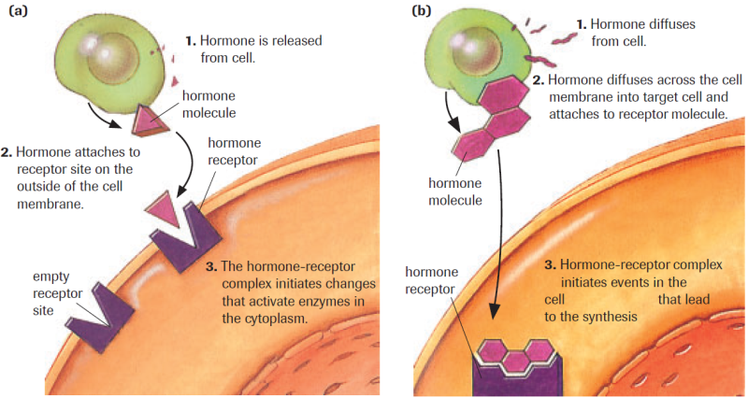
Water-soluble vs. Lipid-soluble

Slide 19
Nervous & Endocrine
Along with the nervous system, the endocrine system provides integration and control of the organs and tissues to maintain homeostasis.
The nervous system enables the body to adjust quickly to changes in the environment.
The endocrine system is designed to maintain control over a longer duration.
The Hypothalamus serves as the intersection between the two systems.

Slide 20
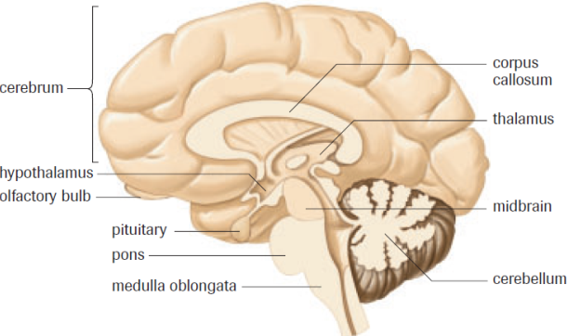
Tropic (Releasing) Hormones
Hormones that are released from the hypothalamus
and pituitary gland are known as tropic hormones,
because they target other endocrine glands and
stimulate endocrine glands to release other
hormones.

Slide 21
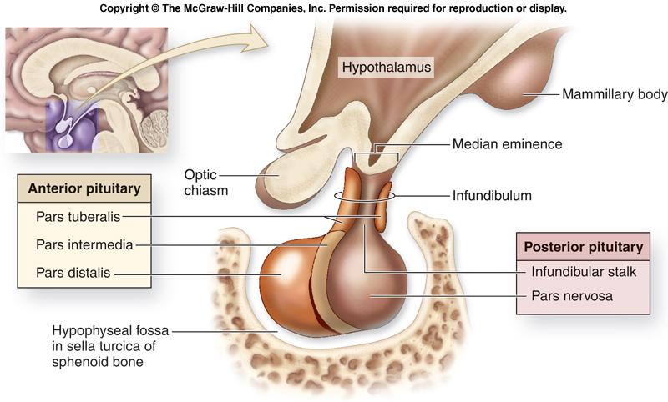
Pituitary Gland
The Pituitary gland exercises control over all the other endocrine glands.
Sometimes referred to as the ``Master Gland``
Attached to (below) Hypothalmus
Two parts:
Posterior lobe
Anterior lobe

Slide 22
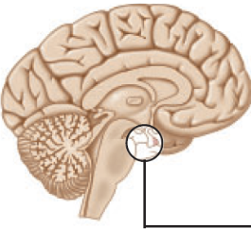
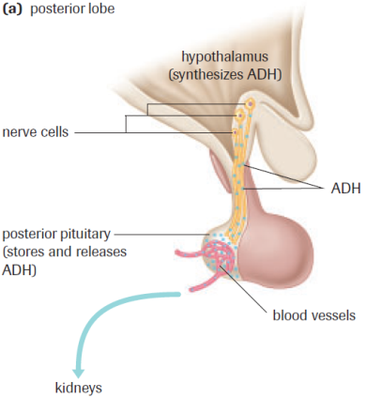
Pituitary Gland – Posterior Lobe
1. Oxytocin smooth muscle contraction (uterus & mammary)
2. ADH - kidneys - distal tubule & collecting duct (increases H₂O re-absorption)

Slide 23
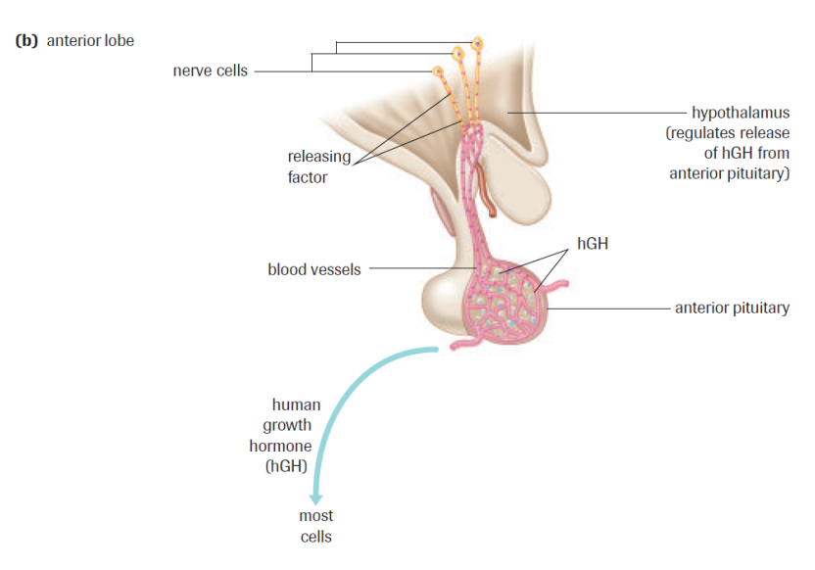
Pituitary Gland – Anterior Lobe
1. TSH
2. ACTH
3. hGH
4. FSH
5. LH
6. PRL

Slide 24
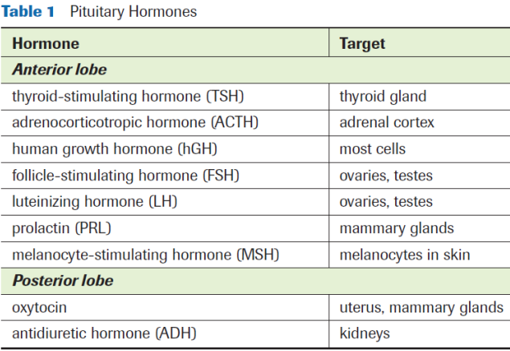
Pituitary Gland

Slide 25
Practice
Pg. 472 – 475 Practice #1-6
Section 15.1 Questions
# 1-7

Slide 26
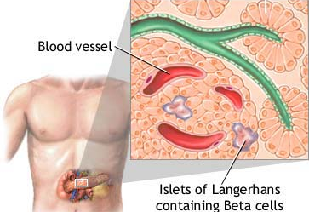
Hormonal Regulation of Blood Sugar
Topic 15.2 A

Slide 27
Endocrine vs. Exocrine
Makes hormones
secretes into blood
no ducts or tubes
Ex. Pituitary, Thyroid, Parathyroid, Pancreas, Adrenal, Gonads (testes, ovaries)
No hormones
secretes into body cavity or externally
uses ducts or tubes
Ex. Sweat, Salivary, Gastric, Pancreas

Slide 28
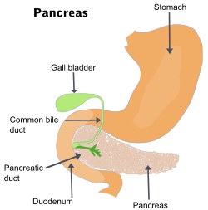
The Pancreas and Hormones
The pancreas is located behind the
stomach and is attached to the small
intestine.
Exocrine (secretes digestive enzymes) and Endocrine gland (secretes hormones)
Pancreatic endocrine cells are known as islets of Langerhans
Beta cells
Alpha cells

Slide 29
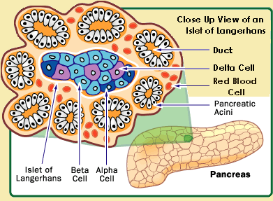
Islets of Langerhans
Beta cells: secrete insulin = decreases blood glucose levels
Alpha cells: secrete glucagon = increases blood glucose levels

Slide 30
Insulin: Negative Feedback Loop
Eating increases blood glucose levels–
Beta cells secrete insulin –
Body cells become permeable to glucose –
glucose converted to glycogen for storage –
decrease in glucose levels slows/stops insulin
release

Slide 31
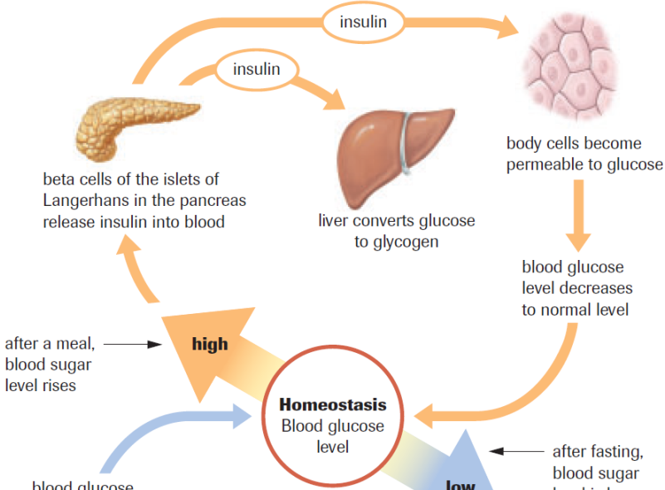
Insulin: Negative Feedback Loop

Slide 32
Glucagon: Negative Feedback Loop
Exercise drops blood glucose levels (glucose used up)–
alpha cells release glucagon –
glucagon stimulates the liver to convert glycogen to glucose –
glucose released into bloodstream

Slide 33
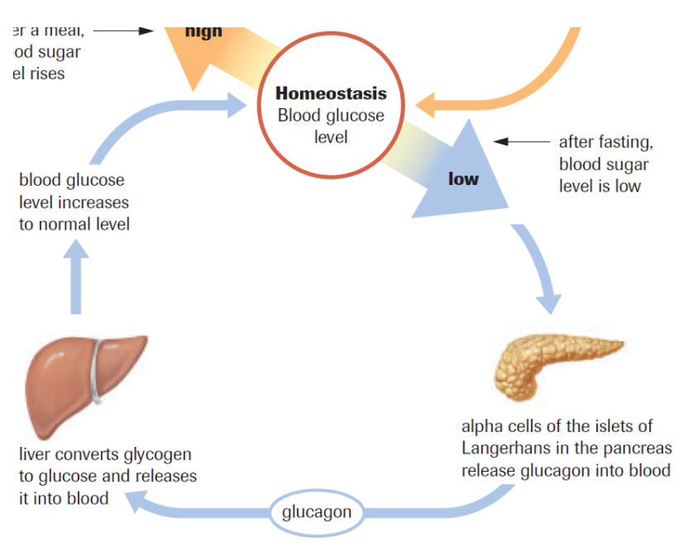
Glucagon: Negative Feedback Loop

Slide 34
Glucose Imbalance
Diabetes mellitus (Short-term)
Cause - Body does not produce enough insulin or does not respond to insulin
Effects:
High blood glucose levels (aka hyperglycemia)
Body breaks down fats and proteins instead
When fats are metabolized they produce ketones
Poor glucose re-absorption from kidneys and glucose is flushed out through urine (leads to dehydration b/c more water is released as well)

Slide 35
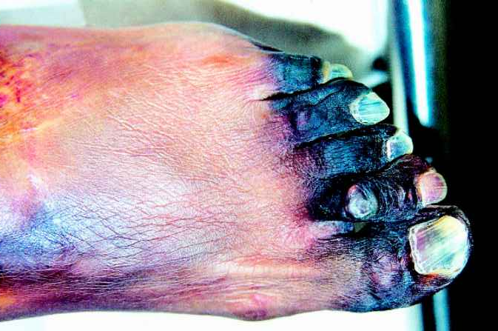
Glucose Imbalance
Diabetes mellitus (Long-term effects)
Effects:
Blindness
Kidney failure (dialysis)
Nerve damage
Gangrene of limbs

Slide 36
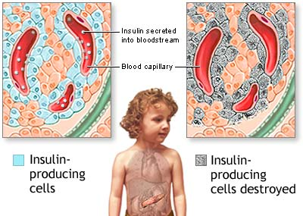
Causes of Diabetes
Type 1 diabetes:
Juvenile-onset
Insulin-dependent
Body’s antibodies
attack beta cells
(unable to produce
insulin)
Treatment: daily insulin injections

Slide 37
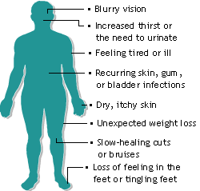
Causes of Diabetes
Type 2 diabetes:
Adult-onset
Non-insulin-dependent
90% of people have this type
Insulin receptors stop
responding to insulin
Diet and genetic factors (high
intake of refined carbohydrates and saturated and trans
fats)
Can develop into type 1 diabetes if untreated
Treatment: exercise and diet

Slide 38
Diabetes Treatment - Transplantation
Islet cells are transplanted to the diabetics pancreas
Required to take immunosuppressive drugs (life-long)
Complicated procedure, requires many pancreases to do one transplant
Have had a good success rate at U of A medical centre.

Slide 39
Practice
Summary
Pg. 479 Practice #1-3

Slide 40
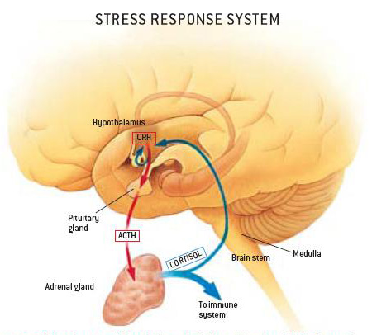
Hormonal Regulation of the Stress Response
Topic 15.2 B

Slide 41
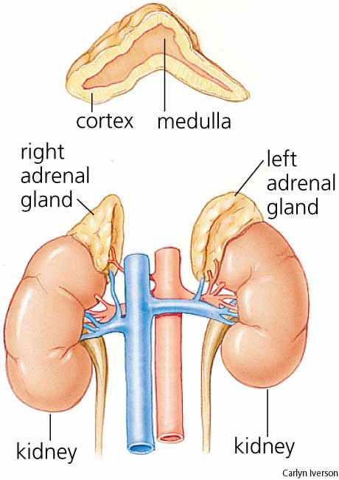
Adrenal Glands
Two glands located on top
of the kidneys
Inner layer –
adrenal medulla
Outer layer –
adrenal cortex

Slide 42
The Adrenal Medulla
Short-term stress response
Produces epinephrine (EPN) and norepinephrine (NE)
Similar responses as when the Sympathetic N.S. is activated (``fight-or-flight``) but lasts about ten minutes longer:
Increase metabolism
Increase heart rate
Increase breathing rate
Increase blood flow
**Glycogen converted to glucose in the liver**

Slide 43
The Adrenal Medulla
Hypothalamus –
Spinal Cord –
Adrenal Medulla (releases EPN and NE) –
Sympathetic Responses

Slide 44
The Adrenal Cortex
Long-term stress response
Releases:
Mineralcorticoids
Increases sodium and water retention
Increases blood pressure & volume
Glucocorticoids
Increase blood sugar (by breakdown of fats and proteins)
Suppression of inflammation

Slide 45
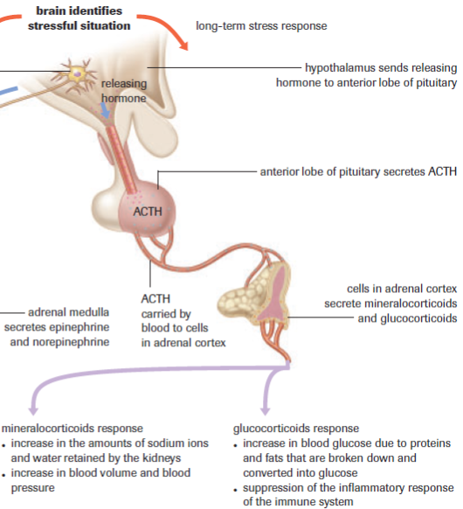
The Adrenal Cortex
Hypothalamus
Anterior pituitary
releases ACTH
Adrenal cortex
releases
Mineralcorticoids
and
Glucocorticoids

Slide 46
Cortisol
Type of glucocorticoid (most abundant)
Produced by the adrenal cortex
Steroid hormone synthesized from cholesterol (natural anti-inflammatory)
Works in conjunction with EPN but is longer lasting
MAIN PURPOSE: increase blood glucose levels

Slide 47
Cortisol and Blood Glucose Level
Cortisol stimulates the break down of muscle proteins and fat cells to increase blood glucose levels
Cortisol prevents further production of ACTH (negative feedback loop)
Chronic stress is due to continual release of cortisol:
Impaired thinking
Damage the heart
High blood pressure
Diabetes
Increased susceptibility to infection

Slide 48
Aldosterone
Type of mineralcorticoid
Increases absorption of sodium into the bloodstream, which draws in more water and increases blood pressure
Low levels of aldosterone results in low water and solute in the blood (lots through urine) = low blood pressure, thirst, and electrolyte imbalance which can lead to death

Slide 49
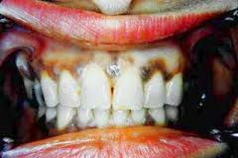
Addison’s Disease
Damage to the Adrenal Cortex = inadequate amounts of mineralcorticoids and glucocorticoids released
Symptoms:
Muscle weakness/fatigue
Weight loss
Darkening of your skin
(hyperpigmentation)
Low blood pressure
Low blood sugar (hypoglycemia)
Nausea, diarrhea or vomiting Treatment:
Muscle or joint pains corticoid replacement
Depression (drug) therapy

Slide 50
Practice
Summary
Pg. 483 Practice #4-6
Section 15.2 Questions
Pg. 484 # 1-4, 6, 7

Slide 51
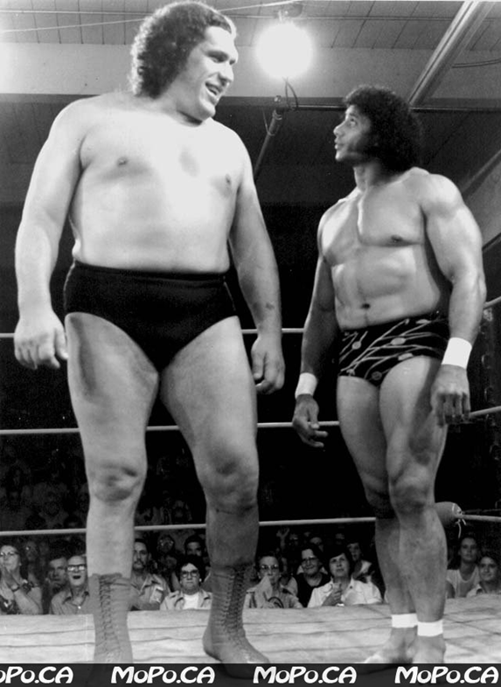
Hormonal Regulation of Growth, Development and Metabolism
Topic 15.3

Slide 52
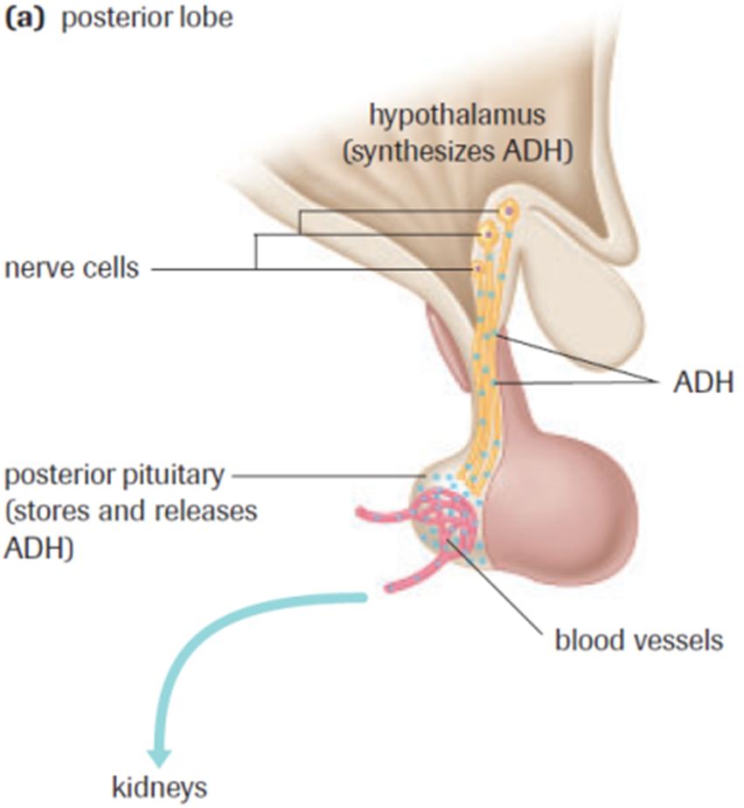
Role of the Hypothalamus
Posterior pituitary: Hormones synthesized by the hypothalamus are transferred by neuronal axons to posterior for release.

Slide 53
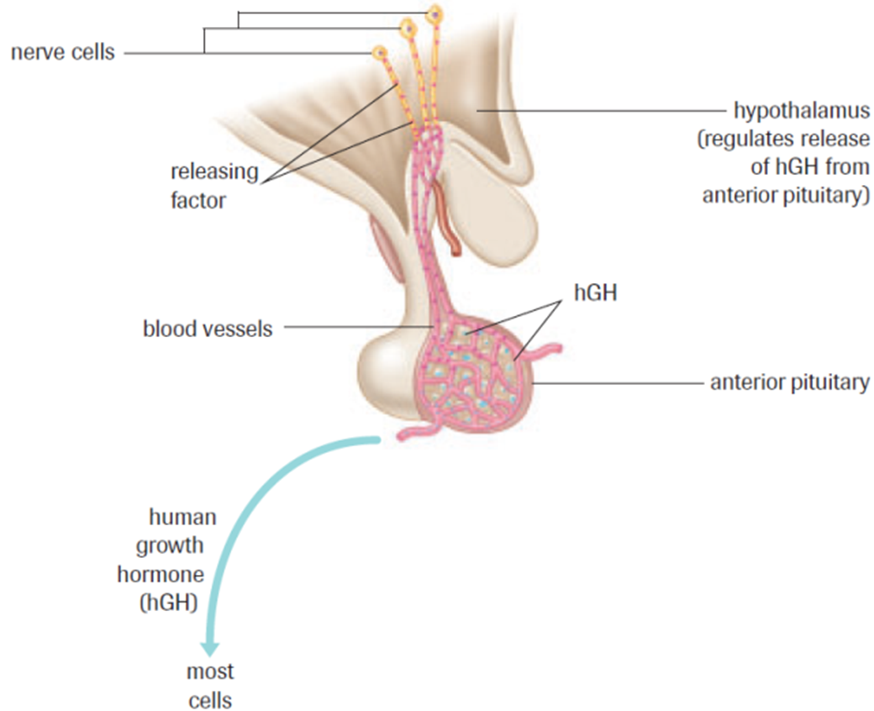
Role of the Hypothalamus
Anterior pituitary: Hormones from the hypothalamus (releasing hormones) are carried through blood vessels to the anterior pituitary and either stimulate or inhibit release of hormones.

Slide 54
Human Growth Hormone (hGH)
Regulates growth, development and metabolism
Increases protein synthesis
Increases cell division (hyperplasia) and growth (hypertrophy) of bone, cartilage and muscle
Increases metabolic break down of fat stores for energy.

Slide 55
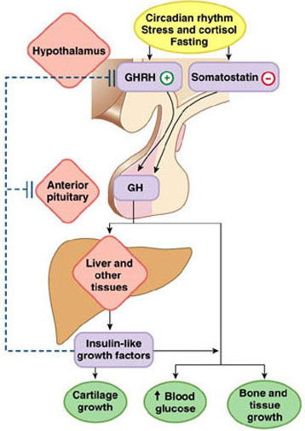
hGH Negative Feedback Loop
Hypothalamus (RH) –
anterior pituitary (release hGH) –
liver (releases growth factors) –
Growth factors (-) feedback
stimulates:
muscle (growth)
bone/cartilage (growth)
fat cells (metabolizes)

Slide 56
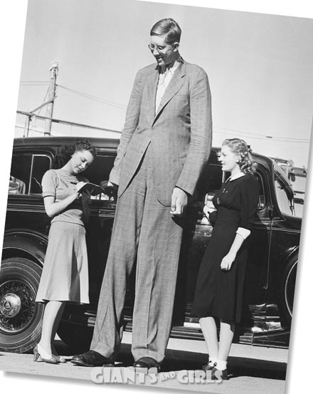
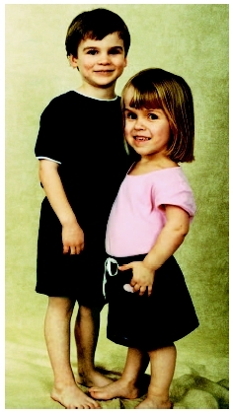
Human Growth Hormone (hGH)
Excessive amounts during childhood leads to gigantism
Insufficient amounts during childhood leads to pituitary dwarfism (small, but normal proportions)

Slide 57
Human Growth Hormone (hGH)
Excessive amounts during adulthood leads to acromegaly
Bones begin to widen since plates have already fused and cannot grow in length
Untreated:
Cardiovascular disease
Sugar intolerance (diabetes)
Muscle weakness
Colon cancer
Breathing problems

Slide 58
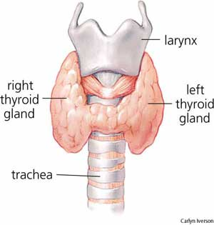
The Thyroid Gland
“The Metabolic Thermostat”
Secretes “immature” thyroid
hormones in between cells
Hormones become functional and
are released into the bloodstream
Thyroxine (T4) – increases rate of metabolism (fats, proteins and carbohydrates)
Calcitonin – lowers calcium levels in the blood by stopping (re-)absorption and promoting bone deposition.

Slide 59
The Thyroid Gland
Hypothyroidism
Cause: Low amounts of thyroxine released
Effects:
Thyroid underdeveloped (cretinism) - children
Stocky and short - children
Mental delays if untreated –children
Tired, slow pulse, hair loss, weight gain (low metabolism) - adults

Slide 60
The Thyroid Gland
Hyperthyroidism
Cause: High amounts of thyroxine released
Effects:
Anxiety, heat intolerance, irregular heartbeat and weight loss (high metabolism)
Grave’s disease
Body’s immune system attacks thyroid, can interfere with vision due to swelling around the eyes
Treatment - medication or removal/ irradiation of part(s) of the thyroid

Slide 61
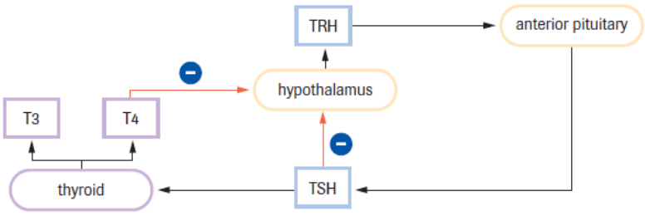
Negative Feedback Loop
Hypothalamus (TRH)– Anterior Pituitary (TSH) – Thyroid (thyroxine – T4) - Thyroxine feeds back to hypothalamus and anterior pituitary and inhibits further release of TSH

Slide 62
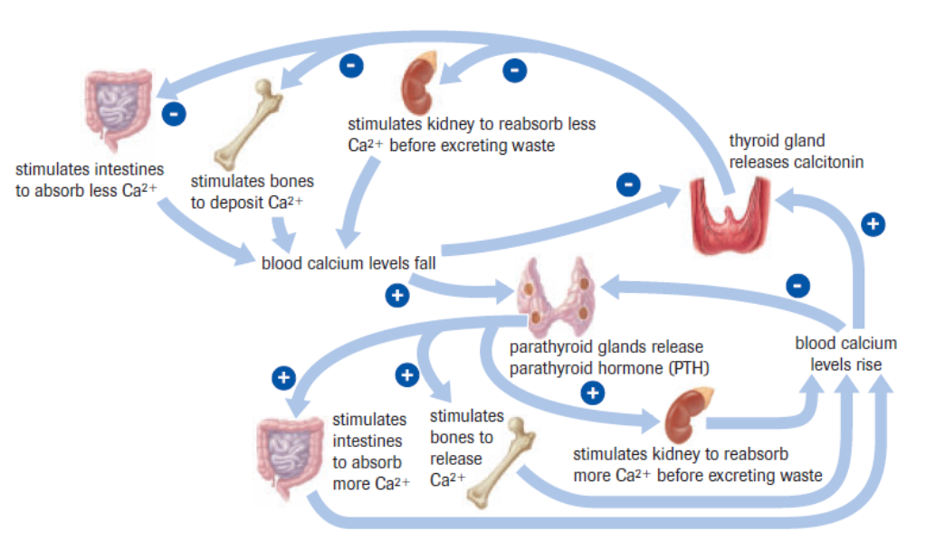
Negative Feedback Loop #2
Calcitonin released by the Thyroid lowers calcium
levels in the blood by stopping re-absorption in
kidneys and intestines and promoting bone
deposition.

Slide 63
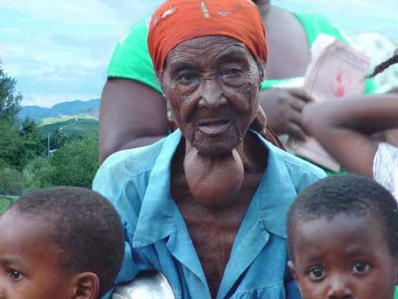
The Thyroid Gland
Iodine is needed for thyroxine (T4) production (levels can be 25x higher in thyroid than in the bloodstream)
If Iodine levels drop, T4 will not be produced and there will be no negative feedback mechanism
Leads to over production of
TSH causing hyper stimulation of
The thyroid. Produces swelling
– known as a goitre

Slide 64
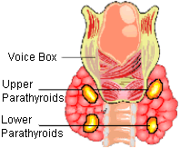
The Parathyroid Gland
4 small glands embedded
in the thyroid
Produce parathyroid hormone (PTH)
Released in response to low blood calcium levels
Low Ca²⁺ levels also inhibit Calcitonin release from Thyroid

Slide 65
The Parathyroid Gland
Stimulates break down and release of calcium from bones into the bloodstream
Consequently a large amount of Phosphate (PO4³⁻)is excreted
Stimulates kidneys to reabsorb calcium from urine and activate Vitamin D
Vitamin D stimulates absorption of calcium from food in the small Intestine & is important for bone development.

Slide 66
The Parathyroid Gland: Negative Feedback Loop
Low blood calcium –
parathyroid releases PTH –
re-absorption of calcium in kidneys –
breakdown of bone releases calcium –
increase absorption of calcium in small intestine
= HIGHER BLOOD CALCIUM

Slide 67
The Parathyroid Gland: Negative Feedback Loop

Slide 68
The Parathyroid vs. Thyroid – Antagonistic Endocrine Glands

Slide 69
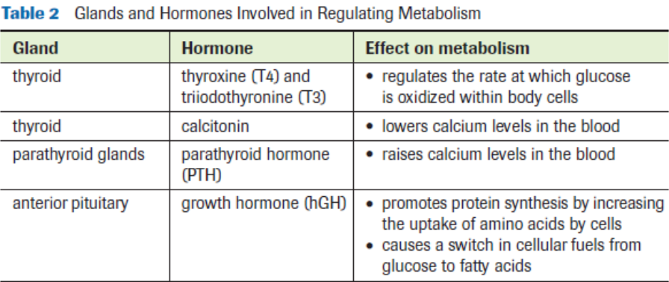
Practice
Pg. 486 Practice #1,2
Pg. 489 Section 15.3 Questions
#1-7, 10

Slide 70
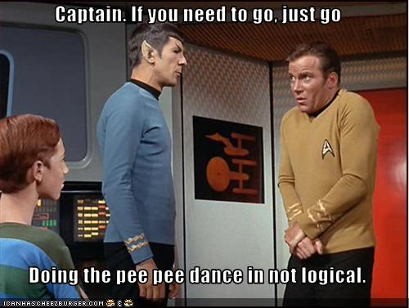
Hormones affecting water & ion balance
Topic 15.4

Slide 71
Antidiuretic Hormone (ADH)
The main function of antidiuretic hormone (ADH) is to conserve body water by reducing urine output.
How does the body know when to conserve water?
There are sensory receptors in the hypothalamus called osmoreceptors, which detect changes in osmotic pressure in body fluids.

Slide 72
ADH Negative Feedback Loop
Decrease in water intake or increase water loss -
Blood solutes become more concentrated (increase blood’s osmotic pressure) -
Water moves from the ECF to the blood causing the osmoreceptor cells of the hypothalamus to shrink –
Osmoreceptors stimulate the posterior pituitary gland to release ADH –
ADH causes the kidneys to reabsorb more water (produce more concentrated urine) –
Decrease in osmotic pressure = negative feedback

Slide 73
ADH Negative Feedback Loop Behavioral
As the osmoreceptors of the hypothalamus shrink, they also stimulate the sensation of thirst –
Drinking water in response to feeling thirsty (behavioural response, not physiological) –
As water intake increases blood solute concentration decreases –
Decrease in osmotic pressure = negative feedback

Slide 74
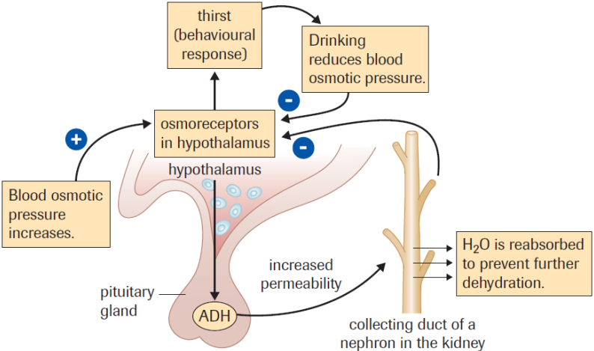
Anti-Diuretic Hormone (ADH)

Slide 75
ADH & Diabetes
Diabetes Insipidus
The most common disease associated with ADH
Symptoms:
production of excessive amounts of urine (as much as 16 litres a day).
Causes:
failure of the posterior pituitary to secrete enough ADH
failure of the kidney to respond to ADH
Treatment:
Hormone replacement or diet (low salt) & drugs

Slide 76
Aldosterone
Aldosterone (mineralcorticoid)
Released as part of the renin-angiotensin-aldosterone (RAAS) system
Increases absorption of Na⁺ into the bloodstream (by DCT’s of nephrons), which draws in more water and increases blood pressure.
Aldosterone is released (in a cascade reaction) when blood pressure sensors in the juxtaglomerular apparatus (JGA) (bundle of cells near the glomerulus) detect low blood pressure/volume.

Slide 77
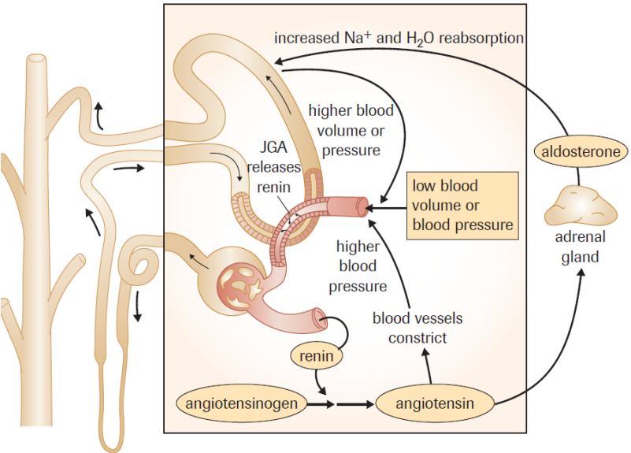
Aldosterone
6.
2.
1.
5.
3.
4.

Slide 78
ADH vs. Aldosterone – Difference?
At first glance it appears that ADH and the RAAS system serve the same purpose. Both increase water reabsorption.
Differences:
ADH responds to an increase in osmotic pressure of the blood.
Ex. Body is dehydrated due to lack of water.
The RAAS system responds when the blood volume is reduced but the osmotic pressure of the blood remains the same.
Ex. large loss of body fluid - severe diarrhea/hemorrhage

Slide 79
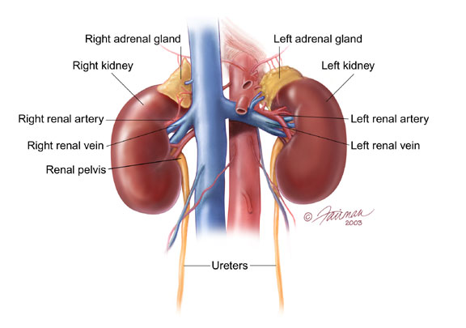
Practice
Pg. 493 - Section 15.4 Questions
# 1-5, 7

Slide 80
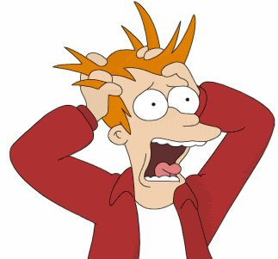
The body’s adjustment to stress
Topic 15.5

Slide 81
Adapting to Stress
When stressful stimulus is identified, both the endocrine system and nervous system make adjustments that enable the body to cope with the problem.
The nervous system rapidly adjusts to stress (increasing heart rate & diverting blood to muscles)
Hormones from the endocrine system provide a slower, more sustained response to the stimulus.

Slide 82
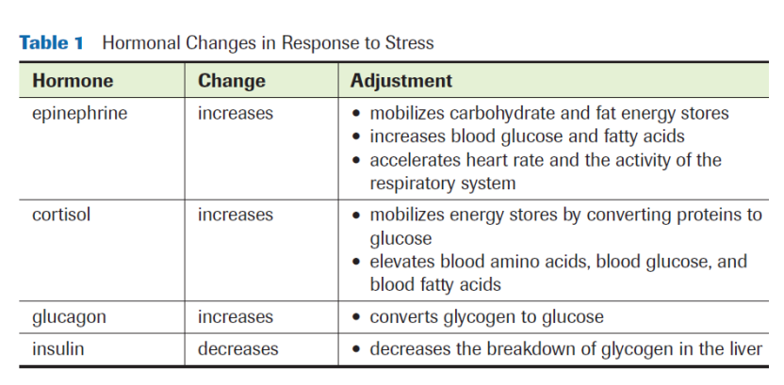
Adapting to Stress
Stress hormones provide more blood glucose to cope with the elevated energy requirements brought on by stress. (Insulin release is inhibited)

Slide 83
Adapting to Stress
Hormones that regulate blood pressure/volume are also released during times of stress.
The nervous system activates the RAAS pathway in response to reduced blood flow to the kidneys (increasing Na⁺ reabsorption = increase fluid volume & BP)
The stressor activates the hypothalamus, which causes an increased release of ADH (further increase water reabsorption and blood volume/BP)

Slide 84
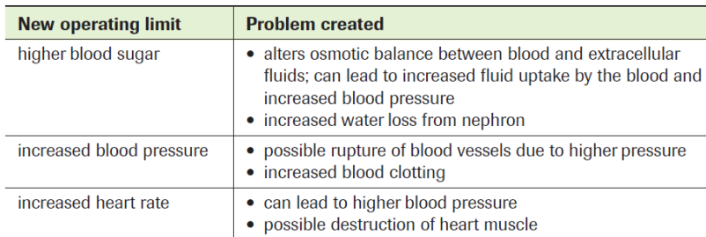
Long Term Stress
Long term stress can lead to many health problems due to continuous release of hormones (including cortisol).
Chronic stress can lead to:

Slide 85
Prostaglandins
A group of hormones produced by almost all cells in the body.
Prostaglandins acts on the cells that produced them (don’t travel to other parts of the body).
Produced when a tissue is damaged (stressed).
Effects of Prostaglandins:
stimulate inflammation
increase blood flow
stimulate platelets to form clots in damaged vessels
role in producing a fever
cause an increase in the perception of pain

Slide 86
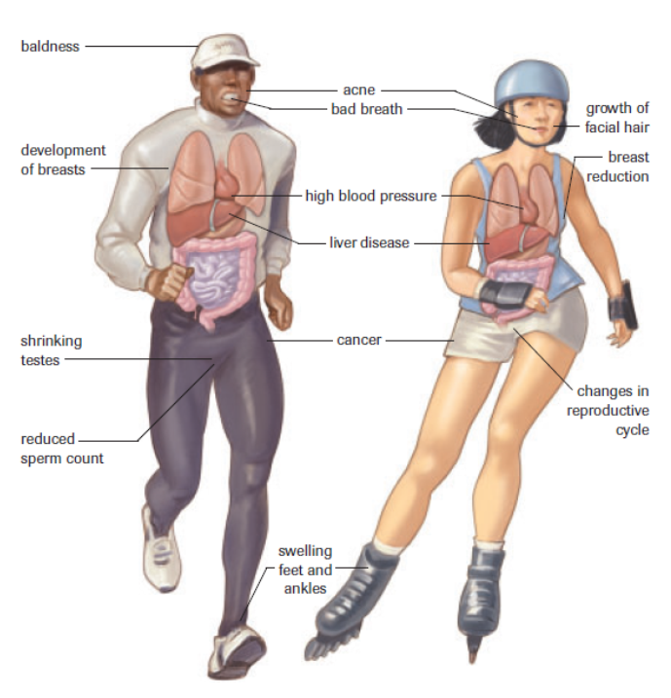
Stress and Sport READ pg. 495-496

Slide 87
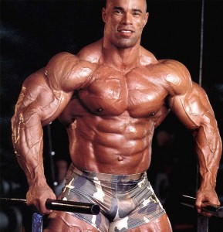
Practice
Pg. 497 - Section 15.5 Questions
# 1-10

