Slide 1
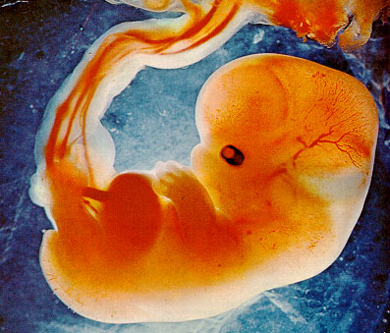
Reproduction and Development
Chapter 16: The Continuance of Human Life

Slide 2
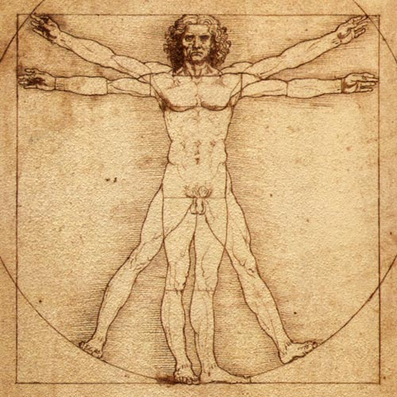
The Male Reproductive System - aNATOMY
PART 1A

Slide 3
Parts of the Reproductive System
Gonads – produce reproductive cells
Testes – produce sperm (spermatogenesis)
Ovaries – produce ova (oogenesis)
Sex hormones
For development primary and secondary sexual characteristics and function of the reproductive system.
Produced in the gonads.

Slide 4
Male Reproduction System
Sperm
Testes
Seminiferous tubules
Sertoli cells
Epididymis
Vas deferens
Scrotum
Penis
Seminal Fluid (semen)
Seminal vesicles
Prostate gland
Cowper’s gland
sperm
Urethra
Ejaculation

Slide 5
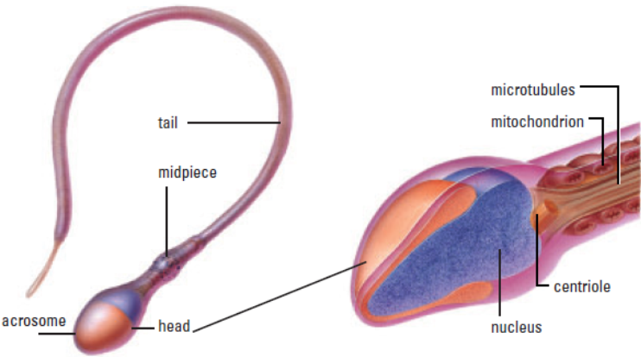
Sperm Cells (gametes)
Produced and stored in the testes
(axial filament)

Slide 6
Testes
Held outside the body by the scrotum (regulates temperature)
Composed of:
Seminiferous tubules: long coiled tubes that produce sperm
Sertoli cells: nourish sperm in the seminiferous tubules
Epididymis: where sperm mature and become motile
Vas deferens: carries sperm to the ejaculatory duct in the penis

Slide 7
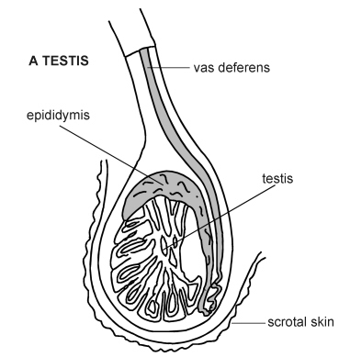
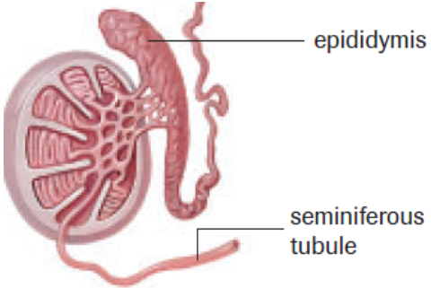
Testes
Epididymis
Seminiferous tubules

Slide 8
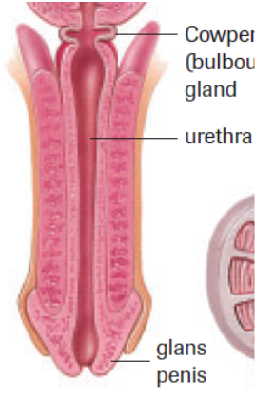
Penis
Primary function is to
transport sperm into female
reproductive tract
Movement of the sperm
cells from the epididymus
to the duct deferens occurs
during an erection

Slide 9
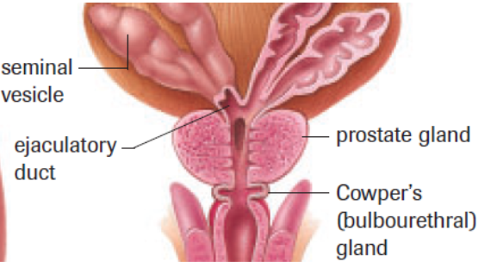
Seminal Fluid
As the sperm pass through the ductus deferentia they are mixed with fluid from other glands to produce semen. Purpose?

Slide 10
Production of Semen
Seminal vesicle: secretes sugar fructose fluid which provides sperm with energy.
Prostate and Cowper’s glands: secrete alkaline fluid to neutralize acids from the urine (in the urethra) and the female reproductive tract.
Urethra: releases (ejaculation) semen

Slide 11
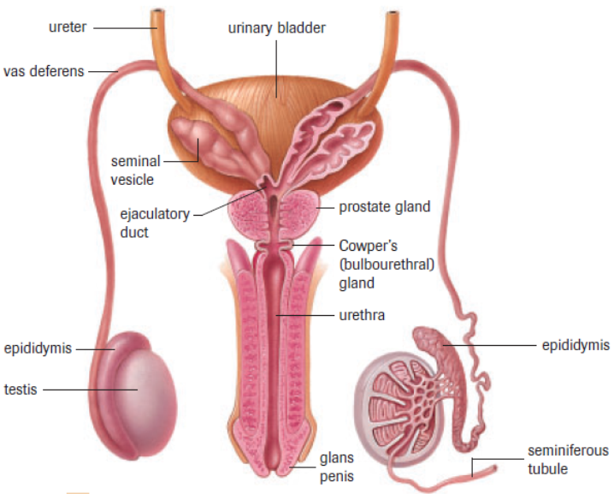
Not parts of reproductive system

Slide 12
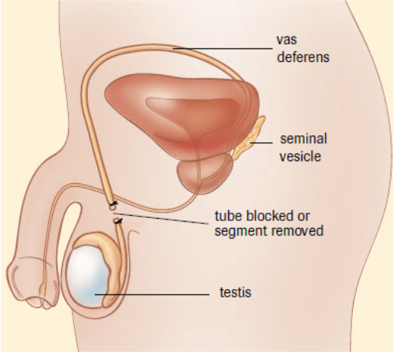
Vasectomy

Slide 13
Practice
Label Male Reproductive System Handout
Draw from memory (self test)
Male Anatomy Quiz Wed. Oct. 10
pg. 519 # 2, 7
Read Section 17.1

