Slide 1
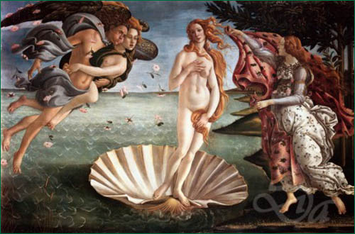
The Female Reproductive System - ANATOMY
PART 1B

Slide 2
Female Reproductive System
Ovaries (female gonads)
Produces ova / ovum (oogenesis) which are 20x larger than sperm head and filled with nutrient rich cytoplasm
Suspended in abdominal cavity
Left and right alternate ovum production month to month

Slide 3
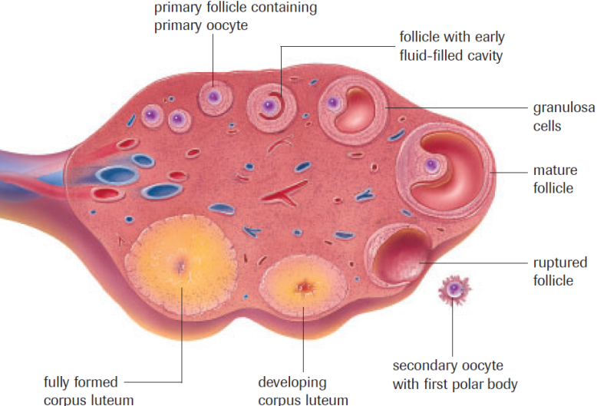
Ovaries contain follicles: site where the ovum matures and then is released. (ovulation)

Slide 4
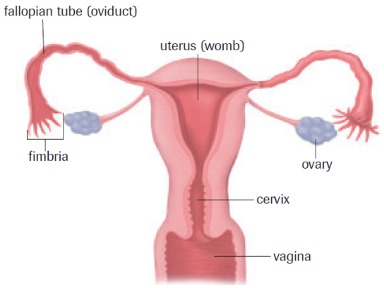
Female Reproductive System
endometrium

Slide 5
Female Reproductive System
Uterus: Hollow organ, protects and nourishes a developing fetus
Endometrium: lining of the uterus, rich in blood vessels and provides nutrients for the developing fetus (site of egg implantation)
Cervix: muscular band that connects the uterus to the vagina
Vagina: sperm entrance, muscular birth canal and exit for menstrual flow
Fallopian tube (oviduct): pathway for ova to uterus, usually the site of fertilization

Slide 6
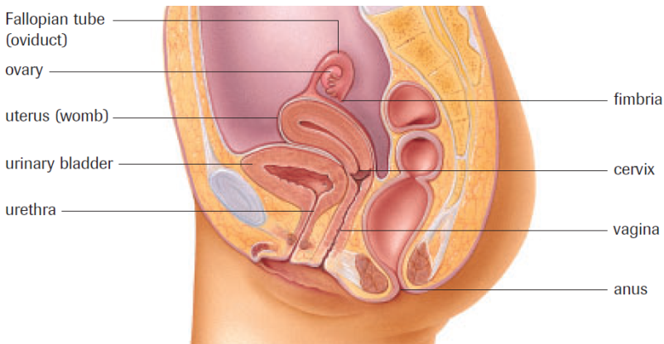
Female Reproductive System
Not parts of reproductive system

Slide 7
Tubal Ligation “Tubes Tied”

Slide 8
Practice
Label Female Reproductive System Handouts
Draw from memory (self test)
Male & Female Anatomy Quiz Thurs. Oct. 11
pg. 529 # 5, 6
Read Section 16.1 & 16.2 (focus on hormones)

