Slide 1
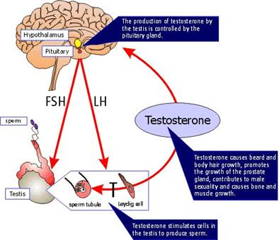
THE Male Reproductive SYSTEM - HORMONES
PART 2A

Slide 2
Sex Hormones
For the first 7 weeks, female and male embryos are identical
The presence and absence of particular hormones and their interactions with genes determines which sex organs develop, when they mature and how they function

Slide 3
Parts of the Reproductive System
Primary sex characteristics
All structures that play a direct role in reproduction (organ, duct, or gland)
Secondary sex characteristics
Any physical feature which distinguishes male from female, but are not required for reproduction (usually develop during puberty)

Slide 4
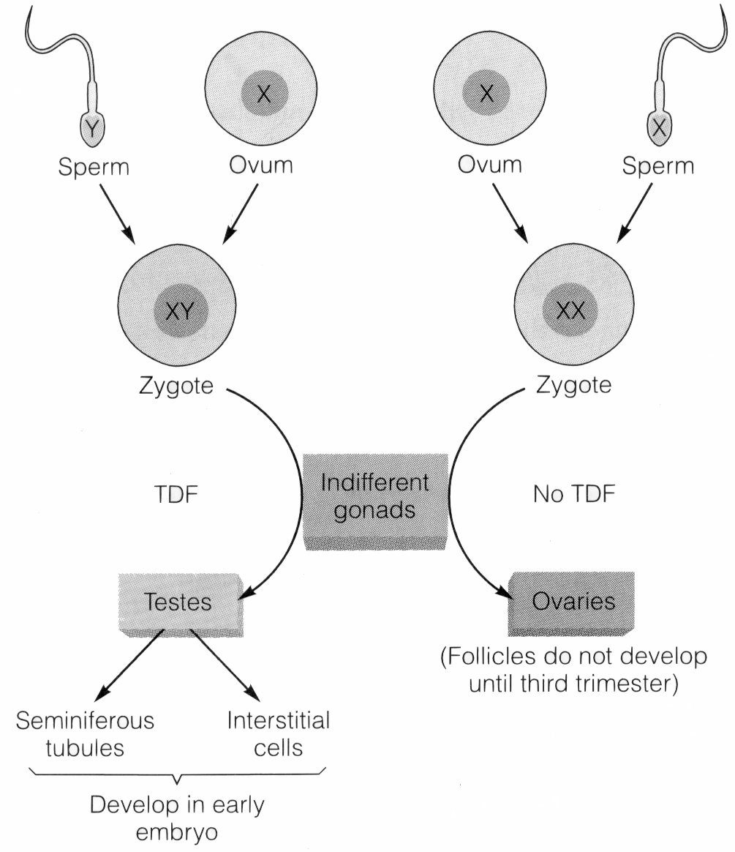
Sex Hormones and Males
Male sex hormones (androgens)
Y chromosome carries TDF
(testis-determining factor) gene
which cause primary sexual
characteristics to begin
development before birth

Slide 5
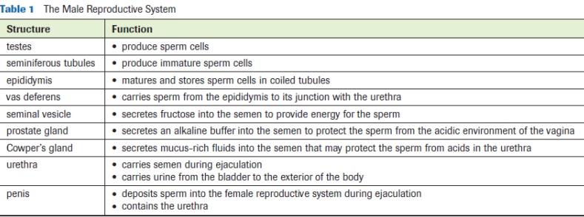
Sex Hormones and Males
Puberty: time when the reproductive system completes its development of primary sexual characteristics and becomes fully functional. Males: 10-13yrs.

Slide 6
Males and Puberty
Puberty marks the beginning of development of secondary sexual characteristics:
Hypothalamus secretes GnRH (Gonadotropin releasing hormone) which acts on the anterior pituitary
Anterior pituitary release FSH (follicle stimulating hormone) and LH (lutenizing hormone)
Causes spermatogenesis in the testes and release of Testosterone

Slide 7
Males and Puberty
*Steroids*http://www.dailymotion.com/video/x2os43_the-man-whose-arms-exploded-one_sport

Slide 8
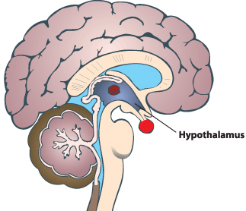
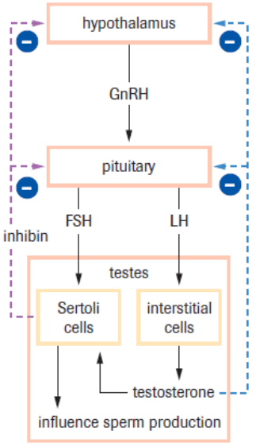
GnRH
Pituitary
Testosterone (-)
Inhibin (-)
FSH
LH
Seminiferous Tubules
Interstitial Cells
Testosterone

Slide 9
Negative Feedback Loop #1
Hypothalamus
Anterior Pituitary
Testes/Seminiferous Tubules
GnRH
(-)
Inhibin
FSH

Slide 10
Negative Feedback Loop #2
Hypothalamus
Anterior Pituitary
Testes
Testosterone
(-)
GnRH
LH

Slide 11
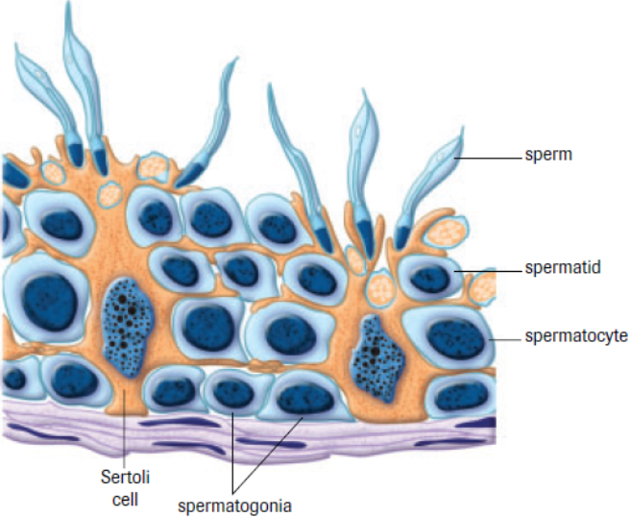
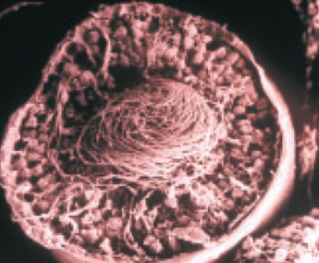
Spermatogenesis & Maturation

Slide 12
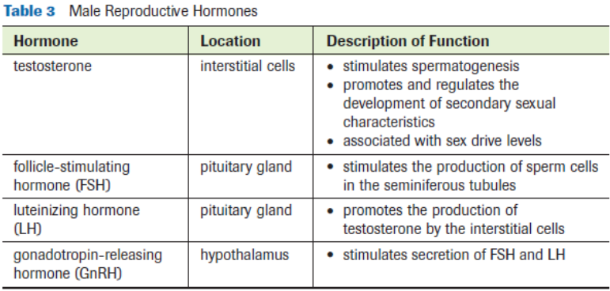
Male Hormones & Functions

Slide 13
Practice
Lab Exercise 16.A
pg. 519 # 3-6
Read Section 16.2 (hormones)

