Slide 1
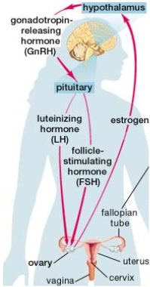
The Female Reproductive System - HORMONES
PART 2B

Slide 2
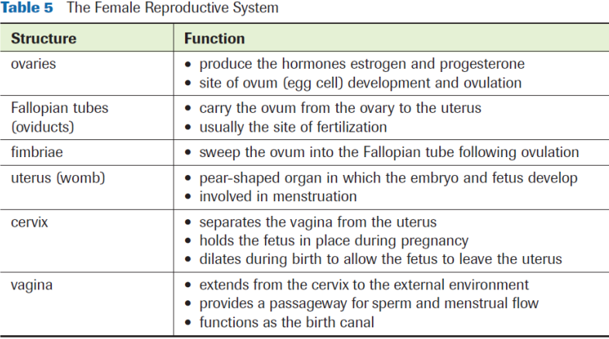
Female Reproductive System

Slide 3
Sex Hormones and Females
Puberty occurs between 9-13yrs. (1-2 years earlier than males on avg.)
Hypothalamus releases GnRH
Anterior pituitary releases FSH and LH
The ovaries release estrogen and progesterone

Slide 4
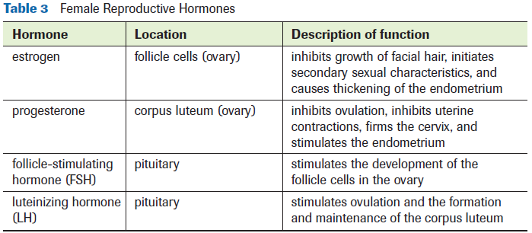
Sex Hormones and Females

Slide 5
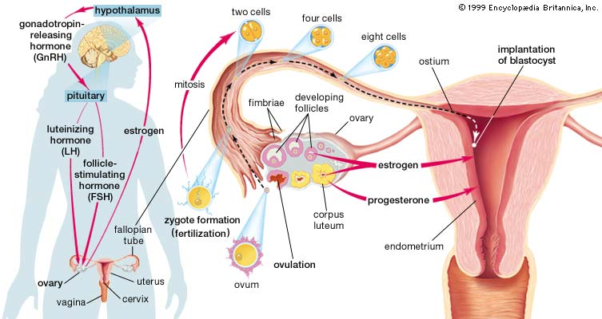
Sex Hormones and Females

Slide 6
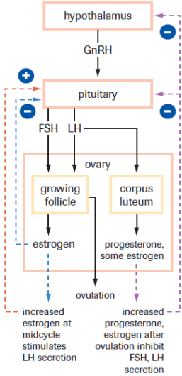
Sex Hormones and Females

Slide 7
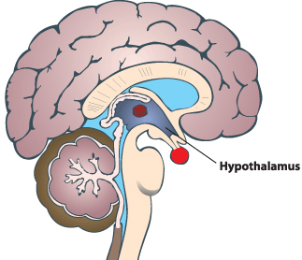
GnRH
Pituitary
Estrogen &
Progesterone (-) (ovulation)
Estrogen (+)
(midcycle)
FSH
LH
Estrogen (-)
(ovulation)
Follicles
Corpus Luteum
Ovulation

Slide 8
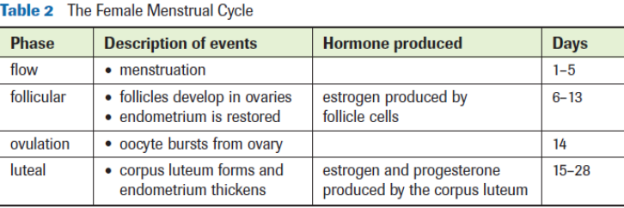
Sex Hormones and Females
Reproductive functions follow a cyclical pattern (aka the menstrual cycle)
Menstrual Cycle
~28 day cycle
Begins and ends with menstrual period
Made up of the ovarian cycle and the uterine cycle

Slide 9
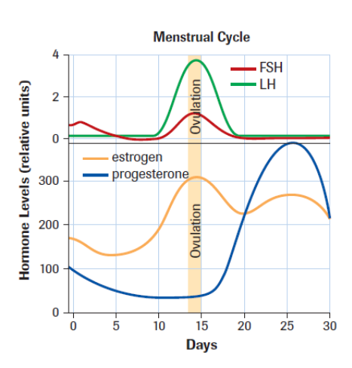

Slide 10
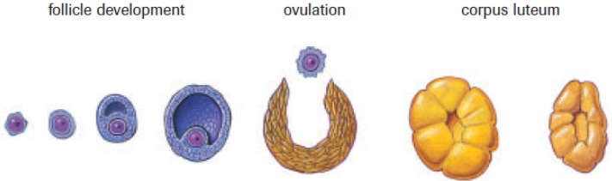
The Ovarian Cycle
If the ovum is fertilized and implanted in the endometrium, then levels of progesterone and estrogen are maintained
Progesterone maintains the endometrium
Estrogen stops ovarian cycle

Slide 11
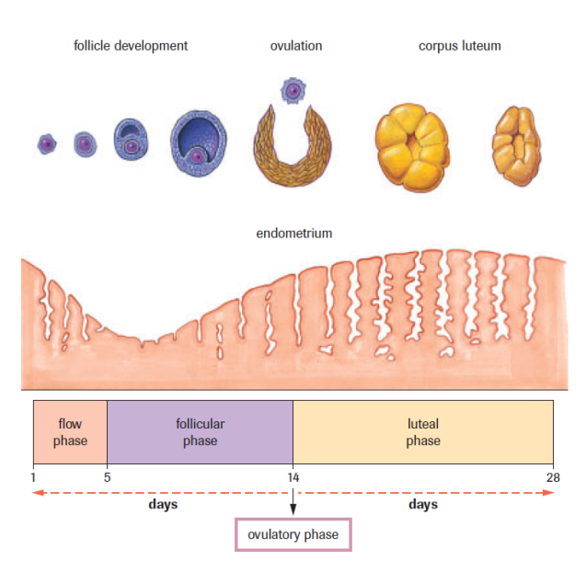
The Ovarian Cycle
One ovum matures in each cycle
Four phases:
Follicle phase
Ovulatory Phase
Luteal phase
Flow Phase

Slide 12
Follicle Phase
Increase in FSH stimulates follicle to mature
Mature follicle stimulates release of estrogen
Estrogen inhibits release of FSH but stimulates release of GnRH
GnRH stimulates release of LH from the anterior pituitary
LH causes the follicle to burst and release its ovum (ovulation)

Slide 13
Follicle Phase

Slide 14
Ovulation (Ovulatory phase)
Release of ovum from mature follicle
Ovum stays in the oviduct for 24hrs after release
Two outcomes:
Fertilization – Ovum travels to the uterus and implants itself in the endometrium to begin development. Ovarian & Uterine Cycles STOP
No fertilization – Menstruation

Slide 15
Ovulation (Ovulatory phase)

Slide 16
Luteal Phase
LH causes the follicle to develop into corpus luteum
Corpus luteum secretes progesterone
Progesterone inhibits further release of FSH and LH
Once corpus luteum degeneration is complete, levels of estrogen and progesterone drop and the follicle stage starts again

Slide 17
Luteal Phase

Slide 18
Menstruation (Flow Phase)
Occurs if ovum is unfertilized
Disintegration of the endometrium; tissues and blood flow out of the vagina

Slide 19
The Uterine Cycle
Starts on the first day of menstruation:
1. Corpus luteum degenerates & endometrial tissue breaks down (due to low sex hormone levels from ovaries)
2. Estrogen (during follicular phase) causes endometrium to begin thickening
3. Ovulation – Follicle changes into corpus luteum
4. Progesterone (during luteal phase, post-ovulation) causes endometrium to become thicker
in preparation for
possible implantation

Slide 20
The Uterine Cycle
1. 2. 3. 4.

Slide 23
Practice
Pg. 523-26 Practice Q’s # 1-4
Lab Exercise 16.B (a-k)
pg. 529 # 1-4, 7, 8

