Slide 1
The Effect of STI’s on the Reproductive System
PART 3

Slide 2
STI (Sexually Transmitted Infection)
Infection that is transmitted only or mainly by sexual contact
Caused by a virus, bacteria or parasite
Viruses: HIV/AIDS, Hepatitis (A,B&C), genital herpes, HPV(human papilloma virus)
Bacteria: chlamydia, gonorrhea & syphilis

Slide 3
HIV / AIDS
HIV (Human Immunodeficiency Virus)
Attacks white blood cells (helper T cells)
Suppresses immune function
Leads to other infections / illnesses
Leads to AIDS (Acquired Immunodeficiency Syndrome)
Transmission
Sex, needles, child birth and breastfeeding
NO CURE!

Slide 4
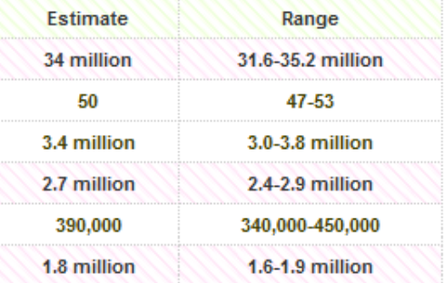
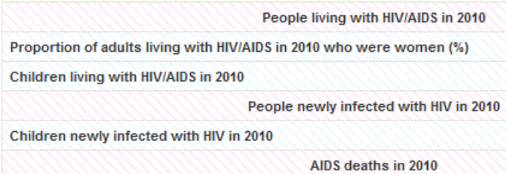
HIV / AIDS STATS
Canadian Statistics (1985 – 2004)
57 000 (HIV)
20 000 (AIDS)
13 000 (died)

Slide 5
Hepatitis
Three types:
Hepatitis A:
Transmitted through water contaminated by fecal matter
Hepatitis B:
Transmitted through sexual contact; infected bodily fluids
Hepatitis C:
Transmitted from blood to blood interaction
(Reason for methadone clinics – 3000Canadians/yr.)

Slide 6
Hepatitis
Symptoms:
Acute: flu-like (headache, fever, nausea etc.)
Chronic: liver infection/failure/cancer
*Asymptomatic*: Someone with Hep B may not show any symptoms and infect others
Vaccinations available for Hep A and B

Slide 7
Genital Herpes
*1/3 people in Canada who are sexually active have genital herpes*
Two Types:
HSV1: infections of mouth, but can be passed to genitals
HSV2: acquired through genital contact
NO CURE!

Slide 8
Genital Herpes
Symptoms:
Appear in ~1month
Vary widely
Tingling, itching, blistering (on genitals, buttocks, thighs and urethra)
Outbreak – flu-like symptoms (triggered by stress, sunlight, intercourse, certain foods
Increases risk of HIV
Transferred during birth can cause blindness, brain disorders and death

Slide 9
HPV
Human Papilloma Virus
‘Genital warts’
Transmitted by skin to skin contact
Asymptomatic
Increase risk of:
Cervical cancer
Tumours of the vulva, vagina, anus and penis

Slide 10
Chlamydia
Bacterial infection
55 000 new/yr.
15-24 yr. old
Higher in women than men
Symptoms
Discharge
Burning while urinating
Fever
75% of infected people are asymptomatic

Slide 11
Chlamydia
If untreated, can spread to the cervix and oviducts causing PID (pelvic inflammatory disease)
Build up of scar tissue
Infertility
Infected during birth – eye and respiratory tract infections
Curable with antibiotics if caught early enough

Slide 12
Gonorrhea
Second most widespread STI in Canada
Twice as high in men than women
Symptoms similar to chlamydia:
Infection of urethra, cervix, rectum and throat
Thick greenish-yellow discharge
Untreated – PID
Spread through bloodstream to joints, heart and brain
Treatable with antibiotics (resistance?)

Slide 13
Syphilis
Bacterial infection
Increased rapidly since 1997
3 Stages:
1. Chancres on infected area (ulcerated sores)
2. Rash anywhere on the skin (palms and soles)
3. Affects cardiovascular and nervous systems (blindness and heart disease) gummas (ulcers) on internal organs

Slide 14
Syphilis
Any stage could infect fetus and cause stillbirth
Not treated – permanent damage (brain)
Curable with antibiotics

