Slide 1
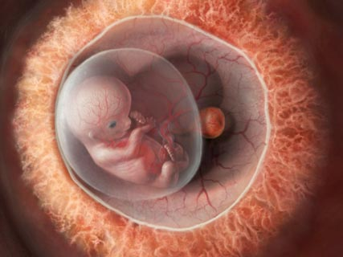
Fertilization and Embryonic Development
PART 4

Slide 2
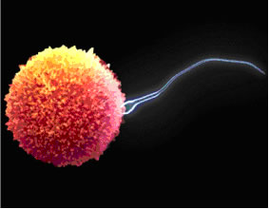
Fertilization
How human development begins
The joining of the male (sperm) and female (ovum) gametes to form a single cell
New cell contains 46
chromosomes (23 from
each parent)

Slide 3
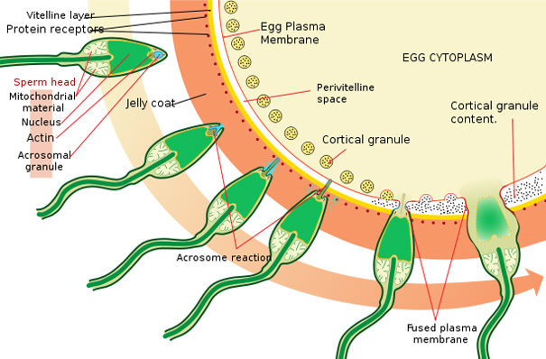
Fertilization
Ovum must be fertilized within 12-24 hours of being released, therefore sperm must travel to the oviduct

Slide 4
Fertilization
within ~12hrs. of the sperm’s nucleus entering the ovum, the egg’s and the sperm’s nuclear membranes disappear and the nuclei fuse.
New cell is called a
zygote (23 PAIRS of
chromosomes – 46 total)

Slide 5
Cleavage and Implantation
~30hrs. following fertilization the zygote divides via mitosis
1 cell divides into 2
2 cells divides into 4
4 cells divides into 8
etc.
Cleavage: process of cell division without the
enlargement
of cells.

Slide 6
Cleavage and Implantation
16 cells = Morula - which reaches the uterus 3-5 days after fertilization
Morula fills with fluid from the uterus and develops into a blastocyst
Blastocyst is made up
of two types of cells:
Trophoblast
Inner cell mass

Slide 7
Blastocyst - Implantation
Trophoblast will develop into the extraembryonic structures:
chorion - which will develop into the placenta
Amnion – which will develop into amniotic sac
Inner cell mass will develop into the embryo
~5-7 days following fertilization the
blastocyst is implanted in to the
endometrium
Pregnant = successful implantation

Slide 9
Implantation
During implantation the trophoblast secretes human chorionic gonadotropin (hCG)
identified by pregnancy tests.
Has similar effects as LH and therefore maintains the corpus luteum
Estrogen and progesterone levels are maintained and menstruation does not occur.
Ovarian & uterine cycles STOP

Slide 10
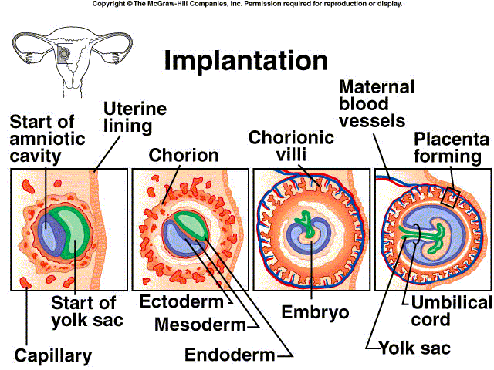

Slide 11
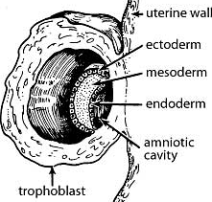
Gastrulation & Tissue Formation
Inner cell mass begins to separate from the trophoblast, forming the amniotic cavity
Gastrulation: the formation of the three primary germ layers:
Ectoderm
Endoderm
Mesoderm

Slide 12
Primary Germ Layer

Slide 13
Morphogenesis
Marked by gastrulation
Series of events that form distinct structures of the developing organism
Relies on differentiation
Differentiation: cellular process that allows cells to have a different shape and function from other cells.

Slide 14
Primary Germ Layers
Ectoderm: nervous system and epidermis
Endoderm: endocrine glands, and lining of digestive and respiratory systems
Mesoderm: skeleton, muscle and reproductive structures

Slide 15
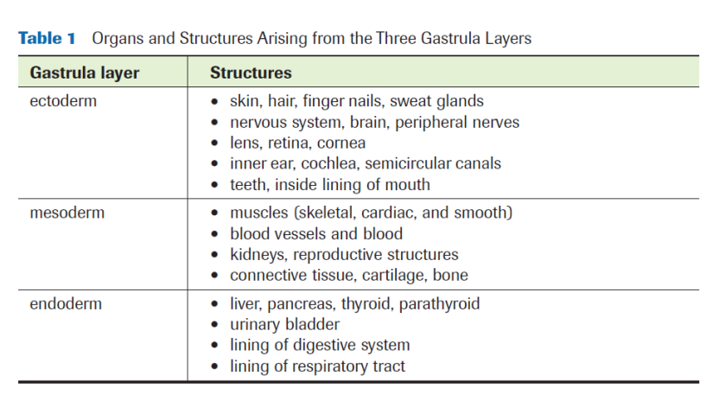
Primary Germ Layers

Slide 16
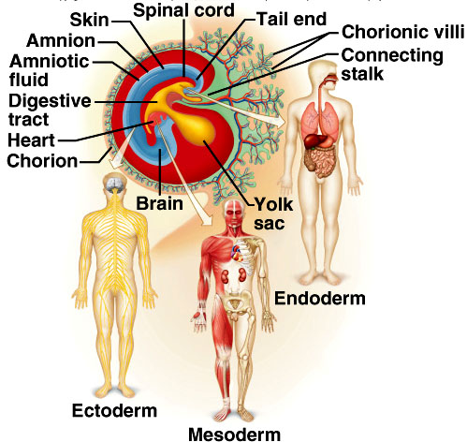
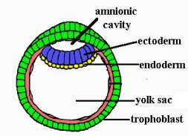

Slide 17
Embryo Development
Extra-embryonic membranes:
Allantois: the foundation of the umbilical cord
Umbilical cord: links fetus and mother
Amnion & chorion: fluid-filled sac which protects the fetus from trauma and temperature fluctuations
**Responsible for protection, nutrition, respiration and excretion for the embryo**

Slide 18
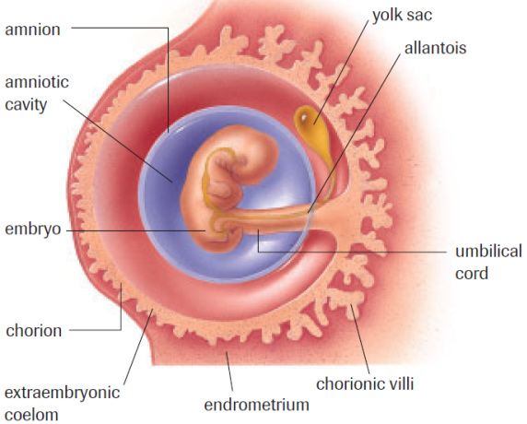

Slide 19
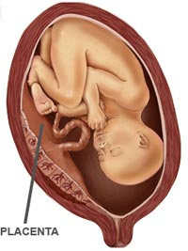
Placenta
Placenta features:
Rich in blood vessels
Attaches fetus to uterine wall
Transports and stores nutrients
Transports waste
Transports oxygen and carbon dioxide
Secretes hormones (estrogen & progesterone)
Transports antibodies from the mother to the fetus (passive immunity)

Slide 20
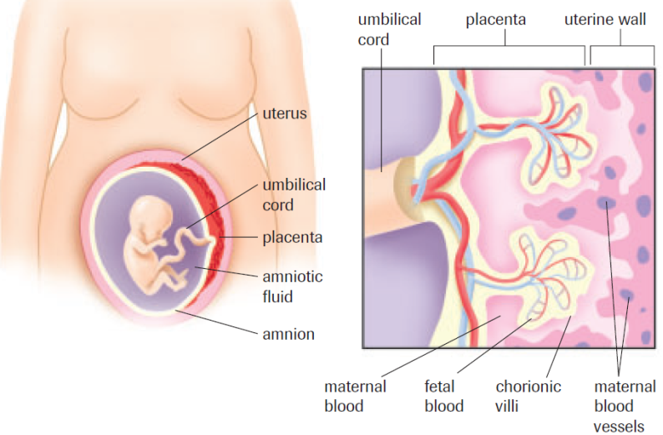
Embryo Support

Slide 21
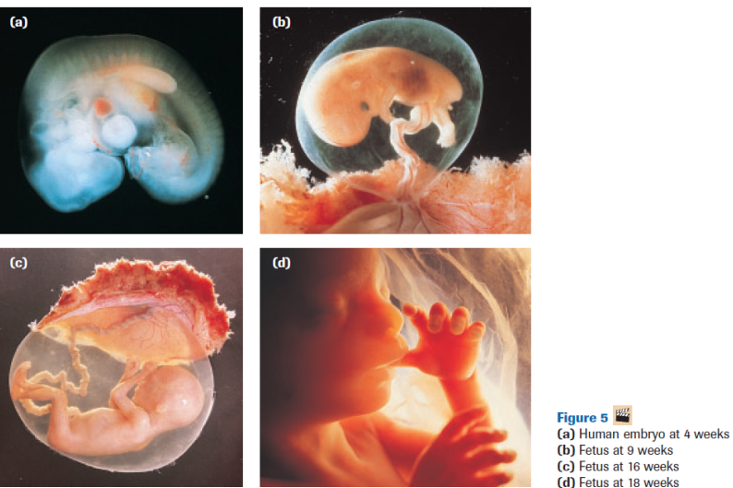
Practice
Pg. 532 Practice #1
Pg. 544 #1, 2, 5

