Slide 1
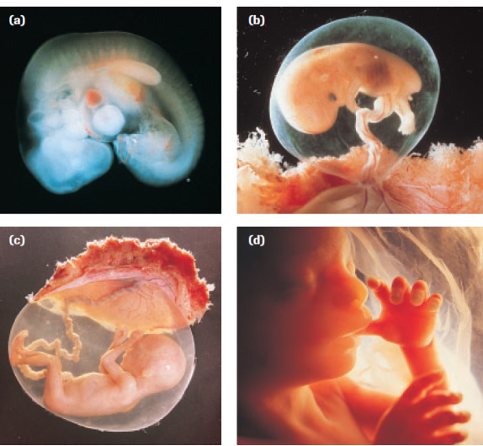
Fetal Development
PART 5A

Slide 2
Neurulation & Organ Formation
Between 3rd – 8th weeks Embryonic development (morphogenesis) occurs which builds the base structures of the body systems.
Neurulation marks the beginning of organ formation
Neurulation is the process of forming the neural tube, which develops into the brain and spinal cord

Slide 3
Primary Germ Layer

Slide 4
Neurulation
Notochord forms from mesoderm
Neural tube starts as a plate of the ectoderm above the notochord
Edges of plate fold inwards and pinches off from the ectoderm (brain/spinal cord)
Cells in the above the neural tube develop into organs, bones and muscle

Slide 5
Neurulation

Slide 6
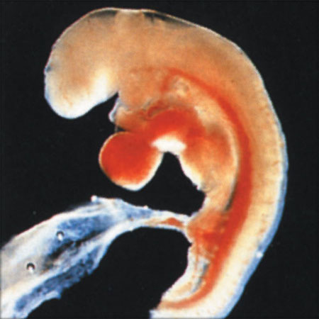
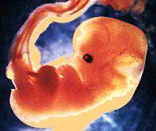
Organ Formation
4th week
Blood cell formation
Kidney and lung formation
Head, eyes, ears and nose
6th week
Rapid brain development
Limbs lengthen
Gonads release hormones for
genitalia development

Slide 7
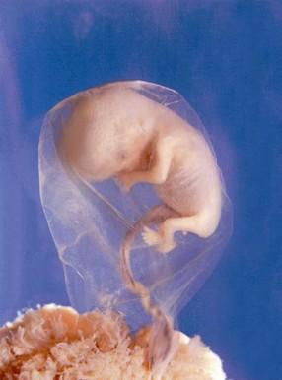
Organ Formation
7th and 8th weeks
Cartilage skeleton has formed
Eyelids formed and closed
Nose formed (plugged by
mucus)
Physical sex not apparent yet
~90% of the organs and other
structures that make up the adult
human body are established

Slide 8
Fetal Development
Starts during the 9th week and continues until birth
Follows embryonic development (building of structures)
Fetal development = growth and refinement of existing structures

Slide 9
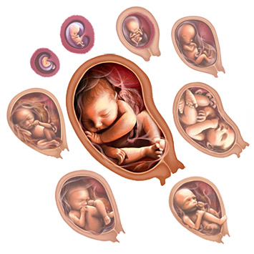
Gestation
3 Trimesters (each approx. 3 months)
TASK:
1. In groups of 3 (because there’s 3
trimesters!) assign one trimester
per person to research and
summarize the basic events that occur.
2. Come to together and share
what you’ve learned and compare and
contrast each trimester (be prepared to share)

Slide 10
First Trimester
Research Notes:

Slide 11
Second Trimester
Research Notes:

Slide 12
Third Trimester
Research Notes:

Slide 13
Compare & Contrast
Trimester 1
Trimester 3
Trimester 2

Slide 14
Teratogens & Development
Teratogen - Any agent that causes a structural abnormality due to exposure during pregnancy
Especially dangerous during embryonic development (building of structures & neurulation)
Examples: cigarettes, alcohol, antibiotics, acne medications, vitamins, anti-cancer drugs, etc.

Slide 15
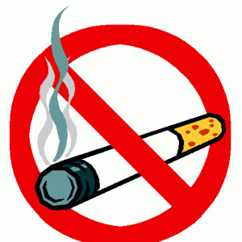
Teratogens: Cigarettes
Constricts the maternal, placental, and fetus’ blood vessels
Increases risk of:
Premature birth
Stillbirth
Miscarriage

Slide 16
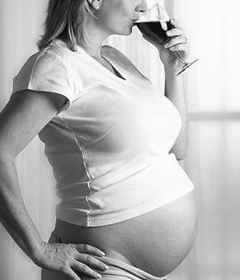
Teratogens: Alcohol
One of the most dangerous
Affects CNS and physical development
Low birth weight, short height, small head
Facial and head deformations
Learning disabilities and unusual
Aggression or personal disorders
Should be AVOIDED when trying
to become pregnant, during
pregnancy and breastfeeding

Slide 17
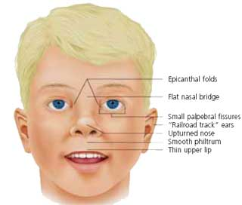
Teratogens: Alcohol
Causes a form of FASD
(Fetal Alcohol Spectrum Disorder)
Can males cause FASD?
These mutations can lead to birth defects,
miscarriage, or illness in the resulting baby.
When children with fathers who are heavy drinkers and non-alcoholic mothers are compared with those with FAS, the children of the drinking fathers are not grossly malformed, but they do have certain intellectual and functional deficits, and they are also more likely to be hyperactive.

Slide 18
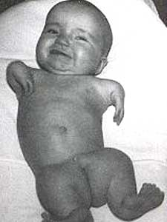
Teratogens: Over-the-Counter Drugs
Thalidomide (1950s)
Used for morning sickness
Caused missing and deformed
limbs in newborns
Vitamin C
Large doses
Sudden drop after birth can lead to scurvy

Slide 19
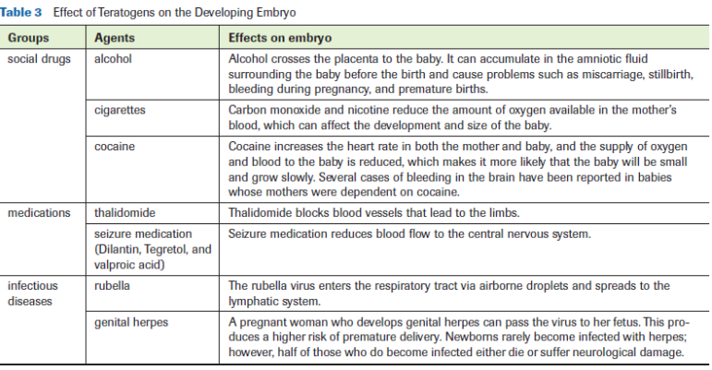
Teratogens

Slide 20
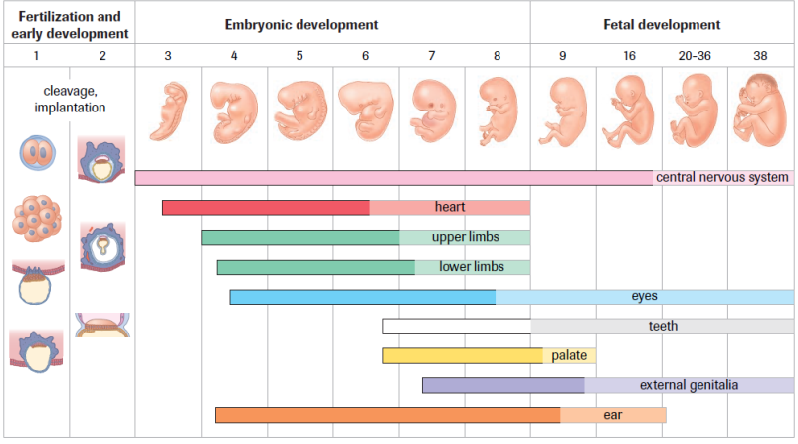
Development Overview

Slide 21
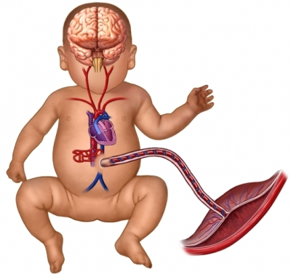
Practice
Pg. 536 Practice #2, 3
Pg. 538 Read Explore
the Issue – FASD
Understand the Issue #1-3
Pg. 544 #2

