Slide 1
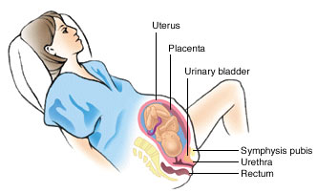
PARTURITION (Birth)
PART 5B

Slide 2
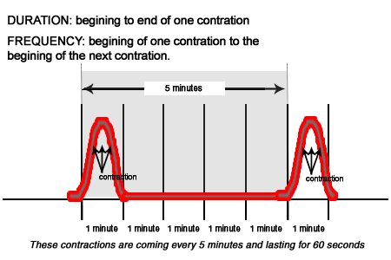
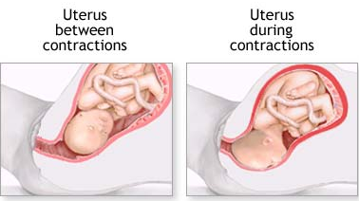
Parturition: Delivery of the Baby
The birthing process or ‘labour’
Begins with uterine contractions
Occurring every 15-20 mins in frequency and lasting for a duration of 40-60 sec.

Slide 3
Parturition
Relaxin hormone is released by the placenta, loosening ligaments of the pelvis and softening the cervix.
Uterus contractions causes stretching of cervix
Stretching of cervix causes release of oxytocin from posterior pituitary gland
Oxytocin stimulates uterine contractions and release of prostaglandins from the uterus
Prostaglandins cause uterine contractions
(+) Feedback Cycle continues until baby is born

Slide 4
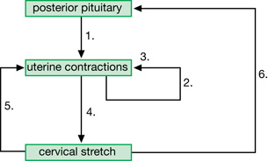
Parturition
Oxytocin
Prostaglandins
Stimulates (+ feedback)
Baby’s head pushes downwards
Stimulates (+ feedback)
Stimulates (+ feedback)

Slide 5
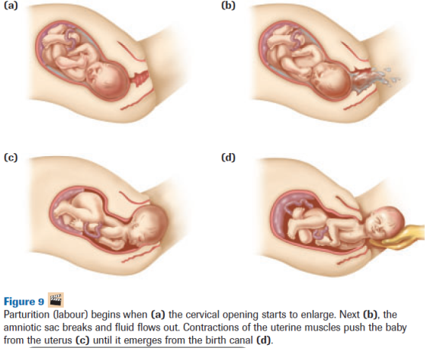

Slide 6
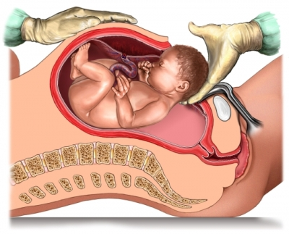
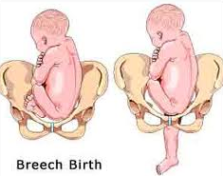
(Caesarean) C-Section
Typical reasons:
Breech births
Small pelvis
STI complications

Slide 7
Lactation
The secretion and formation of breast milk in the mother
Requires the hormone prolactin
not secreted during pregnancy because it is high levels of estrogen and progesterone suppress production
Secreted by anterior pituitary following birth

Slide 8
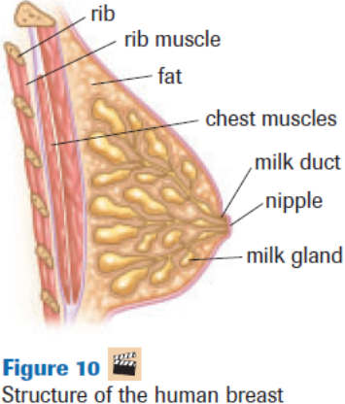
Lactation

Slide 9
Lactation and Suckling
Suckling stimulates nerve endings in the nipples
Nerve impulse causes the hypothalamus to stimulate the posterior pituitary to secrete oxytocin
Oxytocin causes mammary cells to contract causing the milk glands to produce milk
Contractions of milk glands cause milk to be secreted through ducts through the nipple.

Slide 10
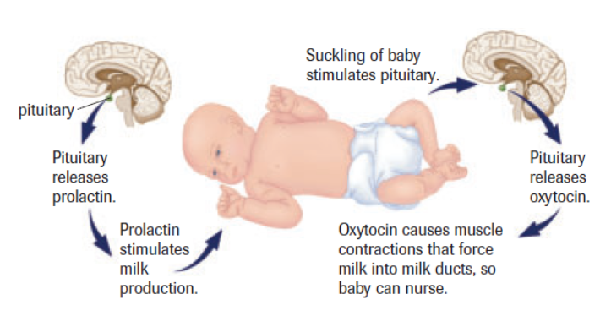
Lactation
BIRTH

Slide 11
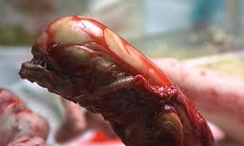
Practice
Pg. 542-3 READ Case Study – Human Reproductive Technology
ANSWER #1-5
Pg. 544 #4

