Slide 1
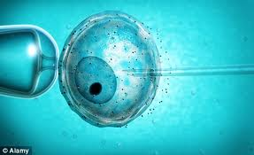
Reproduction, Technology & Society
PART 6

Slide 2
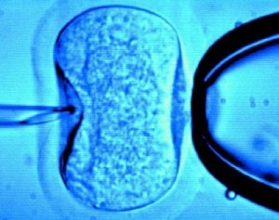
Reproductive Technologies
Technologies that enhance or reduce reproductive potential
http://video.nationalgeographic.com/video/player/science/health-human-body-sci/human-body/ivf-sci.html
Ex. “test tube babies” a.k.a.
IVF (In vitro fertilization)

Slide 3
Technologies That Enhance Reproductive Potential
Why are these technologies necessary?
Sterile vs. Infertile
Sterile: unable to have any children
Infertile: unsuccessful at becoming pregnant for a year or more

Slide 4
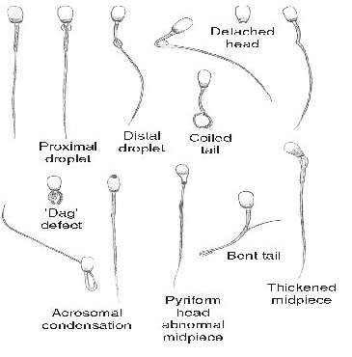
Reasons for Male Sterility or Infertility
Blockage of ductucs (vas) deferens or epididymus
Low sperm count (elevated temperature,
smoking & alcohol)
Abnormal (structural)
sperm
Erectile dysfunction

Slide 5
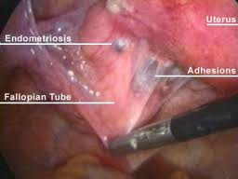
Reasons for Female Sterility or Infertility
Blockage of oviducts (fallopian tubes)
Ex. STIs
Endometriosis - abnormal growth of uterine lining within uterus and other areas. (lesions, scaring, cysts)
Damage to eggs (physical, teratogens, mutagens: chemical or radiation)

Slide 6
Technologies To Enhance Reproductive Potential
Artificial Insemination
Sperm collected and concentrated before being inserted into the women
In Vitro Fertilization
Immature eggs are taken from follicles, combined with sperm and developing embryo is placed in the uterus
Surrogate Mothers
Another women will carry a baby to term
Hormone Treatment (Superovulation)
Production of multiple eggs through by use of fertility drugs (hormones)

Slide 7
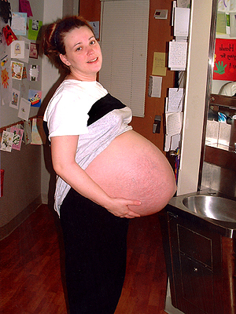
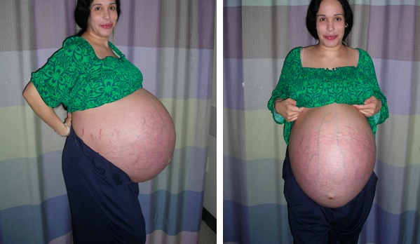
IUF &
Superovulation
IVF

Slide 8
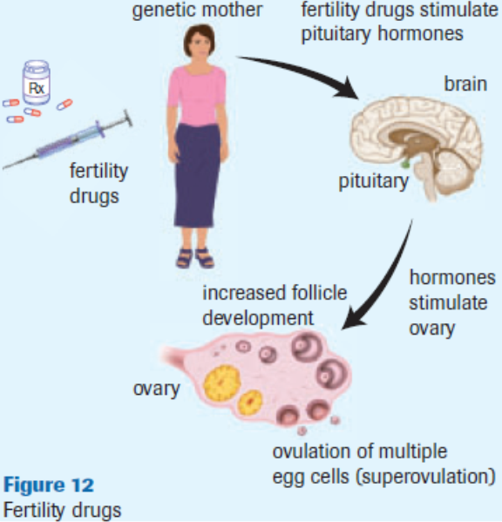
Hormone
Treatment

Slide 9
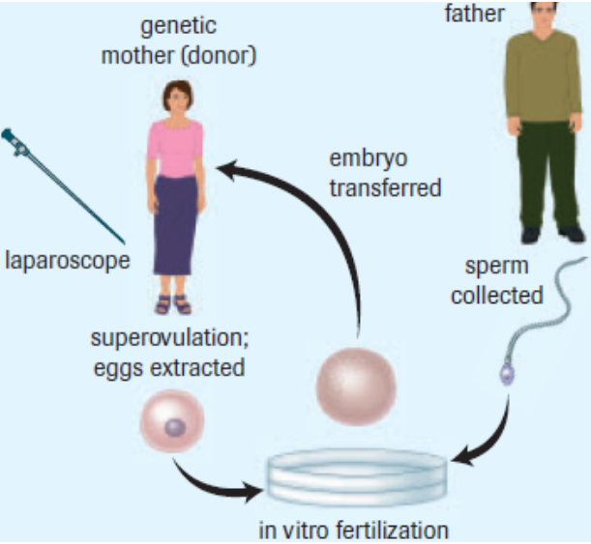
IVF

Slide 10
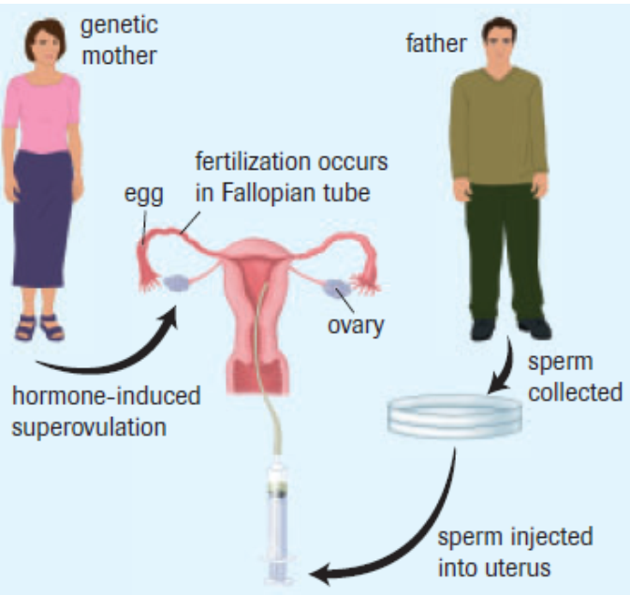
IUF

Slide 11
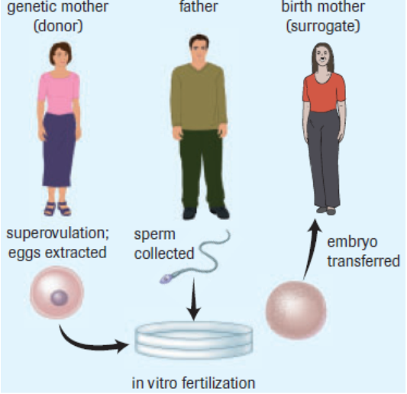
Surrogates

Slide 12
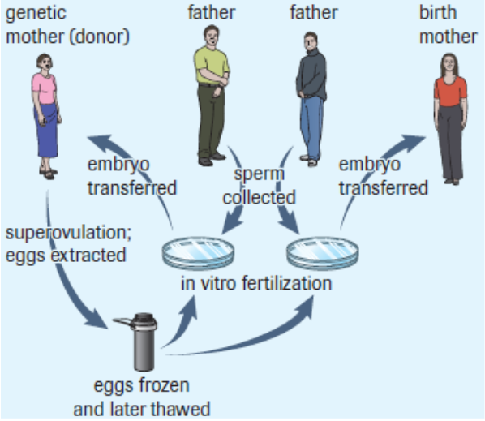
Ovum/Sperm Donation

Slide 13
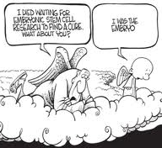
Social and Ethical Concerns?
Zygote rights?
Stem Cell research
What rights do donors
and surrogate parents
have?
How far should reproductive
technologies go?
i.e. GATTACA

Slide 14
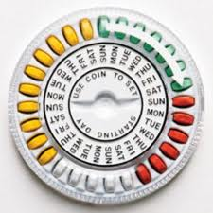
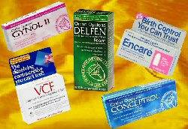
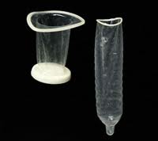
Technologies That Reduce Reproductive Potential
Abstinence (100%)
Surgical Sterilization (100%)
Tubal litigation (cutting oviduct)
Vasectomy (cutting ductus deferens)
Hormone Treatments (90-99%)
Contraceptive birth control
Physical/Chemical Barriers (75%)
Natural Family Planning (70%)
Refrain from sex during most fertile part of cycle

Slide 15
Task
Read through Birth Control Methods handout individually. (10 min.)
With a partner or in a group of three discuss what you read and respond individually to the 5 Edmodo Polls. (10 min.)
Class Discussion of results and points of interest.
(10 min.)

