Slide 1
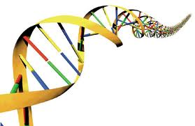
Chapter 20
Molecular Genetics

Slide 2
PART 1 - DNA Structure and replication

Slide 3
What is DNA?
Two types of DNA discovered by Phoebus Levene
DNA (deoxyribonucleic acid): governs process of heredity
RNA (ribonucleic acid): plays a role in gene expression and protein synthesis and has a similar structure to DNA
http://www.youtube.com/watch?v=qy8dk5iS1f0

Slide 4
DNA
Important in the life of a cell for several reasons:
Directs cell activity
Allows traits to be passed on to successive generations of cells
Mutations- arise when DNA is altered, the code is changed.

Slide 5
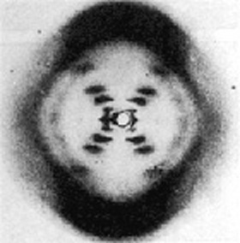
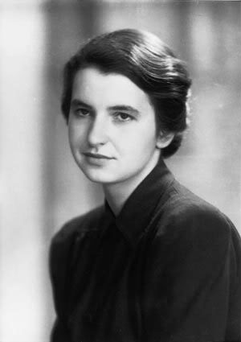
DNA Structure
Rosalind Franklin used X-Ray photography to describe the 3D structure of DNA
Determined that the nitrogenous bases were located on the inside of the helix and were supported by a phosphate backbone
Read pg. 650 “Politics and Science”

Slide 6
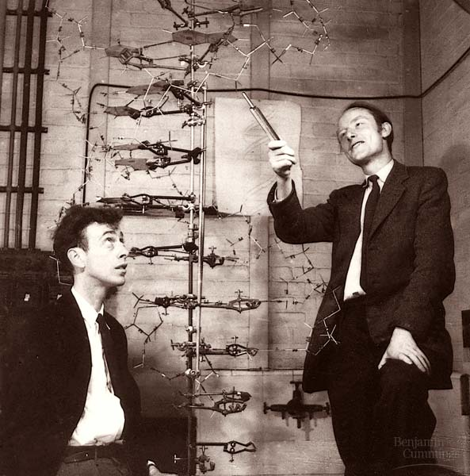
Watson and Crick- 1953
Watson and Crick expanded on Franklin’s work to produce the first structural model of DNA.

Slide 7
The Double Helix
Two long strands of nucleotides bound
together in a spiral (or double helix)
*Sometimes referred to as a ladder:
Handrails = sugar-phosphate backbone
Rungs = complimentary base pairs
Complimentary base pairs on either side
of the ladder are said to run antiparallel;
by knowing the nucleotide sequence of one
strand the other strand can be easily predicted.

Slide 8
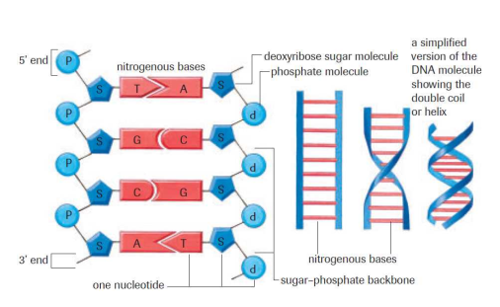
DNA Double Helix

Slide 9
DNA Structure (and RNA)
Long chain of nucleotides
DNA and RNA contain a combination of different nucleotides (chains of molecules):
DNA: adenine (A), guanine (G), cytosine (C), thymine (T)
RNA: adenine(A), guanine(G), cytosine(C), uracil(U)

Slide 10
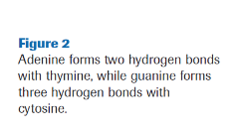
Purine vs. Pyrimidine
*A purine is always complementary paired with a pyrimidine:
Purine:
Adenine (A)
Guanine (G)
Pyrimidine:
Thymine (T) DNA or Uracil (U) RNA
Cytosine (C)
Hydrogen bonds between the bases on opposite strands hold the double helix together.

Slide 11
Chargaff’s Rule
Found that nucleotides are not presented in equal amounts.
He found that the amount of A was similar to the amount of T and that the amount of C was similar to the amount of G.
*A-T are base pairs and C-G are base pairs
Ex. If there is found to be 10% Adenine in a strand of DNA, what are the percentages of the other base chemicals?

Slide 12
To Do:
http://www.youtube.com/watch?v=sf0YXnAFBs8
Label DNA hand out
DNA Drawing from Memory
Page 663 #1-3
Finish reading Section 20.1

