Slide 1
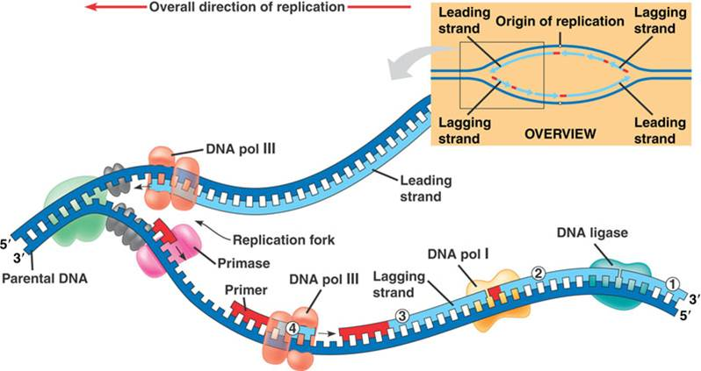
PART 2 - DNA Structure and replication

Slide 2
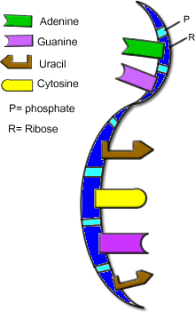
Differences between RNA and DNA
The sugar component of RNA is ribose (DNA is deoxyribose)
RNA has uracil (U) as a nucleotide
rather than thymine (T)
RNA is single-stranded

Slide 3
Genes and the Genome
Gene: a functional subunit of DNA that directs the production of one polypeptide
Genome: the sum of all the DNA that is carried in each cell of an organism
The Human Genome:
Genes are not regularly spaced along the chromosome (#4 – 200 000 000 bp and 800 genes, #19 – 55 000 000 bp and 1500 genes)

Slide 4
DNA Replication
Replication: a process of creating an exact copy of a molecule DNA
A single strand of nucleotides acts as a template for the formation of a complementary strand of DNA
Occurs during the S phase of interphase
Error rate = 1/1 000 000 000 nucleotide pairs

Slide 5
DNA Replication is…
Semi-conservative: each new molecule of DNA contains one strand of the original, complementary DNA and one new strand
“Conserves half its DNA”

Slide 6
4 Steps to Replication:
Uncoils
Unzips
Weak hydrogen bonds are broken
Ladder unzips
It takes more energy to break a strand high in C’s and G’s due to hydrogen bonding.
Complimentary strand forms using the old strand as a template
Recoils
Initiation
Elongation
Termination

Slide 7
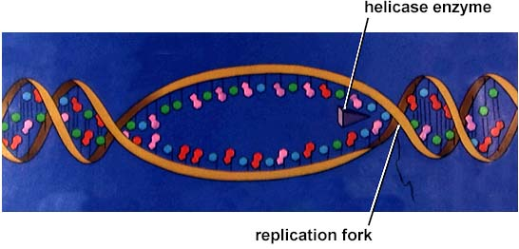
Initiation
In eukaryotic cells, DNA replication begins at one of the thousands of origins of replication. This happens along the entire length of the DNA strand simultaneously.
replication bubble

Slide 8
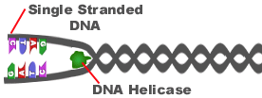
Initiation
The enzyme, DNA Helicase, binds to the origin of replication and cleaves and unravels part of the DNA double helix.
The separation of the strands serves as a template for the new strands.

Slide 9
Elongation
The enzyme, DNA polymerase III, begins to add nucleotides into complimentary strands to create the new DNA strands.
Not many mistakes in the process of DNA replication due to “proof reading” ability of DNA polymerase III and I
http://www.youtube.com/watch?v=teV62zrm2P0
http://apod.nasa.gov/apod/ap120821.html

Slide 10
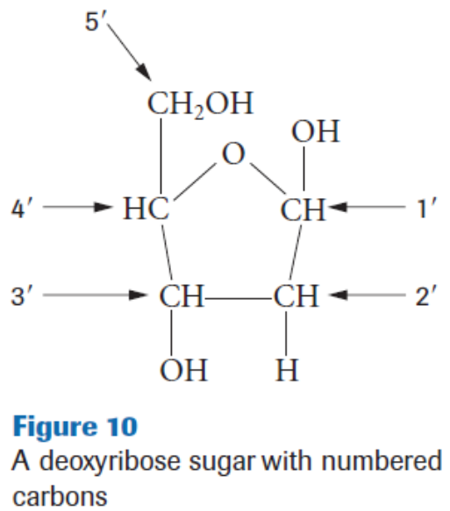
Elongation
Nucleotides are attached to the free 3’ hydroxyl end of the pre-existing chain of nucleotides.
During replication, the DNA is always copied from 5’ to 3’
These numbers are given based on the type of carbons at either end of the strands. This helps us to figure out the direction of replication.

Slide 11
Elongation

Slide 12
Elongation- page 665
Leading strand (5’ to 3’):
Replicated in one piece easily
Lagging strand (3’ to 5’):
Replicated in many pieces called Okazaki fragments
A DNA primer attaches to the DNA strand to act as a starting point
Nucleotides are added in a 5’-3’ direction and then spliced together by the enzyme DNA ligase

Slide 13
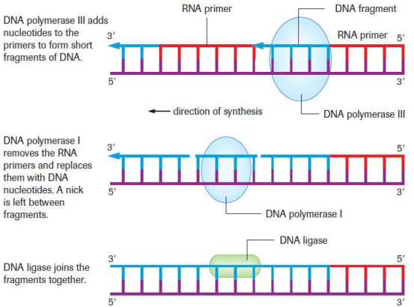
Elongation

Slide 14
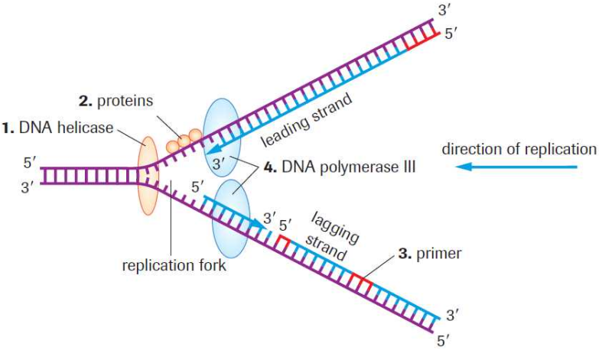
DNA Replication

Slide 15
Termination
Termination: The completion of the new DNA strands and the dismantling of the enzymes
http://www.freesciencelectures.com/video/dna-replication-process/

Slide 16
Sequencing Genes
DNA sequencing: the process of identifying the precise nucleotide of a DNA fragment
The Human Genome Project (completed in 2003):
Why is this important?
http://abcnews.go.com/Archives/video/human-genome-map-dna-10190454

Slide 17
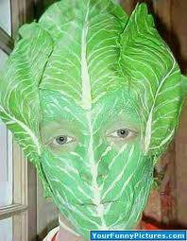
Why am I not a piece of lettuce?
When you eat food you do not take on the traits of the foods’ DNA
Digestive system breaks
down the cells
You use the nucleotides
from the food you eat to
make your own DNA

Slide 18
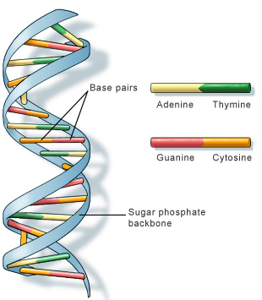
To Do
Page 663 – Building a DNA Model
Page 666 - #1-7
Read Section 20.3

