Slide 1
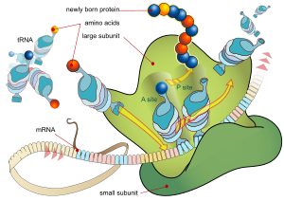
PART 3 - Protein Synthesis and Gene Expression

Slide 2
Remember…
What are the differences between DNA and RNA??
RNA is single-stranded
RNA has uracil instead of thymine
RNA has ribose as its sugar, instead of deoxyribose (DNA)

Slide 3
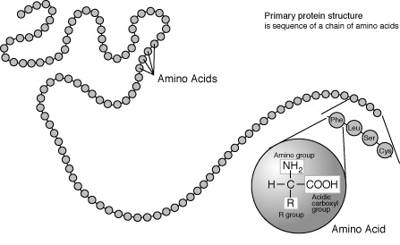
Amino Acids
Frederick Sanger
established that proteins
consist of a sequence of
molecules called amino acids.
This sequence determines the type of proteins a cell will manufacture and ultimately determines the function and development of the cell

Slide 4
Quick Review of Proteins
Proteins are made of amino acids
Humans only have 20 amino acids
We get amino acids from our food

Slide 5
The Genetic Code
Sequence of DNA nucleotides code for certain amino acids
Amino acids make up proteins
Proteins determine structure, function and development of cells
How is DNA turned into protein?
TRANSCRIPTION & TRANSLATION
START AT 2:50

Slide 6
What does it mean to…
Transcribe?
Translate?

Slide 7
Transcription & Translation
Transcription: the process of DNA being copied into RNA
Takes place in the nucleus (eukaryotic cells)
Translation: mRNA (messenger RNA) nucleotide sequence directs the synthesis of a polypeptide with the aid of tRNA (transfer RNA)
Occurs in the cytoplasm of the cell

Slide 8
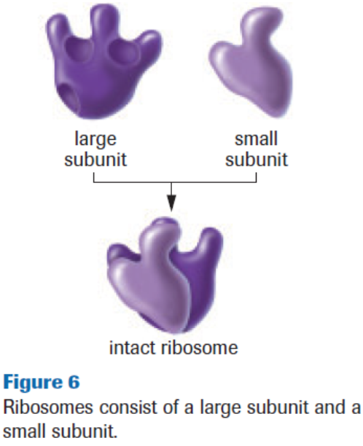
Translation
Ribosomes are the site
of translation.
Composed of two
subunits (1 large &
1 small) of RNA.

Slide 9
And now the starting line-up for your Protein All-Stars!!!
#1 – DNA – Contains the gene template.
#2 – mRNA – Compliments the DNA, contains the codons.
#3 – tRNA – Compliments the mRNA, Delivers amino acids to the ribosome.
#4 – Ribosome – Composed of large and small subunits of rRNA, site of translation.
#5 – Amino Acids – Building blocks of proteins, different sequences = different functions.

Slide 10
Transcription & Translation

Slide 11
The Genetic Code
3 Important Characteristics of The Genetic Code:
1. Redundant: several codons may code for the same amino acid
Ex. 3 codons are stop signals
2. Continuous: reads in a series of three-letter codons without any spaces
3. Universal: all living organisms build proteins with these codons

Slide 12
Transcription – In Depth
GOAL: make messenger RNA
A segment of DNA is copied in to mRNA using RNA Polymerase
Occurs in the nucleus of a cell
Only one strand of DNA (the anti-sense or template strand) is transcribed into mRNA

Slide 13
Transcription – In Depth
RNA polymerase binds to a specific sequence of nucleotides known as the promoter
DNA unwinds
RNA polymerase opens the DNA and works its way in the 5’-3’ direction to create an mRNA strand that is complementary to the antisense strand
T is replaced by U
DNA that is synthesized recoils
RNA polymerase will eventually meet the stop sequence and detach from the DNA
INITIATION
Elongation
Termination

Slide 14
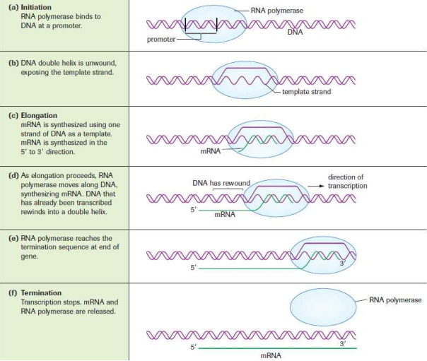

Slide 15
To Do
http://www.youtube.com/watch?v=ztPkv7wc3yU
Page 669 #1,2

Slide 16
From Transcription to Translation
Main purpose of RNA:
Protein synthesis!
The mRNA carries genetic information from DNA in the nucleus through pores in the nuclear membrane (in eukaryotic cells) to the cytoplasm which is the site of protein synthesis.

Slide 17
From Transcription to Translation
Now…
The mRNA must be read and a protein can be made from the instructions
http://www.youtube.com/watch?v=NJxobgkPEAo

Slide 18
Translation – In Depth
In order to create proteins, the mRNA codons are translated into amino acids
Once the mRNA reaches the cytoplasm it binds with an active mRNA complex (rRNA)
tRNA binds an anticodon with each codon; once fused these pairings create amino acids
The first amino acid will always be methionine
Amino acids will be added to the chain until the stop codon is reached
INITIATION
ELONGATION
TERMINATION

Slide 19
Translation – In Depth

Slide 20
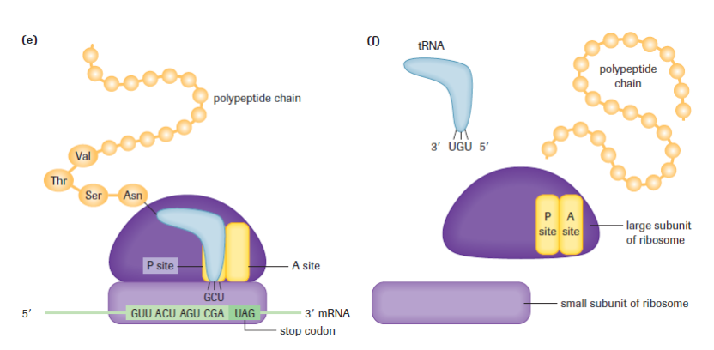
Translation – In Depth

Slide 21
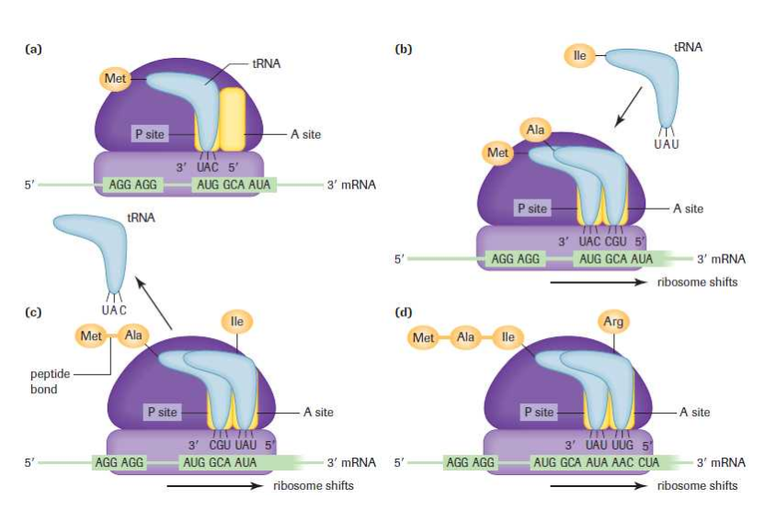
Translation – In Depth

Slide 22
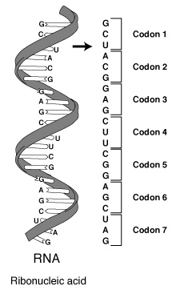
From RNA to Protein...
Every three nucleotides of mRNA is called a codon.
Codons identify the correct amino acid to fit in sequence.
Codon: each set of 3 bases
Always the mRNA bases not the DNA bases

Slide 23
Codons (See Codon Table Handout)
Start codon:
Specific codon that signals the start of translation
(AUG)
Codes for A.A. Methionine
Stop codon:
Specific codon that signals the end of translation
(UGA, UAA, UAG)
Does not code for an A.A.

Slide 25
Translation – In Depth
Procedure
1. Copy each of the sequences onto a separate piece of paper. (Hint: Turn your paper so you can write the sequence out along the horizontal length of the paper. Leave room below each sequence to write your mRNA sequence directly below.)
2. Divide the sequences into triplets (codons) by putting a slash between each group of three bases.
3. Transcribe the DNA into mRNA.
4. If you have multiple pieces of a strand identify the middle, end, and beginning sequence. Use your knowledge of start and stop codons to help you figure it out. (Hint: You will need to examine the codons that start and end a fragment.)
5. Watch out for strings of “dead” code. These codons are the introns, or extra codons, found in a DNA segment.
6. Translate the mRNA into protein using the genetic code.

Slide 26
Codons (See Codon Table Handout)
Try the following:
DNA Template
TACAGGTTGCGGCTTACT
mRNA
AUGUCCAACGCCGAAUGA
A.A.
Met – Ser – Asp – Ala – Glu - STOP

Slide 27
Translation – In Depth
Sequence A
CTCGCGCCGAAACTTCCCTCCTAAACGTTCAACCGGTTCTTAATCCGCCGCCAGGGCCCC
Sequence B
CGTAACAACTTGTTACAACATGGTCATAAACGTCAGATGGTCAATCTCTTAATGACT
Sequence C
TACAAACATGTAAACACACCCTCAGTGGACCAACTCCGCAACATAAACCAAACACCG

Slide 28
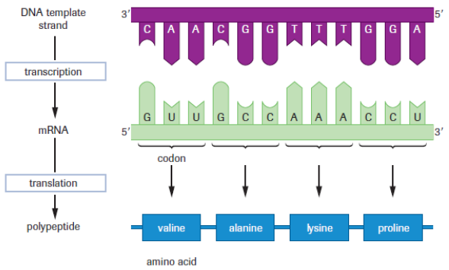
To Do
http://www.youtube.com/watch?v=NJxobgkPEAo&feature=related
Codons Practice
Page 676 #2, 4-6, 8-10
Read Section 20.4

