Slide 1
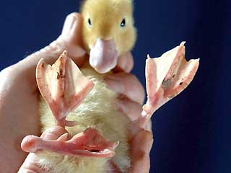
PART 4 - Mutations and Genetic Recombination

Slide 2
Restriction Enzymes
Restriction Enzymes: catalyze the cleavage of DNA at specific nucleotide sequences to form restriction fragments
Especially important for defending cells against foreign DNA
Restriction Endonucleases: A type of restriction enzyme that recognizes a target sequence within a strand of DNA and cuts the DNA at a particular restriction site
Like molecular scissors and cut double-stranded DNA at a specific base-pair sequence.

Slide 3
Restriction Enzymes
Each type of restriction enzyme recognizes a particular sequence of nucleotides that is known as its recognition site.
Most sites are 4 to 8 base pairs long and usually are palindromic. (reading the same forwards and backwards)

Slide 4
Restriction Enzymes
Sticky ends: fragment ends of a DNA molecule with short single-stranded overhangs, resulting from cleavage by a restriction enzyme
Blunt End: fragment ends of a DNA molecule that are fully base paired, resulting from cleavage by a restriction enzyme

Slide 5
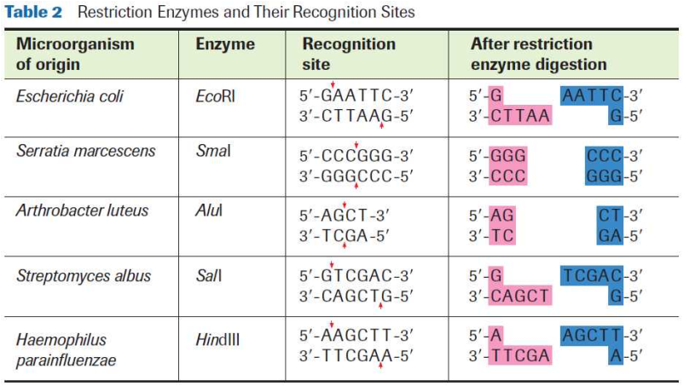
Restriction Enzymes

Slide 6
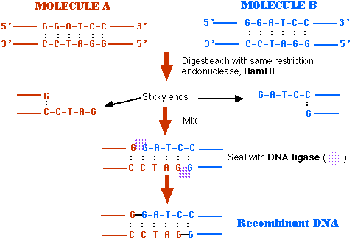

Slide 7
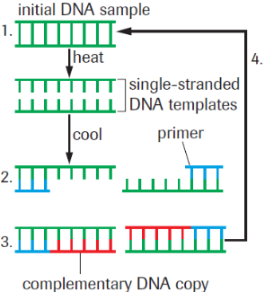
PCR & DNA Fingerprinting
http://www.youtube.com/watch?v=ZxWXCT9wVoI

Slide 8
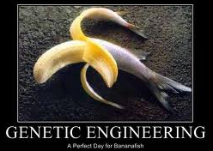
Recombinant DNA
Genetic engineering: manipulation of genetic
material to alter
genes and blend
plant, animal,
and bacterial DNA
into transgenic
organisms.

Slide 9
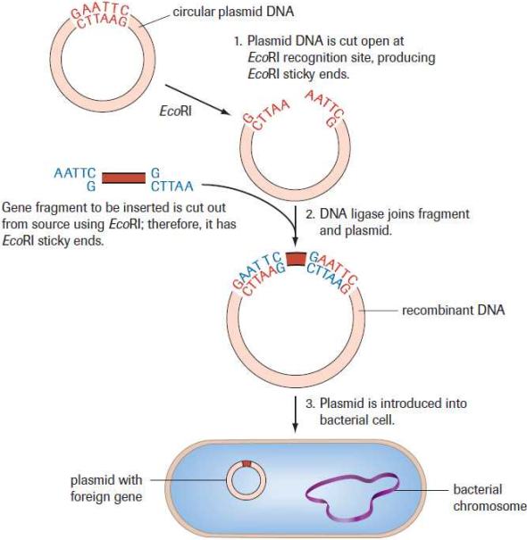
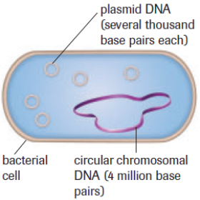
Recombinant DNA & Plasmids

Slide 10
DNA Sequencing & Species Evolution – The origin of the Eukaryotic Cell
Ancestry can be traced through mitochondrial and chloroplast DNA.
Chloroplasts and mitochondria are believed to have once been independent prokaryotic cells
According to the endosymbiont theory; they were engulfed by larger cells and have co-evolved through a mutualistic relationship

Slide 11
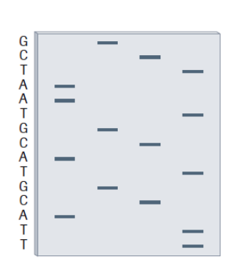
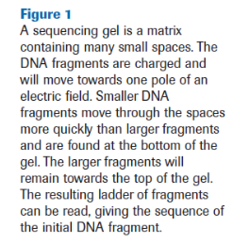
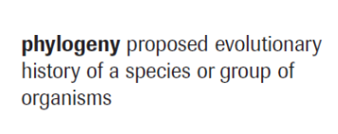
DNA Sequencing & Species Evolution
Pg. 677
The closer the evolutionary relationship of the organisms, the more similar their DNA sequences will be.

Slide 12
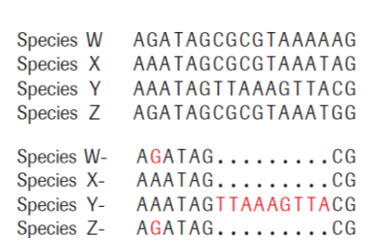
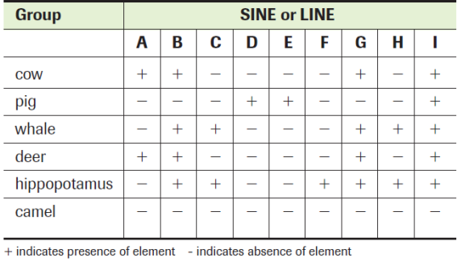
DNA Sequencing & Species Evolution
SINEs and LINEs (pg. 691) are DNA sequences that are inserted (in some cases by retroviruses) into non-coding regions but since they are passed on, can be used to trace evolutionary history of some organisms.

Slide 13
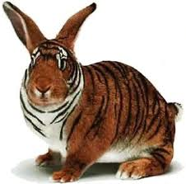
What are mutations?
Mutation: a permanent change in nitrogenous base sequence of DNA.
Inheritable
Can occur in somatic
or germ cells
May or may not change
amino acid sequence

Slide 14
Point Mutations
Point mutations – Substitution of one (or more) base pair in the DNA sequence, may or may not change amino acid that is coded for.
Usually has minor effects on the cell, if any
Ex. ‘silent mutations’ will not have any effect on the polypeptide chain
DNA: CCT to CCC
mRNA: GGA to GGG;
A.A?

Slide 15
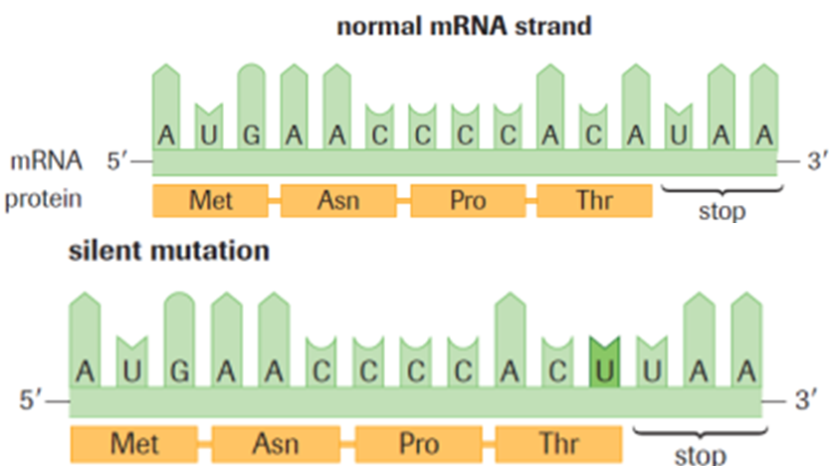
Point Mutations
Ex. silent mutation

Slide 16
Point Mutations
Ex. Hockey Substitution
Lineup looks different, still 5 players and the result is the same.
Ex. Broadway Play Star
Get’s a pipe to the knee, understudy fills in; play might look different but show goes on.

Slide 17
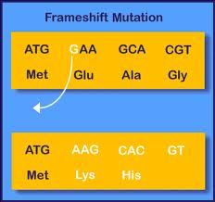
Frameshift Mutations
Frameshift mutation: can be caused by an insertion or a deletion of one or two nucleotides; which causes the reading frame of the gene to be altered.

Slide 18
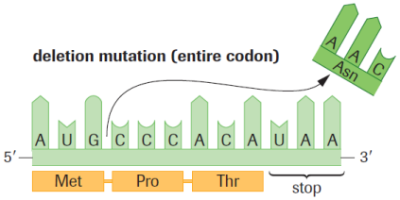
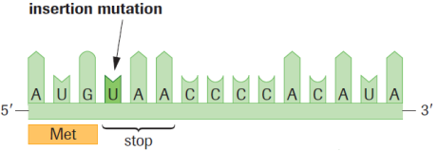
Frameshift Mutations
Deletion:
The elimination of a base pair or group of base pairs from a DNA sequence
Insertion:
The placement of an
extra nucleotide in a
DNA sequence

Slide 19
Frameshift Mutations
Ex. Hockey Power Play
Lose one player, changes how the game is played.
Ex. Broadway Play Star & their Understudy
Get pipe(s) to the knee(s), the show won’t go on.

Slide 20
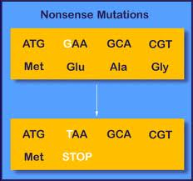
Nonsense Mutations
Nonsense mutation: gene is unable to code for a polypeptide sequence due to the deletion of the start signal or a premature stop signal

Slide 21
Missense Mutations
Missense mutation: results in an
altered protein.
Can be harmful
Ex. Sickle cell anemia
(pg. 727)
Can be useful
Ex. Bacteria develops new
antibiotic resistance

Slide 22
Gene Mutations
Gene Mutation: Changes the amino acids specified by the DNA sequence.
Have pronounced effects on cell structure/ function.

Slide 23
A Simple Guide to Genetic Mutations

Slide 24
A Simple Guide to Genetic Mutations

Slide 25
Causes of Mutations
Spontaneous
Caused by natural, molecular interactions in the cell
Ex. DNA polymerase may incorrectly pair base pairs during DNA replication
Induced
Caused by outside agents from the environment
Either: physical mutagens or chemical mutagens
Mutagen: a substance or event that increases the rate of a mutation

Slide 26
Induced Mutations
Physical Mutagens
Mutagens that cause physical changes in the structure of DNA
Ex. X-rays & gamma rays (most damaging known)
Ex. UV can cause chemical reactions between C-T pairings
Chemical Mutagens
Molecule that can enter the nucleus of a cell and interacts chemically with the DNA
Can cause nucleotide insertions or frameshifts
Can cause incorrect base pairings by inserting themselves into the DNA
Ex. Nitrites, gasoline fumes, second-hand smoke

