Slide 1
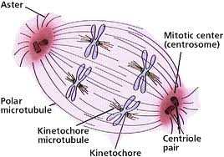
Chapter 17: Cell Division
Cellular Reproduction

Slide 2
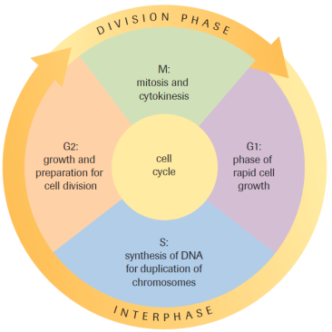
The Cell Cycle
PART 1

Slide 3
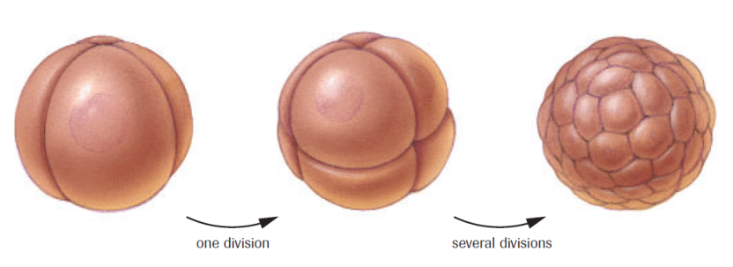
The Cell Cycle
Life cycle of a cell
Sequence of events from one cellular division to another
Length of cycle depends on cell types – many different somatic cells
Blood, skin, nerve etc.

Slide 4
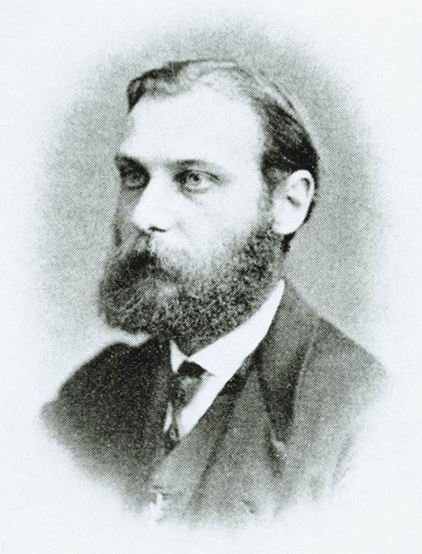
Walther Flemming (1879)
Used a dye to observe the
chromatin within the nucleus
of a cell
Described and coined the term ‘mitosis’
Mitosis: one of the two main processes in cell division; genetic material duplicated and passed from the original parent cell to the daughter cell

Slide 5
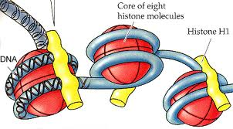
Eukaryotic Cell – DNA Organization
DNA (deoxyribonucleic acid): a molecule that governs the process of heredity in the cells of organisms; found in each chromosome
Histones: protein found in
chromosomes; acts as a scaffold
which DNA wraps around in order
to fit into the nucleus
*Interesting fact: ~3m of DNA in every eukaryotic nucleus*
To 1:43

Slide 6
Chromosome Structure
Chromosome: DNA and its associated proteins

Slide 7
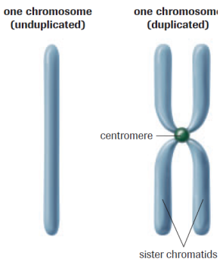
Chromosome Structure
Centromere: The specialized, constricted region in the condensed chromosome where two sister chromatids are joined.

Slide 8
Chromosome Number
Number of chromosomes varies from species to species.
Humans
46 chromosomes (23 pairs)
22 pairs of autosomes (homologous)
1 pairs of sex chromosomes (sometimes homologous)
XX – female
XY - male

Slide 9
Homologous Chromosomes
Carry the same gene at the same locus (location)
Homologous pairs are similar but NOT identical
Different alleles for the same gene
Gene: a sequence of DNA that encodes for a particular protein
Allele: different form of the same gene (ex. Eye color)

Slide 11
Diploid, Haploid and Polyploidy
Diploid: a cell that contains homologous pairs of chromosomes (human somatic cells 2n=46)
Haploid: a cell that contains unpaired chromosomes (human gametes n=23)
Polyploidy: a set of more than two homologous chromosomes (ex. n=4, n=3, n=8 etc.)
Ex. 30-80% of plant species (GMO’s)

Slide 12
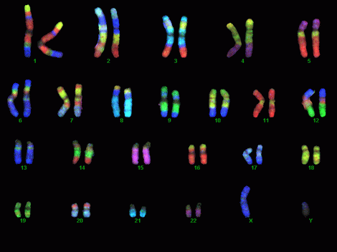
The Karyotype
Karyotype: the particular set of chromosomes that an individual possesses
Chromosomes vary in: - length
location of centromere
staining properties
Karyotype Puzzles!!!

Slide 13
Karyotype Puzzles
Puzzle A Puzzle B
Normal Male Trisomy 21 Male
Puzzle C Puzzle D
Normal Female Trisomy 18 Female
Puzzle E Puzzle F
XXX Syndrome (Females only) XXY Syndrome (Males only)
Puzzle G
Trisomy 13 Male

Slide 14
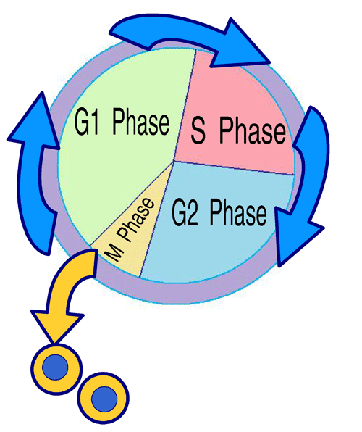
Stages of the Cell Cycle
Interphase (Growth, repair & maintenance)
G1 Phase
S Phase
G2 Phase
M Phase (Cell Division)
Mitosis
Cytokinesis

Slide 15
Interphase
Majority of Cell’s life is spent in
Interphase – growth, metabolism
G1 Phase:
Cell grows quickly (organelles
and volume)
S Phase: (Synthesis)
Chromatin replicates (DNA replication)
Sister chromatids: 2 identical chromosomes
G2 Phase:
Cell replenishes energy reserves for cell division
Manufactures proteins required for cell division

Slide 16
M Phase (Cell Division)
Two processes
Mitosis:
Genetic material and
contents of the nucleus
are divided
Cytokinesis:
Cytoplasm and organelles of the cells separate in to two

Slide 17
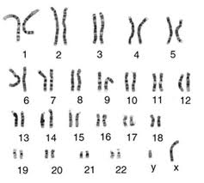
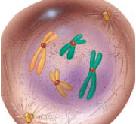
Practice
Karyotype Puzzles
Pg. 564 # 1, 10-12

Slide 18
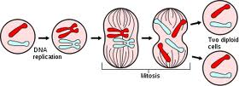
The Reproduction of Somatic Cells (Mitosis)
PART 2

Slide 19
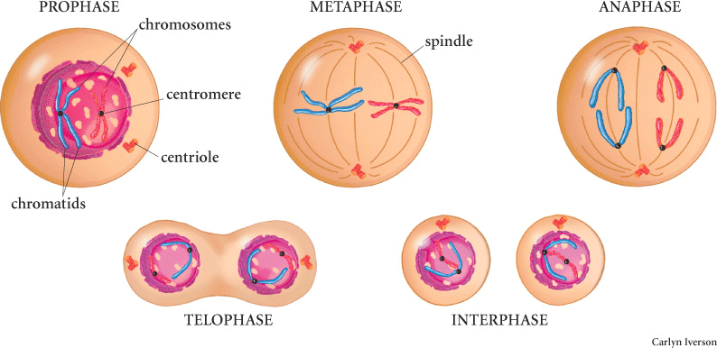
Phases of Mitosis
1) Prophase 2) Metaphase 3) Anaphase 4) Telophase

Slide 20
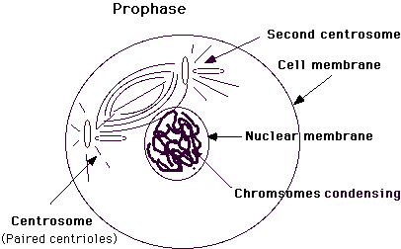
Prophase
Nuclear envelope disappears and the chromosomes are released into the cytoplasm
Centrioles move to
opposite poles of the
cells and spindle
apparatus (spindle
fibres) forms
between them

Slide 21
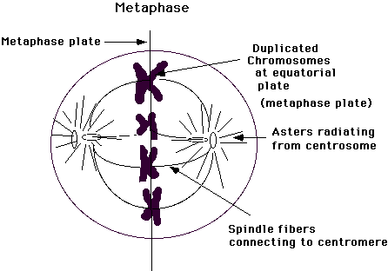
Metaphase
Spindle fibres guide the chromosomes to the equator
Spindle fibres attach the to centromeres
One sister chromatid
faces one pole and the
other faces the other
pole

Slide 22
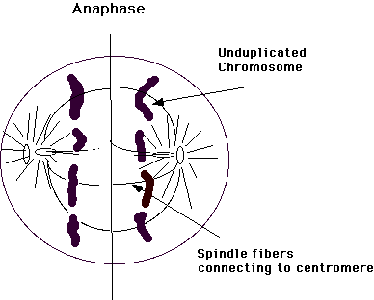
Anaphase
Each centromere splits
Spindle fibres shorten and pull sister
chromatids to
opposite poles

Slide 23
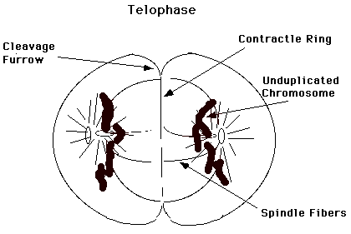
Telophase
Chromatids begin to unwind into less visible strands of chromatin
Spindle fibres break down
Nuclear envelopes
form around each
new set of
chromosomes

Slide 24
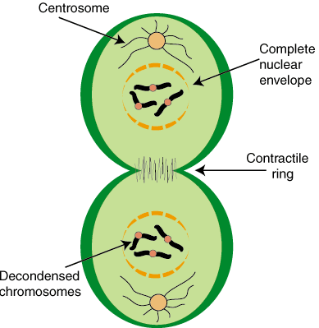
Cytokinesis
Division of the
cytoplasm and
organelles to form
two daughter cells.
Occurs during Telophase

Slide 25
Regulation of the Cell Cycle
In the human body there are ~150 billion cell divisions every day
What would happen if the wrong cells were dividing?
What would happen if cells stopped dividing?
Start and stop signals for cell division
Interferences with signals can cause the cell cycle to proceed at an uncontrolled rate
Ex. Cancerous cells

Slide 26
Practice
Mitosis Recap
Mitosis Matching & Taboo
Pg. 564 #2-9, 15
Read Section 17.3 (For Monday)

Slide 27
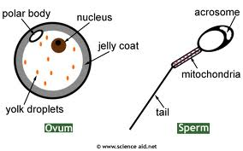
The Formation of Gametes
PART 3

Slide 28
The Formation of Gametes
Meiosis: process that produces haploid gametes from diploid cells in the ovaries and testes
A couple major differences from mitosis:
Reduction division (daughter cells have half the number of chromosomes as the parent cells)
Recombination (products of meiosis have different combinations of gene, therefore offspring are distinct from their parents)

Slide 29
Phases of Meiosis
Five Phases:
Interphase
Prophase
Metaphase
Anaphase
Telophase
Meiosis I contains all five phases, whereas Meiosis II does not have an interphase. (*purpose of the reduction division*)

Slide 30
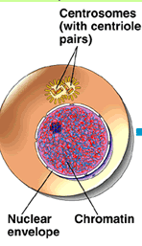
Interphase I
Similar to somatic cells
Germ cell (gamete
producing cells) grows
and synthesizes material
that is need for cell division

Slide 31
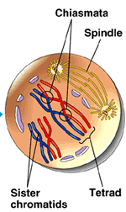
Prophase I
Homologous chromosomes
align side by side forming
synapsis
Tetrad: a pair of homologous
chromosomes (4 sister
chromatids)

Slide 32
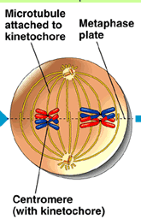
Metaphase I
Spindle fibres attach to
each centromere and pull
the tetrads towards the
equator as homologous
pairs
How is this different
from mitosis?

Slide 33
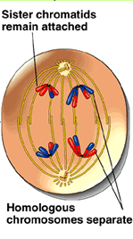
Anaphase I
Spindle fibres shorten,
causing homologous
chromosomes to separate
and move to opposite
poles of the cell.

Slide 34
Telophase I
Some cells do and some cells don’t
Homologous chromosomes uncoil
Spindle fibres disappear
Nuclear envelope forms around each group (now haploid)
NO REPLICATION
before meiosis II

Slide 35
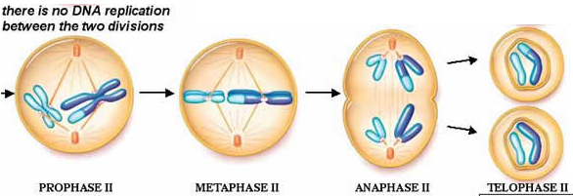
Meiosis II
Similar to mitosis:
Prophase II
Metaphase II
Anaphase II
Telophase II

Slide 36
Sources of Genetic Recombination
Mitosis
Identical to parent
Meiosis
Genetically distinct from parents
One homologous pair from the egg (maternal)
One homologous pair from the sperm (paternal)

Slide 37
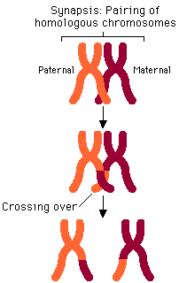
Sources of Genetic Recombination
Crossing over: occurs during
Prophase I; non-sister chromatids
exchange pieces of chromosome
Can occur at several points along the non-sister chromatids.

Slide 38
Sources of Genetic Recombination
Independent Assortment: occurs during Metaphase I / Anaphase I; paternal and maternal chromosomes, of a homologous pair move, to opposite poles.
Each pair is independent from all other pairs
Resulting in a mixture of paternal and maternal chromosomes in the daughter cells.

Slide 39
Independent Assortment
Red = Paternal
Blue = Maternal

Slide 40
Non-disjunction
Occurs during Anaphase I or II
Chromosomes or chromatids DO NOT separate as they should during meiosis
Gametes either have too few OR too many chromosomes

Slide 42
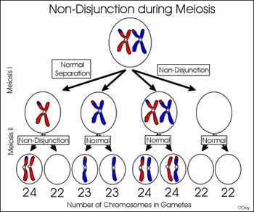
Non-disjunction
Anaphase I: homologous chromosomes DO NOT separate (pulled to the same pole)
Anaphase II: sister
chromatids DO NOT
separate (pulled to same
pole)

Slide 43
Non-disjunction
Can result in:
Monosomy:
one chromosome is lost
Example: Turner’s syndrome (female with only one X chromosome)
Trisomy:
Gain an extra chromosome
Example: Down syndrome

Slide 44
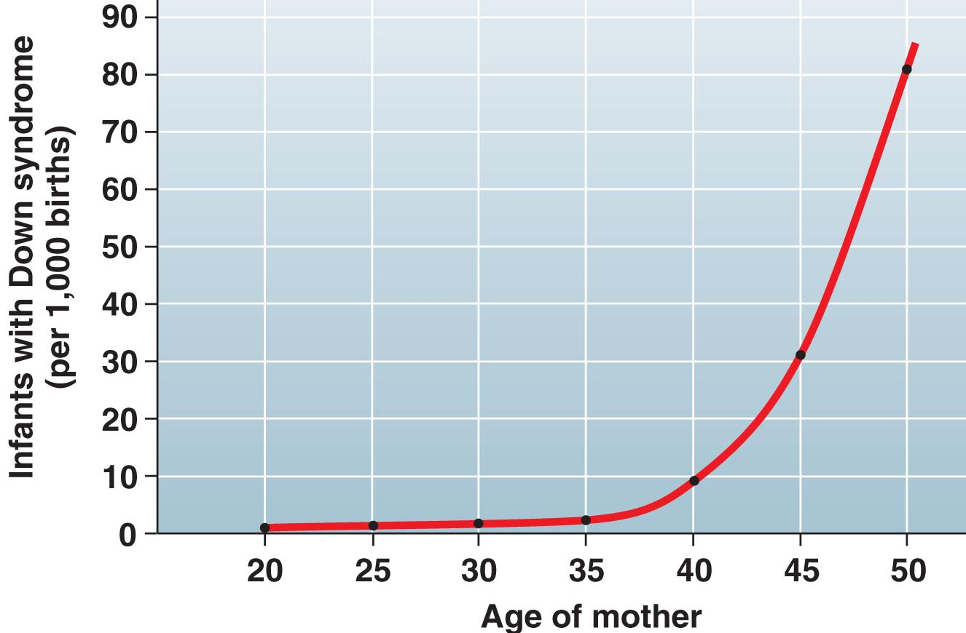
Non-disjunction
**Chances of non-disjunction increase with age**
Example
Trisomy 21 probabilities (women’s age):
1/1490 (20-24yrs.)
1/106 (40yrs.)
1/11 (49yrs.)

Slide 45
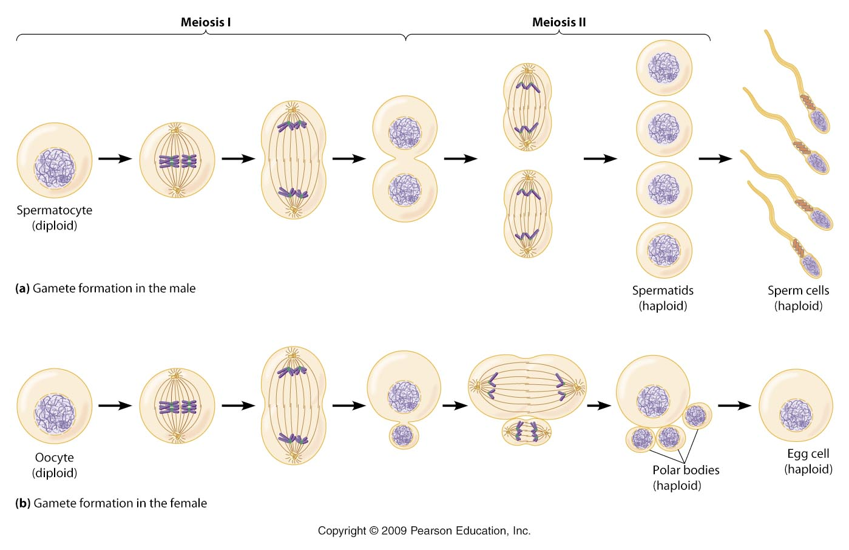
Gamete Formation (animals)
Spermatogenesis
Meiosis takes place in the testes
Oogenesis
Meiosis takes place in the ovaries

Slide 46
Gamete Formation (animals)

Slide 47
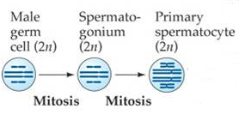
Spermatogenesis
Step One
Spermatogonium (diploid germ cell) is stimulated to divide at puberty through mitosis
Why does it divide through mitosis? One replenishes spermatogonium population and the other becomes a primary spermatocyte

Slide 48
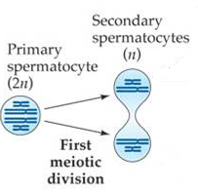
Spermatogenesis
Step Two
Primary spermatocyte
undergoes Meiosis I to
produce TWO secondary
spermatocytes

Slide 49
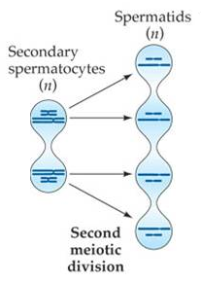
Spermatogenesis
Step Three
The two secondary
spermatocytes undergo
Meiosis II and form
FOUR spermatids.

Slide 50
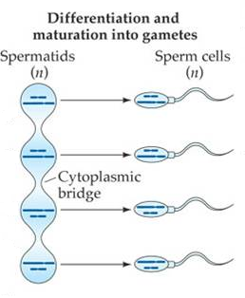
Spermatogenesis
Step Four
Spermatids grow and
mature into functional
sperm

Slide 51
Spermatogenesis

Slide 52
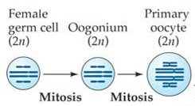
Oogenesis
Step One
Oogonium (diploid germ cell) divides through mitosis in to TWO primary oocytes
Interesting fact: 3months following conception, there are ~3 million oocytes stuck in prophase I until puberty

Slide 53
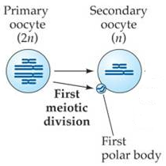
Oogenesis
Step Two
Every month after puberty,
a primary oocyte undergoes
Meiosis I and develops a
secondary oocyte and the
first polar body

Slide 54
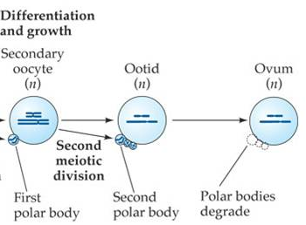
Oogenesis
Step Three
Secondary oocyte undergoes Meiosis II (part one) to produce a mature egg (ovulation) and the second polar body
**Mature egg stuck in metaphase II until fertilization.**

Slide 55
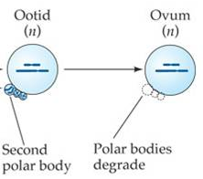
Oogenesis
Step Four
Fertilization causes ovum to complete meiosis II
Interesting Fact: ~400 gametes are produced in a women’s lifetime (from puberty to menopause)

Slide 56
Oogenesis

Slide 57
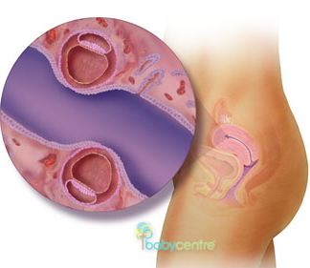
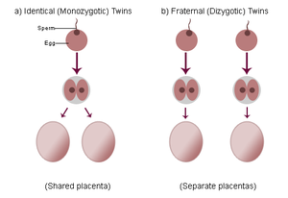
Conception of Twins
Fraternal twins:
Two oocyte are release,
fertilized and implanted
successfully.
Identical twins:
Blastocyst divides into two
separate bodies in the first
few days of development.

Slide 58
Conception of Twins

Slide 59
Assignment
Compare and contrast the steps of meiosis and mitosis.
Include:
Steps in each process; How are they similar? How do they differ?
What type of cells undergo mitosis and what types of cells undergo meiosis? Speculate why.

Slide 60
Reproductive Strategies
Topic 16.4

Slide 61
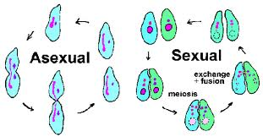
Types of Reproduction
Sexual reproduction: the union of gametes; produces genetically distinct offspring
Asexual reproduction: requires only one parent and no gametes; produces genetically identical offspring

Slide 62
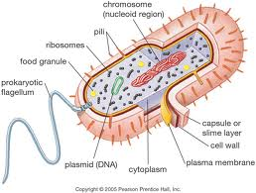
Prokaryotes
Single-celled,
circular DNA and
no nucleus
Use binary fission to reproduce, giving rise to genetically identical offspring.
Use conjugation to reproduce, can lead to new genetic combination.

Slide 63
Reproduction in Prokaryotes
Binary Fission
Conjugation

Slide 64
Asexual Reproduction
Many types (most common in plants):
Budding: miniature version of the parent plant grows off the parent’s body
Vegetative reproduction: occurs in plants
ex. Strawberry and runners
Fragmentation (aka cuttings): portion of parent plant removed and replanted
Parthenogenesis: unfertilized eggs develop into adults; ex. Honey bees
Spore: genetic info and cytoplasm contained in a coat which will break down in favourable conditions

Slide 65
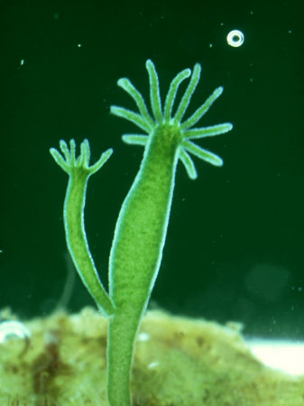
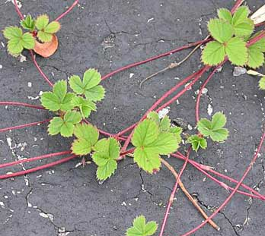
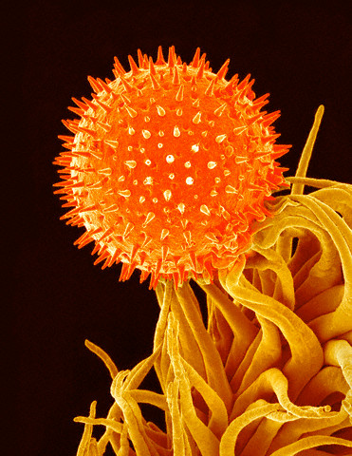
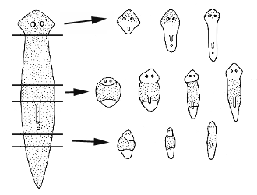
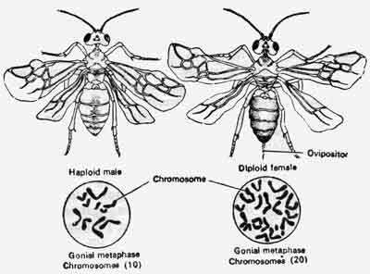
Asexual Reproduction

Slide 66
Alternation of Generations
Life cycle of plants can consist of two generations;
A haploid generation (gametophyte)
A diploid generation (sporophyte)
The sporophyte undergoes meiosis to produce haploid spore(s)
Each spore grows into plant body (gametophyte)
Gametophyte produces male and female gametes which fuse and develop a diploid sporophyte

Slide 68
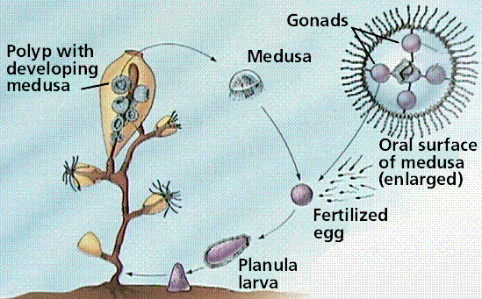
Alternation in Sexual Cycles
DO NOT CONFUSE WITH: Alternation of generation
Some animals will alternate between asexual and sexual reproducing phases
Phylum of Cnidaria

Slide 69
Pros and Cons
In your groups, compare the advantages and disadvantages of the asexual and sexual reproduction strategies which we’ve discussed.

Slide 70
Sexual Reproduction
Advantages
Disadvantages
Population is capable of adapting to environmental changes
Competition among siblings decreases because they are genetically different
Crossing over of homologous chromosomes can replace and repair damaged chromosomes
Requires more energy
Less offspring produced
Requires both parents

Slide 71
Asexual Reproduction
Advantages
Disadvantages
Occurs quickly
Doesn’t require a second parent
Less energy usually required
Maximize chances of offspring survival (ex. budding)
Don’t genetically distinct, therefore, difficulty adapting and higher rates of competition
Damaged chromosomes will be passed on

