Slide 1
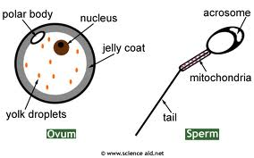
The Formation of Gametes (MEIOSIS)
PART 3

Slide 2
The Formation of Gametes
Meiosis: process that produces 4 haploid (n=23) gametes from 1 diploid (2n=46) cell in the ovaries and testes
Two unique events:
Crossing-over – Meiosis I - products of meiosis have different combinations of gene, therefore offspring are distinct from their parents.
Reduction division – Meiosis I - daughter cells have half the number of chromosomes as the parent cells.

Slide 3
Phases of Meiosis
Nine Total Phases:
Interphase
Prophase
Metaphase
Anaphase
Telophase
Meiosis I contains all five phases , whereas Meiosis II does not have an Interphase. (*purpose of the reduction division*)
Meiosis II
Meiosis I

Slide 4
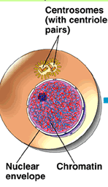
Interphase I
Similar to interphase
process in somatic cells
Germ cell (gamete
producing cells) grows,
replicates DNA (2n*), and
synthesizes material that is
needed for cell division

Slide 5
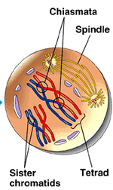
Prophase I
Homologous chromosomes
align side by side forming
Tetrads.
Tetrad: a pair of homologous
chromosomes (4 sister
Chromatids)

Slide 6
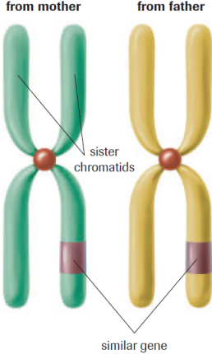
Homologous Chromosomes
This pairing of homologous chromosomes into tetrads is called Synapsis.
During Synapsis, the chromatids often intertwine. Sometimes the intertwined chromatids from different homologues break and exchange segments in a process called crossing over

Slide 7
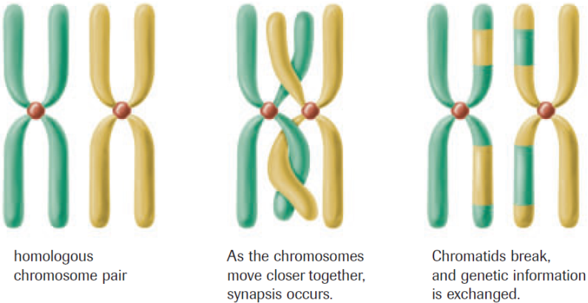
Crossing Over
(Tetrad)
Why is this process essential?

Slide 8
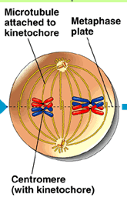
Metaphase I
Spindle fibres attach to
each centromere and pull
the tetrads towards the
equator as homologous
pairs
Independent movement of
homologous pairs is known as
Independent Assortment

Slide 9
Independent Assortment
Red = Maternal
Blue = Paternal

Slide 10
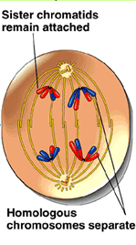
Anaphase I
Spindle fibres shorten,
causing homologous
chromosomes to separate
and move to opposite
poles of the cell.
Known as segregation

Slide 11
Telophase I
Homologous chromosomes uncoil
Spindle fibres disappear
Nuclear envelope forms around each group
Cytokinesis occurs
NO REPLICATION
before meiosis II
(reduced from
2n to n)

Slide 12
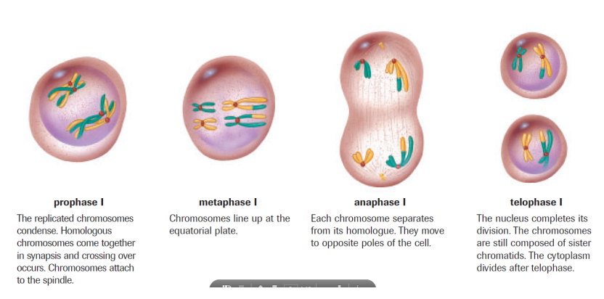
Meiosis I

Slide 13
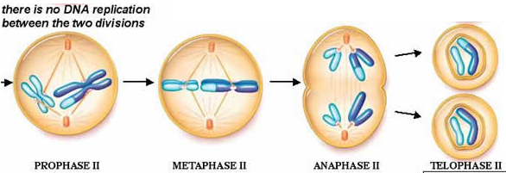
Meiosis II
Similar to mitosis:
Prophase II
Metaphase II
Anaphase II
Telophase II

Slide 14
Prophase II
Centrioles move to
opposite poles of the
cells and spindle
apparatus (spindle
fibres) forms
between them

Slide 15
Metaphase II
Spindle fibres guide the chromosomes to the equator
Spindle fibres attach to the
centromeres
One sister chromatid faces one
pole and the other faces the
other pole

Slide 16
Anaphase II
Each centromere splits
Spindle fibres shorten
and pull sister
chromatids to
opposite poles

Slide 17
Telophase II
Homologous chromosomes uncoil
Spindle fibres disappear
Nuclear envelope forms around
each group
Cytokinesis occurs
Result = 4 haploid (n) gametes

Slide 18
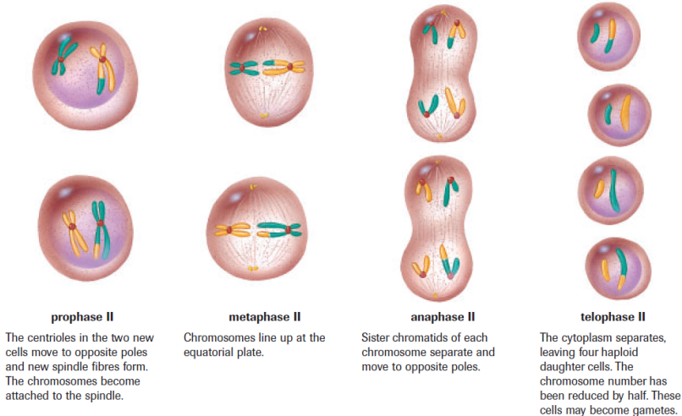
Meiosis II

Slide 19
Cell Division Comparison
Mitosis
Somatic (body) cells
2 diploid (2n) cells
Identical to parent (clone cells)
Meiosis
Gametes
4 haploid (n) cells
Genetically distinct from parents
One homologous pair from the egg (maternal = mom)
One homologous pair from the sperm (paternal = dad)

Slide 20
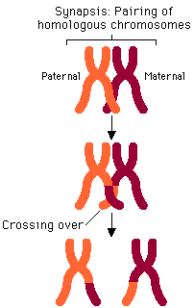
Sources of Genetic Variation
Crossing over: occurs during
Prophase I; non-sister (from
different parents) chromatids
exchange pieces of chromosome
Can occur at several points
Along the non-sister
chromatids.

Slide 21
Sources of Genetic Recombination
Independent Assortment: occurs during Metaphase I; paternal and maternal chromosomes, of a homologous pair, move to opposite poles.
Each pair is independent from all other pairs
Resulting in a mixture of paternal and maternal chromosomes in the daughter cells.

Slide 22
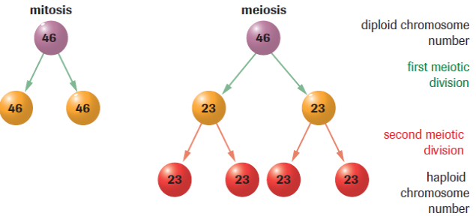
Mitosis vs. Meiosis

Slide 23
Practice
Meiosis Recap
Pg. 575 # 2-6
Pg. 578 # 7
Pg. 581 #1-4
Mitosis/Meiosis Matching & Taboo
Read pg. 578-580

