Slide 1
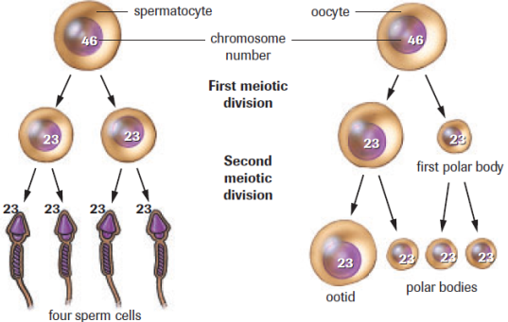
Gamete Formation (animals)
Spermatogenesis
Meiosis takes place in the testes
Oogenesis
Meiosis takes place in the ovaries

Slide 2
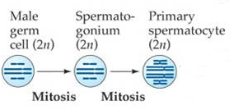
Spermatogenesis
Step One
Spermatogonium (diploid germ cell) is stimulated to divide at puberty through mitosis
Why does it divide through mitosis?
Notes:
One replenishes spermatogonium population and the other becomes a primary spermatocyte

Slide 3
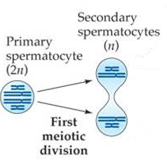
Spermatogenesis
Step Two
Primary spermatocyte
undergoes Meiosis I to
produce TWO secondary
spermatocytes

Slide 4
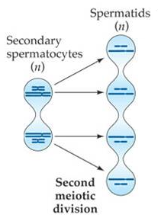
Spermatogenesis
Step Three
The two secondary
spermatocytes undergo
Meiosis II and form
FOUR spermatids.

Slide 5
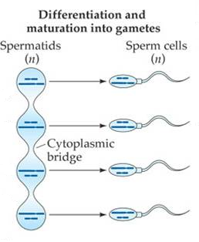
Spermatogenesis
Step Four
Spermatids grow
and mature into
functional sperm

Slide 6
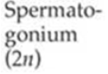
Spermatogenesis
Why does it divide through mitosis?

Slide 7
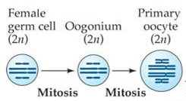
Oogenesis
Step One
Oogonium (diploid germ cell) divides through mitosis in to TWO primary oocytes
Interesting fact: 3 months following conception, there are ~3 million oocytes stuck in prophase I until puberty

Slide 8
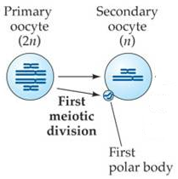
Oogenesis
Step Two
Every month after puberty,
a primary oocyte undergoes
Meiosis I and develops a
secondary oocyte and the
first polar body

Slide 9
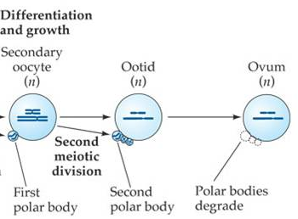
Oogenesis
Step Three
Secondary oocyte undergoes Meiosis II (part one) to produce a mature egg or Ootid (released during ovulation) and the second polar body
**Mature egg stuck in metaphase II until fertilization.**

Slide 10
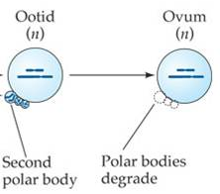
Oogenesis
Step Four
Fertilization causes Ovum to complete meiosis II
Interesting Fact: ~400 gametes are produced in a women’s lifetime (from puberty to menopause)

Slide 11
Oogenesis

Slide 12
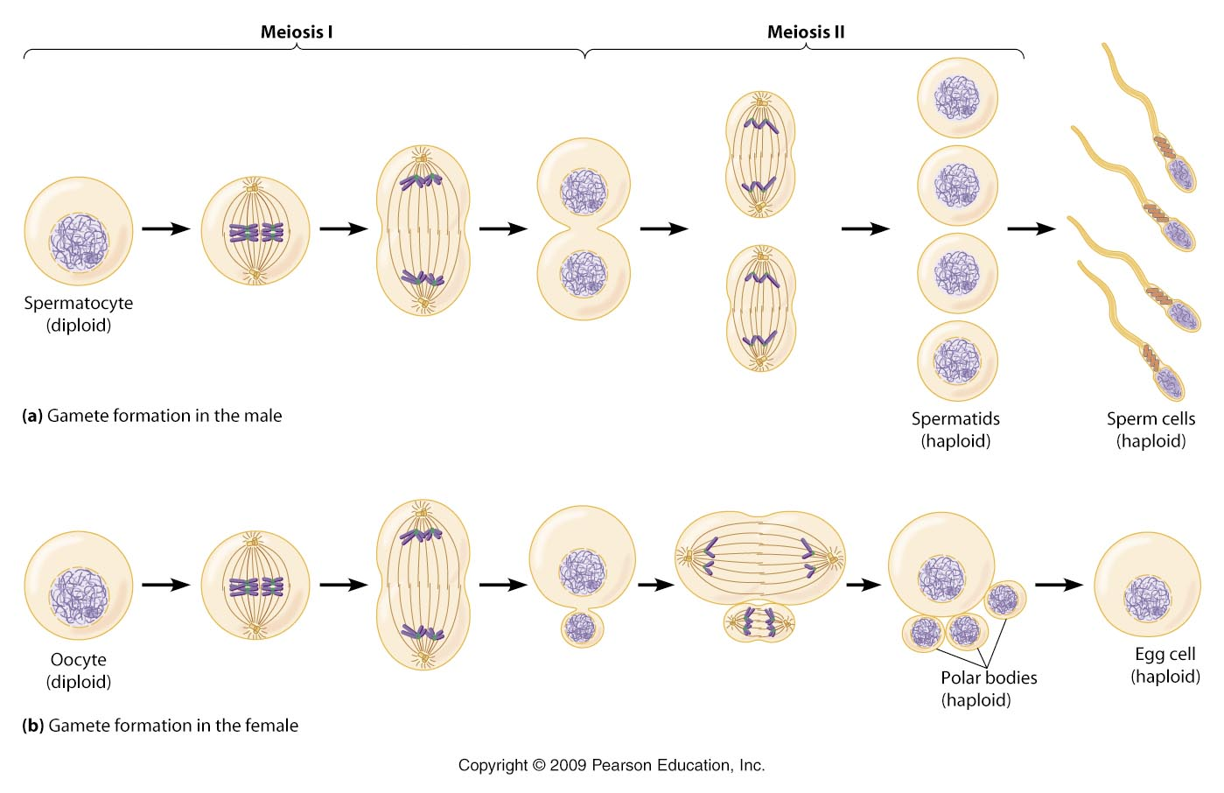
Gamete Production Recap!

Slide 13
Gamete Production Recap!

Slide 14
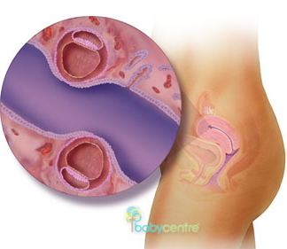
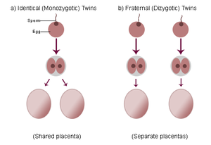
Conception of Twins
Fraternal (dizygotic) twins:
Two oocytes are release,
fertilized and implanted
successfully.
Identical (monozygotic)
twins:
Blastocyst divides into two
separate bodies in the first
few days of development.

Slide 15
Conception of Twins

Slide 16
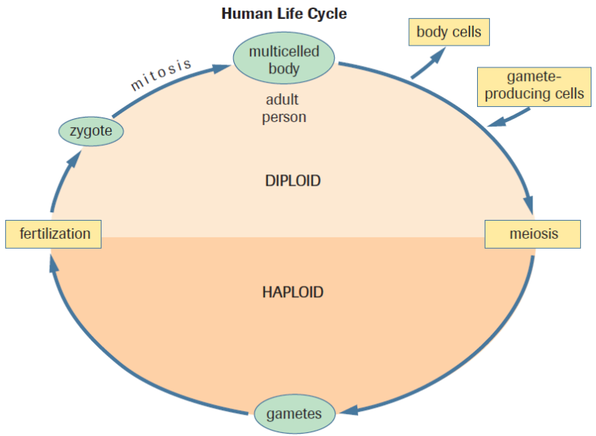
Practice
Pg. 581 # 5, 6, 8-10
Mitosis/Meiosis Matching & Taboo

