Slide 1
ABNORMAL MEIOSIS & Reproductive Strategies
PART 4

Slide 2
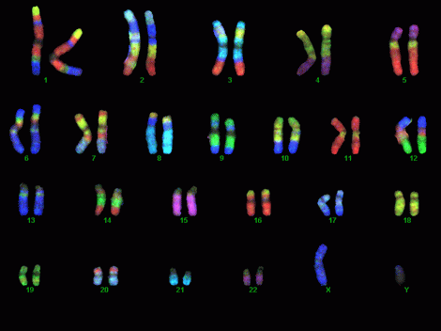
The Karyotype
Karyotype: the particular set of chromosomes that an individual possesses
Can be used to diagnose chromosomal abnormalities
Karyotype Puzzles!!!

Slide 3
Non-disjunction
Occurs during Anaphase I or II
Chromosomes or chromatids DO NOT separate as they should during meiosis
Gametes either have too few OR too many chromosomes.
Can result in missing chromosomes or polyploidy related disorders

Slide 4
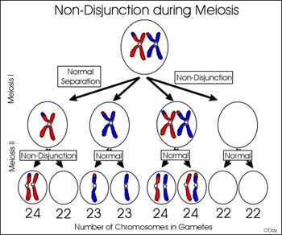
Non-disjunction
Anaphase I: homologous chromosomes DO NOT separate (pulled to the same pole)
Anaphase II: sister
chromatids DO NOT
separate (pulled to
same pole)

Slide 6
Non-disjunction
Can result in:
Monosomy:
one (of the two) chromosomes is lost
Ex: Turner’s syndrome - female with only one X chromosome
Trisomy:
Gain an extra chromosome (now 3)
Ex: Down’s syndrome – male or female with extra 21st chromosome

Slide 7
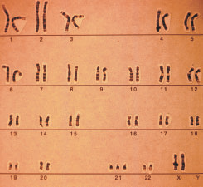
Ex. Trisomy 21 – Down’s Syndrome

Slide 8
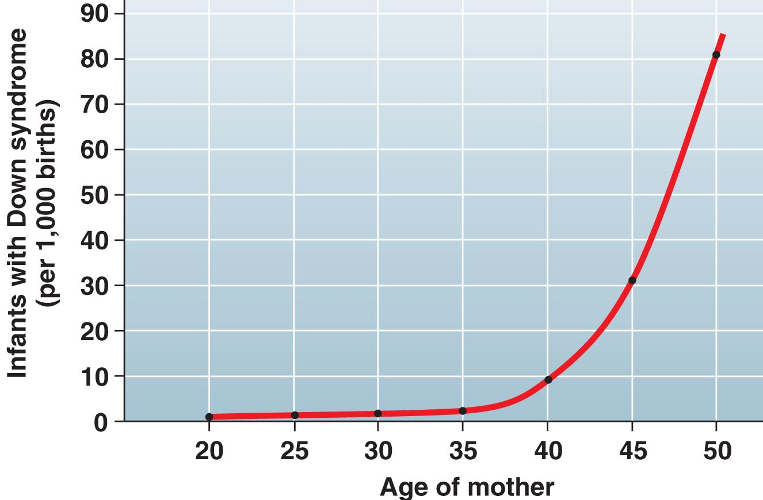
Non-disjunction
**Chances of non-disjunction increase with age**
Example
Trisomy 21 probabilities (women’s age):
1/1490 (20-24yrs.)
1/106 (40yrs.)
1/11 (49yrs.)

Slide 9
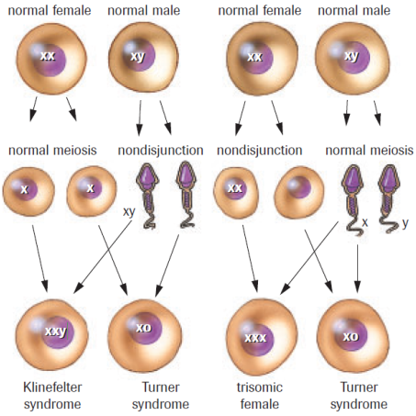
Non-disjunction
*Phone Search

Slide 10
Disorders
Choose 2-3 and do some quick research on your phone. Record the effects of each disorder and be prepared to share. Trisomy 21 (Down Syndrome) – extra 21 Trisomy 18 (Edwards Syndrome) – extra 18 Trisomy 13 (Patau Syndrome) – extra 13 (Kleinfelters Syndrome) – extra X chromosome (XXY) (Turner’s) – missing a sex chromosome (XO) (Super Male) – extra Y chromosome (XYY) XXX Syndrome – extra X (women only)

Slide 11
Karyotype Puzzles
Puzzle A Puzzle B
Normal Male Trisomy 21 Male
Puzzle C Puzzle D
Normal Female Trisomy 18 Female
Puzzle E Puzzle F
XXX Syndrome (Females only) XXY Syndrome (Males only)
Puzzle G
Trisomy 13 Male

Slide 12
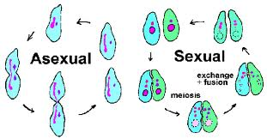
Types of Reproduction
Sexual reproduction: the union of gametes; produces genetically distinct offspring
Asexual reproduction: requires only one parent and no gametes; produces genetically identical offspring

Slide 13
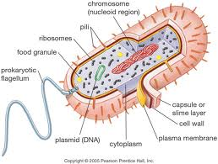
Prokaryotes
Single-celled,
circular DNA and
no nucleus
Use binary fission to reproduce, giving rise to genetically identical offspring.
Use conjugation to reproduce, can lead to new genetic combination.

Slide 14
Reproduction in Prokaryotes
Binary Fission
Conjugation

Slide 15
Asexual Reproduction
Many types (most common in plants):
Budding: miniature version of the parent plant grows off the parent’s body
Vegetative reproduction: occurs in plants
ex. Strawberry and runners
Fragmentation (aka cuttings): portion of parent plant removed and replanted
Parthenogenesis: unfertilized eggs develop into adults; ex. Honey bees
Spore: genetic info and cytoplasm contained in a coat which will break down in favourable conditions

Slide 16
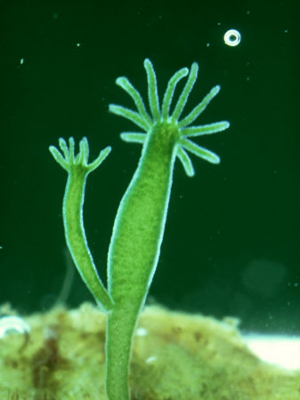
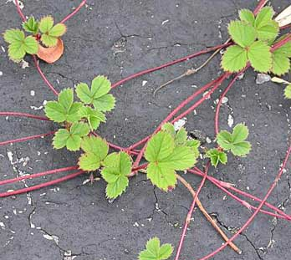
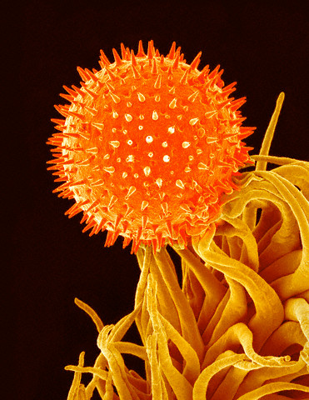
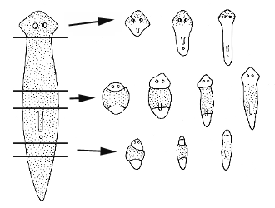
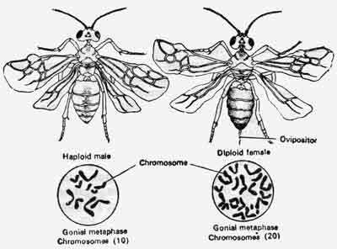
Asexual Reproduction

Slide 17
Alternation of Generations
Life cycle of plants can consist of two generations:
A haploid generation (gametophyte)
A diploid generation (sporophyte)
The sporophyte undergoes meiosis to produce haploid spore(s)
Each spore grows into plant body (gametophyte)
Gametophyte produces male and female gametes which fuse and develop a diploid sporophyte

Slide 18
Alternation of Generations

Slide 19
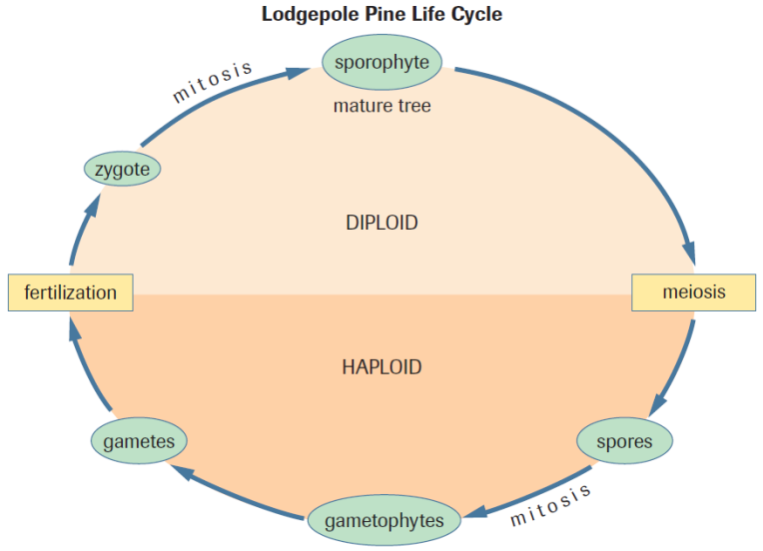

Slide 20
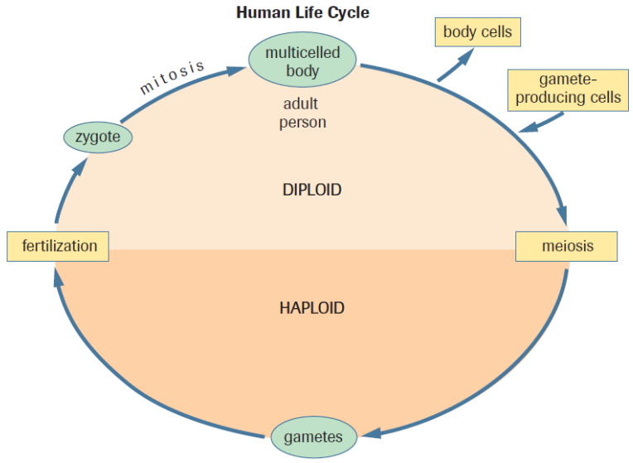

Slide 21
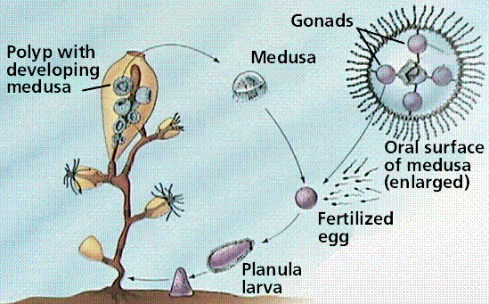
Alternation in Sexual Cycles
DO NOT CONFUSE WITH: Alternation of generation
Some animals will alternate between asexual and sexual reproducing phases
Phylum of Cnidaria

Slide 22
Pros and Cons
In groups (2-3 ppl), compare the
advantages and disadvantages of the
asexual and sexual reproduction
strategies which we’ve discussed.

Slide 23
Sexual Reproduction
Advantages
Disadvantages
Population is capable of adapting to environmental changes
Competition among siblings decreases because they are genetically different
Crossing over of homologous chromosomes can replace and repair damaged chromosomes
Requires more energy
Less offspring produced
Requires both parents

Slide 24
Asexual Reproduction
Advantages
Disadvantages
Occurs quickly
Doesn’t require a second parent
Less energy usually required
Maximize chances of offspring survival (ex. budding)
Don’t genetically distinct, therefore, difficulty adapting and higher rates of competition
Damaged chromosomes will be passed on

Slide 25
Practice
Pg. 581 #7, 11
Pg. 585 Sample Exercise #1
Pg. 586 Practice #1
Pg. 586 Section 17.3 Q’s #1,2,4,6

