Slide 1
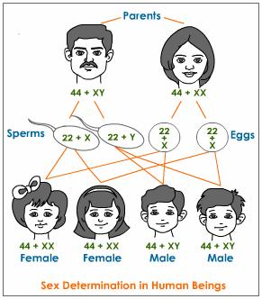
Patterns and Processes in Inheritance
Chapter 18 & 19

Slide 2
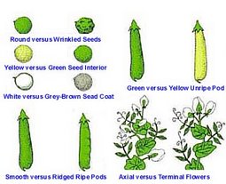
Laying Foundations & SINGLE ALLELES
PART 1A

Slide 3
Genes and Heredity
Heredity - passing of traits from parents to offspring.
Genes - units of instruction located on the chromosome that produce or influence a specific trait in the offspring.
Alleles - two or more alternate forms of a gene.
23 chromosomes containing thousands of genes inherited from mother and father

Slide 4
Selective Breeding
Choosing and breeding specific plants and animals for particular physical features or behaviours
Occurred before anyone knew anything about genes
http://www.dnatube.com/video/574/Dog-Breeding
http://animal.discovery.com/videos/dogs-101-dogo-argentino.html

Slide 5
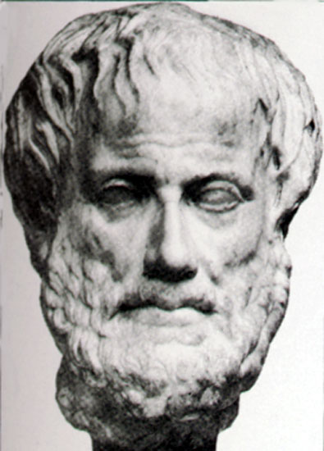
Early Theories
Aristotle
Pangenesis: the egg and sperm
contain particles from all parts of
the body and upon fertilization,
these parts will develop into
body parts

Slide 6
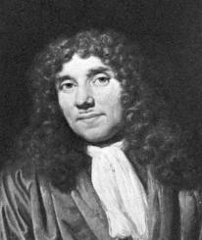
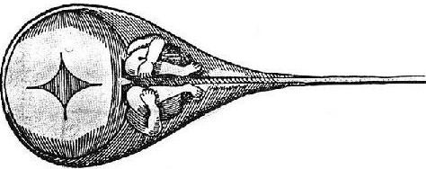
Early Theories
Antony van Leeuwenhoek
Believed the sperm contained a miniature human, or homunculus, which would develop in the mother after fertilization.

Slide 7
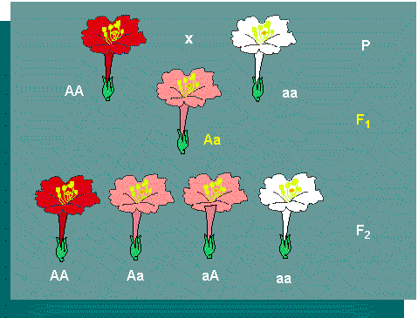
Early Theories
1800s
While breeding plants, scientists noticed that daughter plants had characteristics of both parents

Slide 8
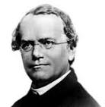
Mendelian Genetics
Gregor Mendel
1860’s
Austrian monk
Laid the foundation for genetics by observing pea plants (can self and cross-pollinate)
Pollinated plants by hand to ensure accuracy of experiments
Examined seven traits that were expressed in two distinguishable forms
http://science.discovery.com/videos/100-greatest-discoveries-shorts-genetics.html

Slide 9
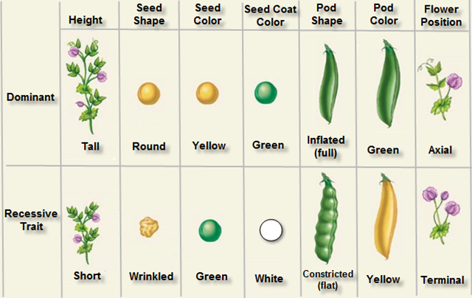
Mendelian Genetics

Slide 10
Mendelian Genetics
Mendel used self-pollination to ensure true breeding prior to conducting his experiments
True breeding: plants exhibit the same characteristics generation after generation
Why did Mendel want to ensure true breeding prior to conducting any cross-breeding trials?

Slide 11
Mendelian Genetics
P generation (parental): true breeding plants cross-pollinated with opposite characteristics
Ex. Round vs. Wrinkled seed
F1 generation: offspring from the breeding of the p generation know as the first filial generation.
F2 generation: offspring from the breeding of the F1 generation.
Monohybrid cross: cross of two individuals that differ in ONE trait.
Ex. Round vs. Wrinkled seed

Slide 12
Complete Dominance
Dominant - Determines the traits expressed in offspring (F1 generation).
NOT dependent on sex of parent that contributed it.
Recessive - The trait that is not expressed in the F1 generation (overruled by dominant).

Slide 13
Mendelian Genetics

Slide 14
The Law of Segregation
In some experiments, Mendel observed that the traits that did not appear in the F1 generation suddenly appeared in the F2 generation.
Mendel developed the Law of Segregation to describe his observations of the F2 generation monohybrid cross.
Why would this happen?

Slide 15
Law of Segregation
Points:
Discrete (individual) alleles determine individual traits
Every organism has a pair (2 copies) of alleles (one from each parent)
The pair of alleles separate via meiosis
Gametes receive one copy of each allele

Slide 16
Genetic Crosses
Alleles are represented by letters; usually the first letter of the dominant trait
Ex. peas - R = round and r = wrinkled
Genotype: the combination of alleles that an individual has (genetic info = not always observable)
RR, Rr, rr
Phenotype: the traits which a person expresses (physical traits = always observable)
Round OR wrinkled

Slide 17
Genetic Crosses
Homozygous: an individual who has two identical alleles for a trait
RR (Homozygous dominant)
OR
rr (Homozygous recessive)
Heterozygous: an individual who has two different alleles for a trait
Rr Review pg. 599

Slide 18
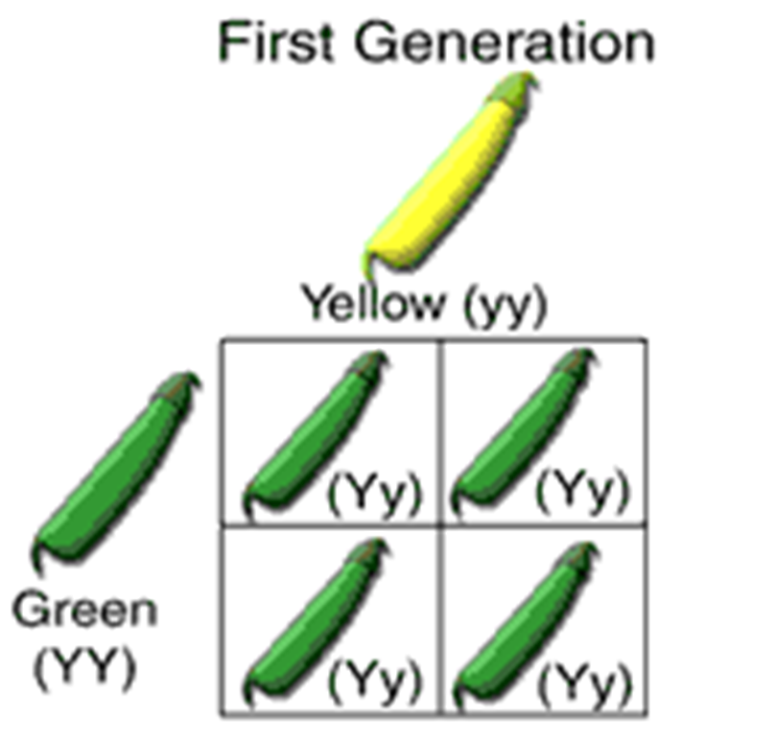
Punnett Square
A tool for analyzing crosses; by analyzing genotypes of parents, phenotypes of the offspring can be determined.

Slide 19
Using a Punnett Square
What am I being asked to find?
2. What is the dominance hierarchy?
Assign a letter to alleles (dominant gets capital, recessive is lower case)
Common letter to both
3. Determine genotypes of parents based on info. given

Slide 20
Using a Punnett Square
4. Perform Cross – using a punnett square.
Show parental genotypes and phenotypes on top and left outside edge of punnett square
Show F1 genotypes and phenotypes inside grid
5. Show ratios (genotypic and phenotypic)

Slide 21
Punnett Square Practice
Choose a trait & Determine the genotypes & phenotypes (give ratios) of the F1 generation for the 4 possible scenarios (also F2 generations for 2 and 3)
P = homozygous recessive and heterozygous
Genotypic Ratio _____ Phenotypic Ratio _______

Slide 22
Punnett Square Practice
2. P = homozygous dominant and homozygous recessive
Genotypic Ratio _____ Phenotypic Ratio _______

Slide 23
Punnett Square Practice
3. P = homozygous dominant and heterozygous
Genotypic Ratio _____ Phenotypic Ratio _______

Slide 24
Punnett Square Practice
4. P = heterozygous and heterozygous
Genotypic Ratio _____ Phenotypic Ratio _______

Slide 25
Test Cross (pg. 603)
used to figure out the unknown genotype of an organism
test organism always mated with a known homozygous recessive organism
Why?

Slide 26
Test Cross

Slide 27
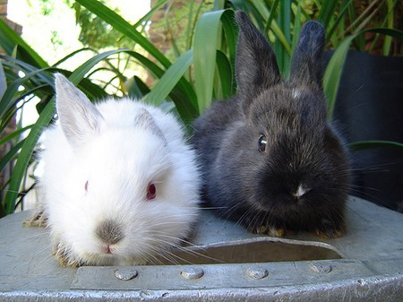
Test Cross
Black bunny x white bunny
Black = DOM, White = REC
F1 = 12 white & 12 black
Determine whether the black bunny is homozygous dominant or heterozygous for the black gene.

Slide 28
Test Cross

Slide 29
Test Cross continued...
If 50% of the offspring show the dominant trait the test organism is heterozygous
If 100% of the offspring show the dominant trait then the test organism is homozygous dominant

Slide 30
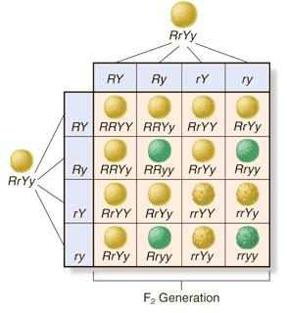
Practice
Pg. 604 #1, 2
Monohybrid Crosses Practice Worksheet
Discuss Tomorrow
Genetics Worksheet PART 1-5
Read & Complete Practice Questions

Slide 31
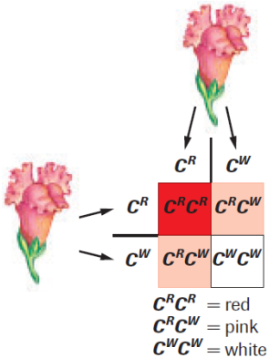
MULTIPLE ALLELES
PART 1B

Slide 32
Multiple Alleles
So far, we know that one gene can produce 3 different genotypes
Ex. RR, Rr, rr
Multiple alleles: a gene with more than two alleles
Ex. Humans and their blood types: A, B, O. Different combinations can produce 4 different phenotypes and 6 different genotypes

Slide 33
Multiple Alleles
Multiple Alleles function much like the ranking of
managers at a job:
Store Manager – in charge any time he is around (dominant over all others)
Assistant manager – in charge when manager is not around (recessive only to manager)
Department manager – in charge of (dominant over) only non-management personnel (recessive to both store managers)
You (a.k.a. Crud) – In charge when you’re the only one around ☹ (recessive to all others)

Slide 34
Multiple Alleles – Blood Types
i = O blood type and no antigen
I^{A} = A blood type and A antigen
I^{B} = B blood type and B antigen
- i recessive
- I^{A} and I^{B} are co-dominant
Therefore, anything paired with i will mask the O blood type.
I^{A} and I^{B} together will produce an AB blood type with both A and B antigens.

Slide 35
Multiple Alleles in Flies
Drosophila melanogaster “fruit fly” - eye color
Red is most common (dominant) - “wild type”
Other colors include: honey, apricot, white
Order of dominance:

Slide 36
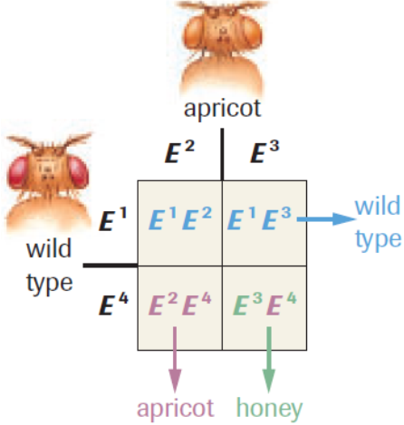
Multiple Alleles in Flies Sample Ex 1 (pg. 609)

Slide 37
Multiple Alleles in Flies Practice #1 (pg. 609)

Slide 38
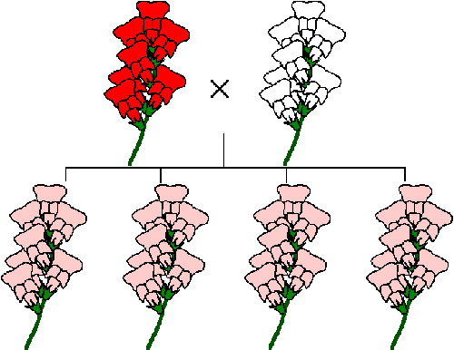
Incomplete Dominance
Called intermediate inheritance
Neither of two alleles for the same gene can completely dominate the other (equally dominant)
Interact to produce a new phenotype – pg. 609
Ex. red and white snapdragons will produce pink offspring when crossed

Slide 39
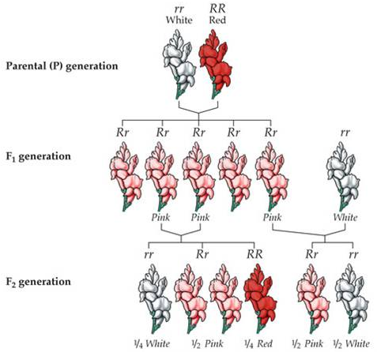
Incomplete Dominance

Slide 40
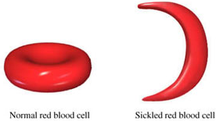
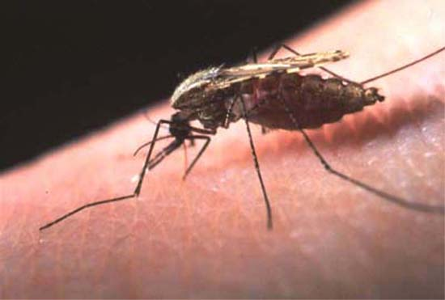
Incomplete Dominance
Sickle cell anemia in humans is a type of incomplete dominance
Hb^{A} Hb^{A} = Normal blood cells
Hb^{A} Hb^{S} = Sickle cell trait (“heterozygous advantage”)
Hb^{S} Hb^{S} = Sickle cell disease
http://video.about.com/rarediseases/Sickle-Cell-Disease.htm
http://www.youtube.com/watch?v=1fN7rOwDyMQ
http://www.youtube.com/watch?v=ujf72mjy0Bg

Slide 41
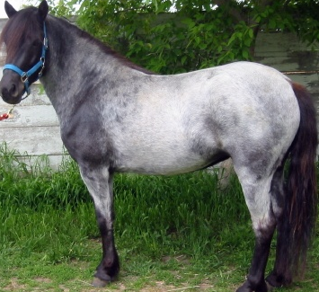
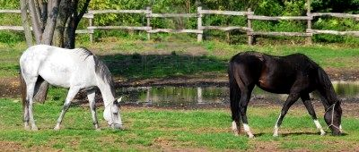
Co-dominance
Both genes are fully expressed at the same time
Page 610
Ex. Roan horse: base colour and white fully expressed in a heterozygous individual

Slide 42
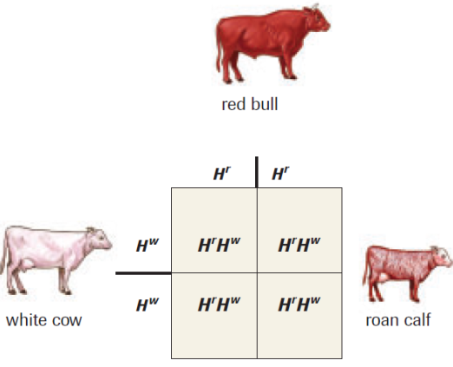
Co-dominance

Slide 43
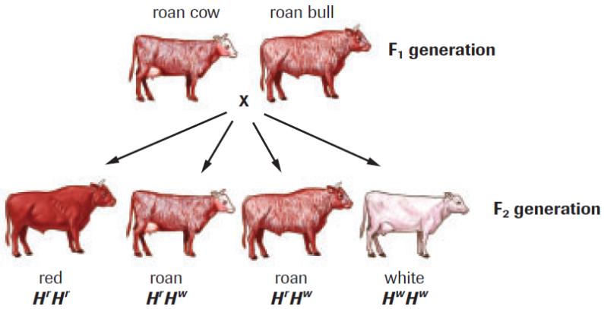
Co-dominance

Slide 44
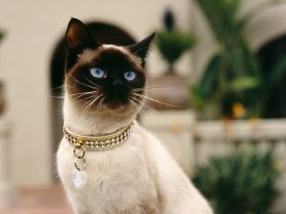
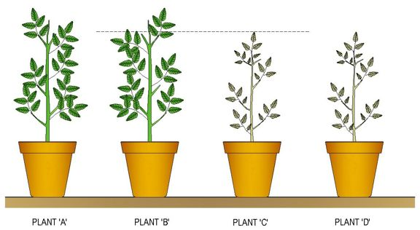
Genes and the Environment
Environmental conditions can affect the expression (phenotype) of certain traits (impossible to determine to what extent they interact with genotype)
Ex. Siamese cats - colouring genes are
only active below certain temperatures.
Ex. Height (plants & animals) - No matter what your genes
code for, you won’t reach your potential
w/o proper conditions.

Slide 45
Practice
Pg. 612 #1-3
SpongeBob CoDominance Worksheet
Discuss Tomorrow
Co & Incomplete Dominance Worksheet
- Discuss Tomorrow
Genetics Worksheet PART 7 & 8

Slide 46
DiHYBRID CROSSES (TWO TRAITS)
PART 2

Slide 47
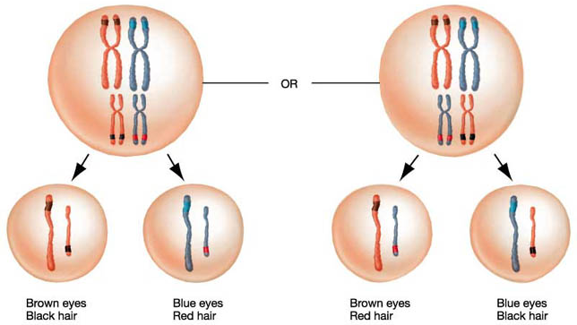
Law of Independent Assortment
Mendel’s second law of inheritance
Two alleles for the same gene will assort independently of the alleles from different genes.

Slide 48
DiHybrid Cross
Cross of two individuals that differ in two traits
Genotype combinations can be found like Algebra

Slide 49
DiHybrid Cross
Ex. Yellow, round peas x green, wrinkled peas
P1
F1

Slide 50
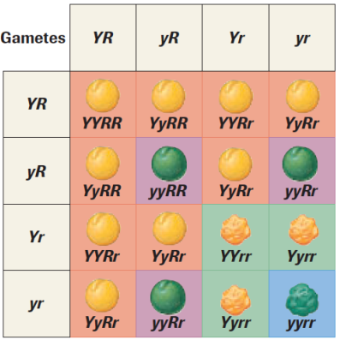
F2 - DiHybrid Cross

Slide 51
Dihybrid Cross

Slide 52
Dihybrid Cross
Make up your own dominance hierarchy for 2 traits
1. H.D, H.D X H.R, H.R.
What is the phenotypic ratio?

Slide 53
Dihybrid Cross
2. H.E, H.D. X H.R, H.D.
What is the phenotypic ratio?

Slide 54
Dihybrid Cross
3. H.E, H.E. X H.R, H.D.
What is the phenotypic ratio?

Slide 55
Dihybrid Cross
4. H.E, H.E. X H.E, H.E.
What is the phenotypic ratio?

Slide 56
Practice
Oompa Loompa
Worksheet - Discuss Tomorrow
Pg. 619 #1-3
SpongeBob Dihybrid Worksheet
Discuss Tomorrow
Mono & DiHybrid Crosses Worksheet
- Discuss Tomorrow
Genetics Worksheet PART 6

Slide 57
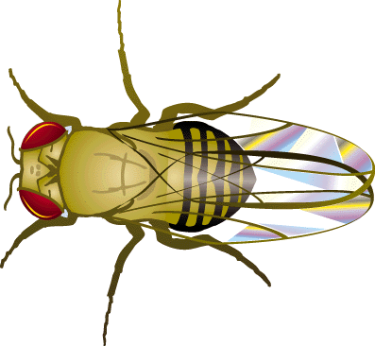
Extending Mendel’s Laws: More Patterns and Probabilities
PART 3

Slide 58
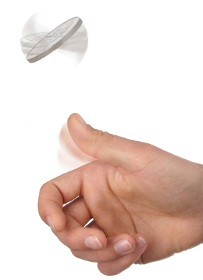
Probability
The probability of an outcome is a measure of the likelihood that the outcome will occur.
Probability may be expressed as a fraction, a decimal, or a percentage.
Probability (P) can be determined using the following formula:

Slide 59
Product Rule
Product rule - the probability of independent events happening simultaneously is equal to the product of these events occurring separately.
Ex. probability of tossing heads after two
tosses is .5 (each toss is independent of the last)
Ex. probability of tossing heads three times in a row is .5 x .5 x .5 = .125
Read pg. 482-83

Slide 60
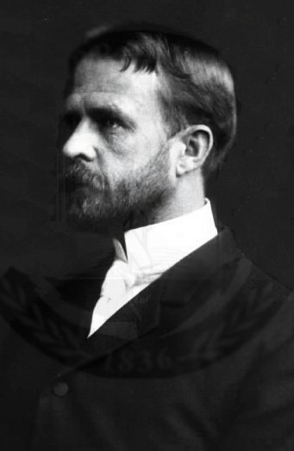
Morgan and Sex-linked Traits
Thomas Hunt Morgan
Studied: Drosophila melanogaster - Fruit flies. They reproduce quickly and have some interesting traits.
He discovered that they seemed to have a special trait that didn’t fit the normal dominant/recessive rules.
It seemed that only males ever expressed recessive white eyes.
Morgan therefore concluded that the trait must be linked to the X chromosome.

Slide 61
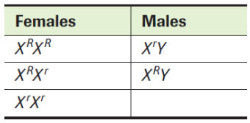
Sex-Linked Inheritance
Traits that are controlled by genes on either the Y or X
chromosomes
Example #1:
Fruit Fly Eye Color
Hierarchy

Slide 62
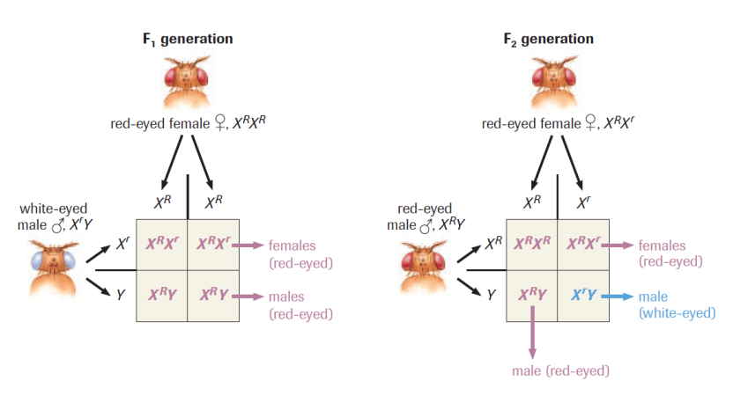
Sex-Linked Inheritance

Slide 63
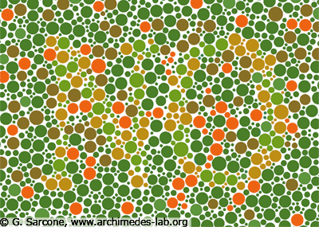
Sex-Linked Inheritance
Example #2:
Red-Green Color Blindness
Hierarchy

Slide 64
Sex-Linked Inheritance
Ex. A heterozygous woman has normal vision but carries the recessive trait for red-green colour blindness (X^{C} X^{c} ). She has children with a man who is colour blind (X^{c} Y).
What is the ratio of
expected phenotypes
among their children?

Slide 65
Can a color blind man have a non- color blind son?

Slide 66
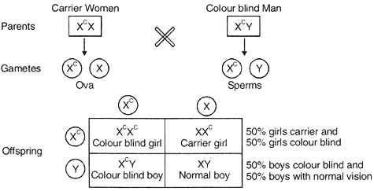
Sex-Linked Inheritance
Can a color blind man have a non- color blind son?

Slide 67
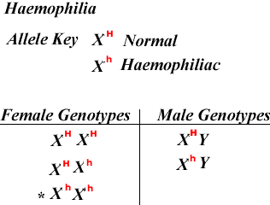
Sex-Linked Inheritance
Example:
Hierarchy

Slide 68
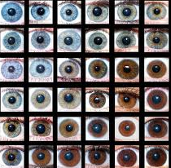
Polygenetic Traits
Polygenetic traits: traits that are controlled by many genes (exhibit a range of phenotypes or Continuous Variation).
Ex. Skin Color, Eye Color, Height
Each of the genes can have
multiple alleles, show
incomplete dominance or
co-dominance, and can be
affected by the environment.

Slide 69
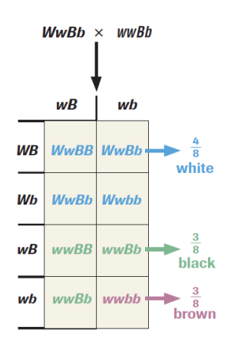
Epistatic genes
Polygenic trait
Epistatic genes mask effects
of another gene (interfere
with its expression).
Read pg. 617
Ex. Albinism

Slide 70
Pleiotropic Genes
Pleiotropic genes - genes that affect many
characteristics.
Use your Mobile Device! [5min.]
Ex. Sickle cell anemia
Ex. Marfan’s syndrome

Slide 71
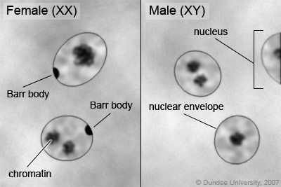
Barr Bodies
Discovered by Dr. Murray Barr
(University of Western Ontario)
Recognized a dark spot in some of
the somatic cells of female mammals
during the interphase of meiosis.
This spot proved to be the sex chromatin, which results when one of the X chromosomes in females randomly becomes inactive in each cell.
Revealed that not all female cells are identical; some cells have one X chromosome inactive, while some have the other.
Therefore, some cells may express a certain trait while others express its alternate form, even though all cells are genetically identical. (disrupts predicted phenotypes of crosses)
Ex. Human females & skin disorder anhidrotic ectodermal
Dysplasia (pg. 631)

Slide 72
Practice
pg. 616 # 1
Pg 634 # 2, 4, 5-7
Sex-linked Worksheet
- Discuss Monday
Genetics Worksheet PART 9

Slide 73
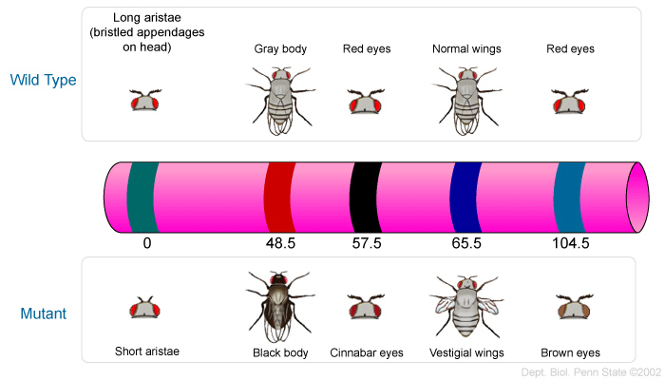
LINKAGE, Recombination & MAP UNITS
PART 4

Slide 74
Chromosomal Theory of Inheritance
Genes exist at specific sites and are arranged in a linear manner along chromosomes, these chromosomes segregate independently into gametes during meiosis.
READ pg. 635 (Morgan & Linkage)
Linked genes: different genes that are found on the same chromosome
(Will not assort independently)

Slide 75
Linked Genes & Meiosis

Slide 76
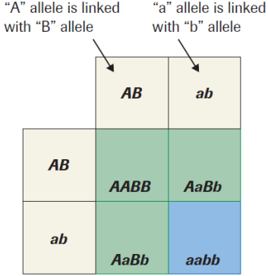
Linked Genes & Meiosis
Morgan’s predicted outcome for the following cross:
wild type (A), straight winged (B)
X
black body (a), curved wings (b)

Slide 77
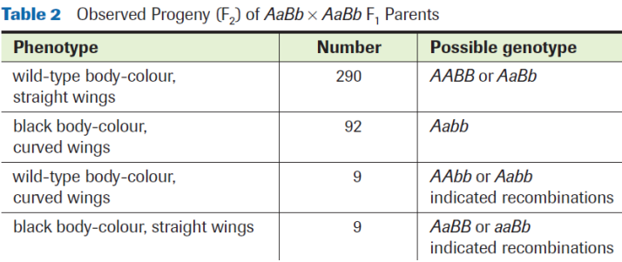
Linked Genes & Meiosis
Morgan observed some strange mixing of alleles in the F2 generation that were not predicted by the normal 3:1 phenotypic ratio from his punnet square.
How can linked genes end up in different gametes if they do not assort independently?

Slide 78
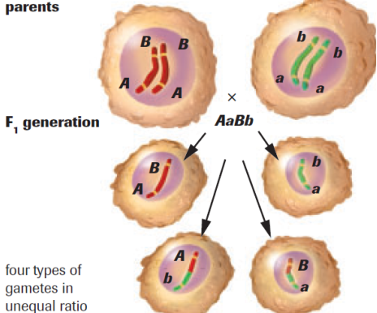
Gene Linkage & Cross-Over

Slide 79
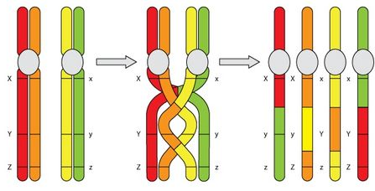
Crossing over of Linked genes
Alleles on different chromosomes may cross over and migrate to different chromosomes
Crossing over is more likely to happen to genes that are farther apart on the chromosome than genes that are closer together

Slide 80
Gene Linkage & Cross-Over
Are like relationships:
If you are in close proximity to the person you’re in a relationship, see each other often, live together, etc. You’ll probably stay together.
If you’re in a long-distance relationship, there’s more chance of one, or both of you “crossing-over” to a new chromosome.

Slide 81
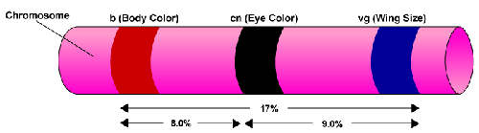
Chromosome Mapping
Chromosome mapping determines the relative position of genes on a chromosome
Has helped identify Linkage groups and the locations (loci) of them on chromosomes.
Position of genes are measure in map units (m.u.)

Slide 82
Recombination Frequency
Recombinant types: chromosomes of the F1 generation that have a different combination of alleles than the chromosomes predicated by the P generation (due to cross-over)
Parental types: chromosomes of the F1 generation which are identical to the P generation
Recombination frequency: the percentage of times that crossing over occurs as the P gametes were formed.

Slide 83
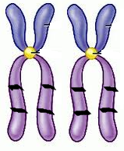
Recombination Frequency

Slide 84
Recombination Frequency
Ex. You cross a black bunny with green eyes who is homozygous dominant (BBGG) with a white bunny with red eyes that is homozygous recessive (bbgg).
What is the expected phenotypic ratio for this cross?
Twelve offspring are born; 10 black with green eyes, 1 black with red eyes and 1 white with green eyes.
b) What was the recombination frequency for this cross?

Slide 85
Recombination Frequency
Ex. You cross a black bunny with green eyes who is heterozygous (BbGG) with a white bunny with red eyes that is homozygous recessive (bbgg).
What is the expected phenotypic ratio for this cross?
10 offspring are born; 4 black with green eyes and 4 white with green eyes, and 2 white with red eyes
b) What was the recombination frequency for this cross?

Slide 86
Map Units
Map units are determined by the recombination frequency.
The percentage is directly related to the physical distance between the genes.
Ex. If the recombination frequency between aristae and wing shape genes is 65.5%, then the number of map units, between the same two genes, is 65.5.

Slide 87
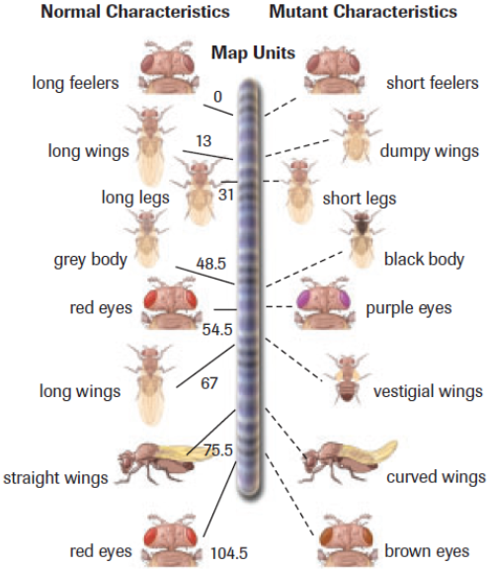
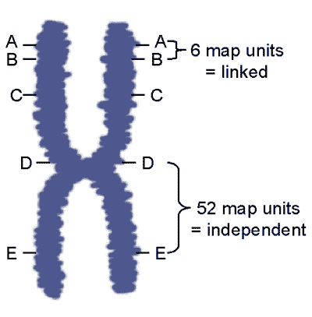
Map Units
The higher the recombination frequency, the further the genes are apart, the more likely they are to undergo independent assortment (cross-over)

Slide 88
Map Units
READ pg. 638 SAMPLE exercise 1
Pg. 639 PRACTICE #1

Slide 89
Map Units
You have been examining 4 traits in an organism (W, X, Y, Z). You know that they are on the same chromosome but you want to determine where they are found relative to each other.
After performing thousands of crosses, you have determined that the recombination frequencies are as follows:
traits Y and Z: 37%
traits W and X: 16%
traits X and Z: 26%
traits W and Y: 27%
Draw where you believe the genes may be found on the blank chromosome below and determine the number of map units between traits W and Z a well as traits X and Y

Slide 90
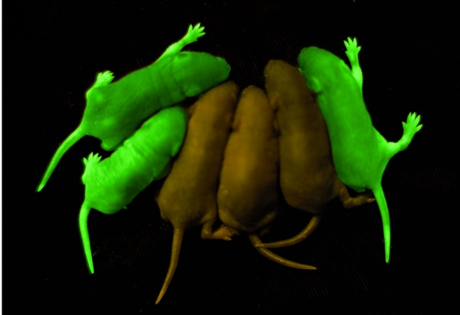
Using Marker Genes
Marker genes can be used to
follow the inheritance of a linked
trait (it will be inherited with the
trait).
Marker genes give rise to an
easily identifiable phenotype
(stands out) and are used to trace
the inheritance of other genes
that are difficult to identify.
The marker gene must be located on the same chromosome
and, ideally, at a very small distance from the gene being traced
(to avoid crossing over).
Ex. READ pg. 641

Slide 91
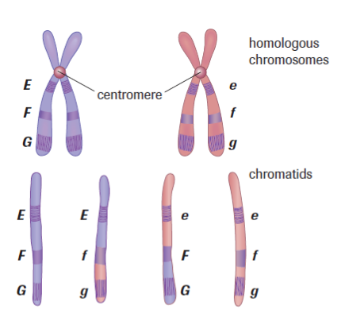
Practice
Mansbridge Homework Chopper
Quiz Tomorrow
pg. 641 #1-3
LAB Exercise 19.B

Slide 92
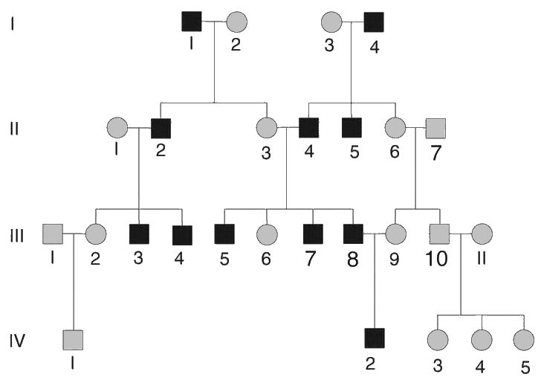
Genetics and Society
PART 5

Slide 93
Inheritance
In order to learn about inheritance of human traits, researchers construct pedigrees
Pedigree: a type of flow chart that uses symbols to show patterns of relationships and traits in a family over many generations
Useful when not able to doing experiments using individuals who generate large numbers of offspring (humans)

Slide 94
Types of Inheritance
Autosomal Inheritance (based on 22 chromosomes)
Types:
autosomal dominant
autosomal recessive
Sex-linked Inheritance (X or Y chromosomes)
Types:
X-linked dominant
X-linked recessive
Y-linked

Slide 95
Analyzing Pedigrees
http://www.youtube.com/watch?v=HbIHjsn5cHo (9mins)

Slide 96
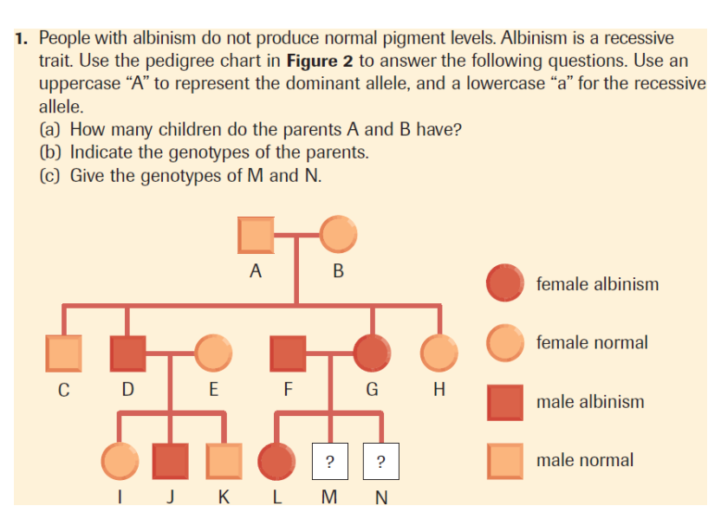
Pedigree Example

Slide 97
Auto Dom

Slide 98
Auto Rec

Slide 99
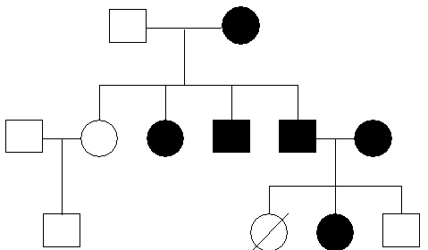
X Dom

Slide 100
X Rec

Slide 101
Y

Slide 102
Human Genetics Analysis
Genetic screening: identifying people who are at risk of developing particular genetic conditions or of passing these conditions on to their children
Genetic counsellor: estimate the risk of inheriting a particular genetic condition
http://abclocal.go.com/kgo/video?id=7542608
3mins

Slide 103
Practice
Pedigree Worksheet
Discuss Tomorrow
Pg. 607 #1, 2
Pg. 611 Case Study – A Mystery of Blood Types
Lab Exercise 19.A (pg. 632)

Slide 104
Review Questions
1. What is selective breeding?
2. What is the difference between a true breeding plant and a hybrid plant?
3. Explain P, F1, and F2 generation.
4. In your own words describe Mendel’s two laws of inheritance.
5. What is the purpose of a test cross?
6. What is the difference between incomplete dominance and co-dominance? Give an example of each.

Slide 105
Review Questions
7. A homozygous black bunny with long ears is crossed with a homozygous white bunny with short ears. Black colouring and long ears is the dominant trait in this particular species. Draw a dihybrid cross for the following scenario. What is the phenotypic ratio that will be observed in the F2 generation?

