Slide 1
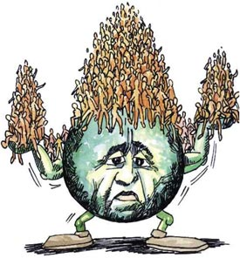
Population and Community Dynamics
Chapter 21 – PART 1

Slide 2
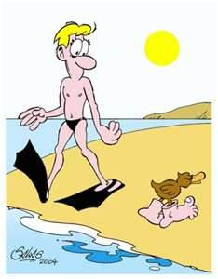
Populations
Successful individuals of a species are able to
reproduce and adapt to their environments.
What role might their genetic makeup
play in meeting these two demands?

Slide 3
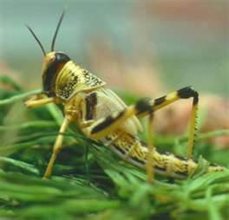
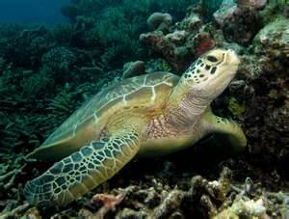
Populations
The population size of marine green turtles shows little change over time, while the locust population in the Canadian prairies varies widely from year to year.
What might this suggest about the environments in which they live?
Which environment is most stable?

Slide 4
Populations
Population:
A group of organisms of the same species that live in the same habitat or ecosystem at the same time.
Each individual has a different genotype.
Differences in genotypes and environmental influences account for differences among the phenotypes of individuals of the same species.
All of the genes that occur in a population are referred to as the gene pool.
Maintains continuity of traits from generation to generation.

Slide 5
Hardy-Weinberg Terminology
Allele frequency:
The proportion of allele copies in a population of a given gene.
Changes in populations can be measured in part by looking for changes in allele frequencies.
Note: not all genes exhibit variation
Fixed frequency:
The frequency of an allele within a population when only a single allele is present for a particular gene.
The allele’s frequency is always 100% (only option)

Slide 6
Hardy-Weinberg Terminology
Genotypic ratio:
The ratio of offspring with each possible allele combination from a particular cross
Ex. 250 AA : 500 Aa : 250 aa
Phenotypic ratio:
The ratio of offspring with a dominant trait to the alternative, recessive trait.
Ex. 750 Squid : 250 not Squid

Slide 7
Hardy-Weinberg Principle
The idea behind Hardy-Weinberg is that scientists studying inheritance of traits in populations wanted an equation to calculate the number of alleles in a population.
They did this by measuring the allele’s frequency.
http://www.khanacademy.org/science/biology/heredity-and-genetics/v/hardy-weinberg-principle?playlist=Biology

Slide 8
Solving a Hardy-Weinberg Problem
What am I being asked to find?
Create Dominance Hierarchy.
Identify what info. has been given to you.
If allele frequency is given, you already have either p or q (easy to solve).
If no allele frequency is given, use info. you have been given to find q², then take √q² to get q and solve.
Be sure you are solving what the question is asking (know your terminology)

Slide 9
Remember…
An allele is one of several forms of the same gene.
Ex. The gene for wing colour in moths has 2 alleles:
Brown and white
Brown is dominant to white
Let’s say that A= brown and a= white
Write down the 3 possible genotypes:

Slide 10
Hardy-Weinberg Principle
In our example population there are 500 moths:
320 homozygous brown
160 heterozygous brown
20 white
What are the genotype frequencies?
Type of moth/total number of moths
What are the allele frequencies?
Remember: each individual contributes 2 alleles to the gene pool

Slide 11
Hardy-Weinberg Principle
320 AA = 640 A (from AA genotype)
160 Aa = 160 A + 160 a (from Aa genotype)
20 aa = 40 a (from aa genotype)
TOTAL: 1000 → the number of alleles in the gene pool
Allele frequency:
A =
a =

Slide 12
Hardy-Weinberg Equation
For a gene with only 2 alleles
p + q = 1
p= frequency of allele A (dominant)
q= frequency of allele a (recessive)
p² + 2pq + q² = 1
p2= frequency of homozygous dominant
2pq= frequency of heterozygous
q2= frequency of homozygous recessive

Slide 13
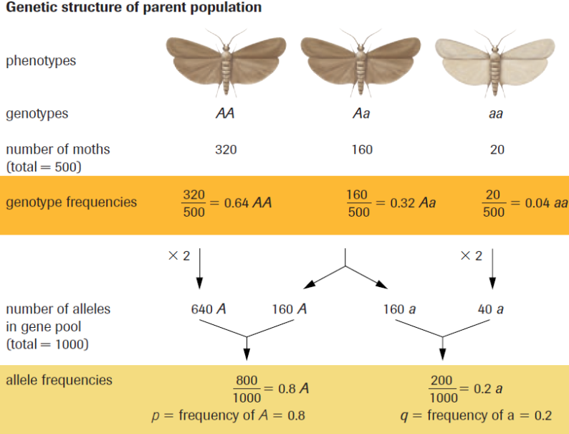

Slide 14
H.W. Equation Contd.....
p= frequency of A = 0.8 or 80%
q= frequency of a = 0.2 or 20%
p² + 2pq + q² = 1
AA genotype =
Aa genotype =
Aa genotype =

Slide 15
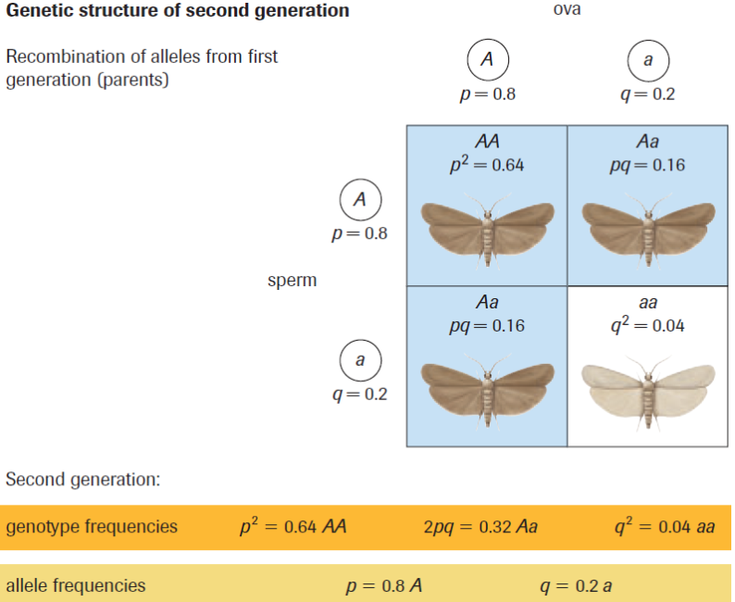

Slide 16
Conditions of the Hardy-Weinberg Principle:
Allele frequencies in a population will
not change if:
The population is infinitely large
No migration occurs
No mutations occur
No natural selection occurs
Mating is random

Slide 17
Practice
Pg. 720 #1-3
Pg. 722 #5-8
KEYS POSTED WED. EVE. (Check your Work!)
Hardy-Weinberg Worksheet
Discuss Tomorrow

