Slide 1
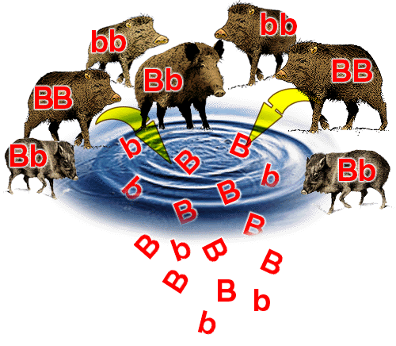
Changes in Gene Pools
Chapter 21 – PART 2

Slide 2
Review of Hardy-Weinberg…
Conditions for H.W. Equilibrium include:
1.
2.
3.
4.
5.
In a H.W. Equation:
p = q =
p²= q²= 2pq=

Slide 3
When is a Gene Pool predicted to change?
When a population is small, chance fluctuations in numbers will cause changes in allele frequencies
When individuals migrate
Mutations: new alleles will arise or existing ones will change
Natural Selection occurs
When mating is not random
In other words.....gene pools are always changing because the environment is in a constant state of change. Hardy-Weinberg only exists as a model, not in real life.

Slide 4
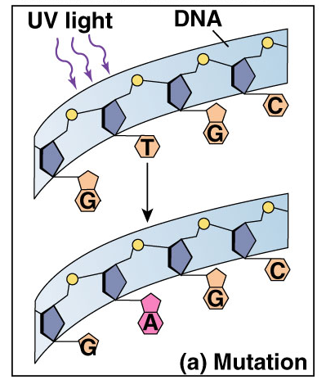
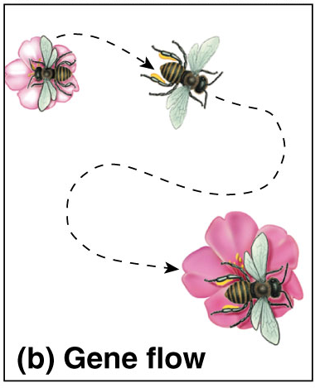
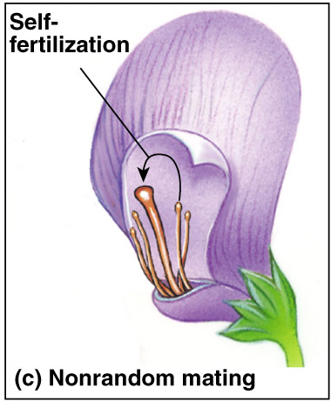
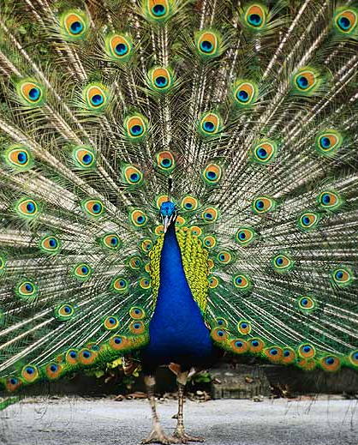
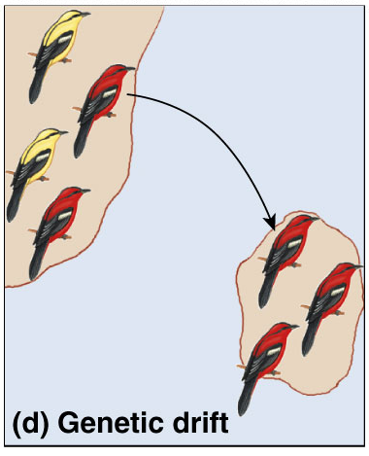
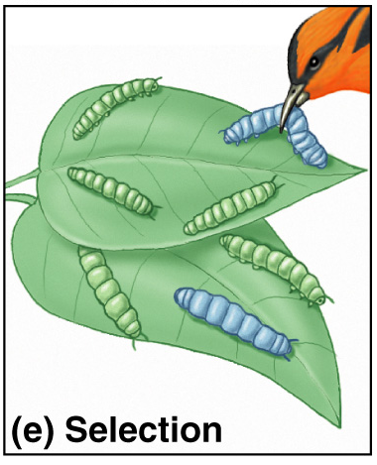
5 Agents of Evolutionary Change
Mutation
Gene Flow
Non-random mating
Genetic Drift
Selection

Slide 5
Genetic Drift
Is a change in the genetic makeup of a
population resulting from chance (random
events).
Ex. Small populations - can lead to fixation of alleles.
Increases the % of homozygous individuals within a population and reduces its genetic diversity
Watch to 3:50
https://www.youtube.com/watch?v=mjQ_yN5znyk&feature=related

Slide 6
Genetic Drift Amplified in low populations

Slide 7
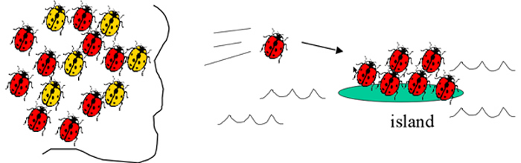
Founder Effect
Genetic drift that results when a small number of
individuals separate from their original population
and find a new population.
Allele frequencies likely to not be the same as those of original population

Slide 8
Bottleneck Effect
A dramatic, often temporary, reduction in population
size, usually resulting in significant genetic drift.
Frequency of alleles in the survivors is very different from that in the original population.
Narrows gene pool
Ex. Elephant seals (Fig 4 pg. 724)
https://www.youtube.com/watch?v=Q6JEA2olNts

Slide 9
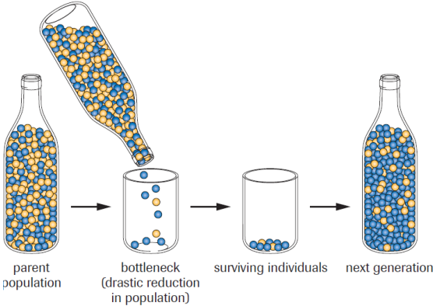
Bottleneck Effect

Slide 10
Gene Flow
The movement of alleles from one
population to another through the
movement of individuals or gametes.
Alters both populations
Occurs in wild populations
Ex #1 Seed & pollen distribution by wind & insects
Ex #2 Migration of animals
sub-populations may have different allele frequencies
causes genetic mixing across regions
reduce differences between populations

Slide 11
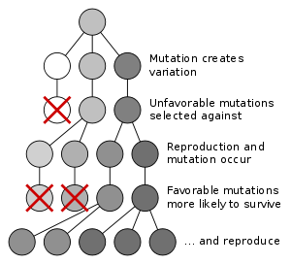
Mutations
Can be beneficial or
harmful
Mutation creates
variation
new mutations are
constantly appearing
Mutation changes the DNA sequence
changes in protein may change phenotype & therefore change fitness

Slide 12
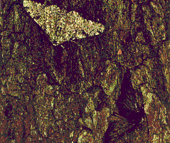
Natural Selection
Differential survival & reproduction due to changing
environmental conditions
climate change
food source availability
predators, parasites, diseases
toxins
Combinations of alleles that provide “fitness” increase in the population
adaptive evolutionary change
Ex. The Peppered Moth & Malaria/Sickle Cell Anemia

Slide 13
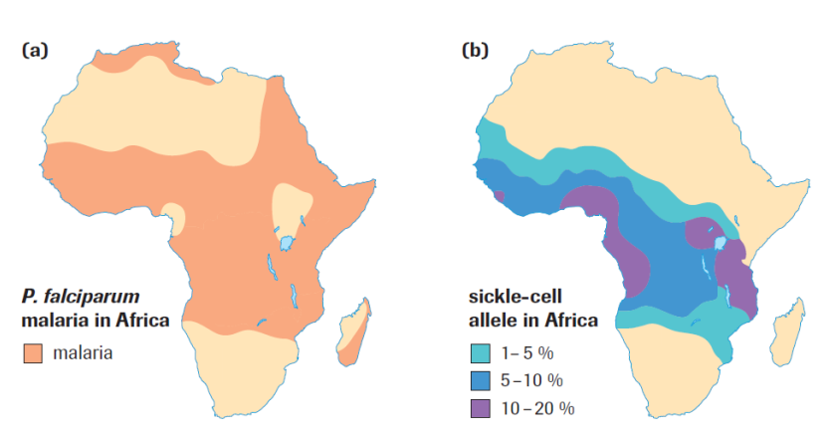
Natural Selection

Slide 14
Non-Random Mating
Sexual Selection
Differential reproductive success that results from variation in the ability to obtain mates
When combined with evolutionary pressures can create Sexual Dimorphism within a species:
Striking differences in the physical appearance of males and females not usually applied to behavioral differences between sexes.
https://www.youtube.com/watch?v=9GgAbyYDFeg&list=PLPTIy3JA29L7xnWCaic2A4t8XTLNu64OZ&index=1&feature=plpp_video

Slide 15
Practice
For each type of change in a gene pool that we have discussed, write down how each affects the alleles in a population.
Case Study pg. 727 #1-5
Pg. 730 #2-12
Homework Chopper Quiz Monday (terms posted Sunday)

