Slide 1
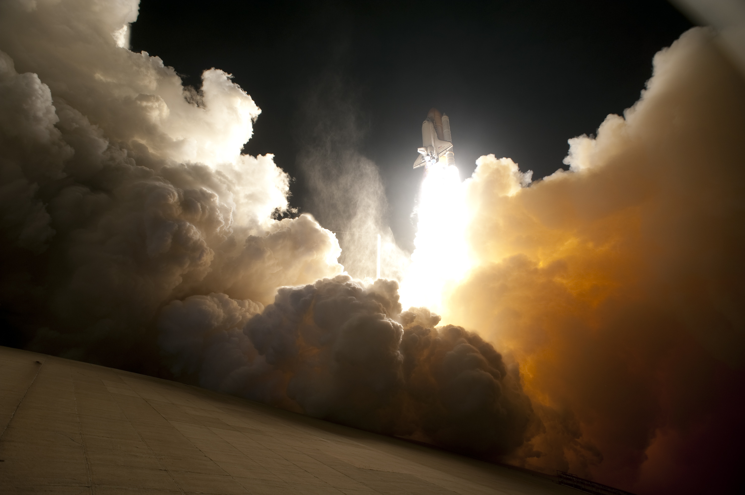
CHAPTER 2: SPACE
TRANSPORTATION

Slide 2
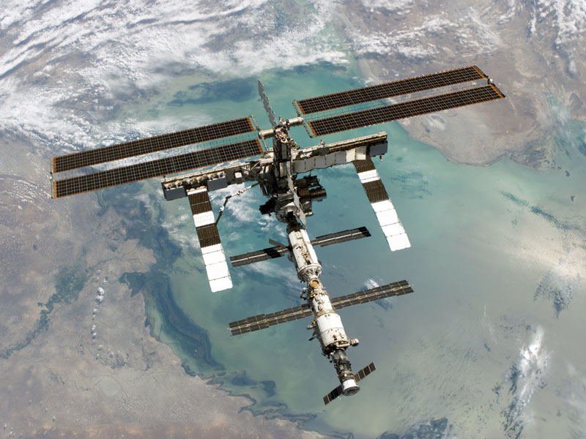
2.1 Getting There: Technologies for Space Transport
Space transport technology began with simple rockets, and today’s spacecraft are still launched using the same principles.

Slide 3
Rocket Science
A rocket is a tube that contains combustible material in one end and a payload in the other end; it moves by the action-reaction principle.
The payload can be an explosive, a measuring device, or even a person.
Staged rockets can fly faster and higher because a section of the rocket drops off after its fuel is used up (makes it lighter each time).

Slide 4
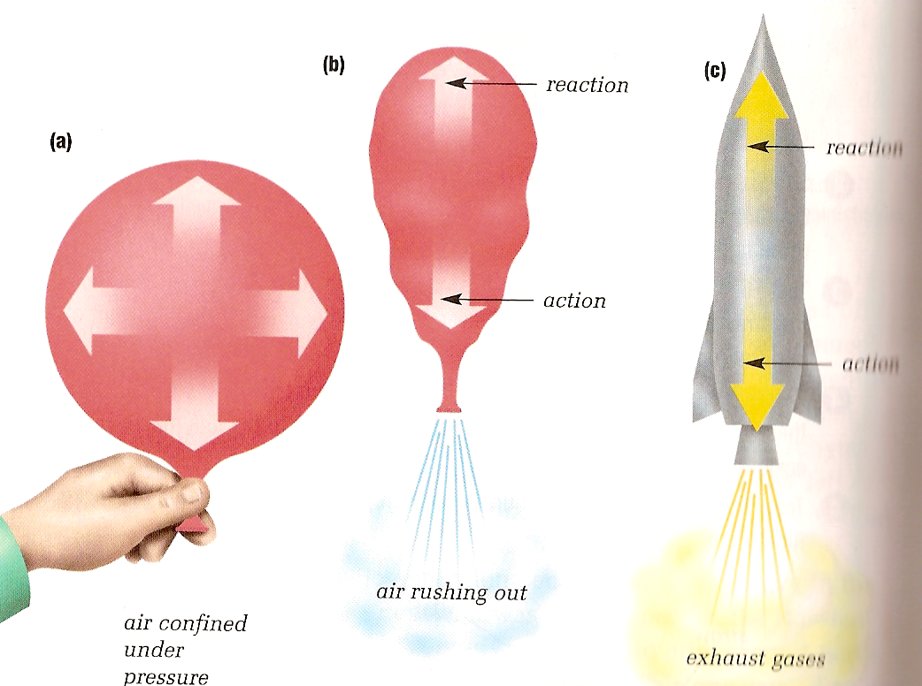
Action-Reaction Principle (Newton’s 3rd Law)

Slide 5
Rocket Science Cont’d
Liquid fuel gives a higher exhaust velocity but solid fuels can also be used (more fuel in less space).
In order to escape Earth’s gravity a rocket must reach at least 8 km/s!
The first artificial satellite launched into orbit was the Russian Sputnik 1 in 1957.
Notes:
video clip – 7:58 minutes

Slide 6
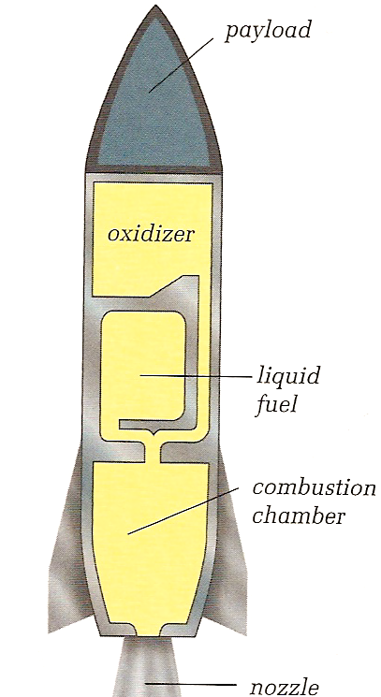
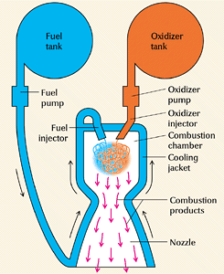
Liquid Fuelled Rockets

Slide 7
Rockets in the 20th Century

Slide 8
Challenger Disaster - 1986

Slide 9
Alternative Transportation Technologies
http://apod.nasa.gov/apod/ap070722.html
Read pg 413 and describe the two other space transport technologies discussed:
_
_

Slide 10
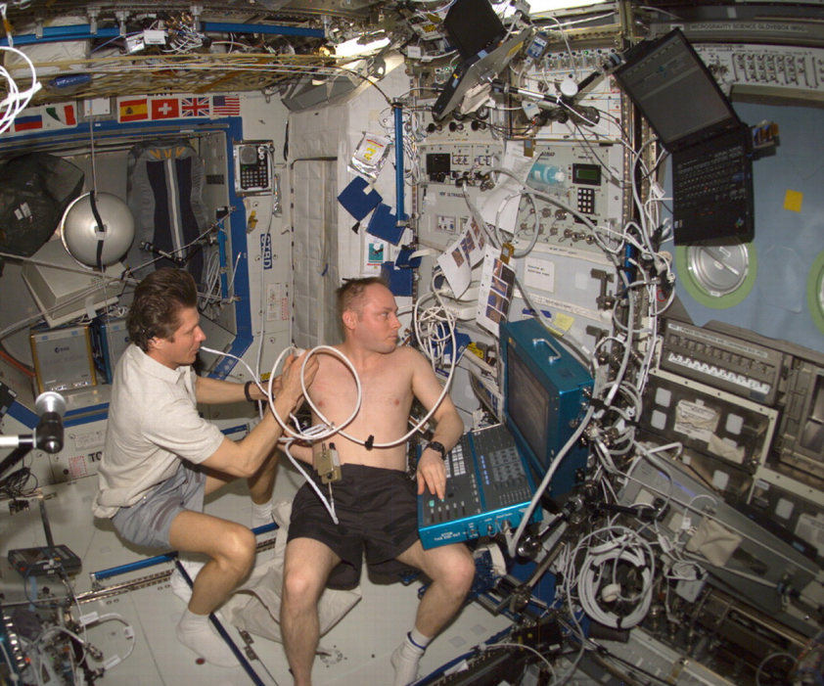
2.2 Surviving There: Technologies for Living in Space
For humans to live outside of Earth’s atmosphere, the basic requirements for life must be met in space.
This means that
food
shelter
water
air
must be produced artificially or brought with.
Notes:
Use “give it a try” activity (p.418) as an introduction.

Slide 11
You cannot go outside
without protection
Imagine being stuck in the same room with 6 other people for 2 months! Or even a year!
What if one of those people was your brother or sister? What if it was someone you hated?
Long periods in confined spaces such as the ISS can lead to psychological problems.

Slide 12
Life on the ISS

Slide 13
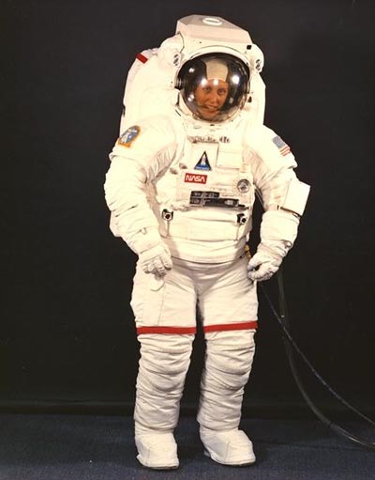
Space
Suit

Slide 14
Personal Survival Bubble
Supplies air, water, heat, air conditioning
Includes a portable toilet
Custom made for the wearer
Must be flexible
Supplies/Power for about 9 hours!

Slide 15
Modern Space Suits

Slide 16
Recycling Water
Who cares about recycling water?
You can’t live without it!
It has to be clean!
Think about how much water you use each day. Uses?
The astronauts have to have up to 365x that amount! Why?

Slide 17
Clean Water ‘aint Easy!

Slide 18
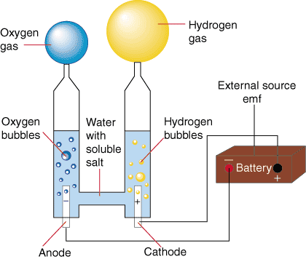
Producing Oxygen
Water (H₂O) is split into H₂ and O₂ through electrolysis (use of electricity)
H₂ = waste/fuel gas
… vented into space
O₂ = needed gas
… breathed by
astronauts

Slide 19
Inside the ISS

Slide 20
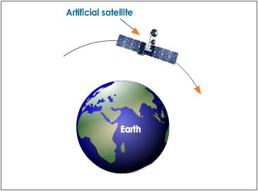
Microgravity
There is almost as much gravity in orbit as there is on Earth; however gravity is effectively eliminated inside a spacecraft due to the free-fall effect of orbiting Earth. The result is a feeling of weightlessness.
Problems:
Loss of bone density
Loss of muscle mass
Loss of red blood cells

Slide 21
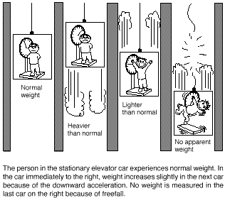

Slide 22
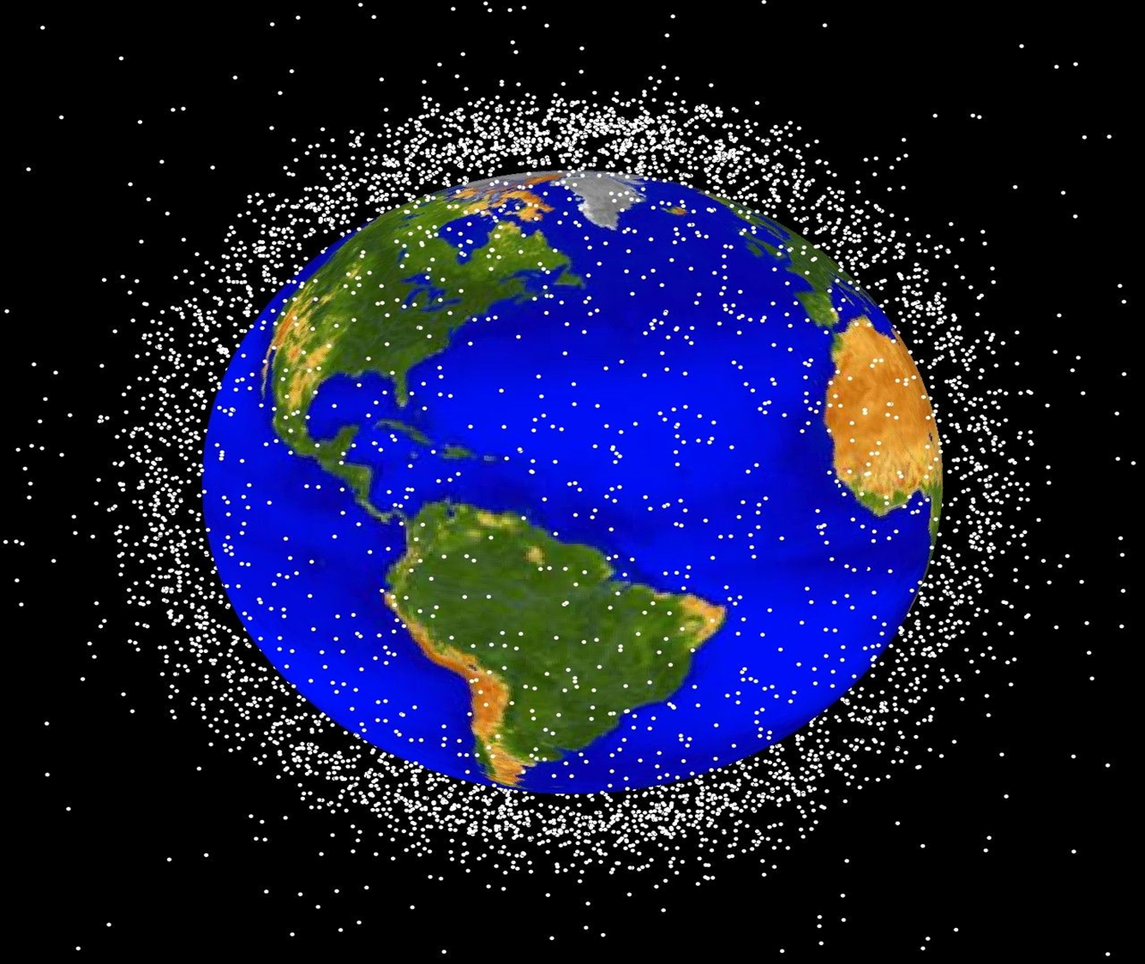
2.3 Using Space Technology to Meet Human Needs on Earth
Satellites orbiting Earth transmit information to us about:
weather
Agriculture
natural resources
We can also use space
technology to locate our
exact position on Earth.

Slide 23
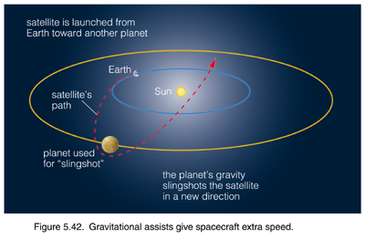
Launching Satellites/Probes
https://www.youtube.com/watch?v=OmFHwQkCYlQ

Slide 24
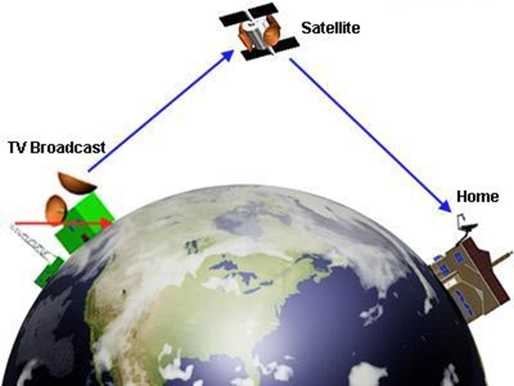
Geosynchronous
36 000 km above Earth, directly over the equator
move in the same direction as Earth rotates
orbit Earth once every
24 hours
appear motionless above
the Earth. Why?
tracked by stationary antennae

Slide 25
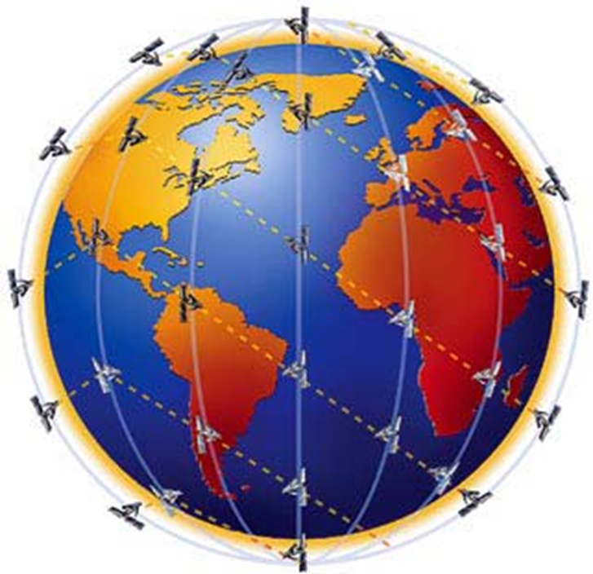
Low Earth Orbit
200-800 km above Earth
orbit Earth once every 1.5 hours
appear to move
across the sky in
minutes
tracked by moving
antennae
used for telecommunications—eliminates lag in conversations

Slide 26
“Space Age” Materials
Many concepts designed for use in space have found applications on Earth. These include materials used for communication, medicine, entertainment, and transportation.
The different materials which are used to make spacesuit are:
Nylon tricot
Spandex
Urethane-coated Nylon
Dacron
Neoprene-coated Nylon
Mylar
Gortex
Kevlar (material in bullet-proof vests)
Nomex
All of the layers are sewn and cemented together to form the suit.

Slide 27
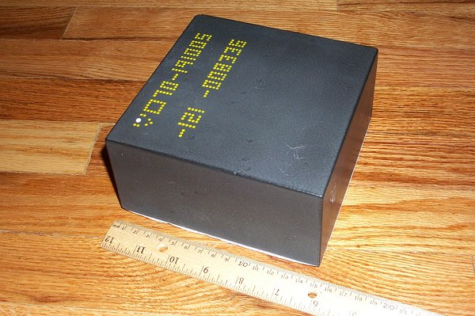
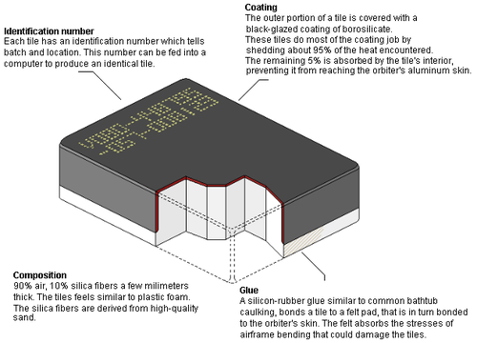
Space Shuttle Tiles
https://www.youtube.com/watch?v=V1dvzsls8Rg

Slide 28
Assignment
read pages 408-431
pg. 433 #1-9
Space Puzzle

