Slide 1
Chapter 3 3.1 Using Technology to See the Visible
Reflecting and refracting are two types of optical telescopes

Slide 2
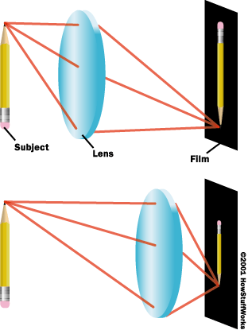
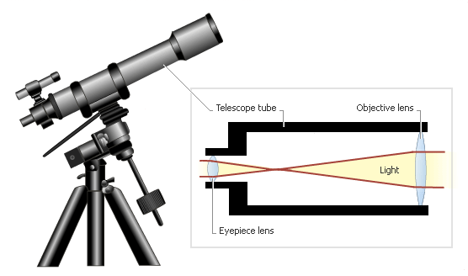
Refracting Telescopes
invented in 1608 by Hans Lippershey
Use lenses to focus light
Can have problems with image distortion

Slide 3
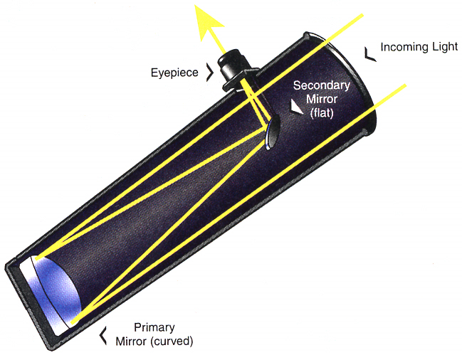
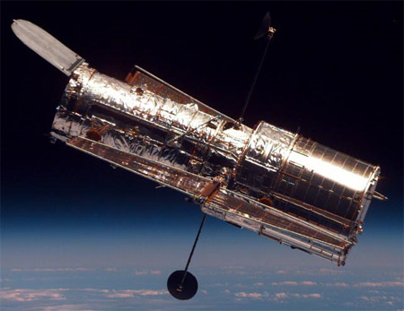
Reflecting Telescopes
use mirrors to focus light
Ex. Hubble Space Telescope
Concave

Slide 4
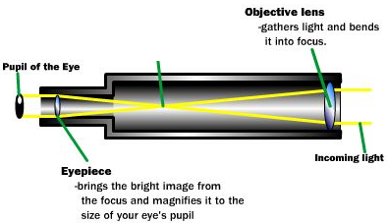
Optical Telescopes Cont’d
The ocular lens (or eyepiece) is the lens through which you view a magnified object using a telescope.
The objective lens is the large lens at the front of a telescope.
Ocular Lens

Slide 5
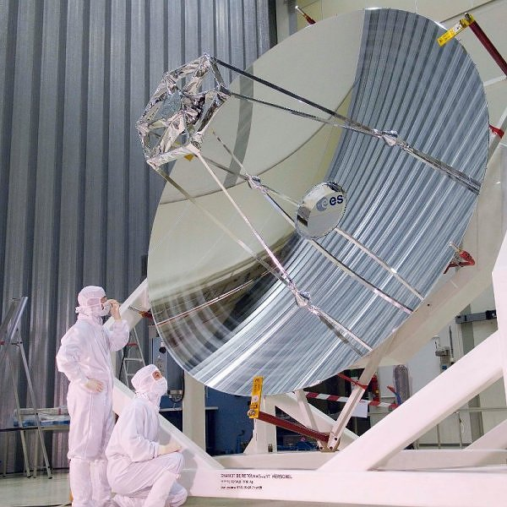
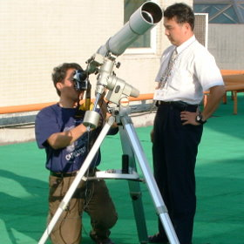
Optical Telescopes Cont’d
Resolving power determines the fineness of detail a telescope can produce of an object in view.
-or-
The bigger the lens/mirror on the telescope, the more light it can take in and the more detail you can see.
Ex. Vs.

Slide 6
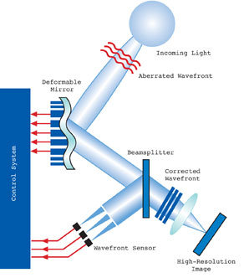
Optical Telescopes Cont’d
Adaptive Optics
Technology that adjusts
the mirror of a telescope,
or adjusts the image of a
telescope, to cancel the
effects of the constant
changes in Earth’s
atmosphere

Slide 7
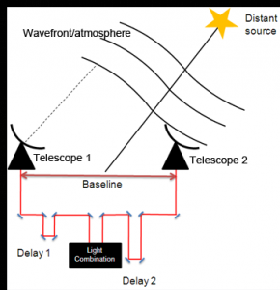
Optical Telescopes Cont’d
Interferometry
Technology that links
multiple telescopes
electronically to build a
higher quality image of
electromagnetic
radiation

Slide 8
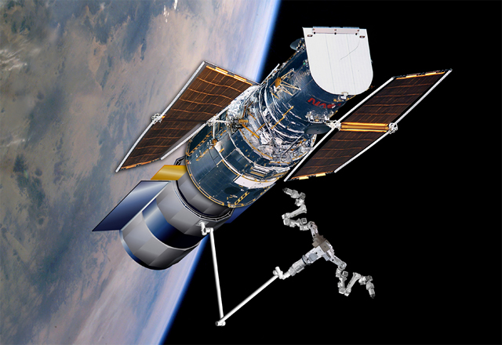
Assignment
Check and Reflect
Pg. 439
# 1-9

Slide 9
3.2 Using Technology to See Beyond the Visible
Electromagnetic Radiation (EMR)

Slide 10
Electromagnetic Spectrum
Visible light is only one part of the electromagnetic spectrum.
This spectrum includes infrared, X-ray, ultraviolet, and gamma radiation—which can also be emitted by objects in space.
Specific technologies are designed to detect these forms of radiation that come to us from space.

Slide 11
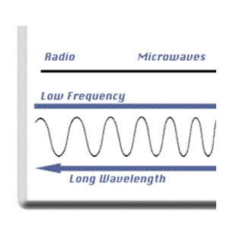
Radio Telescopes
collect and analyze radio waves
emitted from bodies in space
radio waves penetrate dust clouds and are not affected by weather (can see “thru” other objects in space)
lower resolution than optical telescopes
allow astronomers to “see” parts of space that seemed to be empty
can also be connected using interferometry. This can increase image detail by 100x or more!

Slide 12
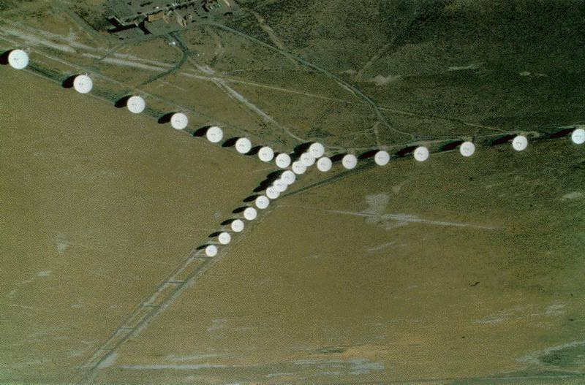
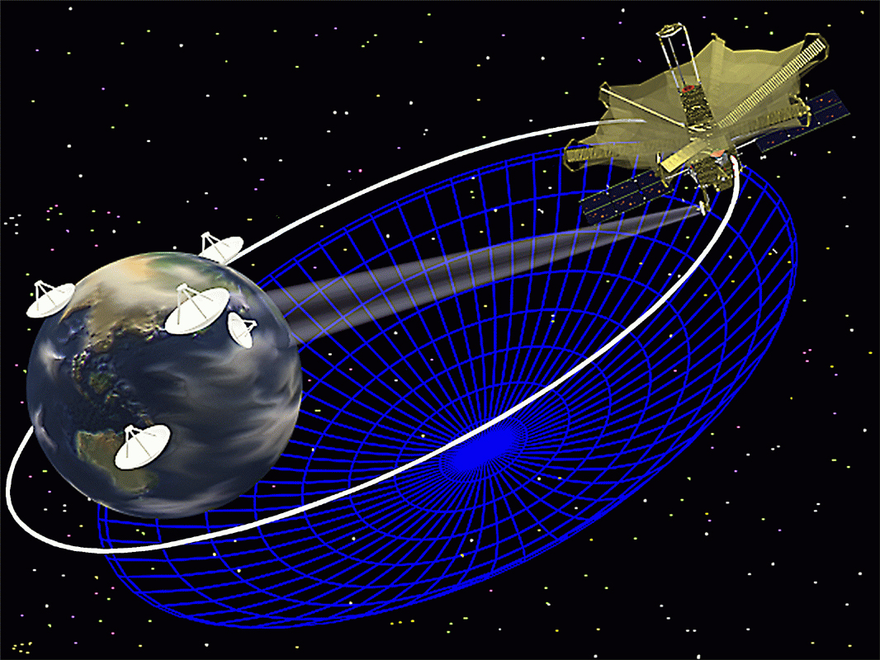
V.L.A
V.L.B.I

Slide 13
Space Probes
unmanned satellites or remote-controlled “landers” used to explore areas or objects in space that are too difficult or dangerous to send humans to
Notes:
video clip – 6:35 min

Slide 14
Huygens Probe

Slide 15
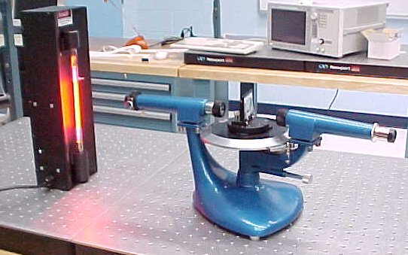
Spectroscopy
A spectroscope is a device that passes light through a diffraction grating to produce a focused spectrum.
The lines in the spectrum of a star can be compared to spectra of known chemicals to find out the composition of the star.
Notes:
Video clip – 2:45 min

Slide 16
Spectroscopy

Slide 17
Three Types of Spectra:
Notes:
Gustav Kirchoff and Robert Bunsen discovered that each element produces a unique spectral pattern. They also learned that there are three types of spectra.

Slide 18
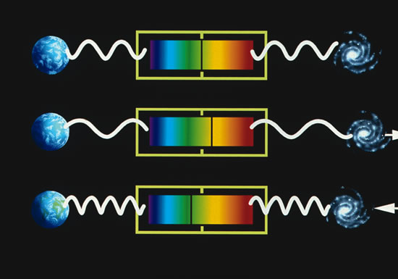
Doppler Effect
By observing the shift in the spectrum of a star, we can tell if it is moving toward or away from Earth.
red shift – moving away
blue shift – moving towards

Slide 19
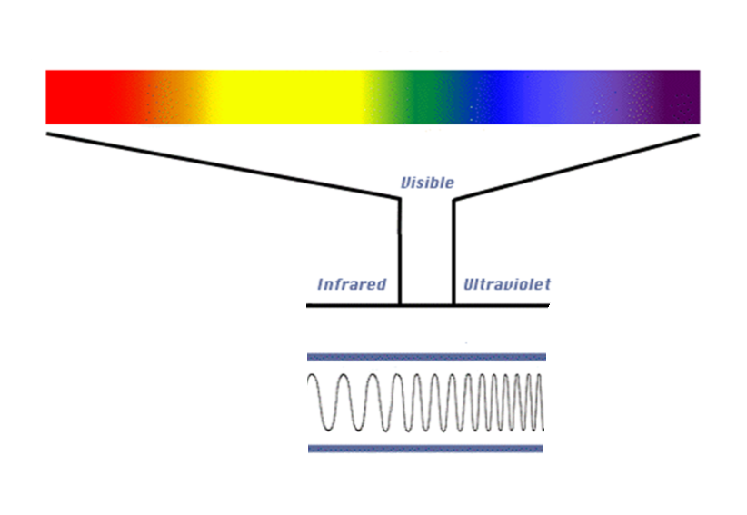
Red Shift vs. Blue Shift

Slide 20
3.3 Using Technology to Interpret Space
Triangulation and parallax are two techniques for measuring distances in space.

Slide 21
Parallax
The apparent shift in position of a nearby object against a distant background when the object is viewed from two different positions.
Ex. Your Thumb
Notes:
video clip – 5:26 min

Slide 22
Triangulation
A method of measuring distance indirectly by creating an imaginary triangle between an observer and an object whose distance is to be estimated
Ex. GPS units receive radio signals from 3 satellites and then use triangulation to pinpoint their location on the ground
Object
Distance
Angle 1
Baseline
Angle 2

Slide 23
Triangulation

