Slide 1
Unit C
Photosynthesis and Cellular Respiration

Slide 2
6.1
Photosynthesis and Pigments

Slide 3
I can see the light!
EMR: electromagnetic radiation
The sun emits light in all wavelengths
We can see some of those wavelength, some we cannot

Slide 4
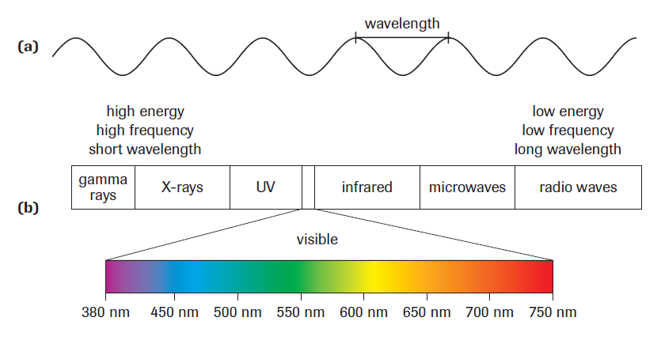
Light
Small wavelengths: high energy
Long wavelengths: little energy

Slide 5
Energy
Producers use the energy from the sun to undergo photosynthesis
carbon dioxide + water + energy → glucose + oxygen
CO2(g) + H2O(l) + energy → C6H12O6(s) + O2(g)
Green plants capture photons from the sun to use as energy

Slide 6
Chlorophyll
chlorophyll the light-absorbing green-coloured pigment that begins the process of photosynthesis
It absorbs photon energy

Slide 7
types
chlorophyll a (blue-green) All photosynthetic organisms use chlorophyll a as the primary light-absorbing pigment.
chlorophyll b (yellow-green)
Chlorophyll transmits the photon energy in 500-600nm which we see as green

Slide 8
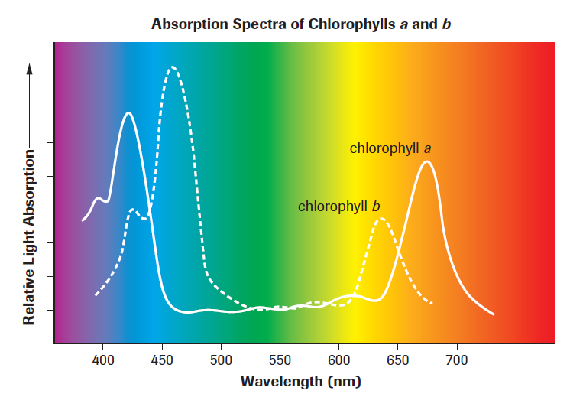
Spectrometer

Slide 9
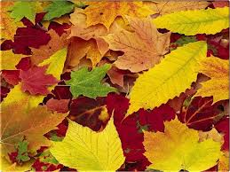
Chlorophyll b
Chlorophyll b acts as an accessory pigment, absorbing photons that chlorophyll a absorbs poorly
In autumn with lower temps, the plant stops producing chlorophyll and the colours change from green to red, yellow, orange and brown.

Slide 10
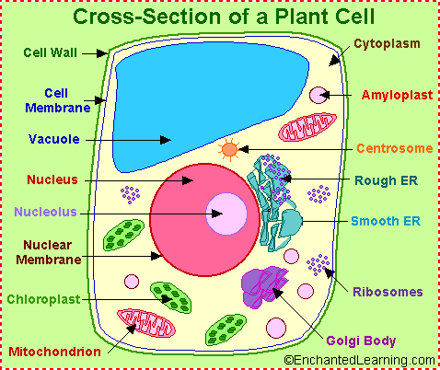
chloroplast
Chloroplast: membrane-bound organelle in green plant and algal cells that carries out photosynthesis
very small

Slide 11
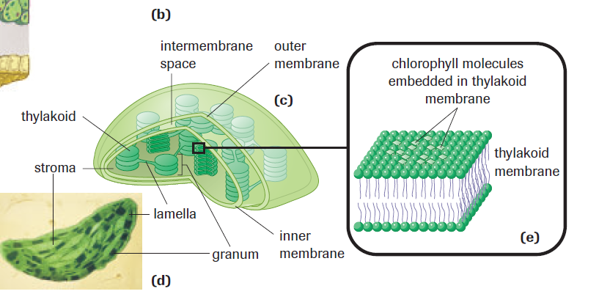
Page 183
chloroplast

Slide 12
Chloroplasts
Have an outer lining and an inner lining
Inside that space is a protein rich semi-liquid called stroma
Inside the stroma there are thylakoids layered on top of each other
These thylakoid bundles are called grana
A chloroplast has 60 grana, with 30 to 50 thylakoids.

Slide 13
Cont.
Adjacent grana are connected to one another by unstacked thylakoids called lamellae.
thylakoid membrane: the photosynthetic membrane within a chloroplast that contains light-gathering pigment molecules and electron transport chains
Photosynthesis occurs partly in the stroma and the thylakoid membrane

Slide 14
Cont.
thylakoid lumen the fluid-filled space inside a thylakoid
thylakoid structure increases the surface area = increases the efficiency of photosynthesis.
Chloroplasts are able to replicate, by division, independently of the cell.

Slide 15
Diagram again

Slide 16
“Operation Cue”
1955 atomic bomb test in Nevada
On 6 August 1945, a uranium gun-type fission bomb code-named "Little Boy" was detonated over the Japanese city of Hiroshima. Three days later, on 9 August, a plutonium implosion-type fission bomb code-named "Fat Man" was exploded over Nagasaki, Japan.

Slide 17
6.2
Reactions of Photosynthesis

Slide 18
Photosynthesis
Photon energy is converted to chemical energy

Slide 19
Energy molecules
Glucose is stored as energy for later use by cells
ATP: adenosine triphosphate.
Used by all living cells to provide immediate energy

Slide 20
ATP
Made by combining inorganic phosphate (Pi) with ADP
ADP: adenosine diphosphate
Energy is released when ATP is separated back into phosphate and ADP

Slide 21
ATP = ADP + P + energy

Slide 22
NADP
Nicotinamide dinucleotide phosphate
In cellular reactions NADP accepts one Hydrogen atom and two electrons to form NADPH
NADPH can then donate electrons to become NADP again

Slide 23
Photosynthesis
Chlorophyll and other pigments absorb solar energy
The plant converts solar energy to chemical energy in the chloroplast
3 stages

Slide 24
Photosynthesis
Capture solar energy by transferring it to electrons. Light dependant.
Solar energy makes ATP and transfers high energy electrons to NADP to form NADPH. Light dependant.
ATP and high energy electrons carried by NADPH and CO2 make glucose. Light independent

Slide 25
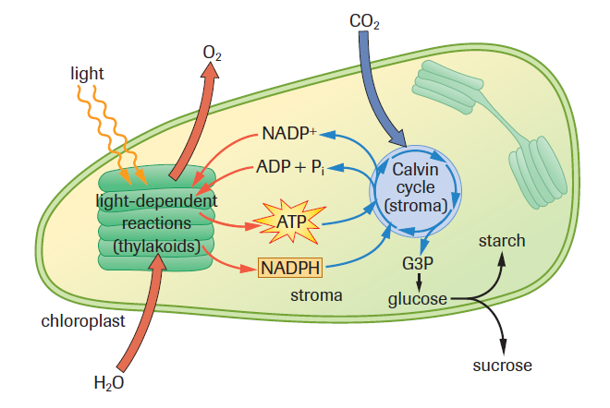
Photosynthesis

Slide 26
Stage 1 in detail
Photosystems: cluster of photosynthetic pigments in the thylakoid membrane
Two distinct photosystems (I and II)
Responsible for actual capturing of light
Solar energy is harnessed when an electron in a chlorophyll absorbs a photon

Slide 27
Stage 1 in detail
Before the photon, the electrons have a low amount of energy. After the photon is absorbed the electron has a high energy level
The electron is “excited”

Slide 28
Stage 1 in detail
The excited electron is removed from the photosystem and moved from one molecule to another: this is called the electron transport chain
each electron being removed must be replaced: process called photolysis

Slide 29
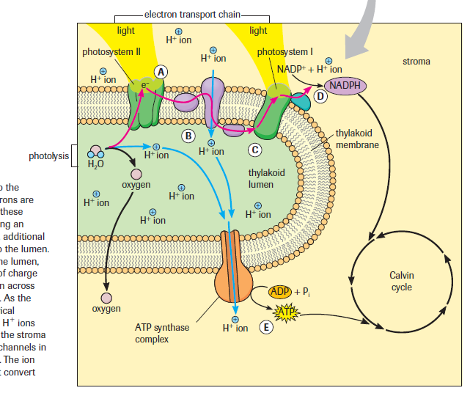

Slide 30
Stage 1 in detail
Photolysis: solar energy is used to split water into H ions and oxygen gas
This replaces the excited electron
Occurs in the thylakoid lumen
Two water molecules are consumed every 4 hours.
2H2O + energy = 4H + 4e + O2

Slide 31
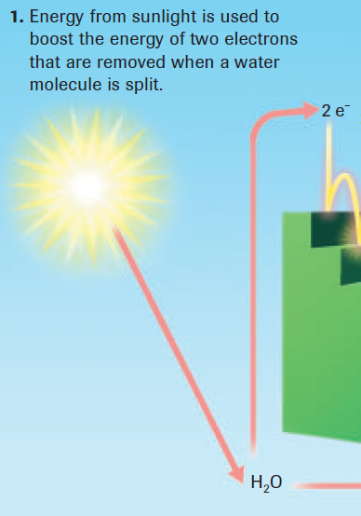
Stage 2 in detail
The electron transport chain
Similar to a set of stairs
Solar energy excites the electron and in a single leap is at the top of the stairs

Slide 32
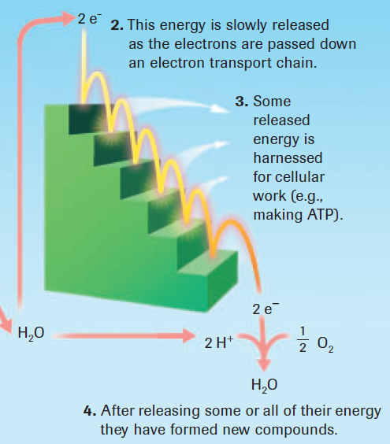
Stage 2 in detail
The electron transport chain cont.
the energy is then used to make ATP

Slide 33
Stage 2 in detail
electron transport chain cont.
Electrons eventually rejoin H ions in the formation of new compounds

Slide 34
Stage 2 in detail
Oxidation-Reduction Reactions
Or redox reactions
Oxidation: atom loses electrons
Reduction: atom gains electrons
OIL RIG

Slide 35
Stage 2 in detail
NADPH carries electrons and then loses them: oxidation
NADP gains electrons: reduction
When NADPH is oxidized it loses a hydrogen ion and 2 electrons which then is converted to NADP

Slide 36
Stage 2 in detail
When something is reduced its becomes more stable and releases energy
NADPH donates electrons other processes of photosynthesis can happen

Slide 37
Stage 2 in detail
Excited electrons are passed along in the electron transport chain
They move across the outer surface of the thylakoid membrane towards the thylakoid lumen (A)
Photosystem II

Slide 38
Stage 2 in detail

Slide 39
Stage 2 in detail
Electrons now enter photosystem I
Here they replace electrons that are energized by light
Excited electrons in photosystem I are not put in an electron transport chain like photosystem II, they are used to make NADP

Slide 40
Stage 2 in detail
NADP can receive 2 electrons and an H ion as it changes to NADPH
NADPH are used to transform high energy electrons to the Calvin cycle in stage 3

Slide 41
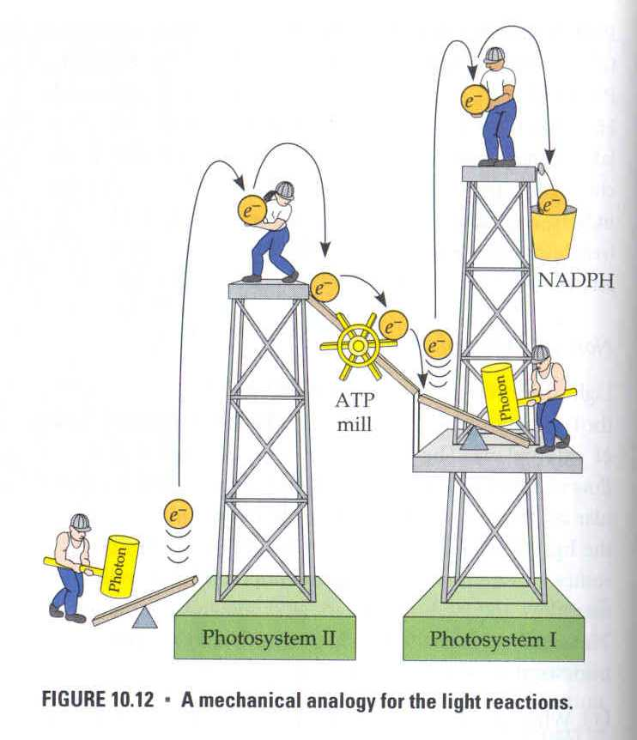

Slide 42
Stage 2 in detail

Slide 43
Stage 2 in detail
chemiosmosis
The movement of the electrons creates energy which pulls positive H ions across the membrane into the lumen
Electrons have lost most of their energy they have received from photosystem I
A positive charge builds up in the lumen

Slide 44
More of stage 2 in detail
Chemiosmosis process:
The movement of positive H ions into the thylakoid membrane create an electrical gradient
H ions must use ATP synthase complexes to leave the lumen
When e- move out the protein transport energy is created
This energy is used to combine P and ADP to make ATP!!!

Slide 45
Stage 2 in detail

Slide 46
summary
Excited electrons from photosystem II move on the electron transport chain to the inner thylakoid membrane
Some of their energy is used to pull positive H ions into the thylakoid membrane
Electrons have now lost most of their energy and now go to the photosystem I
Excited electrons from photosystem I are transferred to NADP to form NAPDH

Slide 47
stage 3 in detail
The Calvin cycle and carbon fixation
H2O + CO2 + energy = O2 + C6H12O6
Light independent: doesn’t need light

Slide 48
Stage 3 in detail

Slide 49
Stage 3 in detail
Calvin cycle: uses ATP and excited electrons carried by NADPH to make G3P sugar
G3P sugar then makes glucose

Slide 50
Stage 3 in detail
Glucose: C6H12O6
Carbon and oxygen are provided by CO2
H is provided by light dependent reactions
For every CO2 molecule: 3 ATP’s and 2 NADPH’s are used

Slide 51
Stage 3 in detail
For every CO2 molecule: 3 ATP’s and 2 NADPH’s are used
CO2 diffuses in the plant through tiny holes
To make 1 glucose molecule you need:
6 CO2
18 ATP
12 NADPH

Slide 52
