Slide 1
7.1
Cellular Respiration

Slide 2
7.1
Cellular Respiration and why it’s cool
Page 204

Slide 3
Cellular Respiration
Glucose is the product from photosynthesis
Plants store glucose in the form of starch
Animals store glucose in the form of glycogen
Cells need ATP for energy for particular processes

Slide 4
Clothespins and Muscle Fatigue Activity
Get into groups
Need: clothespin and timer (cell phone)

Slide 5
Molecules in Cellular Respiration
NADH: It is an electron carrier and donated electrons.
NAD: it accepts electrons
FADH2: electron carrier, donates electrons
FAD: electron carrier, accepts electrons

Slide 6
Glucose and ATP
ATP is not abundant in food and doesn’t provide a large amount of energy per molecule: not used for long term storage
Glucose is used for long term storage: it has 100x more energy than ATP
Glucose can be converted to ATP
Glucose is small and highly soluble
Analogy = money

Slide 7
Releasing Energy
Energy is released when new bonds form
Respiration is an energy releasing process
The energy released is used to make ATP
36% of the energy from glucose goes into ATP, the remaining 64% is lost as heat

Slide 8
2 Types of Cellular Respiration
Aerobic cellular respiration
Needs oxygen
Complete oxidation of glucose
End product: CO2, H2O, 36 ATP
Anaerobic cellular respiration
No oxygen
Glucose is not oxidized
Two types
Both produce 2 ATP molecules

Slide 9
Stages Involved…
1) AEROBIC Cellular Respiration
1) Glycolysis
2) Pyruvate Oxidation
3) The Krebs Cycle
4) Electron Transport Chain & Chemiosmosis
2) ANAEROBIC Cellular Respiration
1) Glycolysis
2) Fermentation
Note that both process start with Glycolysis

Slide 10
Cellular Respiration Reaction Summaries…
1) AEROBIC Cellular Respiration
C₆H₁₂O₆ + 6O₂ + 36 ADP + 36 Pi → 6CO₂ + 6H₂O + 36 ATP
2) ANAEROBIC Cellular Respiration
C₆H₁₂O₆ + 2 ADP + 2 P_{i} → 2C₂H₅OH + 2CO₂ + 2 ATP ethanol
OR
C₆H₁₂O₆ + 2 ADP + 2 P_{i} → 2C₃H₆O₃ + 2CO₂ + 2 ATP lactic acid
http://www.youtube.com/watch?v=rGaP9nE8d9k&feature=related

Slide 11
7.2
Glycolysis
1st step in both anaerobic and aerobic cellular respiration

Slide 12
Energy, Cells, ATP
Energy is needed in cells for many processes: need ATP
Sodium potassium pumps
Motion
Building molecules
Turning reactions on or off
1 human cells have 1 Billion ATP molecules!
ATP releases energy when it is broken down into ADP and Pi

Slide 13
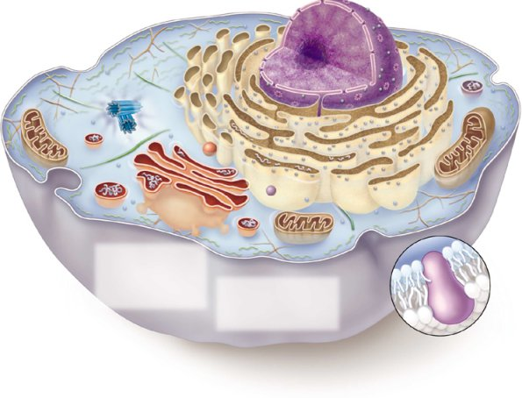
Glycolysis
C₆H₁₂O₆
2 ATP
2 ADP + 2P_{i}
2 NAD⁺
4 ADP + 4 P_{i}
2 NADH + H₊
4 ATP
C₃H₄O₃
C₃H₄O₃

Slide 14
Glycolysis Occurs in the Cell’s Cytoplasm
What Cells?
Plant? Animal?
Bacterial?

Slide 15
Glycolysis is Greek for “Sugar Splitting”
Glucose
Pyruvate Pyruvate
… which exactly
describes the process
C₆H₁₂O₆
C₃H₄O₃
C₃H₄O₃

Slide 16
Glycolysis
The carbon “backbone” of glucose is split in half
6-carbon
sugar
3-carbon
sugar

Slide 17
Glycolysis
Happens in both Aerobic and
Anaerobic Respiration, but is
an Anaerobic Process
(oxygen is not required)
The carbon “backbone” of glucose is split in half
6-carbon
sugar
3-carbon 3-carbon
sugar sugar
Glucose
Pyruvate

Slide 18
Glycolysis
There are ten reactions that occur in the cytoplasm to convert Glucose into 2 Pyruvate Molecules
… don’t need to know all 10 steps

Slide 19
Glycolysis
2 ATP molecules are used in the process
2 ATP
2 ADP + 2P_{i}

Slide 20
Glycolysis
2 ATP molecules are used in the process
4 ATP molecules are made in the process
2 ATP
2 ADP + 2P_{i}
4 ADP + 4 P_{i}
4 ATP

Slide 21
Glycolysis
2 ATP molecules are used in the process
4 ATP molecules are made in the process
= Resulting in a Net Gain of 2 ATP Molecules
2 ATP
2 ADP + 2P_{i}
4 ADP + 4 P_{i}
4 ATP

Slide 22
Glycolysis
2 ATP molecules are used in the process
4 ATP molecules are made in the process
= Resulting in a Net Gain of 2 ATP Molecules
2 ATP
2 ADP + 2P_{i}
4 ADP + 4 P_{i}
4 ATP
(Remember that Aerobic Respiration Results in 36 ATP Total)

Slide 23
Glycolysis
Redox Reactions
also produce 2 NADH molecules and 2 H⁺
2 ATP
2 ADP + 2P_{i}
2 NAD⁺
4 ADP + 4 P_{i}
2 NADH + H₊
4 ATP

Slide 24
Glycolysis
C₆H₁₂O₆
How many C, H, & O atoms are there before and after?
2 ATP
2 ADP + 2P_{i}
2 NAD⁺
4 ADP + 4 P_{i}
2 NADH + H₊
4 ATP
C₃H₄O₃
C₃H₄O₃

Slide 25
Glycolysis
The 4 hydrogen atoms went to
make 2NADH molecules and 2 H⁺
C₆H₁₂O₆
2 ATP
2 ADP + 2P_{i}
2 NAD⁺
4 ADP + 4 P_{i}
2 NADH + H₊
4 ATP
C₃H₄O₃
C₃H₄O₃

Slide 26
Net Equation of Glycolysis:
C₆H₁₂O₆
2 ATP
2 ADP + 2P_{i}
2 NAD⁺
4 ADP + 4 P_{i}
2 NADH + H₊
4 ATP
C₃H₄O₃
C₃H₄O₃
1 glucose + 2ADP + 2P_{i} + 2NAD⁺ →
2 pyruvate + 2ATP + 2NADH + 2H⁺

Slide 27
Stages Involved…
1) AEROBIC Cellular Respiration
1) Glycolysis √
2) Pyruvate Oxidation
3) The Krebs Cycle
4) Electron Transport Chain & Chemiosmosis
2) ANAEROBIC Cellular Respiration
1) Glycolysis √
2) Fermentation
Note that both process start with Glycolysis

Slide 28
Glycolysis
Really not that efficient
Only 2.2% efficient
Simple organisms use glycolysis for all their energy needs

Slide 29
NET ATP GAIN SO FAR
Glucose
- Glycolysis………………………………….
2 ATP
Pyruvate
Acetyl CoA
Krebs Cycle
TOTAL 36 ATP

Slide 30
7.3
Aerobic Cellular Respiration
Needs oxygen

Slide 31
Stages Involved…
1) AEROBIC Cellular Respiration
1) Glycolysis √ = Cytoplasm
2) Pyruvate Oxidation
3) The Krebs Cycle
4) Electron Transport Chain
& Chemiosmosis
Mitochondria
VIDEO:
http://www.youtube.com/watch?v=rGaP9nE8d9k&feature=related

Slide 32
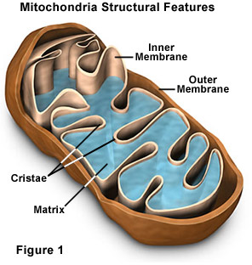
Mitochondria
Cellular Organelles

Slide 33
Mitochondria
The vital organelles specialize in the production of large quantities of ATP
Composed of smooth outer membrane and highly folded inner membrane

Slide 34
Mitochondria
The Inner Membrane…
… performs many functions associated with aerobic cellular respiration
… creates two compartments within the mitochondrion

Slide 35
Mitochondria
Matrix
= Fluid that fills the interior space
Intermembrane Space
= Fluid-filled space between the inner and outer membrane

Slide 36
Stages Involved…
1) AEROBIC Cellular Respiration
1) Glycolysis √ = Cytoplasm
2) Pyruvate Oxidation
3) The Krebs Cycle
4) Electron Transport Chain
& Chemiosmosis
Mitochondria

Slide 37
Stage 2: Pyruvate Oxidation
Pyruvate Oxidation:
→ a chemical pathway that connects glycolysis in the Cytoplasm with the Krebs Cycle in the Mitochondrial Matrix

Slide 38
Stage 2: Pyruvate Oxidation
Pyruvate
Once in the Mitochondria:
1) A CO₂ molecule is removed from each pyruvate
(a 3rd of the CO₂ we breathe out is comes from this!)
CO₂

Slide 39
Stage 2: Pyruvate Oxidation
2) Pyruvate undergoes and oxidization reaction and NAD⁺ undergoes a reduction reaction
And transfers high-energy H⁺ from Pyruvates to NAD⁺ molecules
(a 3rd of from this!)
Pyruvate
NAD⁺
NADH
CO₂

Slide 40
Stage 2: Pyruvate Oxidation
3) A compound called Coenzyme A (CoA) becomes attached to the remaining 2-carbon molecule
Pyruvate
NAD⁺
NADH
CO₂
CoA
Acetyl - CoA

Slide 41
Stage 2: Pyruvate Oxidation
Pyruvate Oxidation ends with the Acetyl-CoA compound
(2 Carbons and CoA)
Pyruvate
NAD⁺
NADH
CO₂
CoA
CoA

Slide 42
REMEMBER:
Glycolysis makes 2 pyruvate molecules
Pyruvate
Pyruvate

Slide 43
REMEMBER:
Glycolysis makes 2 pyruvate molecules … so this happens twice
Pyruvate
Pyruvate
NAD⁺
NAD⁺
CO₂
CO₂
NADH
NADH
CoA
CoA
CoA
Acetyl-CoA
CoA
Acetyl-CoA

Slide 44
So Far…
2 ATP
Glycolysis
in the Cytoplasm
2 ADP + 2P_{i}
2 NAD⁺
4 ADP + 4 P_{i}
2 NADH + H₊
4 ATP
NAD⁺
NAD⁺
CO₂
CO₂
Pyruvate Oxidation
in the Mitochondrial Matrix
NADH
NADH
CoA
CoA
CoA
CoA

Slide 45
Stage 3: The Krebs Cycle
CoA
An 8 step cyclic series of reactions that…
… transfers energy from organic molecules to ATP, NADH, and FADH₂
… removes carbon atoms as CO₂
We will not be going over the 8 steps

Slide 46
Stage 3: The Krebs Cycle
Is Cyclic, because….
One of the products of the 8th step is a reactant for step 1
CoA

Slide 47
Stage 3: The Krebs Cycle
CoA
As Acetyl-CoA enters the cycle,
CoA is released (can go back to Pyruvate Oxidation step)
CoA

Slide 48
Stage 3: The Krebs Cycle
CoA
Two CO₂ molecules
are released
CoA
2 CO₂

Slide 49
Stage 3: The Krebs Cycle
CoA
3 NAD⁺ molecules are reduced to form 3 NADH
CoA
NADH
2 CO₂
NAD⁺
2 NAD⁺
2 NADH

Slide 50
Stage 3: The Krebs Cycle
CoA
1 FAD molecule is reduced
to form 1 FADH₂
CoA
NADH
2 CO₂
NAD⁺
2 NAD⁺
FADH₂
2 NADH
FAD

Slide 51
Stage 3: The Krebs Cycle
CoA
ADP and P_{i} combine
to form 1 ATP molecule
CoA
NADH
2 CO₂
NAD⁺
2 NAD⁺
2 NADH
ATP
FADH₂
FAD
ADP + P_{i}

Slide 52
So, from 1 Glucose Molecule…

Slide 53
So, from 1 Glucose Molecule…
2 ATP
Stage 1:
Glycolysis
2 ADP + 2P_{i}
2 NAD⁺
4 ADP + 4 P_{i}
2 NADH + H⁺
4 ATP
Stage 2:
Pyruvate Oxidation
NAD⁺
NAD⁺
CO₂
NADH
CO₂
NADH
CoA
CoA
CoA
CoA
CoA
CoA
Stage 3:
The Krebs
Cycle
NADH
2 CO₂
NADH
2 CO₂
NAD⁺
NAD⁺
2 NAD⁺
2 NAD⁺
FADH₂
ATP
2 NADH
FADH₂
ATP
2 NADH
FAD
FAD
ADP + P_{i}
ADP + P_{i}

Slide 54
NET ATP GAIN SO FAR
Glucose
- Glycolysis………………………………….
- 2 ATP
- 2 NADH
Pyruvate
- 2 NADH
Acetyl CoA
Krebs Cycle
- 6 NADH
- 2 FADH₂
- 2 ATP………………………………. 2 ATP
TOTAL 36 ATP

Slide 55
NET ATP GAIN SO FAR
Glucose
- Glycolysis…………………………………. 2 ATP
- 2 NADH
Pyruvate
- 2 NADH
Acetyl CoA
Krebs Cycle
- 6 NADH
- 2 FADH₂
- 2 ATP………………………………. 2 ATP
TOTAL 36 ATP
Still need to make
32 ATP molecules!!

Slide 56
Stage 4: Electron Transport & Chemiosmosis
The NADH and FADH₂ eventually move from the Matrix to the Inner Mitochondrial Membrane

Slide 57
Stage 4: Electron Transport & Chemiosmosis
The NADH and FADH₂ eventually move from the Matrix to the Inner Mitochondrial Membrane
Intermembrane
Space
Inner
Membrane
Matrix
NADH

Slide 58
Stage 4: Electron Transport & Chemiosmosis
The NADH and FADH₂ eventually move from the Matrix to the Inner Mitochondrial Membrane
… where they undergo oxidization reactions, giving up 2 high-energy electrons
NAD⁺
2 e⁻
NADH

Slide 59
Stage 4: Electron Transport & Chemiosmosis
As the electrons make there way from carrier molecule to carrier molecule, they release energy
2 e⁻

Slide 60
Stage 4: Electron Transport & Chemiosmosis
As the electrons make there way from carrier molecule to carrier molecule, they release energy
… which is used to push H⁺ across the membrane
H⁺
H⁺
H⁺
H⁺
H⁺
H⁺
H⁺
H⁺
H⁺
2 e⁻
H⁺
H⁺
H⁺

Slide 61
Stage 4: Electron Transport & Chemiosmosis
After going through the last Carrier Molecule, the 2 low-energy electrons combine with oxygen and 2 H⁺ … Forming Water
H⁺
H⁺
H⁺
H⁺
H⁺
H⁺
H⁺
H⁺
H⁺
2 e⁻
2 H⁺ + O H₂O

Slide 62
Stage 4: Electron Transport & Chemiosmosis
FADH₂ from the Krebs Cycle undergoes the same process, but it drops off its electrons at a different carrier molecule and FADH2 has lower energy = not as many H+ ions can cross
H⁺
H⁺
H⁺
H⁺
H⁺
H⁺
H⁺
H⁺
H⁺
NAD⁺
2 e⁻
H⁺
H⁺
NADH

Slide 63
Stage 4: Electron Transport & Chemiosmosis
STILL HAVEN`T MADE ANY MORE
ATP MOLECULES!!
H⁺
H⁺
H⁺
H⁺
H⁺
H⁺
H⁺
H⁺
H⁺
2 e⁻
H⁺
H⁺

Slide 64
Stage 4: Electron Transport & Chemiosmosis
JUST LIKE IN PHOTOSYNTHESIS, H⁺ IONS QUICKLY PASS THROUGH ATP SYNTHASE, GIVING OFF THE ENERGY NEEDED TO MAKE ATP
H⁺
H⁺
H⁺
H⁺
H⁺
H⁺
H⁺
H⁺
H⁺
H⁺
H⁺
H⁺
H⁺
ATP
H⁺
ADP + P_{i}

Slide 65
Stage 4: Electron Transport & Chemiosmosis
Oxidative ATP synthase: production of ATP through oxidation reactions
H⁺
H⁺
H⁺
H⁺
H⁺
H⁺
H⁺
H⁺
H⁺
H⁺
H⁺
H⁺
H⁺
NAD⁺
2 e⁻
ATP
2 H⁺ + O → H₂O
H⁺
ADP + P_{i}
NADH

Slide 66
SUMMARY OF AEROBIC CELLULAR RESPIRATION
Step 1: Glycolysis
2 ATP
2 ADP + 2P_{i}
2 NAD⁺
4 ADP + 4 P_{i}
2 NADH + H⁺
4 ATP
Step 2: Pyruvate
Oxidation
Step 4: Electron Transport
and Chemiosmosis
NAD⁺
NAD⁺
H⁺
H⁺
NADH
CO₂
CO₂
H⁺
H⁺
H⁺
H⁺
NADH
H⁺
H⁺
H⁺
H⁺
H⁺
H⁺
CoA
CoA
H⁺
ATP
CoA
CoA
CoA
CoA
NADH
2 CO₂
NADH
2 CO₂
NAD⁺
NAD⁺
2 NAD⁺
2 NAD⁺
FADH₂
ATP
2 NADH
FADH₂
ATP
2 NADH
FAD
FAD
Step 3: Krebs Cycle
ADP + P_{i}
ADP + P_{i}

Slide 67
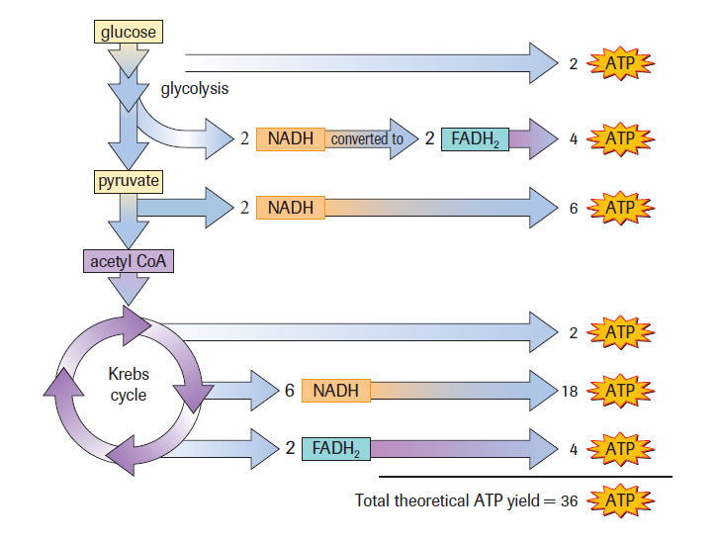
Aerobic Balance Sheet

Slide 68
7.4
Anaerobic Cellular Respiration
NO OXYGEN
Starts with glycolysis just like aerobic respiration

Slide 69
Anaerobic Cellular Respiration
To re-form NAD⁺ anaerobic respiration involves transferring the hydrogen atoms of NADH to certain organic molecules
… this process is called Fermentation

Slide 70
Stages Involved…
1) AEROBIC Cellular Respiration
1) Glycolysis
2) Pyruvate Oxidation
3) The Krebs Cycle
4) Electron Transport Chain & Chemiosmosis
2) ANAEROBIC Cellular Respiration
1) Glycolysis
2) Fermentation

Slide 71
Anaerobic Cellular Respiration
Fermentation
Bacteria have evolved many forms
Eukaryotes primarily use 2 methods: 1) Alcohol Fermentation 2) Lactic Acid Fermentation

Slide 72
Alcohol Fermentation
Pyruvate
A carbon dioxide molecule is removed from the pyruvate by the pyruvate decarboxylase enzyme to form acetaldehyde
CO₂
Acetaldehyde

Slide 73
Alcohol Fermentation
Pyruvate
The Acetaldehyde molecule gains electrons and hydrogen from NADH to form Ethanol
The resulting NAD⁺ can be used for glycolysis
CO₂
Acetaldehyde
NADH
NAD⁺
Ethanol

Slide 74
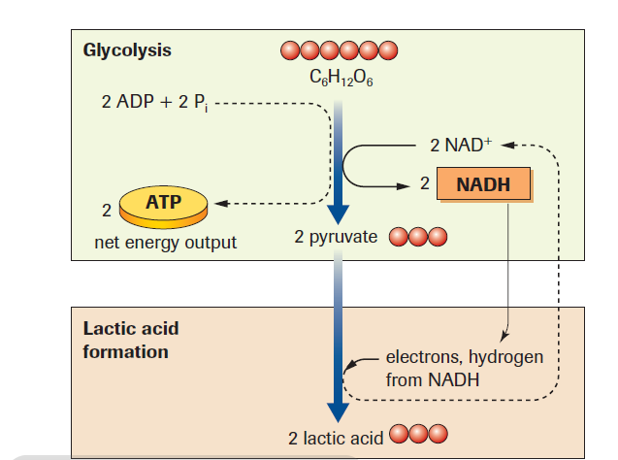

Slide 75
Alcohol Fermentation
C₆H₁₂O₆ + 2 ADP + 2 P_{i} → 2C₂H₅OH + 2CO₂ + 2 ATP ethanol
The 2 ATP molecules that these alcohol-fermenting organisms produce is enough to satisfy their energy needs.
The CO₂ and ethanol are expelled as waste products

Slide 76
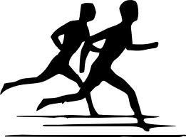
Under normal conditions, animals obtain energy from AEROBIC RESPIRATION; however, during strenuous exercise, muscles demand more ATP than it can produce

Slide 77
Under normal conditions, animals obtain energy from AEROBIC RESPIRATION; however, during strenuous exercise, muscles demand more ATP than it can produce
Under these conditions, additional ATP molecules are supplied by Lactic Acid Fermentation

Slide 78
Lactic Acid Fermentation
Pyruvate
NADH transfers its hydrogen atoms to pyruvate in the cytoplasm, forming Lactic Acid
The resulting NAD⁺ can be used for glycolysis
NADH
NAD⁺
Lactic Acid

Slide 79
Lactic Acid Fermentation
C₆H₁₂O₆ + 2 ADP + 2 P_{i} → 2C₃H₆O₃ + 2 ATP Lactic Acid
The accumulation of lactic acid in muscles causes stiffness, soreness and fatigue
When vigorous exercise ends, lactic acid is converted back to pyruvate, which can undergo the remaining stages of aerobic respiration

