Slide 1
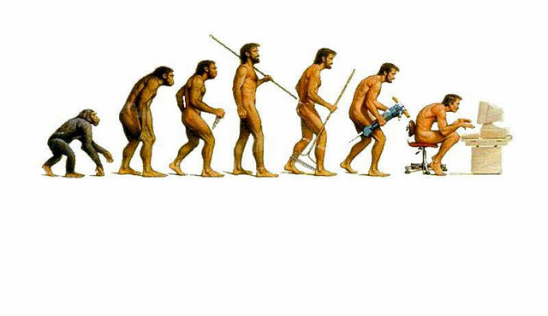
EVOLUTION !!
The process by which living organisms are thought
to have developed and diversified from earlier
forms during the history of the earth

Slide 2
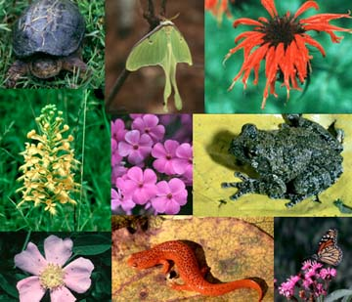
Some things to think about…
The Earth incredibly diverse and home to at least 10, 000, 000 different species of organisms
This is just a fraction of all the species that have inhabited the Earth

Slide 3
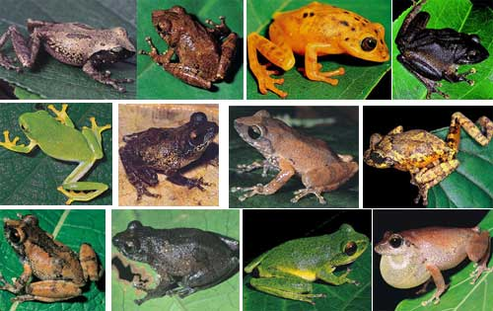
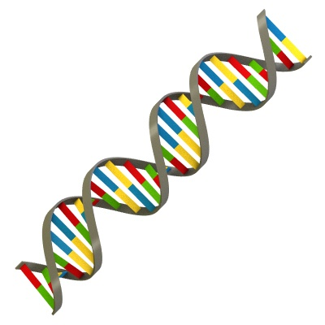
Biological Diversity can be attributed to …
Species Diversity (differences among species)
and
Genetic Diversity (differences within a species)

Slide 4
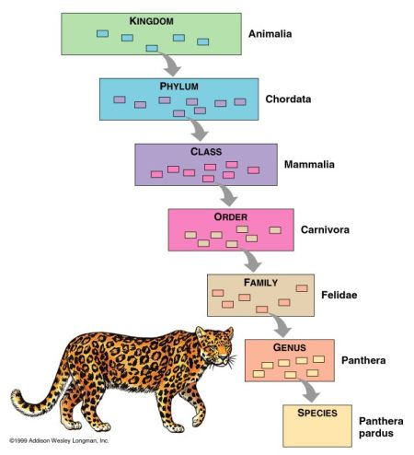
TAXONOMY
CLASSIFICATION OF ORGANISMS ACCORDING TO THEIR PRESUMED RELATIONSHIPS

Slide 5
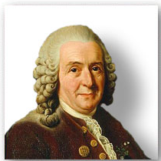
TAXONOMY
Our Biological Classification System was created by Swedish Botanist Carl Linnaeus

Slide 6
TAXONOMY
Classified organisms based on organisms’ physical and structural features.

Slide 7
PROKARYOTIC vs. EUKARYOTIC ORGANISMS
Eukaryotic Organisms (Eukaryotes): → An organism consisting of a cell or cells in which the genetic material (DNA) is contained within a distinct nucleus.
Prokaryotic Organisms (Prokaryotes): → A single-celled organism that does not have a distinct nucleus with a membrane

Slide 8
TAXONOMY
Binomial Nomenclature:
A method of naming organisms by using 2 Latin names:
Genus species
Example: Homo sapiens
The Latin names assigned in binomial nomenclature is commonly based upon characteristics, such as color or habitat

Slide 9
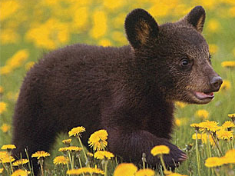
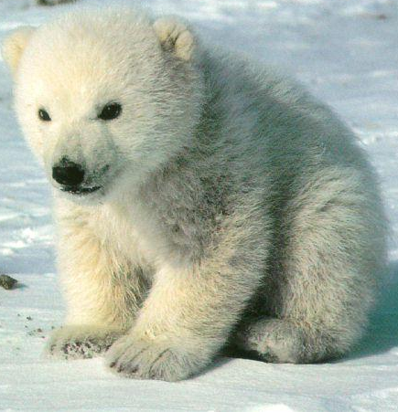
TAXONOMY
Genus species
Genus → includes several species
Species → group of organisms that look alike and can interbreed to produce fertile offspring
Examples:
Ursus americanus (black bear)
Ursus horribilis (grizzly bear)
Ursus maritimus (polar bear)

Slide 10
TAXONOMY
Our Entire Classification System:
Contains Seven Levels,
called TAXA

Slide 11
TAXONOMY
Our Entire Classification System:
Increasing
Specificity

Slide 12
TAXONOMY = KINGDOMS
KINGDOM
EUBACTERIA
ARCHAEBACTERIA
PROTISTA
FUNGI
PLANTAE
ANIMALIA
There are
6 Kingdoms

Slide 13
TAXONOMY = KINGDOMS
KINGDOM | General Characteristics | Cell Wall? | Representative Organisms
EUBACTERIA
ARCHAEBACTERIA
PROTISTA
FUNGI
PLANTAE
ANIMALIA
Table 2 = Pg 137

Slide 14
Over time, a species changes to adapt to its changing environment
The history of the evolution of a species or group of organisms is referred to as PHYLOGENY

Slide 15
Over time, a species changes to adapt to its changing environment
The history of the evolution of a species or group of organisms is referred to as PHYLOGENY
This history is depicted in a Phylogenetic Tree

Slide 16
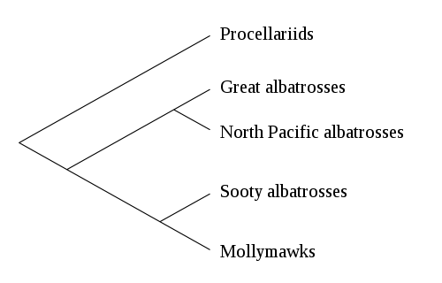
Over time, a species changes to adapt to its changing environment
The history of the evolution of a species or group of organisms is referred to as PHYLOGENY
This history is depicted in a Phylogenetic Tree
Example →
TIME
Common
Ancestor
(1 species)

Slide 17
Evolution occurs over long periods of time, and can’t be observed in one human lifetime…
… so how do we know it is occurring?

Slide 18
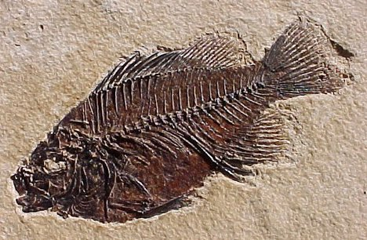
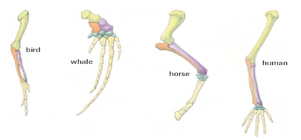
Evidence for Evolution
Evidence of a Changing Earth (causing species to evolve or die)
- paleontology
- geological changes
- biogeography
Evidence of Biological Evolution
- anatomy
- biochemistry
- artificial selection

Slide 19
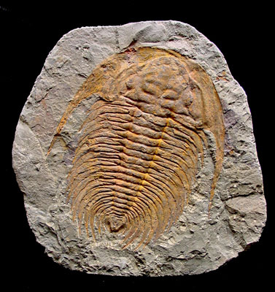
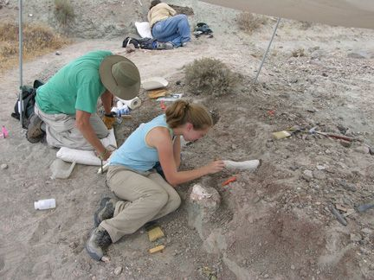
Paleontology
→ the study of fossils
→ fossilized remains and impressions from past geological ages provides direct physical evidence of past life

Slide 20
Paleontology
Information provided includes
1) Almost all species that have lived on Earth are now extinct
2) Organism complexity has increased from the distant past to present day
3) Currently living species and their most closely related fossils are located in same geographic region

Slide 21
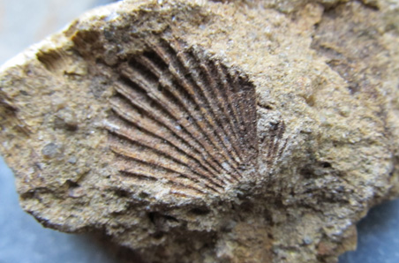
Geological change is slow, gradual, and occurs over a vast expanse of time…
… based on their understanding of geology, radioactivity, and decay, paleontologists use a technique called “Radiometric Dating” to determine the age or a rock or fossil

Slide 22
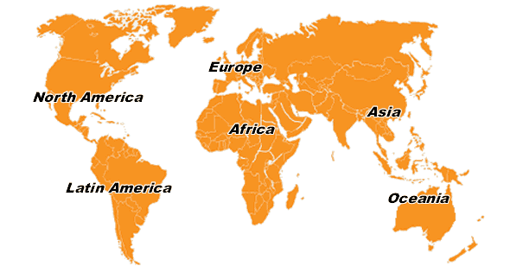
Biogeography is the study of the geographic distribution of past and present life on Earth.
Patterns of geographic distribution provide important clues to the history of life on Earth

Slide 23
About 225 million years ago, the Earth`s continents were still together – in one landmass, called Pangea
222 Million Years Ago → 200 Million Years Ago → 135 Million Years Ago → 65 Million Years Ago → Present Day Earth
A slow drift of Earth’s tectonic plates,
resulted in separating of the continents.
Many species had habitats that were split up…

Slide 24
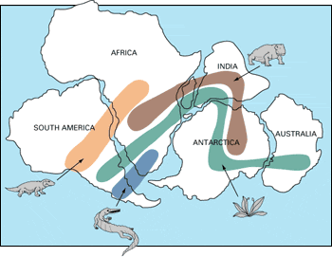
Evidence: Fossil remains of species that lived more that 150 million years ago can be found on many continents
Lystrosaurus
(land reptile)
Cynognathus
(land reptile)
Glossopteris
(fern)
Mesosaurus
(freshwater reptile)

Slide 25
Lystrosaurus
(land reptile)
Cynognathus
(land reptile)
Glossopteris
(fern)
Mesosaurus
(freshwater reptile)
Once continents separated, the organisms within the same species were restricted …and evolved separately into separate species!

Slide 26
Evidence of Evolution …
Comparing the physical anatomy of organisms helps provide evidence to support the theory of evolution

Slide 27
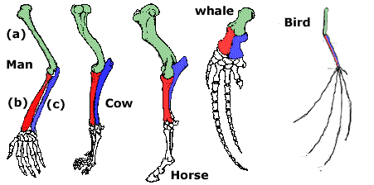
The forelimbs of these species all have very similar bone arrangements, but they serve different functions. What might this tell us??

Slide 28
These observations strongly suggest that an ancestral forelimb evolved to better serve the species in its environment.

Slide 29
Homologous vs. Analogous Features
Homologous Features = features with similar structures but different functions, that appear to have the same evolutionary origin
Analogous Features = features that are similar in appearance and function, that do not appear to have the same evolutionary origin
Examples:
Forearms…
Tailbones…

Slide 30
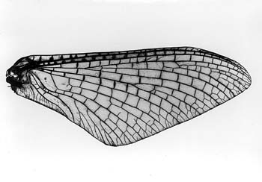
Homologous vs. Analogous Features
Analogous Features = features that are similar in appearance and function, that do not appear to have the same evolutionary origin
Examples:
bird & insect wings

Slide 31
Evolution…
Discovery Education - Evolution Vid

