Slide 1
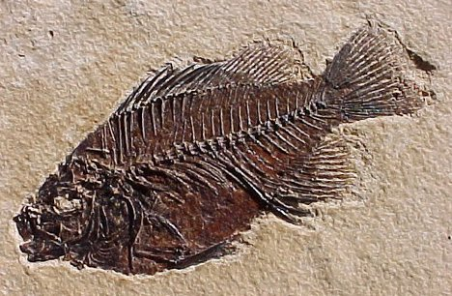
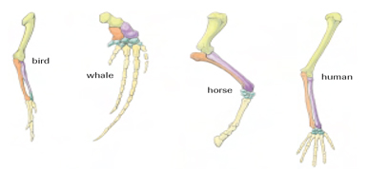
Evidence for Evolution
Evidence of a Changing Earth (causing species to evolve or die)
- paleontology √
- geological changes √
- biogeography √
Evidence of Biological Evolution
- anatomy √
- biochemistry
- artificial selection

Slide 2
Biochemical Evidence for Evolution

Slide 3
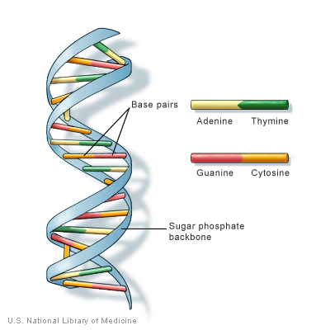
Biochemical Evidence for Evolution
DNA
= hereditary material that determines which characteristics are passed on
= composed of 4 nucleotide bases (adenine, thymine, cytosine, % guanine)
= a grouping of 3 consecutive bases is called an amino acid

Slide 4
Biochemical Evidence for Evolution
DNA
= hereditary material that determines which characteristics are passed on
= composed of 4 nucleotide bases
- adenine (A)
- thymine (T) - cytosine (C) - guanine (G)
A
T
G
C

Slide 5
Biochemical Evidence for Evolution
DNA
= hereditary material that determines which characteristics are passed on
= composed of 4 nucleotide bases (adenine, thymine, cytosine, & guanine)
= a grouping of 3 consecutive bases is a code for a specific an amino acid molecule

Slide 6
Biochemical Evidence for Evolution
DNA
= hereditary material that determines which characteristics are passed on
= composed of 4 nucleotide bases (adenine, thymine, cytosine, & guanine)
= a grouping of 3 consecutive bases is a code for a specific an amino acid molecule
A
G
T
Example: AGT codes for the Serine amino acid

Slide 7
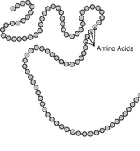
Biochemical Evidence for Evolution
Chains of Amino Acids make Proteins
= molecules that make up organismal structures, including muscle and skin cells

Slide 8
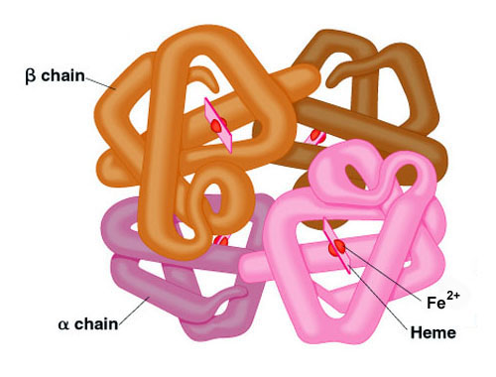
Biochemical Evidence for Evolution
Studying Proteins
= Over time, similar proteins in different species become increasingly different… suggesting the molecules are undergoing an evolution
Example:
Amino acid sequence differences among Hemoglobin molecules

Slide 9
Biochemical Evidence for Evolution
Example:
Amino acid sequence differences among Hemoglobin molecules
Human Macaque Dog Bird Frog Lamprey
Time
1 25 50 75 100 125
Number of Amino Acid Differences between Hemoglobin Molecules

Slide 10
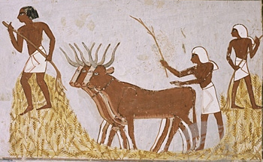
Evidence from Artificial Selection
Since agriculture first started, people have been artificially selecting crops and livestock to alter their appearance, behaviour and chemical composition
- simulates how Natural Selection works (but much faster)

Slide 11
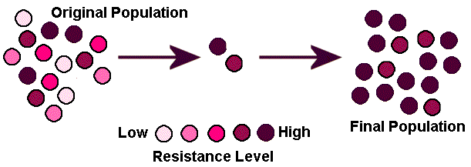
Evidence from Artificial Selection
Trait being selected for:
Worst Best
Individuals (within the plant or animal population)that have the desired trait are selected and bred. The best offspring are then picked to breed again

Slide 12
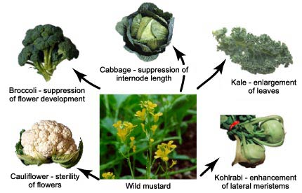
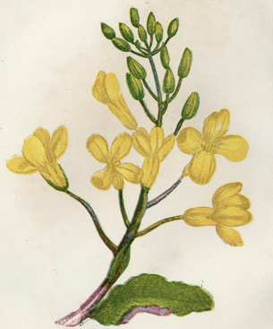
Evidence from Artificial Selection
Sea Cabbage
Example:
Different characteristics of the sea cabbage have been selected for, resulting in different varieties of the same plant species

Slide 13
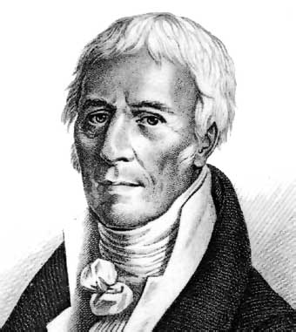
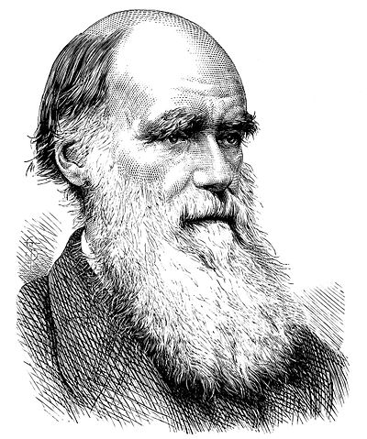
Theories of Evolution
LAMARCKIAN EVOLUTION
DARWINIAN EVOLUTION
VS.

Slide 14
LAMARCKIAN EVOLUTION
In the early 1800s, Jean-Baptiste Pierre Antoine de Monet Chavalier de Lamarck proposed the idea of
SPONTANEOUS GENERATION
suggests that living things arose from non-living matter and gradually became more complex
organisms are able to produce new parts to satisfy there need to adapt to their environment

Slide 15
LAMARCKIAN EVOLUTION
Example: If a giraffe needs to reach higher for food, continual stretching will result in the slight elongation of the neck. And this new trait can be passed to the next generation, and so on.

Slide 16
LAMARCKIAN EVOLUTION
Example: If a giraffe needs to reach higher for food, continual stretching will result in the slight elongation of the neck. And this new trait can be passed to the next generation, and so on... so the acquired trait can be inherited!!

Slide 17
LAMARCKIAN EVOLUTION
Lamarck’s theory is now referred to as
“The Inheritance of Acquired Characteristics”

Slide 18
LAMARCKIAN EVOLUTION
Lamarck’s theory is now referred to as
“The Inheritance of Acquired Characteristics”
and has been completely dismissed as a wrong!
X

Slide 19
LAMARCKIAN EVOLUTION
Lamarck’s theory is now referred to as
“The Inheritance of Acquired Characteristics”
and has been completely dismissed as a wrong!
… Acquired traits cannot be inherited
X

Slide 20
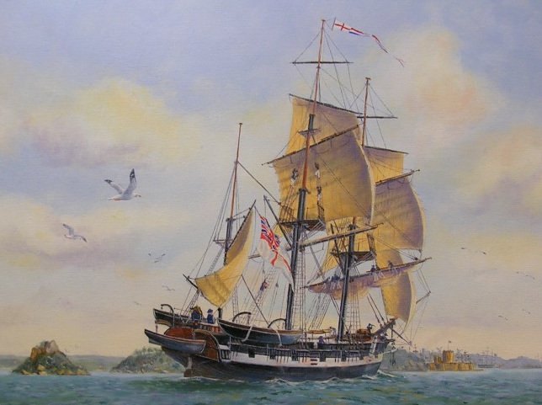
DARWINIAN EVOLUTION
In 1831, Charles Darwin travelled the world on the HMS Beagle.
What he saw of the natural world, left him with many questions…

Slide 21
DARWINIAN EVOLUTION
Observations and Predictions
1) Sloths and Armadillos living in SA resembled the smaller fossils found in the same area
2) The African tropics and South American tropics had very few organisms in common
3) The Galapagos Islands were home to 13 different species of finches
The larger, living forms of Sloth and Armadillo might have descended from these fossils
Each continent acted like an isolated nursery with species evolving
All 13 species evolved from a single ancestor on the island

Slide 22
DARWINIAN EVOLUTION
Observations and Predictions
1) Sloths and Armadillos living in SA resembled the smaller fossils found in the same area
2) The African tropics and South American tropics had very few organisms in common
3) The Galapagos Islands were home to 13 different species of finches
The larger, living forms of Sloth and Armadillo might have descended from these fossils
Each continent acted like an isolated nursery with species evolving
All 13 species evolved from a single ancestor on the island

Slide 23
DARWINIAN EVOLUTION
Observations and Predictions
1) Sloths and Armadillos living in SA resembled the smaller fossils found in the same area
2) The African tropics and South American tropics had very few organisms in common
3) The Galapagos Islands were home to 13 different species of finches
The larger, living forms of Sloth and Armadillo might have descended from these fossils
Each continent acted like an isolated nursery with species evolving
All 13 species evolved from a single ancestor on the island

Slide 24
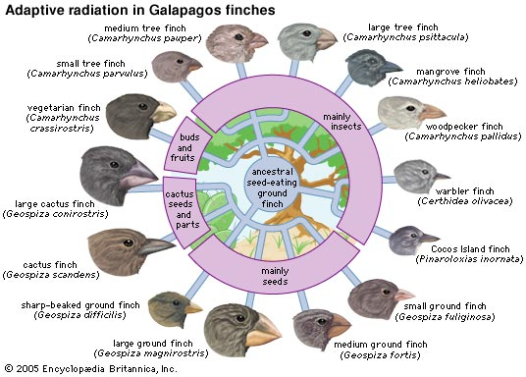
DARWINIAN EVOLUTION
Darwin’s Finches → from one species, many evolved to take advantage of different food

Slide 25
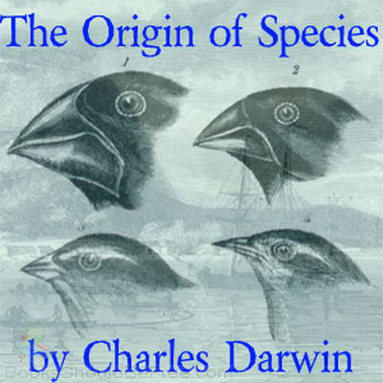
DARWINIAN EVOLUTION
Darwin’s Theory of Natural Selection
→ The process whereby organisms better adapted to their environment tend to survive and produce more offspring

Slide 26
DARWINIAN EVOLUTION
Summary
Individuals of the same species are in constant struggle for survival
Individuals with more favourable traits are more likely to survive and pass on their genetic information. This is natural selection!
These individuals contribute more offspring to succeeding generations and therefore their favourable traits will become more common. This is Evolution!

Slide 27
DARWINIAN EVOLUTION
BACK TO THE GIRAFFES!

Slide 28
INHERITED VARIATION
What does this mean?
“Inherited” refers to traits being passed down genetically from parent to offspring
In order for natural selection to occur, there needs to be variation among traits in the population… where does this variation come from?

Slide 29
INHERITED VARIATION
Variation in species comes from two biological processes:
Mutations & Sexual Reproduction

Slide 30
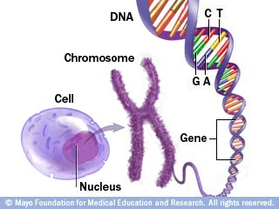
DNA is found in the Chromosomes of a nucleus
Chromosomes contain Genes
Genes are sequences of amino acid codes that have an associated trait
DNA consists of millions of genes & can be considered a blueprint for a particular organism
In most cases, DNA stays the same throughout the organisms life

Slide 31
Mutations
Random changes in the DNA sequence of a chromosome
May or may not result in a change in the gene’s trait

Slide 32
Mutations
Random changes in the DNA sequence of a chromosome
May or may not result in a change in the gene’s trait
Example:
DNA Segment Before Mutation = ACT AGG CTG
DNA Segment After Mutation = ACT AGT CTG
Before
After
A
A
G
G
G
T

Slide 33
Mutations can be Caused by:
Environmental Factors (example: exposure to chemicals or radiation)
Errors when cells are making copies of the DNA

Slide 34
Effects of a Mutation depends on
what DNA sequence is altered
how gene expression is impacted

Slide 35
Neutral Mutations: no immediate effect on organism’s fitness (fitness = reproductive success)
Harmful Mutations: reduces organism’s fitness
Beneficial Mutations: gives organism an advantage over others and increases fitness

Slide 36
Neutral Mutations: no immediate effect on organism’s fitness (fitness = reproductive success)
Harmful Mutations: reduces organism’s fitness
Beneficial Mutations: gives organism an advantage over others and increases fitness
LEAST COMMON
IN NATURE

Slide 37
INHERITED VARIATION
Variation in species comes from two biological processes:
Mutations & Sexual Reproduction

Slide 38
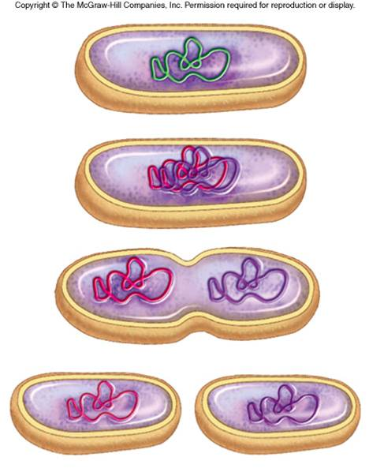
Asexual vs. Sexual Reproduction
Asexual
= Individuals reproduce without a mate
= Offspring receives identical copy of parent’s DNA
= Siblings have identical traits (same as parent)
= mutations are the only source of inherited variability, therefore little opportunity for natural selection to take place
Asexual Reproduction
of Bacteria

Slide 39
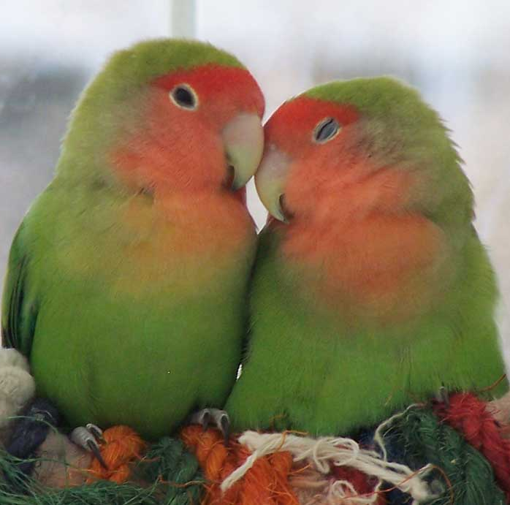
Asexual vs. Sexual Reproduction
Sexual
= The production of offspring by the union of sex cells from two different parents
= Offspring inherit a combination of genes from both parents
= Results in a great amount of variability…

Slide 40
Asexual vs. Sexual Reproduction
3 Reasons for this Great Variability
Each parent has 2 copies of every gene (may or may not be the same) and give one copy to the offspring… leading to many possible combinations!
The gene copies are passed down randomly
Sexually reproducing organisms choose different mates with different genetic a make-up… leading to even more potential combinations of genes!

