Slide 1
What Not To Do…

Slide 2
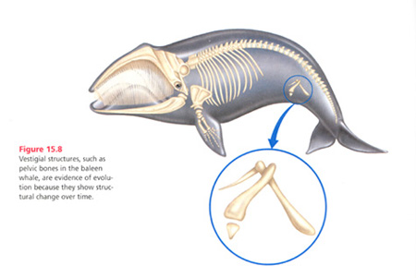
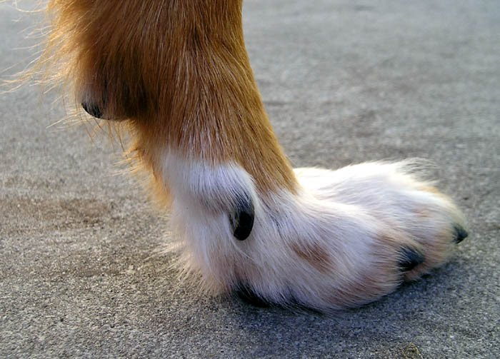
Further Evidence of Evolution: Vestigial Features!
= Structural features on an organism that serves NO useful purpose
Examples:
→Whales have vestigial hip and leg bones
→ Many mammals have vestigial toes
Compelling evidence because it suggests the structure once served a purpose for an ancient ancestor

Slide 3
Speciation
The formation of a new species

Slide 4
Speciation
Most new species form through a process called Allopatric Speciation, which consists of three steps

Slide 5
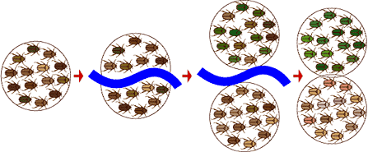
Steps of Allopatric Speciation
Physical barrier separates a single interbreeding population into 2 or more groups isolated from each other.
Any mutations within one of these groups are not shared with the other population(s)

Slide 6
Steps of Allopatric Speciation
2) Natural selection works on the separated groups independently… leading to two populations with different genetic variations
In other words, evolution occurs independently

Slide 7
Steps of Allopatric Speciation
3) An accumulation of physical/behavioural differences between the populations become so pronounced that the groups could no longer sexually reproduce
At this point, they are distinct species

Slide 8
Steps of Allopatric Speciation
So, what are some examples of barriers that could split up a population??
Mountain ranges, oceans, rivers, canyons, dams, canals, etc.

Slide 9
The Theory of Gradualism
States that speciation occurs at a vey slow, steady pace

Slide 10
The Theory of Gradualism
States that speciation occurs at a vey slow, steady pace
… but the fossil record commonly doesn’t provide evidence of this.
Instead, new species appear abruptly, with little evidence of intermediates between distinct species.

Slide 11
To account for these abrupt changes in the fossil record, scientists proposed the Theory of Punctuated Equilibrium

Slide 12
To account for these abrupt changes in the fossil record, scientists proposed the Theory of Punctuated Equilibrium, which states:
1 - Many species evolve very rapidly (in evolutionary time)
2 - Speciation usually occurs in small isolated populations (accounts for rare fossil record)
3 - After an initial burst of evolution, species are well adapted to their environment and do not change much for long periods

Slide 13
Different Evidence in the Fossil Records are Compatible with Both Theories
Gradualism
Punctuated Equilibrium

Slide 14
Macroevolution – Figure 5 (Pg 160)
Since life began, Earth has seen a steady increase in diversity of living things.
But numerous extinction events have acted as setbacks (or resets) in this process.
After these extension events, surviving organisms took advantage of the many empty ecological niches...
…results in an explosion of evolution into many different species (“Divergent Evolution”)

Slide 15
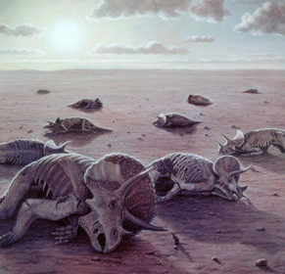
Macroevolution – Figure 5 (Pg 160)
Since life began, Earth has seen a steady increase in diversity of living things.
But numerous extinction events have acted as setbacks (or resets) in this process.
After these extension events, surviving organisms took advantage of the many empty ecological niches...
…results in an explosion of evolution into many different species (“Divergent Evolution”)

Slide 16
Evolution Questions:
Pages
→ 137 = # 1 – 4
→ 139 # 1, 2, 3, & 7
→ 143 #1 & 2
→ 152 # 1
→ 161 # 2, 4, & 5
14 in Total

