Slide 1
Control of the Kidneys
The function of the kidneys can be affected by:
Hormones (ADH & Aldosterone)
Drugs (alcohol, caffeine, nicotine)
Cardiovascular Health (BP)
Diet (salts & protein)

Slide 2
Hormones
ADH - antidiuretic hormone - Acts on kidneys to increase water reabsorption in the collecting duct (control H₂O balance).
More concentrated urine results from ADH release.
= Increases H₂O reabsorption.
This will increase blood volume and blood pressure.
Scenarios? (+ & -)

Slide 3
Hormones
Aldosterone – Stimulates kidney to retain sodium and reabsorb water to maintain body fluid levels.
Increases reabsorption of NaCl and H₂O in distal tubules and collecting duct.
This will also increase blood volume and blood pressure.
Scenarios? (+ & -)

Slide 4
Drugs
Alcohol, caffeine - Can act as diuretics – Increase the amount of water excreted in the urine, usually by interfering with ADH or aldosterone.
Nicotine - Can act as a anti-diuretics – Decreases the amount of water in the urine, usually by causing release of ADH or aldosterone.

Slide 5
Cardiovascular Health (BP)
Increased blood pressure will increase the amount of filtrate created in the bowman’s capsule.
Can also cause problems with reabsorption due to high capillary pressure.
Sustained high BP can cause physical damage.

Slide 6
Diet
Excess salt and protein in the diet can be hard on the kidneys.
Excess salt can cause fluid retention and issues with blood pressure and thus filtration and reabsorption in the kidney.
Excess protein can leak through into nephrons and cause water excretion and dehydration.

Slide 7
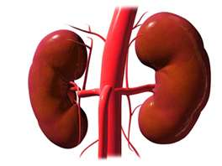
Maintenance of the Body’s pH
The kidneys play an important role
Body’s pH needs to stay between 7.3-7.5 (slightly basic).
But.............

Slide 8
During Cellular Respiration
cells produce carbon dioxide (CO₂)
…which forms carbonic acid (H₂CO₃)
…which ionizes to produce H+ ions
…which lowers the blood’s pH = more acidic
...OMG!

Slide 9
To maintain a stable pH, a BUFFER SYSTEM is used….
Bicarbonate ions (HCO₃⁻) help eliminate H⁺ ions
HCO₃⁻ bonds with H⁺ and reforms Carbonic Acid (H₂CO₃)
H₂CO₃ can then break down into CO₂ and H₂O again
Lungs expel the CO₂

Slide 10
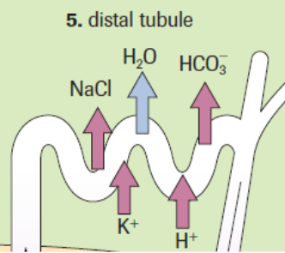
The Kidneys help BUFFER by:
Reabsorbing Bicarbonate ions (HCO₃⁻) in the blood that have been used up in the buffering reaction in both proximal and distal tubules.
Secreting H⁺ ions from the
blood into the proximal and
distal tubule for excretion.

Slide 11
Section 12.2 = Kidney Dysfunction
Diabetes Mellitus
Nephritis
Kidney Stones
Dialysis
Kidney Transplants
Jigsaw Activity
Read your assigned paragraphs 3 times (yes, 3 times!!!)
Make notes and summarize it into ~3 sentences
When I say, share with your group

Slide 12
Chapter 12 Questions
Excretory System Worksheet
Chapter 12 REVIEW
Pg. 396 – PART 1 - # 1-5
Pg. 396 – PART 2 - # 6-13, 16, 18

