Slide 1
UPCOMING SCHEDULE:
Today, Thurs, Fri
→ Excretion (chap. 12)
Monday, May 7th x2
→ Rat Dissection!!! (BRING digital CAMERA)
Tuesday, May 8th
→ Chap. 12 Quiz
→ Rat Dissection Presentation Work
Wednesday, May 9th
Unit 4B REVIEW
Thursday, May 10th
→ *** Unit 4B Unit Exam ***

Slide 2
The Excretory System
http://www.youtube.com/watch?v=aQZaNXNroVY
Don’t worry about the details!... Just try to follow the general workings of the system
After the Video
The Excretory System
READ pages 376 - 380

Slide 3
The Excretory System:
THE LIVER & THE KIDNEY

Slide 4
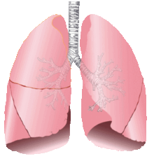
Eliminating Waste Products…
The lungs eliminate CO₂
The skin eliminates small quantities of Urea
The liver transforms toxins into soluble compounds that can be eliminated by the kidneys
The kidneys are the MAIN excretory organ

Slide 5
Eliminating Waste Products…
The lungs eliminate CO₂
The skin eliminates small quantities of Urea
The liver transforms toxins into soluble compounds that can be eliminated by the kidneys
The kidneys are the MAIN excretory organ

Slide 6
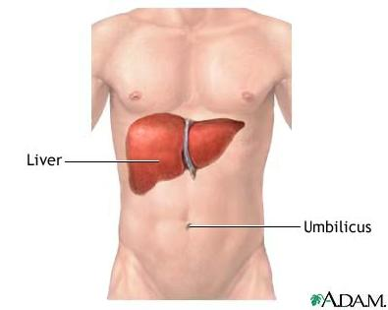
Eliminating Waste Products…
The lungs eliminate CO₂
The skin eliminates small quantities of Urea
The liver transforms toxins into soluble compounds that can be eliminated by the kidneys
The kidneys are the MAIN excretory organ

Slide 7
Eliminating Waste Products…
The lungs eliminate CO₂
The skin eliminates small quantities of Urea
The liver transforms toxins into soluble compounds that can be eliminated by the kidneys
The kidneys are the MAIN excretory organ

Slide 8
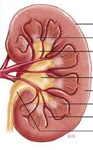
The Kidneys’ Functions
Remove waste products
Balance blood pH and
metabolites
Maintain water balance

Slide 9
… this process is called Deamination
Amino acids in the body contain an amino group (NH₂) that must be discarded
Occurs in the Liver
Produces the harmful byproduct, AMMONIA

Slide 10
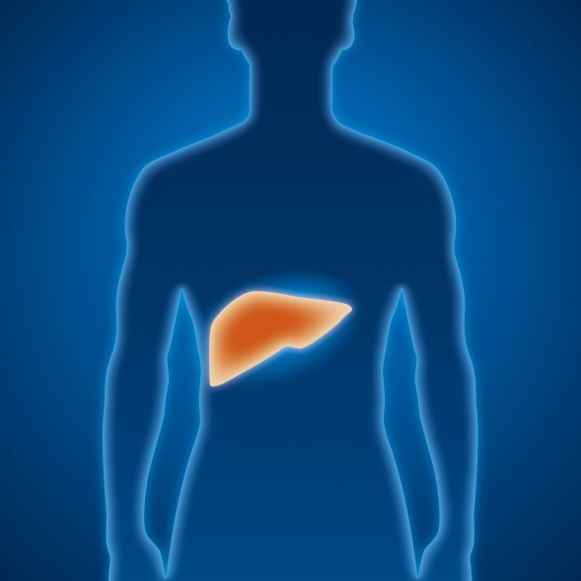
Occurs in the Liver
Produces the harmful byproduct, AMMONIA
The Liver combines two molecules of ammonia with one molecule of CO₂, creating UREA (which is much less harmful).
ALSO
Uric Acid
A waste product that comes form the breakdown of nucleic acids in the body

Slide 11
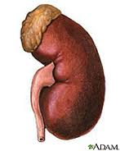
Both Uric Acid and Urea are removed from Excreted by the KIDNEYS

Slide 12
Anatomy of the Urinary System
a) __________________
b) __________________
c) __________________
d) __________________
e) __________________
f) __________________
g) __________________
h) __________________
i) __________________
j) __________________
k) __________________
f
a
g
b
h
i
c
j
d
k
e

Slide 13
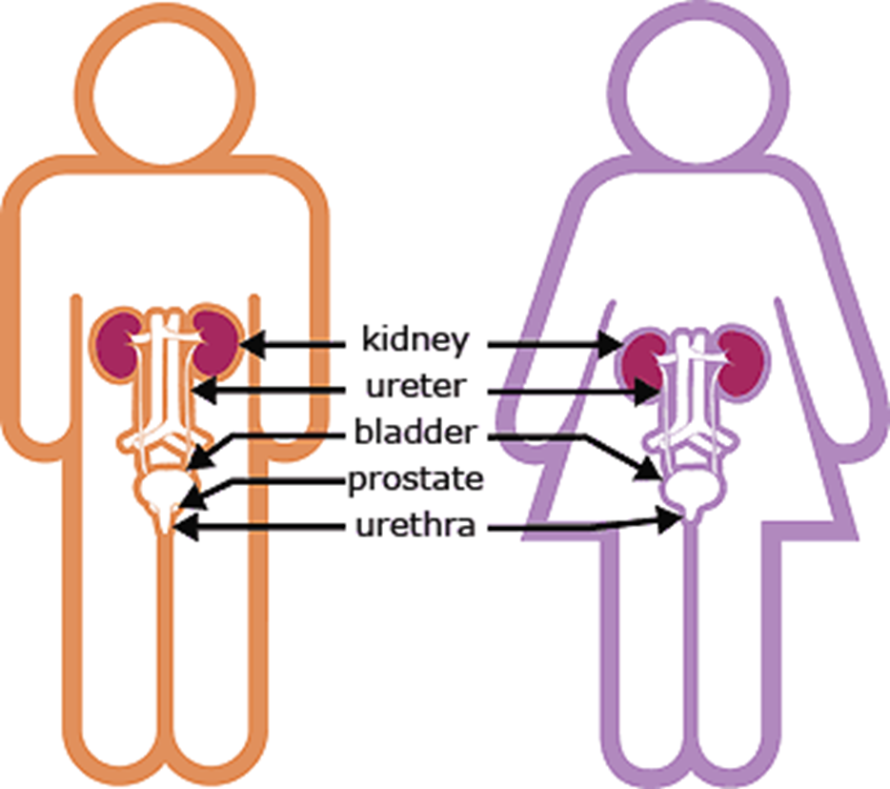
Male vs. Female

Slide 14
Cross Section of a Kidney
1) __________________
2) __________________
3) __________________
4) __________________
5) __________________
6) __________________
1
2
3
4
5
6

Slide 15
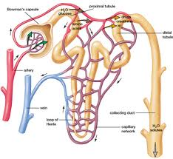
The Excretory System:
THE NEPHRON

Slide 16
The Excretory System:
THE NEPHRON
Regulates the concentration of water
and soluble substances (like sodium salts) by filtering the blood and reabsorbing what is needed
→ Excretes the rest as urine

Slide 17
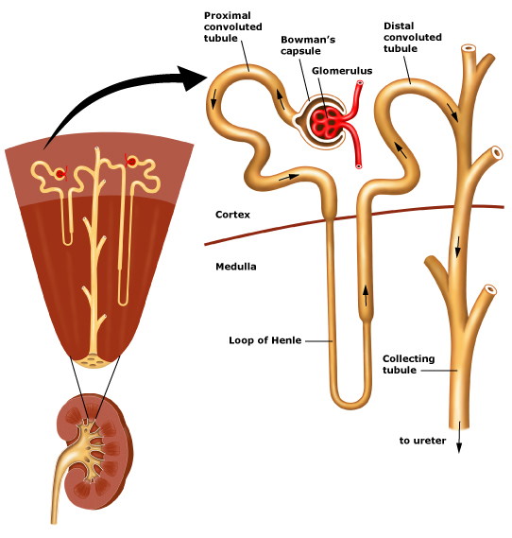
THE NEPHRON

Slide 18
THE NEPHRON
A
B
D
E
C
A = Proximal Tubule
Section of the Nephron that connects Bowman’s Capsule to The Loop of Henle
F
H
G

Slide 19
THE NEPHRON
A
B
D
E
C
B = Bowman’s Capsule
A cuplike structure that surrounds the Glomerulus
F
H
G

Slide 20
THE NEPHRON
A
D
E
B
C
C = Glomerulus
A high pressure capillary bed that is the site of FILTRATION
F
H
G

Slide 21
THE NEPHRON
A
D
B
E
C
D = Afferent Arteriole
A branch of the renal artery that carries blood to the Glomerulus
F
H
G

Slide 22
THE NEPHRON
A
E
B
D
C
E = Distal Tubule
Conducts urine from the Loop of Henle to the Collecting Duct
F
H
G

Slide 23
THE NEPHRON
A
D
E
B
C
F = Efferent Arteriole
A branch of the renal artery that carries blood from the Glomerulus to the Peritubular Capillaries
F
H
G

Slide 24
THE NEPHRON
A
D
E
B
C
G = Collecting Duct
A tube that carries urine from the Nephron to the renal pelvis of the Kidney
F
H
G

Slide 25
THE NEPHRON
A
D
E
B
C
H= Loop of Henle
Carries filtrate from the Proximal Tubule to the Distal Tubule
F
H
G

Slide 26
THE NEPHRON
A
D
E
B
C
I = Peritubular Capillary
A network of small blood vessels that surround the tubule portion of the Nephron
F
I
H
G

Slide 27
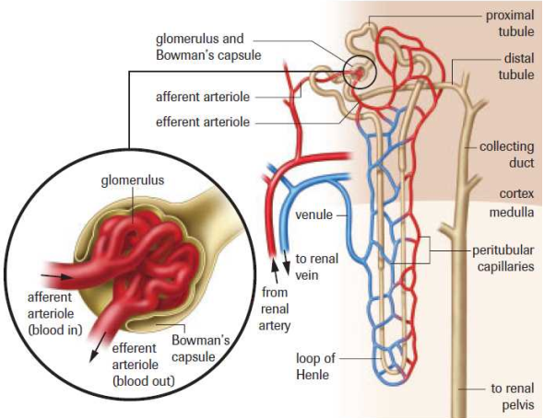

Slide 28
The Hard Working Kidneys…
Approx. 600 mL of fluids flow through the kidney every minute
120 mL is filtered into the Nephron
…of this filtered fluid, only
1 mL of URINE is formed!

Slide 29
The Formation and Disposal of
URINE

Slide 30
The Formation and Disposal of
URINE
Depends on three processes:
1) Filtration
2) Reabsorption
3) Secretion

Slide 31
The Formation and Disposal of
URINE
Depends on three processes:
1) Filtration
2) Reabsorption
3) Secretion
Page 382 in Textbook

Slide 32
FILTRATION…
Blood moves through the afferent arteriole into the glomerulus

Slide 33
FILTRATION…
Blood moves through the afferent arteriole into the glomerulus
… which acts as a high
pressure filter

Slide 34
FILTRATION…
Solutes move through the walls of the glomerulus and into Bowman`s Capsule (from high to low pressure)

Slide 35
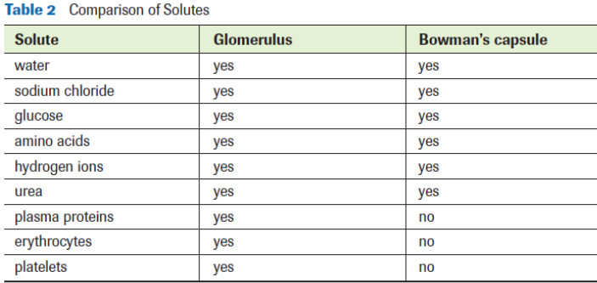
FILTRATION…
Solutes move through the walls of the glomerulus and into Bowman`s Capsule (from high to low pressure)

Slide 36
REABSORPTION…
Much of the fluid & solutes filtered into Bowman’s Capsule are reabsorbed back into the bloodstream

Slide 37
REABSORPTION…
Much of the fluid & solutes filtered into Bowman’s Capsule are reabsorbed back into the bloodstream by both Passive and Active Transport

Slide 38
REABSORPTION…
Carrier molecules (active transport) move Na⁺ out of the Nephron
Negative Ions (Cl⁻ & HCO³⁻) passively follow Na⁺ through charged attraction

Slide 39
REABSORPTION…
Limited amounts of Glucose and Amino Acids moved back to blood through active transport
The excess is
excreted in Urine

Slide 40
REABSORPTION…
Removal of these solutes creates an Osmotic Gradient…

Slide 41
REABSORPTION…
Removal of these solutes creates an Osmotic Gradient…
…therefore, H₂O also leaves the Proximal Tubule

Slide 42
REABSORPTION…
The Proximal Tubule also maintains blood pH by excreting H⁺ and reabsorbing HCO₃⁻

Slide 43
REABSORPTION…
The Descending Loop of Henle is only permeable to H₂O. Removing it concentrates the urine even more

Slide 44
REABSORPTION…
The Ascending Loop of Henle is only permeable to NaCl. Removing it creates an osmotic gradient in the Interstitial Fluid to help pull out more H₂O from the Nephron

Slide 45
REABSORPTION…
The Distal Tubule helps the body regulate K⁺ and NaCl in body fluid
Also maintains blood pH by excreting H⁺ and reabsorbing HCO₃⁻

Slide 46
REABSORPTION…
The Collecting Duct finalizes the formation of urine
Urea, H₂O and NaCl can be reabsorbed in this last stage

Slide 47
SECRETION…
The movement of substances from the blood into the tubular portion of the Nephron
→ Ammonia (NH₃) at Proximal Tubule
→ H⁺ at Proximal and Distal Tubules
→ K⁺ at Distal Tubules

Slide 49
Re-Cap…
http://www.youtube.com/watch?v=cc8sUv2SuaY&feature=related

