Slide 1
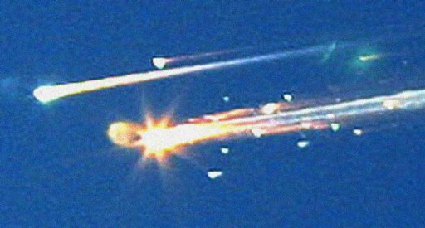
The Risks and Dangers of Space Exploration
Space Shuttle Challenger – January 28, 1986
Space Shuttle Columbia – February 1, 2003
Notes:
video clip – 2:04 min.

Slide 2
There are many dangers associated with both manned and unmanned space exploration. Some of those dangers are posed by debris floating in space around Earth and by solar and cosmic radiation

Slide 3
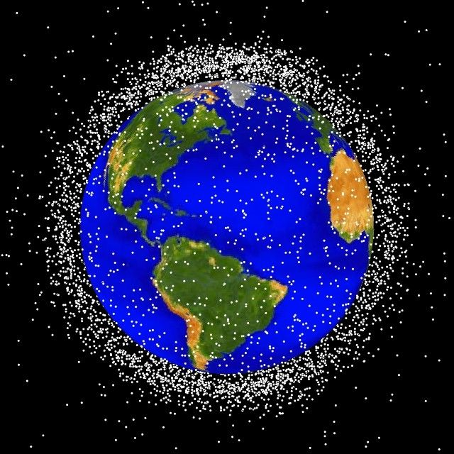
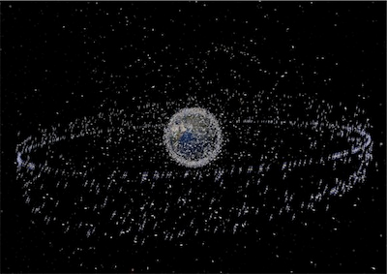
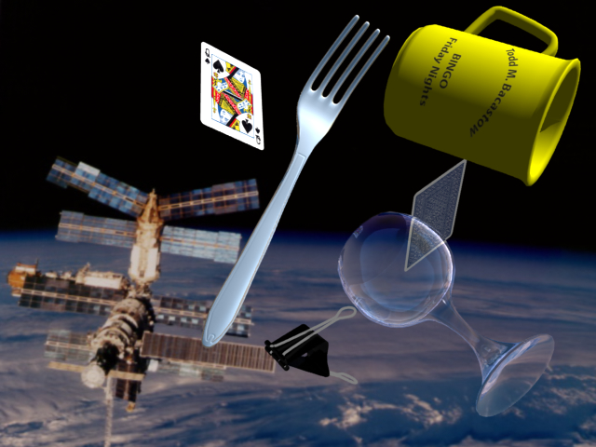
Space Junk
pieces of debris that have fallen off rockets, satellites, space shuttles, and space stations and remain floating in space

Slide 4
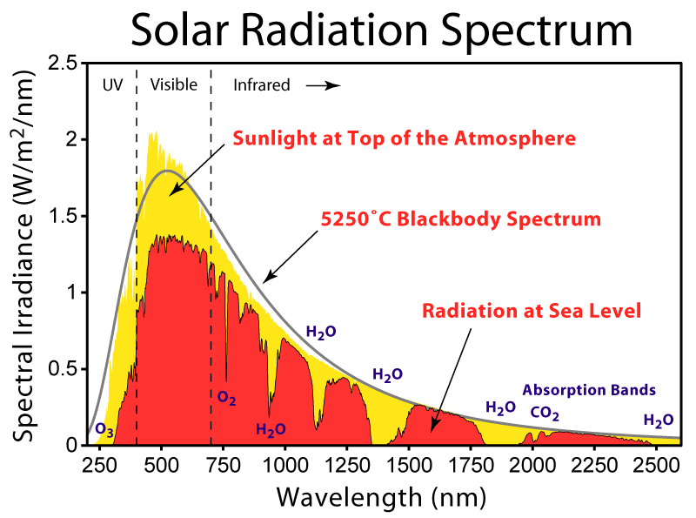
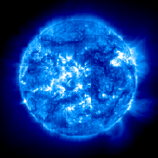
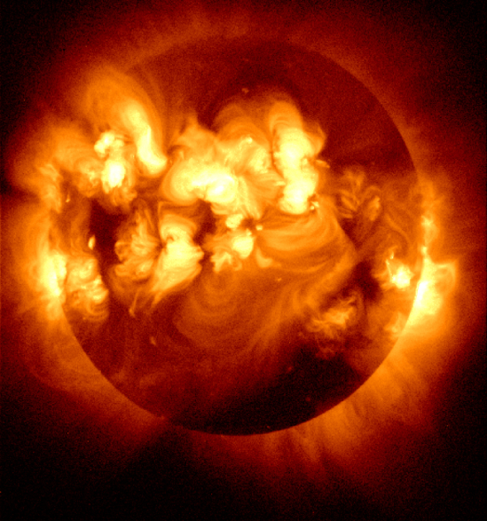
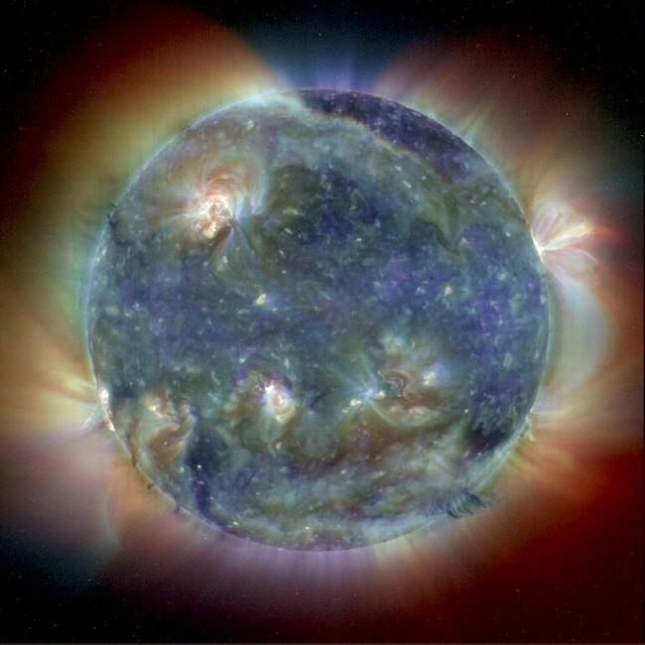
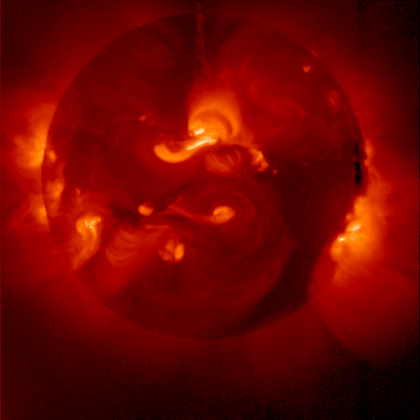
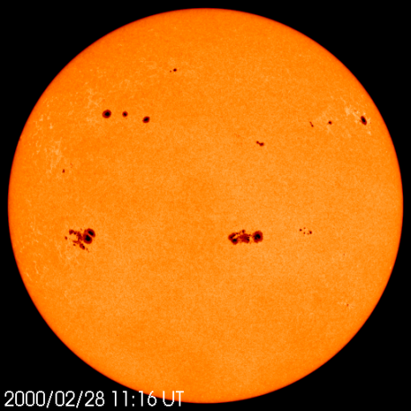
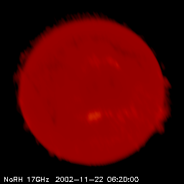
Radiation
Radiation 100 km from Sea Level

Slide 5
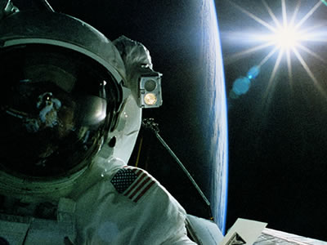
Historical Space Moments pg.420
First successful unmanned orbit – USSR – Sputnik 1 – October 4, 1957.
First successful manned orbit – USSR – Yuri Garagin – April 12, 1961
First American orbit – Alan Shepard – May 5, 1961 (was supposed to be previous year)
First man on the moon – Apollo 11 – USA – July 20, 1969
First Canadian in Space – Marc Garneau – 1984
First Woman in Space – Valentine Tereshkova – 1963
First Canadian Woman in Space – Roberta Bondar – 1992

Slide 6
Canadian Contributions to Space Exploration and Observation
Canada has a long and proud history of participation in space research and exploration.

Slide 7
Canadian Space Firsts
Marc Garneau – 1st in space (1984)
Roberta Bondar – 1st woman, 2nd Canadian (1992)
Chris Hadfield – walk in space (2001)

Slide 9
Canadian Robotics
Canadarm – part of all shuttles since 1981
Canadarm 2 – attached to ISS in 2001
(SSRMS—space station remote manipulator system)
Dextre – attached to the end of Canadarm 2
(SPDM – special purpose dextrous manipulator)
Dextre has also been nicknamed “Canada Hand”

Slide 10
Issues Related to Space Exploration
Many issues concerning ownership of space and its resources are yet to be resolved. These include political, environmental, and ethical issues.
Notes:
video clip – 4:32 min.

Slide 11
Assignment
SPACE ISSUES wkst.

