Slide 1
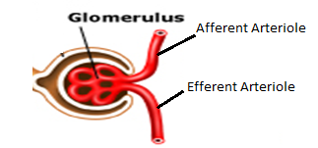
Glomerulus, Afferent Arteriole, and the Efferent Arteriole Brenna & Bailey
Afferent Arteriole- carries blood into the glomerulus
Glomerulus- a high pressure capillary that carries out filtration. The glomerulus carries out the first step of urine production which is filtration after blood has entered from the Afferent Arteriole. Amino acids, glucose, water, NaCl, H+, and urine get filtered into the glomerulus. The urine on a scale of 1-10 for concentration would be around a 3 or 4 because it is only the first step and isn’t very concentrated.
Efferent Arteriole- carries blood away from the Glomerulus to the peritubular capillaries

Slide 2
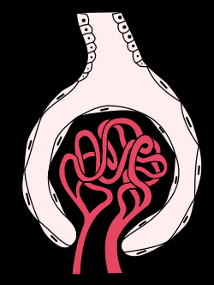
Bowman’s Capsule
Cole, Kaden and Serge
Thin walled, sac like structure.
Located at beginning of tubular
component of a nephron.
Expansion at the closed end of a renal tubule
Serves in filtration to remove organic wastes, excess inorganic salts, and water

Slide 3
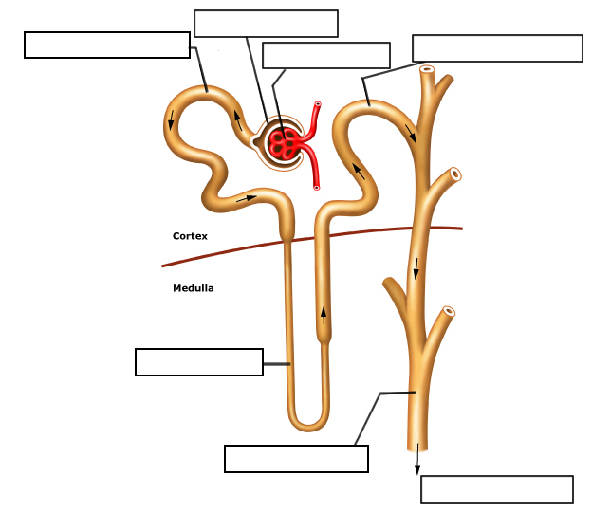
Proximal Convoluted Tubule
Jeremy, Jonathan, Paige
In the proximal tubule many things will be reabsorbed into the bloodstream.
H20
HCO3
NaCl
Nutrients
C6H12O6 (glucose)
Amino Acids
Things like NH3 (ammonia) and H+ ions are secreted into the convoluted tubule.

Slide 4
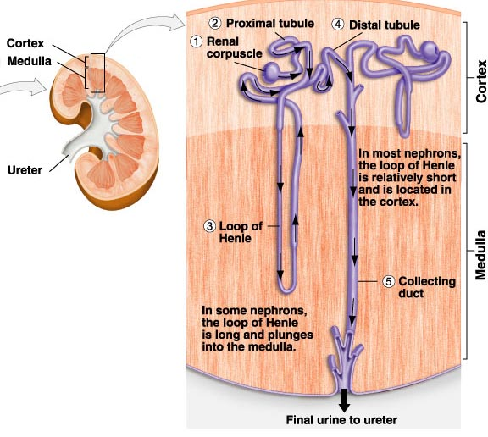
Descending Loop of Henle
By Conner Peta and Andrew MacDonald
Function
Dilutes salts in the medulla
permeable to only water
Urine Formation
Releases H20 back into the blood, so you will not have to dispose of water (every 5 minutes)
Involved in Reabsorption
The descending loop of henle is only permeable to water, removing it concentrates urine even more.
Urine scale 5-6

Slide 5
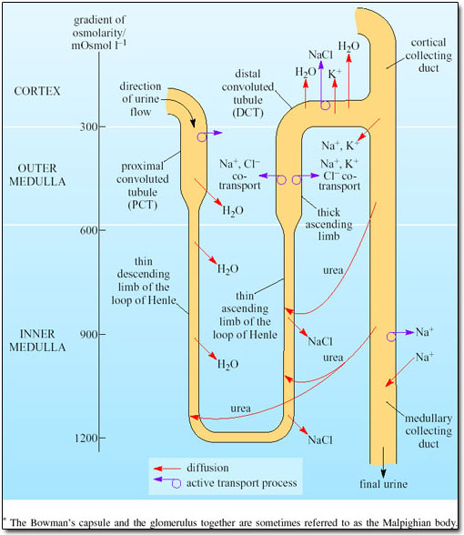
Ascending Loop of Henle
Mike, Kevin
The loop of Henle goes through the Cortex and the Medulla.
The Loop of Henle creates an osmotic concentration in the fluid immediately around it, making it possible to produce urine more osmotically concentrated then blood plasma
As the loop descends it extracts water because of the high concentration of salt
When ascending through the loop of Henle It extracts NaCl
Descending the Loop of Henle It has a high concentration of NaCl and Low concentration ascending.

Slide 6
Distal Tubule
Attalia, Caley, Cecilia
Found between the Loop of Henle and Collecting Duct
It is partially responsible for regulating Potassium, Sodium, Calcium and pH
It regulates pH by absorbing bicarbonate and secreting protons (H⁺) into the filtrate, or by absorbing protons and secreting bicarbonate into the filtrate.
Sodium and potassium levels are controlled by secreting K⁺ and absorbing Na⁺.
It also participates in calcium regulation by reabsorbing Ca²⁺

Slide 7
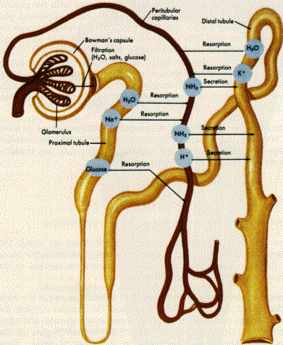

Slide 8
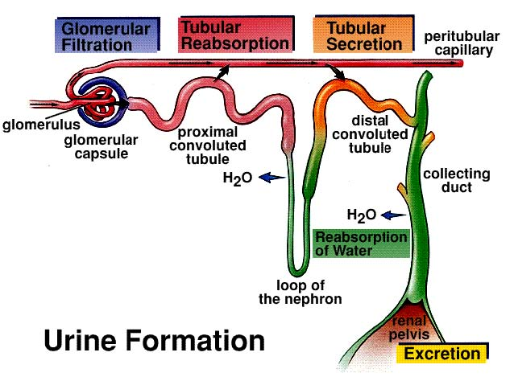
Collecting Duct
Kaitlin Sibbet & Shealyn Cossette
The collecting duct is the part of the nephron that collects urine from the distal convoluted tubule, and sends it to the pelvis of the kidney.
The collecting duct can contribute up to 4-5% of the kidneys’ reabsorption of sodium, 5% of water and 24% of filtered water (during extreme dehydration)

Slide 9
Collecting Duct
The collecting duct helps in the
regulation of electrolytes.
In humans, the system accounts for 4-5% of the kidney's reabsorption of sodium and 5% of the kidney's reabsorption of water.
Tubular Secretion is the step of urine formation that happens within the collecting duct.
This is the step where the urine is made concentrated by increasing the concentration of waste elements.
Sodium and water are involved in reabsorption of the collecting duct.
By: Kristen Bridge and Hotira

Slide 10
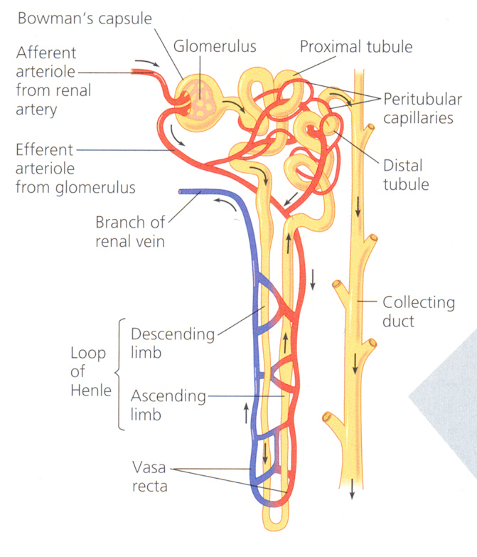
Peritubular Capillaries by Patrick
System of capillaries that branch off from the efferent arteriole and form a net around the nephron.
Involved in reabsorption and secretion in collecting duct, distal and proximal tubules and reabsorption in loop of henle. (all substances)
Urine Con^{c} = 0 (because it is outside the nephron)

